Slide 1
Acquaintance with
Functions
Notes:
well well
We have completed first course of the python. the half range of our journey is finished without any accident or malfunction. so we have reached out the second part. python plus.

Slide 2
Table of Contents
Introduction
Calling a Function
Built-in Functions

Slide 3
Introduction to Functions
1
Notes:
yes, now, i am gonna show you functions that are one of the most used structures in python. but before doing this, i would like to see your opinions, your responses

Slide 4
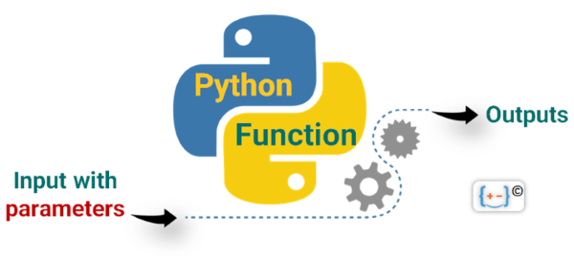
Introduction
Notes:
Basically, a function is a block of code that executes some logic for you, e.g. prints a text, deletes some data or square a number. In other words, a function is a piece of code that only runs when it is called.
Functions in Python provide organized, reusable and modular code to perform a set of speciﬁc actions. Functions simplify the coding process, prevent redundant logic, and make the code easier to follow.
You can enter or input data, known as arguments, into a function and it returns/outputs something good that you want.

Slide 5
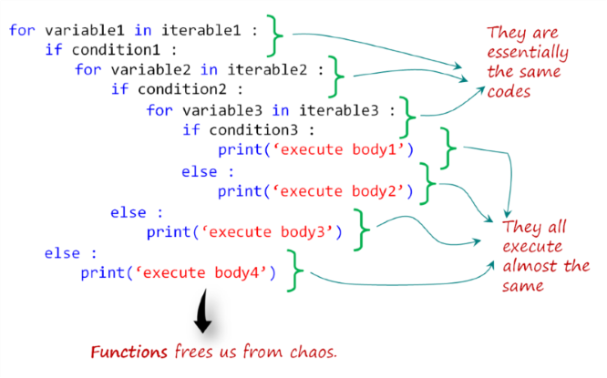
Introduction (review)
Functions free us from chaos.
Notes:
For example, in this slide, you see a generic code block. A code block made up of some small snippets of code that are nested and repetitive. it looks unnecessarily messy and hard to understand, right?

Slide 6
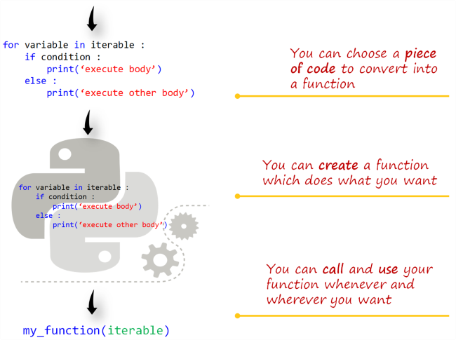
Introduction (review)
Notes:
….this is a purely generic representation. do not focus on the code block just try to focus on overall diagram on the slide. i am trying to visualize the process for better understanding. anyway, let’s move on.

Slide 7
Calling a Function
2

Slide 8
Calling a Function Means Using It(review)
Reading a function is very easy in Python.
multiply(2, 5)
name of the function
arguments of the function
Notes:
as it is in the title, calling a function means actually using a function. when you need it then you call and use it, right? for example, let’s say we have a function named multiply which takes two arguments. integer numbers and multiply them. …..
multiply(2, 5)

Slide 9
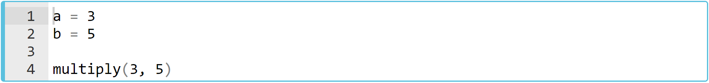
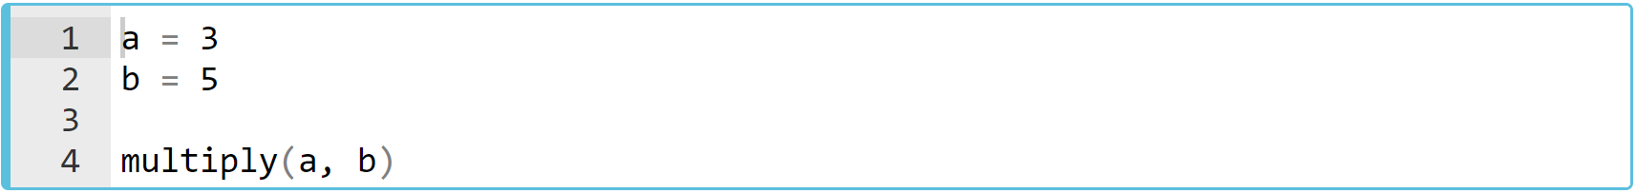
Calling a Function Means Using It(review)
👇
Notes:
….If you want to multiply two numbers, you can just write the name of that function and the numbers (arguments) inside the parenthesis.
a = 3
b = 5
multiply(a, b)

Slide 10
Calling print() Function (review)
Take a look at the example 👇
Notes:
print("Say : I love you!")
print()
print("me too", 2019)

Slide 11
Built-in Functions
3
Notes:
and… from this part of the lesson i would like to show you a several the most used built-in functions in python. what we are gonna do is a quick review. and I aim to take your attention to existence of the built in functions in python. all right.

Slide 12
Built-in Functions (review)
The number of built-in functions :
In the latest version
Python 3.11
71
Notes:
If you are considering a function which may do something that you want, it probably exists. You just need to be aware of its existence.
There are a range of functions and types built into the Python interpreter, so they are always usable.
Yes i am talking about built in functions. These functions are defined for you inside the python background.
let’s take a quick review of several important built in functions. i would draw your attention that i aim to make you familiar with some basic built in functions. you know, we can not cover all these functions in our lessons. it is not realistic. so i am gonna show you some of them and you will be able to get familiar with those functions. ok let’s start with the famous ones.

Slide 13
Built-in Functions (review)
So far we have learned 👇
print(), int(), list(), input(), range()
Some of them return bool type 👇
all(iterable), any(iterable), callable(object)
Notes:
after i showed you these functions, what you need to do is that : you have to go to python official documents. and you have to take some time to quick review of these functions. it is up to you. i suggest you to take some time this issue. Let's go through fast one by one, then we will use some functions with a few examples.

Slide 14
Built-in Functions (review)
Some of them help you convert data types 👇
bool(), float(), int(), str()
For creating and processing the collection types. 👇
dict(), list(), tuple(), set(), len(), zip(), filter(function, iterable), enumerate(iterable)

Slide 15
Built-in Functions (review)
Some others tackle numbers. 👇
max(), min(), sum(), round()
The others are built for special purposes. 👇
map(function, iterable, ...), eval(expression[, globals[, locals]]), sorted(iterable), open(), dir([object]), help([object])
Notes:
by this quick presentation i hope that you now get familiar with that there is a built in function page of python official docs site.when you need something in programming you can access numerous information about functions.

Slide 16
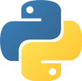
Defining (Creating) a Function
+
Notes:
yes. it is time to define our first functions in lesson.

Slide 17
Table of Contents
Main Principles of 'Defining'
Execution of a Function
Notes:
well. what you are gonna learn at the end of this lesson. after this lesson you will be able define a function in detail and use it in your code stream.

Slide 18
Main Principles of 'Defining'
1

Slide 19
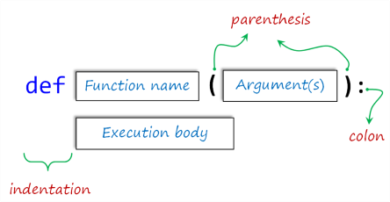
Main Principles of 'Defining' (review)
The basic formula syntax of user-defined function is:
Notes:
...
The statements that form the body of the function start at the next line and must be indented (leave four spaces).
Variables should be (traditionally) written in lowercase with underscores between words.
Arguments or Parameters are optional, but the parentheses is must.
A colon 👉🏻 : follows the closing parenthesis.
My friends, I would like to emphasize something here. If you remember from pre-class materials there are several statements concerning how difference the arguments and the parameters are… so. as a matter of fact, if you take a look at the official python documents, these two terms are used interchangeably. but it is better know the minor difference between them. ok. it is very simple. the variables that you used when defining a function in the parenthesis, they are the parameters. on the other hand, the values that you pass into the function when calling a function, they are the arguments. but you know what, it doesn’t matter which term you use. and my choice is using the term “arguments” in general but i would say that when i use either the term parameters or arguments, then from now on, you know what i will mean. ok.

Slide 20
Main Principles of 'Defining' (review)
Defining a simple function 👇
2
2
+
argument_1
argument_2
Notes:
….. let’s define our first function. it is a simple function. it sums the square of the arguments prints out the result, right?.. so, we have defined a function. let’s call and use it.
def first_function(argument_1, argument_2):
print(argument_1**2 + argument_2**2)

Slide 21
Main Principles of 'Defining' (review)
Let's call and use first_function.
Notes:
In this example, pass 2 and 3 as the arguments into this function. and when we run it ..
def first_function(argument_1, argument_2):
print(argument_1**2 + argument_2**2)
first_function(2, 3)

Slide 22
Main Principles of 'Defining' (review)
Let's call and use first_function.
Notes:
bingo… it prints out the result.
def first_function(argument_1, argument_2):
print(argument_1**2 + argument_2**2)
first_function(2, 3)

Slide 23
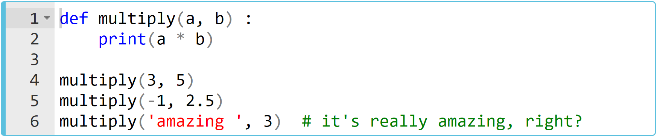
Main Principles of 'Defining' (review)
Let's define the multiplying function multiply(a, b).
What is the output? Try to figure out in your mind...
Notes:
def multiply(a, b):
print(a * b)
multiply(3, 5)
multiply(-1, 2.5)
multiply("amazing", 3)

Slide 24
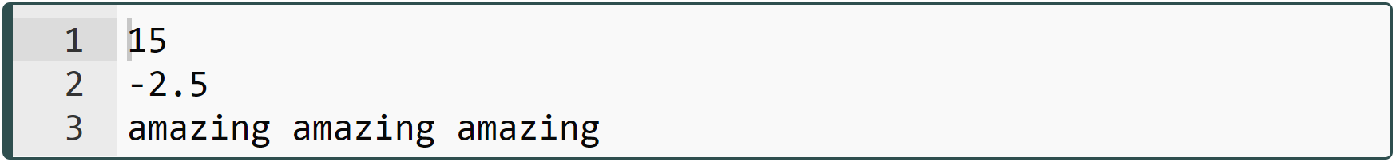
Main Principles of 'Defining'
Let's define the multiplying function multiply(a, b).
Notes:
…. when we pass string value into the function, what did happen? it repeats three times of the string. what is happening here is the same as the string operations you have learned in the previous lessons. same thing here…
def multiply(a, b):
print(a * b)
multiply(3, 5)
multiply(-1, 2.5)
multiply("amazing", 3)

Slide 25
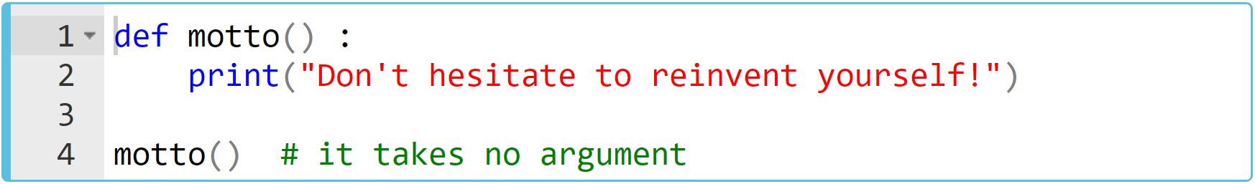
Main Principles of 'Defining' (review)
Let's give an example by leaving the parentheses empty.
What is the output? Try to figure out in your mind...
Notes:
yess. we don’t have to use parameters. it depends on our needs. so in this case, by this function motto, what we do..
def motto():
print("Don’t hesitate to reinvent yourself!")
motto()

Slide 26
Main Principles of 'Defining' (review)
Let's give an example by leaving the parentheses empty.
Notes:
yes. when we call it, it just prints out the string ….
def motto():
print("Don’t hesitate to reinvent yourself!")
motto()

Slide 27
Main Principles of 'Defining'
Task :
Define a function named add to sum two numbers and print the result.
Notes:
i want each one of you to define this simple function. I'm addressing to everyone who knows python well or not.
def add(a, b):
print(a + b)
add(-3, 5)

Slide 28
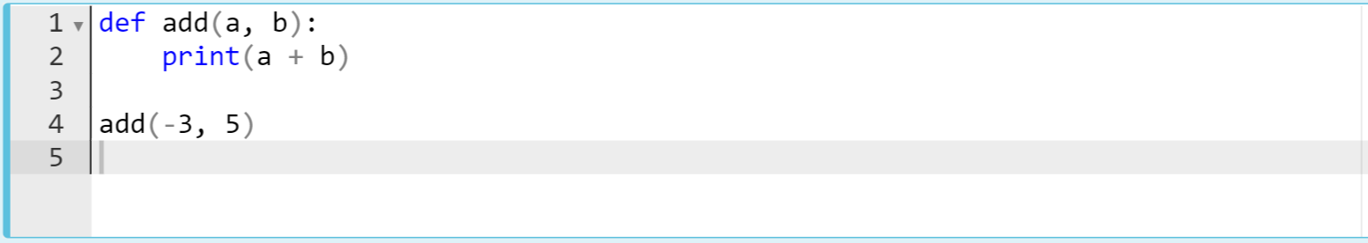
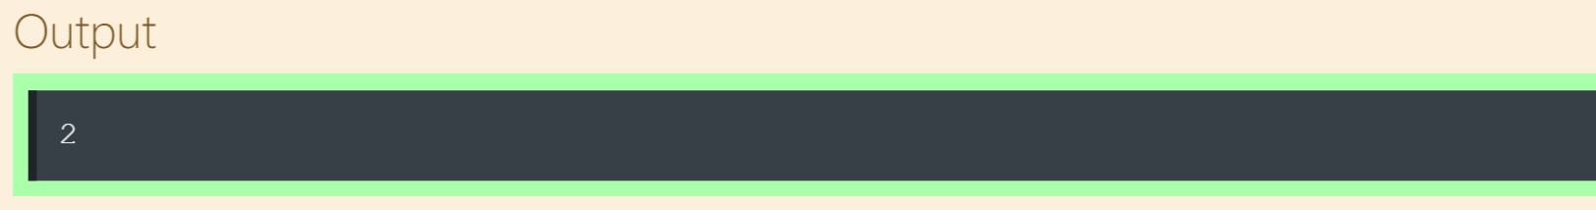
Main Principles of 'Defining' (review)
The code can be like :
Notes:
def add(a, b):
print(a + b)
add(-3, 5)

Slide 29
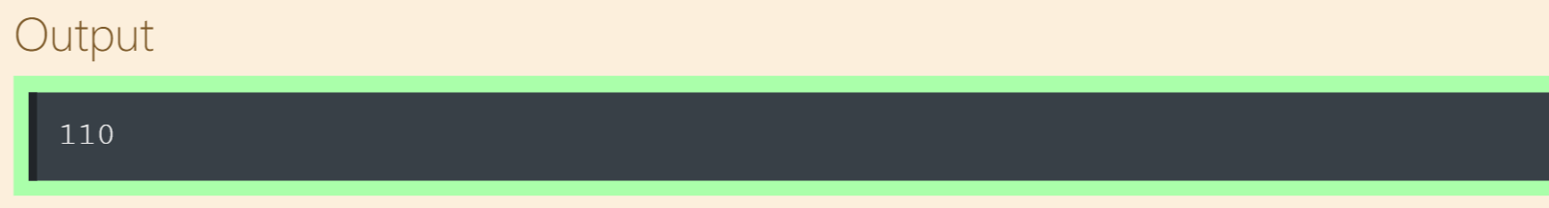
Main Principles of 'Defining'
Task :
Define a function named calculator to calculate four math operations with two numbers and print the result.
Warn user in case of wrong entry : "Enter valid arguments"
Notes:
def calculator(x, y, opr):
if opr == "+":
print(x + y)
elif opr == "-":
print(x - y)
elif opr == "*":
print(x * y)
elif opr == "/":
print(x / y)
else:
print("enter valid arguments!")

Slide 30
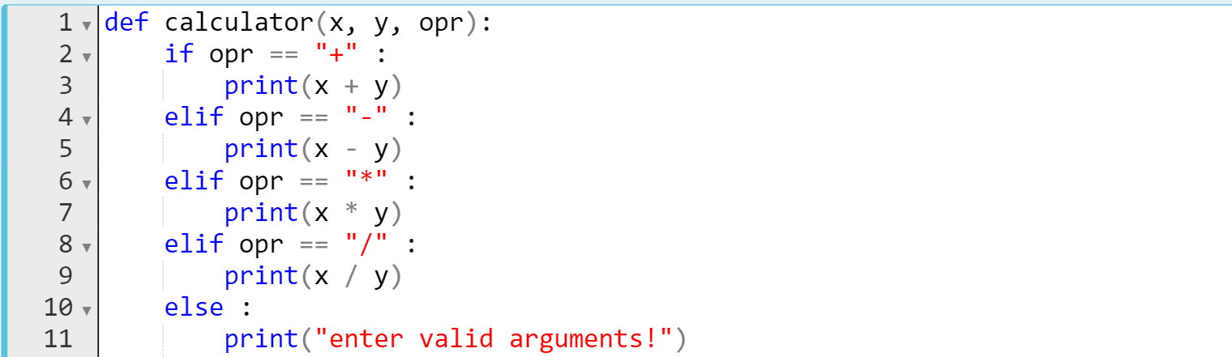
Main Principles of 'Defining'
The code might be like :
Notes:
def calculator(x, y, opr):
if opr == "+":
print(x + y)
elif opr == "-":
print(x - y)
elif opr == "*":
print(x * y)
elif opr == "/":
print(x / y)
else:
print("enter valid arguments!")

Slide 31
Execution of a Function
2

Slide 32

Execution of a Function (review)
The result of a function :
print
return
def multiply_1(a, b) :
print(a * b) # it prints something
multiply_1(10, 5)
Notes:
The functions you have seen so far did not return any types or values but executed some actions.
In order to use the output and data types generated by the functions in our next program flow, we need to define our function with the keyword return.
def multiply_1(a, b) :
print(a * b) # it prints something
multiply_1(10, 5)

Slide 33
Execution of a Function (review)
The result of a function :
print
return
def multiply_1(a, b) :
print(a * b) # it prints something
multiply_1(10, 5)
50
Notes:
multiply one is defined using print statement as an output
def multiply_1(a, b) :
print(a * b) # it prints something
multiply_1(10, 5)

Slide 34
Execution of a Function (review)
The result of a function :
print
return
def multiply_2(a, b) :
return(a * b) # returns any numeric data type value
print(multiply_2(10, 5))
Notes:
multiply two is defined using return keyword.
when we use keyword “return”, then as a result, the function give us an output. which means any data type value. in this example on the screen, we use return keyword and it means that the output of this function is a multiply b. this is the output. when we pass ten and 5 into it then the output will be 50 and we can print it, right?
def multiply_2(a, b) :
return a * b # returns any numeric data type value
print(multiply_2(10, 5))

Slide 35
Execution of a Function (review)
The result of a function :
def multiply_2(a, b) :
return(a * b) # returns any numeric data type value
print(multiply_2(10, 5))
print
return
50
Notes:
def multiply_2(a, b) :
return a * b # returns any numeric data type value
print(multiply_2(10, 5))

Slide 36
Execution of a Function (review)
Compare the usage options :
Notes:
The first function just prints some data what you passed into. The second one generates a numeric type value. If you check their types you will see :
print(type(multiply_1(10, 2)))
print(type(multiply_2(10, 5)))

Slide 37
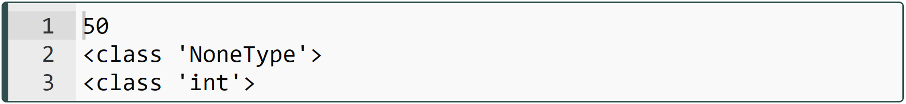
Execution of a Function (review)
The outputs are :
Notes:
…… We can't use the result of the first function since it is NoneType data. But, the second one is integer data that we can use it in the future when we need it.
print(type(multiply_1(10, 2)))
print(type(multiply_2(10, 5)))

Slide 38
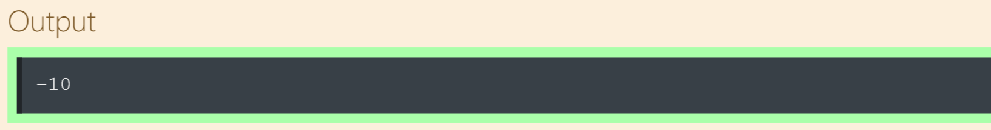
Main Principles of 'Defining'
Task :
Define a function named calculator to calculate four math operations with two numbers and return the result.
Notes:
def calculator(x, y, o):
if o == "+":
return(x+y)
elif o == "-":
return(x - y)
elif o == "*":
return(x*y)
elif o == "/":
return(x/y)
else : return("enter valid arguments!")

Slide 39
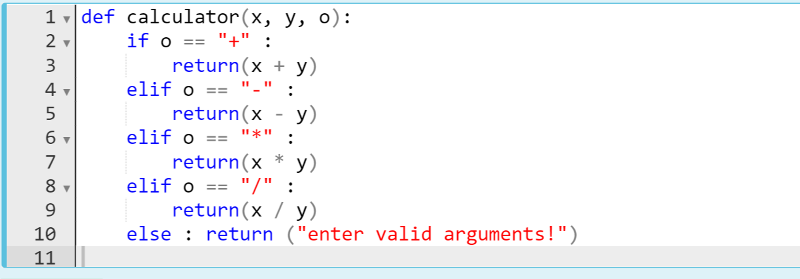
Main Principles of 'Defining'
The code might be like :
Notes:
def calculator(x, y, o):
if o == "+":
return(x+y)
elif o == "-":
return(x - y)
elif o == "*":
return(x*y)
elif o == "/":
return(x/y)
else : return("enter valid arguments!")

Slide 40
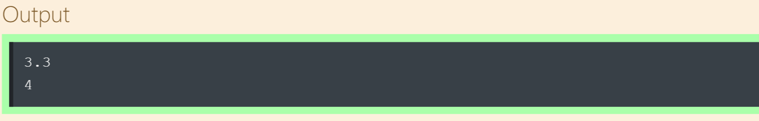
Main Principles of 'Defining'
Task :
Define a function named absolute_value to calculate and return absolute value of the entered number.
Notes:
… in mathematics we can define an absolute value like that : the distance to zero point. right? which means, actually the positive value. ok

Slide 41
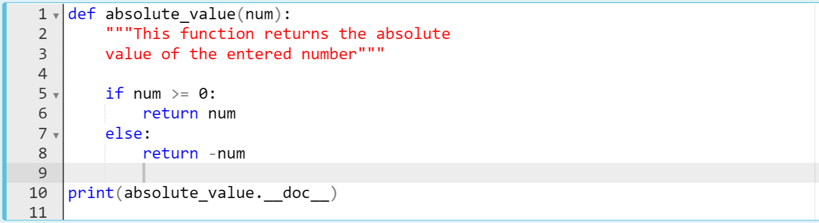
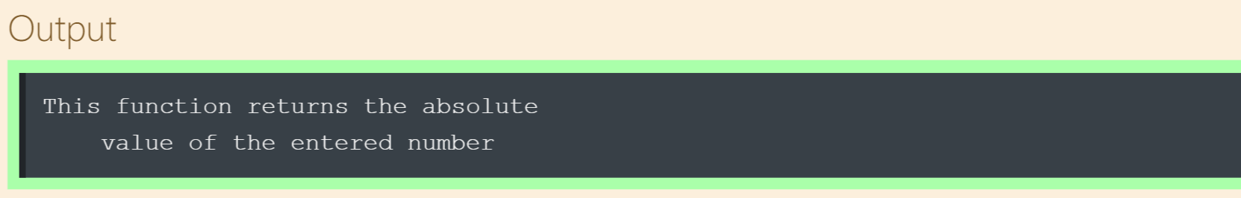
Main Principles of 'Defining'
The code might be like :
By the way, we can display the docstring of this function
By the way, we can display the docstring of this function
Notes:
def absolute_value(num):
"""This function returns the absolute
value of the entered number"""
if num >= 0:
return num
else:
return -num
print(absolute_value.__doc__)

