Slide 1


Slide 2

Linux Plus
for
AWS and DevOps
Session - 7

Slide 3

Table of Contents
Loops
Functions

Slide 4
While loops
Output:
$./while-loops.sh
1
2
3
4
5
6
7
8
9
10
Now, number is 11
#!/bin/bash
number=1
while [[ $number -le 10 ]]
do
echo $number
((number++))
done
echo "Now, number is $number"
while [[ <some test> ]]
do
<commands>
done
Notes:
When writing programs in shell, in some cases it is not enough to execute the block of code only once. The loops are used to repeat (iterate) the execution of a block of code.
- while loops have a boolean logic, similar to if statements. As long as the result of the condition returns True, the code block under while loop runs. When the condition returns to False, the loop execution is terminated and the program control moves further to the next operation

Slide 5
Until loops
Output:
$./until.sh
1
2
3
4
5
6
7
8
9
Now, number is 10
#!/bin/bash
number=1
until [[ $number -ge 10 ]]
do
echo $number
((number++))
done
echo "Now, number is $number"
until [[ <some test> ]]
do
<commands>
done
Notes:
The until loop is identical to the while loop, except that it will execute the commands within it until the test becomes true.

Slide 6
For loops
Output:
#!/bin/sh
echo "Numbers:"
for number in 0 1 2 3 4 5 6 7 8 9
do
echo $number
done
$./for-loop.sh
Numbers:
0
1
2
3
4
5
6
7
8
9
for item in [list]
do
commands
done
Notes:
The until loop is identical to the while loop, except that it will execute the commands within it until the test becomes true.

Slide 7
Continue and Break Statement
Infinite loop
#!/bin/bash
number=1
until [[ $number -lt 1 ]]
do
echo $number
((number++))
done
echo "Now, number is $number"
Notes:
- A loop will continue forever unless the necessary condition is not met. A loop that runs endlessly without terminating can run for an infinite number of times. For this reason, these loops are named infinite loops.

Slide 8
Continue and Break Statement
Break Statement
Output:
#!/bin/bash
number=1
until [[ $number -lt 1 ]]
do
echo $number
((number++))
if [[ $number -eq 10 ]]
then
break
fi
done
./infinite-loop.sh
1
2
3
4
5
6
7
8
9
Notes:
- As we see the infinite loop run forever. The break statement is used to terminate the execution of the entire loop.

Slide 9
Continue and Break Statement
Continue Statement
Output:
#!/bin/bash
number=1
until [[ $number -lt 1 ]]
do
((number++))
tens=$(($number % 10))
if [[ $tens -eq 0 ]]
then
continue
fi
echo $number
if [[ $number -gt 14 ]]
then
break
fi
done
$./continue.sh
2
3
4
5
6
7
8
9
11
12
13
14
15
Notes:
The Continue statement is similar to the Break command, except it causes the current iteration of the loop to exit, instead of the whole loop.

Slide 10
Exercise 1
Calculate sum of the numbers between 1 to 100.
Print result.
Notes:
🍐 This is a Pear Deck Text Slide
🍐 To edit the type of question, go back to the "Ask Students a Question" in the Pear Deck sidebar.
#!/bin/bash
sum=0
for list in {1..100};
do
let sum+=$list
done
echo "Total = $sum"
**************
i=1
sum=0
while [[ $i -le 100 ]]
do
sum=$(($sum+$i))
let i++
done
echo "Total = $sum"

Slide 11
Exercise 2
Ask user to input multiple names in a single line
Print “Hello” message for each name in seperate lines.
Notes:
🍐 This is a Pear Deck Text Slide
🍐 To edit the type of question, go back to the "Ask Students a Question" in the Pear Deck sidebar.
read -p "Enter multiple names: " names
for name in $names;
do
echo "Hello $name"
done

Slide 12
Functions
#!/bin/bash
Welcome () {
echo "Welcome to Linux Lessons"
}
Welcome
function function_name () {
commands
}
Notes:
A Bash function is a piece of code that only runs when it is called. Functions enable you to reuse code. We can call the functions numerous times.

Slide 13
Passing Arguments to Functions
#!/bin/bash
Welcome () {
echo "Welcome to Linux Lessons $1 $2 $3"
}
Welcome Joe Matt Timothy
Output:
$./functions.sh
Welcome to Linux Lessons Joe Matt Timothy
Notes:
We can pass any number of arguments to the bash function in a similar way to passing command line arguments to a script. We simply supply them right after the function’s name, separated by a space. These parameters would be represented by $1, $2 and so on, corresponding to the position of the parameter after the function’s name.

Slide 14
Nested Functions
#!/bin/bash
function_one () {
echo "This is from the first function"
function_two
}
function_two () {
echo "This is from the second function"
}
function_one
Output:
$./nested.function.sh
This is from the first function
This is from the second function
Notes:
- One of the useful features of functions is that they can call themselves and other functions.

Slide 15
Variables Scope
Local variable
#!/bin/bash
var1='global 1'
var2='global 2'
var_scope () {
local var1='function 1'
var2='function 2'
echo -e "Inside function:\nvar1: $var1\nvar2: $var2"
}
echo -e "Before calling function:\nvar1: $var1\nvar2: $var2"
var_scope
echo -e "After calling function:\nvar1: $var1\nvar2: $var2"
local variable_name=value
Output:
Before calling function:
var1: global 1
var2: global 2
Inside function:
var1: function 1
var2: function 2
After calling function:
var1: global 1
var2: function 2
Notes:
Global variables are variables that can be accessed from anywhere in the script regardless of the scope. In Bash, by default all variables are defined as global, even if declared inside the function.
Local variables can be declared within the function body with the local keyword and can be used only inside that function.

Slide 16
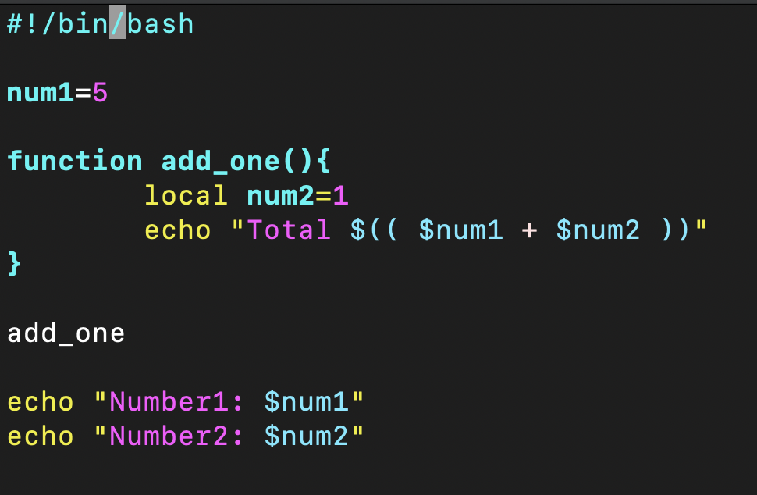
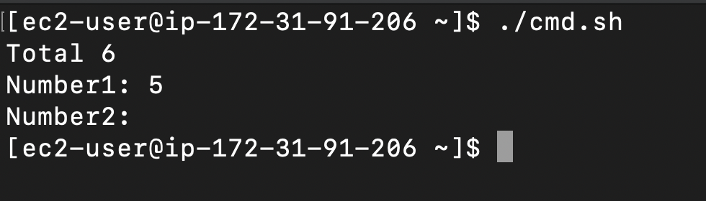
Functions
Local variable
local variable_name=value
Notes:
try without local keyword

Slide 17
Exercise 3
Create a function named print_age that accepts one argument
Ask user to input his/her year of birth and store it to local birth_year variable
Calculate age using current year value from the first argument
Print age with a message
Call print_age function with 2022
Notes:
🍐 This is a Pear Deck Text Slide
🍐 To edit the type of question, go back to the "Ask Students a Question" in the Pear Deck sidebar.
#!/bin/bash
function print_age() {
local birth_year
read -p “Enter your birth day: “ birth_year
age=0
let age=$1-$birth_year # echo (( $1 - $birth_year ))
echo $age
print_age 2021
}
************
#!/bin/bash
age=0
function calculate_age() {
let age=$1-$2
}
year=2021
for i in {1..5}
do
read -p “Enter birth year: “ birth_year
if [ $birth_year -gt $year ]
then
echo “Incorrect year”
break
else
calculate_age $year $birth_year
echo “Your age is $age”
fi
done

Slide 18
THANKS!
Any questions?

