Slide 1
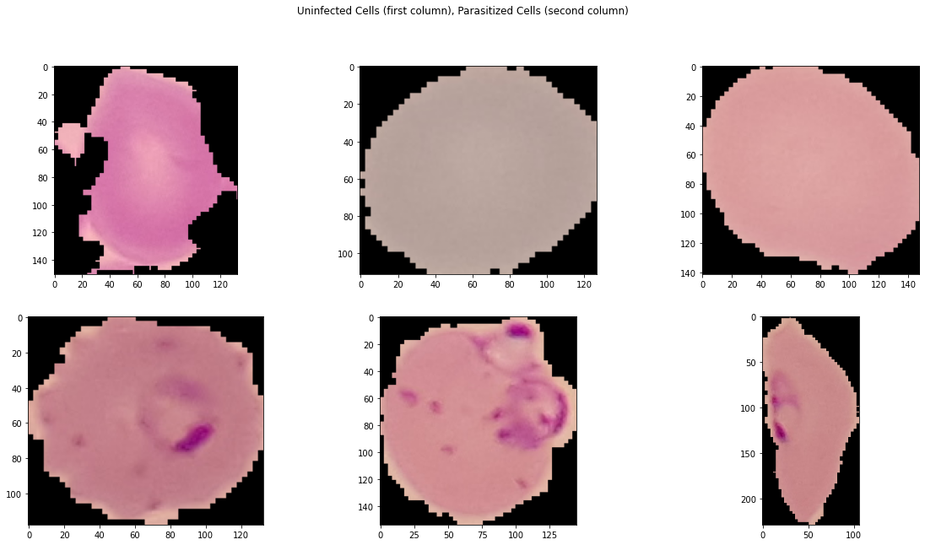
Malaria Dataset
Uninfected Cells
13 779 Images
Label = 0
Parasitized Cells
13 779 Images
Label = 1
Partition Ratio: 80/20
Train Images: 22046
Test Images: 5512
Cells have different size and shapes

Slide 2
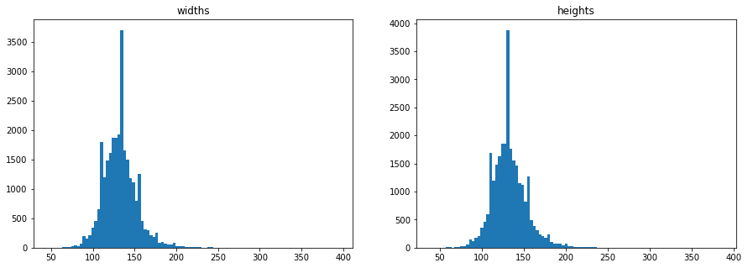
Width and Height
Images have different sizes and width/height ratios
We choose the same size for width and height for all images
The average width is 132.49 px
The average height is 132.98 px
The size of 133x133 px for each image can be considered, but we choose 50x50 px due to high computation time

Slide 3
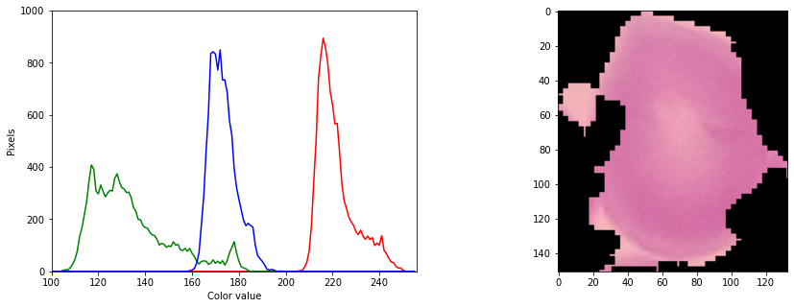
RGB Histogram
A lot of black pixels which doesn‘t contribute to the classification problem
Black Pixels can be considered to be cancelled beforehand with a histogram filter

Slide 4
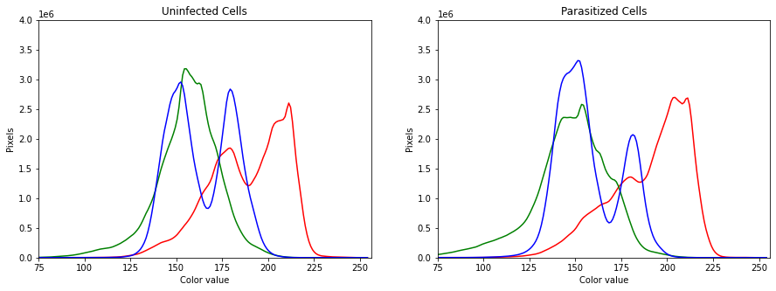
RGB Histogram of Classes
The parasitized cell images shows a more higher amount of darker blue pixels
A color contour filter can be considered, but the threshold must be determined
The color ranges for each label are slightly similar
We choose to use greyscale images for machine learning models to cut computation time and feature dimension

Slide 5
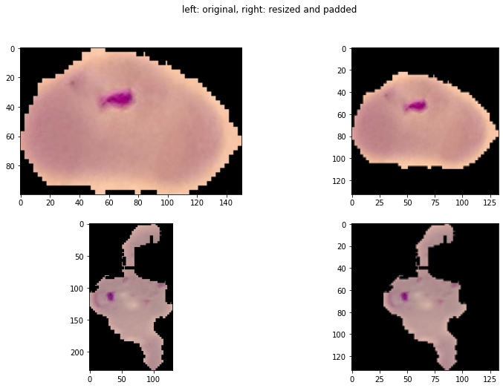
Padding and Resizing
The width/height ratio is always 1
We resized each image and fill the missing pixels with a black border
For this purpose the Pillow padding function is very convenient

Slide 6
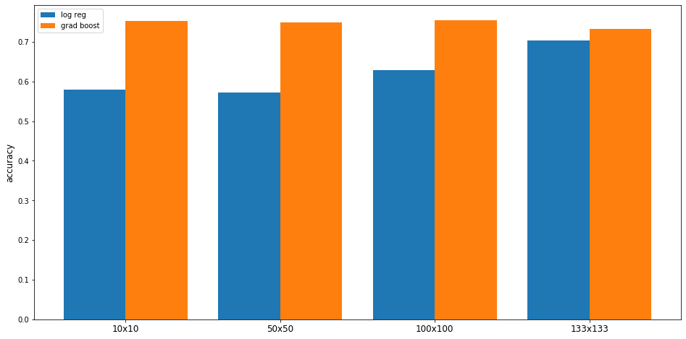
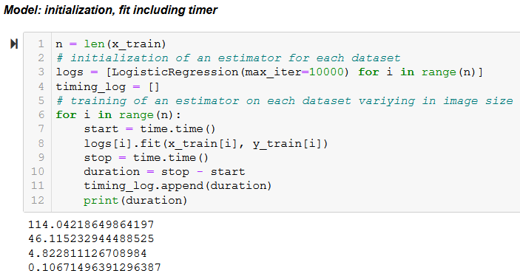
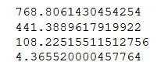
Image Size Analysis
133x133 100x100 50x50 10x10
133x133
100x100
50x50
10x10
133x133
100x100
50x50
10x10

Slide 7
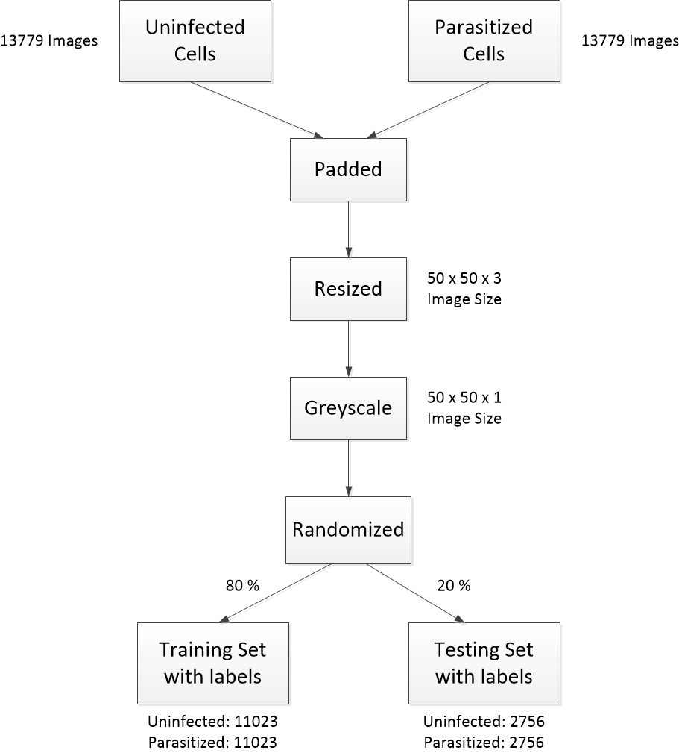
Overall Image Preprocessing

Slide 8
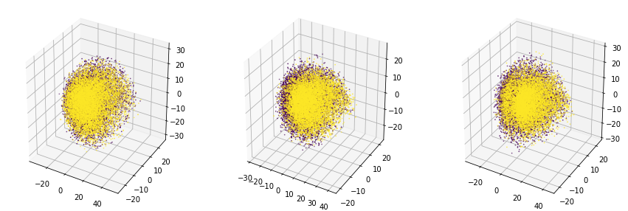
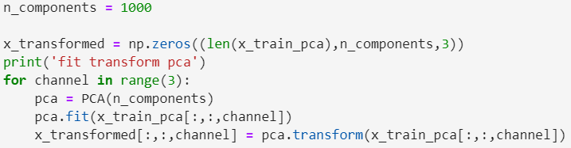
PCA Color Channel
Channel: Red
Channel: Green
Channel: Blue

Slide 9
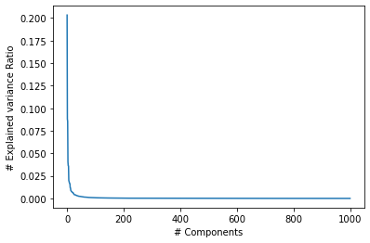
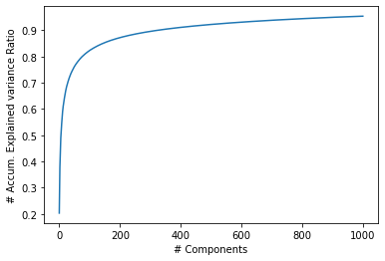
PCA Explained Variance
The first components contribute a lot the explained variance
With higher amount of components, less explained variance is added
PCA for 133x133 px images
17 689 Feature Input
For ~300 Components ~90% of the input image featured can be descibed
For 1000 Components, 95.39 %
Code: n_components = 0.95

Slide 10
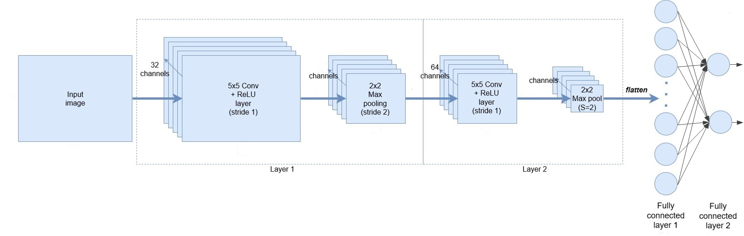
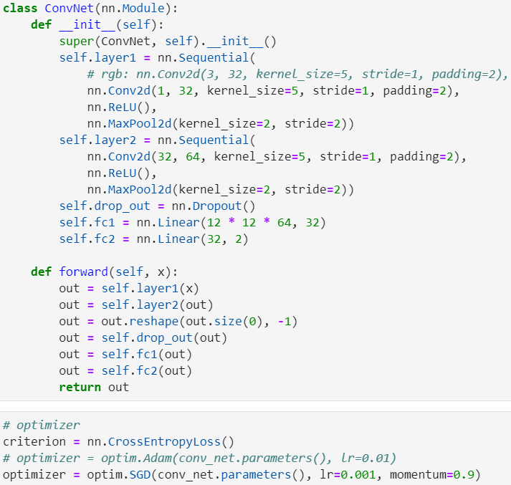
Convolutional Neural Network
1 x 50 x 50
y_pred

Slide 11
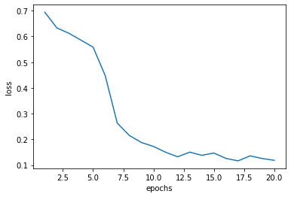
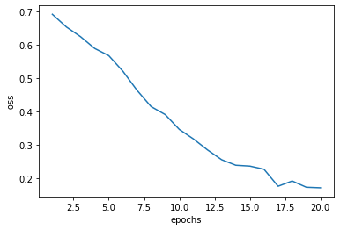
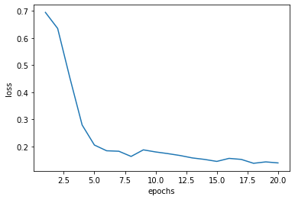
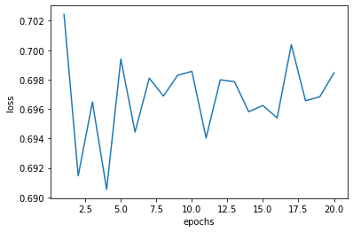
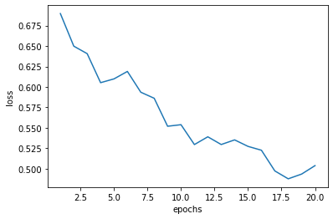
CNN Parameter Testing
 |  |  | Train Accuracy | Test Accuracy
RGB | Lr=0.001 (sgd) | 2 Conv. Layers | 95.87 % | 95.17 %
BW | Lr=0.001 (sgd) | 2 Conv. Layers | 93.54 % | 93.12 %
 | Lr=0.01 (sgd) |  | 94.31 % | 93.80 %
 | Lr=0.1 (sgd) |  | 50 % | 50 %
 | Lr=0.001 (sgd) | 1 Conv. Layers | 78.52 % | 77.54 %
RGB
Lr=0.001
2 Conv.Layers
rgb images are overall better classified as greyscale images
the convergence for sgd learning rate 0.01 (bw) and 0.001 (rgb) is a lot steeper, therefore a good lr is given
for a higher sgd learning rate of 0.1 (bw) the cnn doesn‘t classify at all
BW
Lr=0.001
2 Conv.Layers
BW
Lr=0.01
2 Conv.Layers
BW
Lr=0.001
1 Conv.Layers
BW, Lr=0.1
2 Conv.Layers

Slide 12
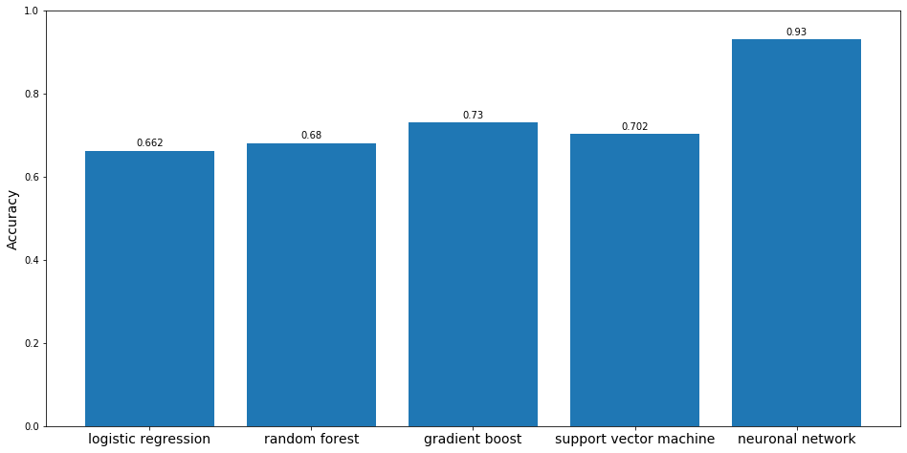
Evaluation

Slide 13
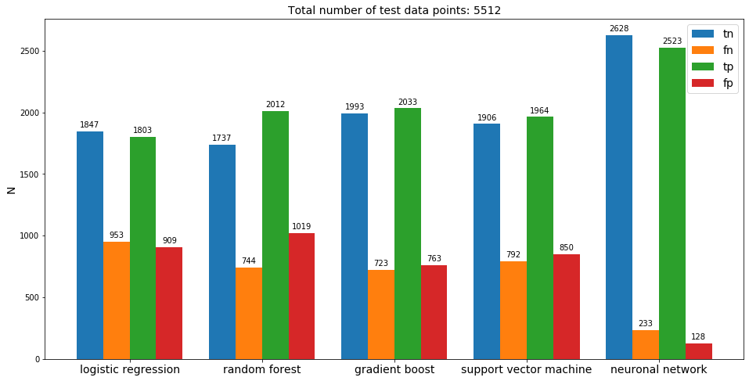
Evaluation

Slide 14
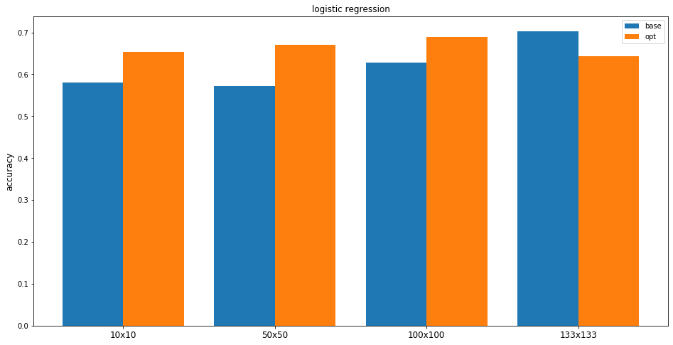
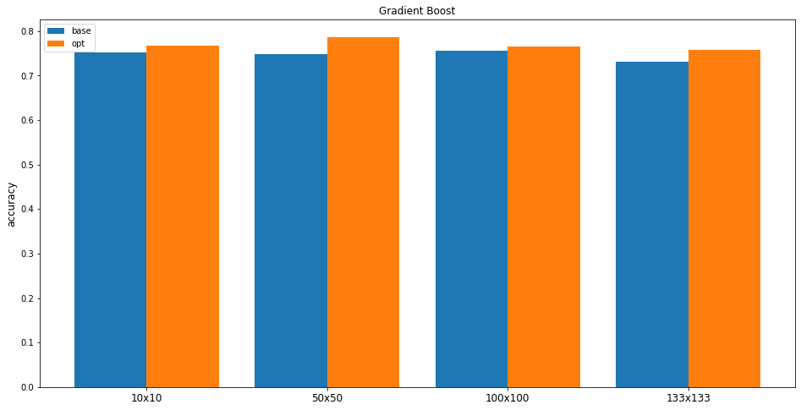
Image Size Analysis pt. 2
133x133 100x100 50x50 10x10
133x133 100x100 50x50 10x10

