Slide 1

Towards Efficient Comparison of Change-based Models
Alfa Yohannis¹ Horacio Hoyos Rodriguez^{∗1}
Fiona Polack^{∗∗2} Dimitris Kolovos¹
¹Department of Computer Science, University of York, United Kingdom
²School of Computing and Maths, Keele University, United Kingdom
{ary506, dimitris.kolovos}@york.ac.uk
∗horacio_hoyos_rodriguez@ieee.org
∗∗f.a.c.polack@keele.ac.uk
ECMFA 2019
Tuesday, 17 July 2019
Eindhoven, Netherlands

Slide 2
Introduction
In modelling and model management, a model can have many versions or variants
They are persisted as snapshots in a state-based format such as XMI
Model comparison are applied to highlight their diﬀerences: changes in properties values, new elements, etc.
Comparing versions of large ﬁle-based models in a state-based format can be computationally expensive
Versions of the model need to be loaded in memory in their entirety before their elements can be matched and diﬀed

Slide 3
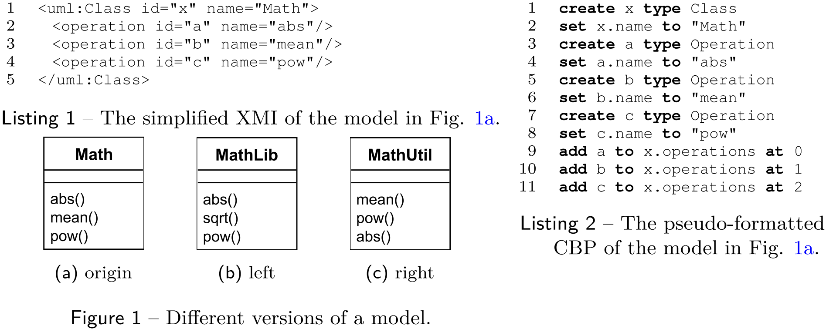
Introduction
Change-Based Persistence (CBP) persists the complete history of changes of a model instead of its eventual state.

Slide 4
Main Goals
Use the persisted changes to optimise:
Incremental model management
Model differencing, conflict detection, and merging
Support Collaborative Modelling
Support common text-based Version Control Systems (e.g. Git, SVN) to persist changes
Facilitate Model Analytics
This paper addresses Model Differencing

Slide 5
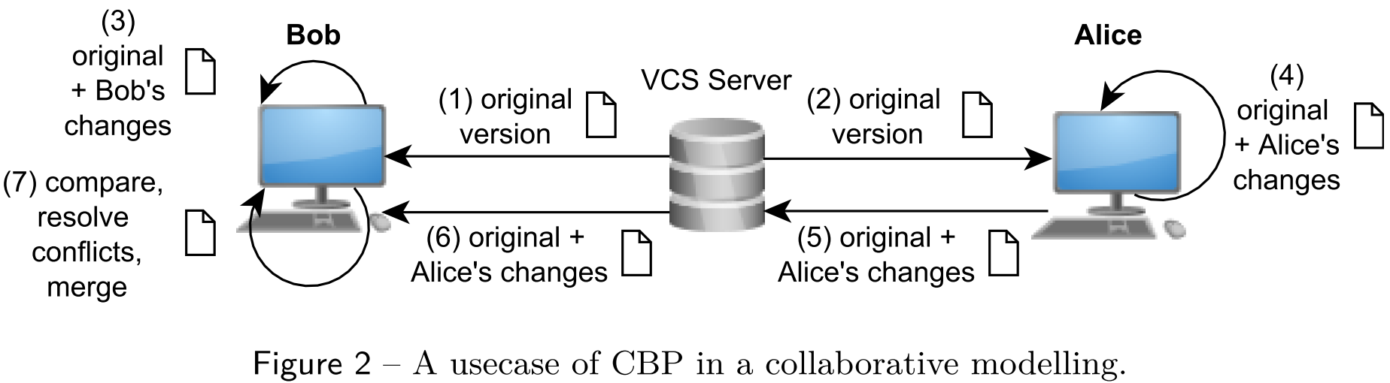
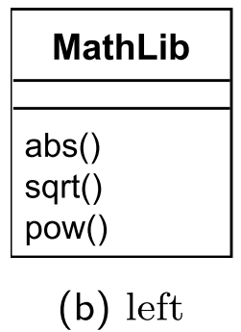
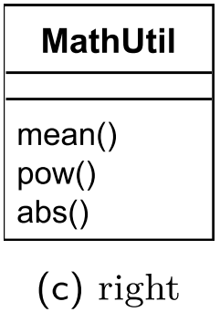
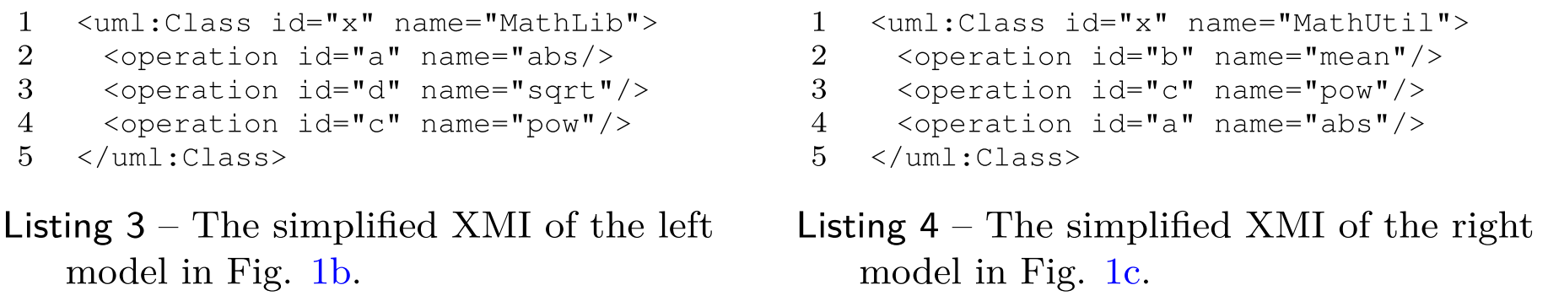
Running Example

Slide 6
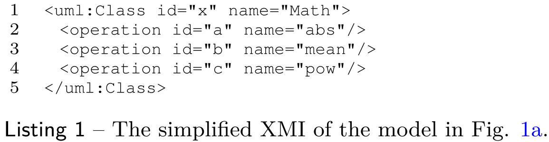
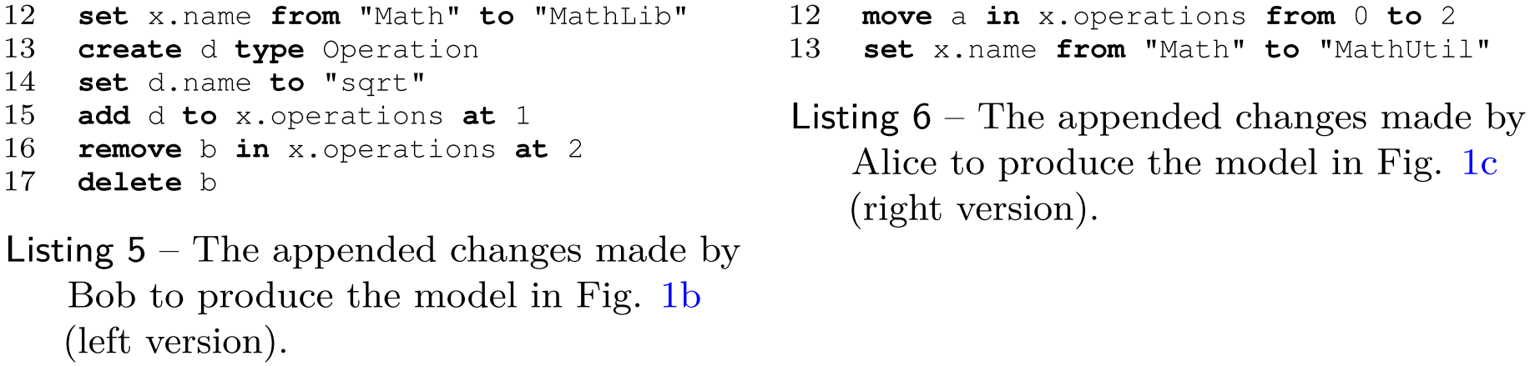
Change-based Model Differencing (1)

Slide 7
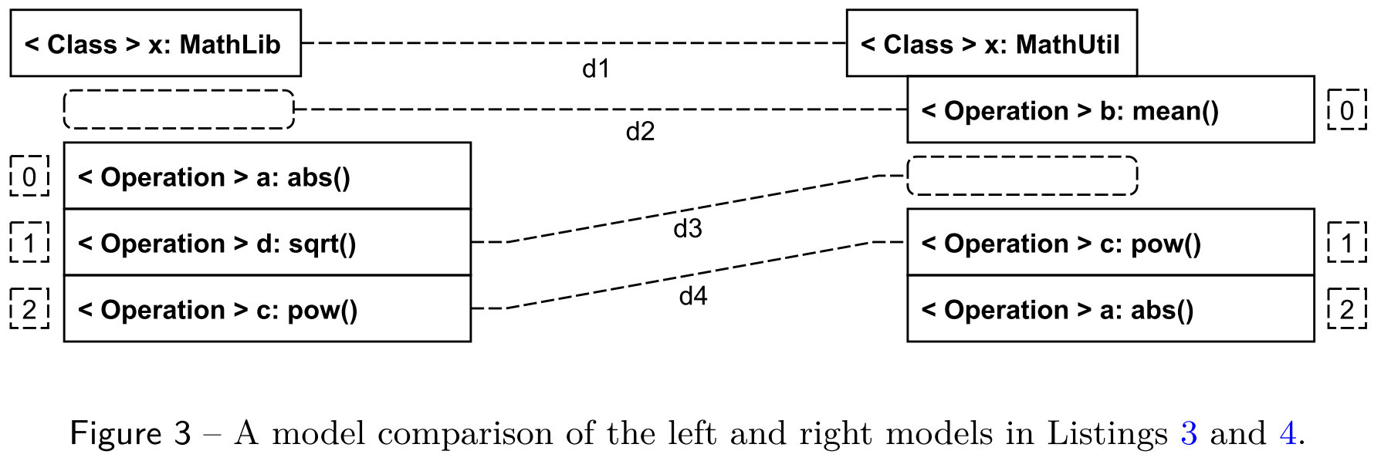
State-based Model Comparison (2)
ds_{n} = [LeftContainer_{n} , RightContainer_{n} , LeftFeature_{n} , RightFeature_{n} ,
LeftIndex_{n} , RightIndex_{n} , LeftValue_{n} , RightValue_{n} , Kind_{n}]
ds₁ = [x, x, name, name, 0, 0, “MathLib”, “Mathutil”, CHANGE]
ds₂ = [x, x, operations, operations, null, 0, null, b, DELETE]
ds₃ = [x, x, operations, operations, 1, null, d, null, ADD]
ds₄ = [x, x, operations, operations, 2, 1, c, c, MOVE]

Slide 8
Change-based Model Differencing (2)
Steps:
Event Loading
Element Tree Construction
Diff Computation
Event Loading
load events from files into memory

Slide 9
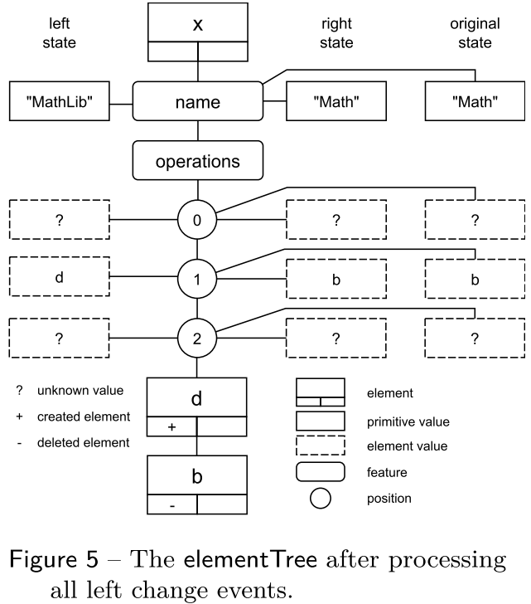
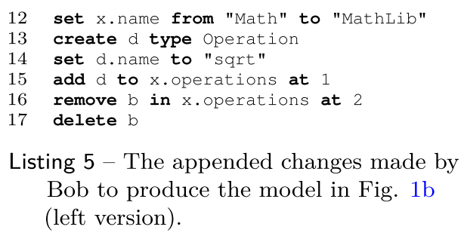
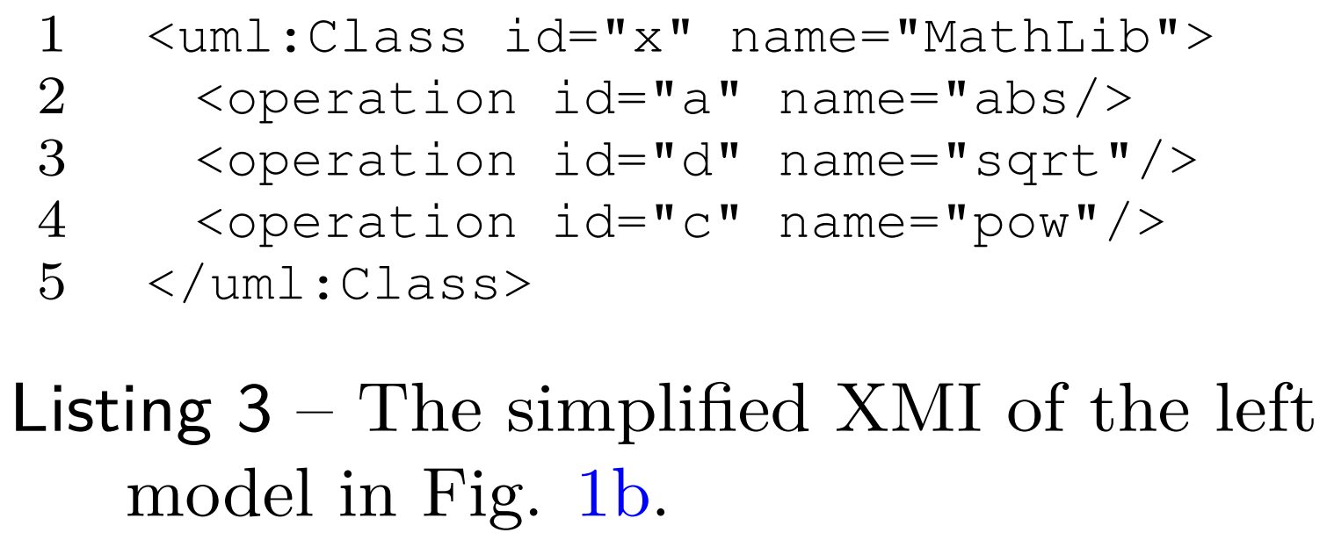
Change-based Model Differencing (4)
Element Tree Construction
Left

Slide 10
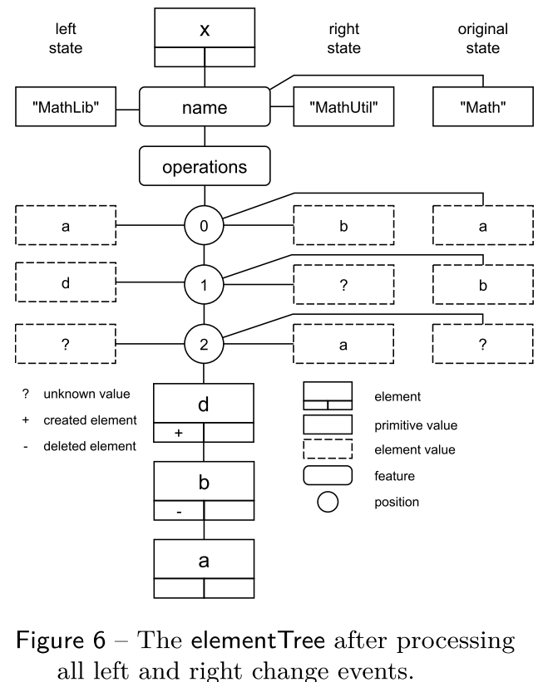
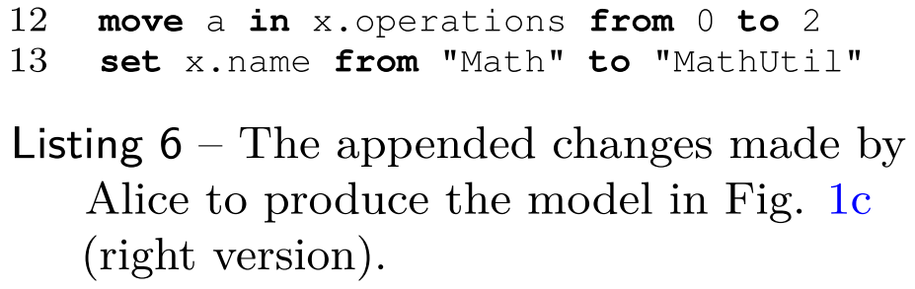
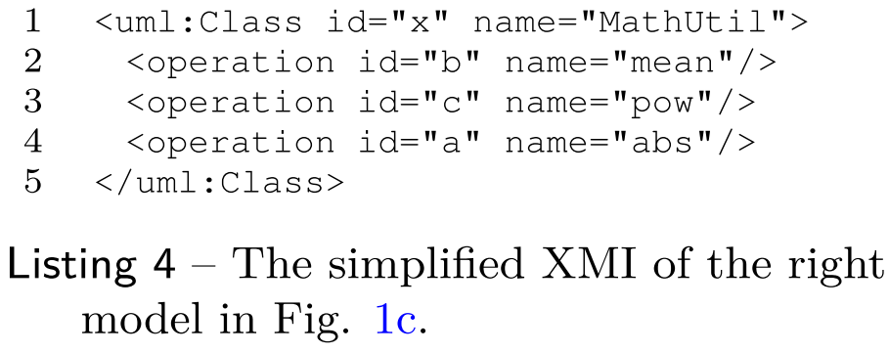
Change-based Model Differencing (5)
Element Tree Construction
Right

Slide 11
Change-based Model Differencing (6)
Diff Computation
How to make right side equal to left side
change x.name from “MathLib” to “MathUtil”
delete b
add d to name.operations at 1
move a in name.operations from 2 to 1

Slide 12
Change-based Model Differencing (6)
Change-based:
dc_{n}= [LeftContainer_{n} , RightContainer_{n} , LeftFeature_{n} , RightFeature_{n} ,
LeftIndex_{n} , RightIndex_{n} , LeftValue_{n} , RightValue_{n} , Kind_{n}]
dc₁ = [x, x, name, name, 0, 0, “MathLib”, “MathUtil”, CHANGE]
dc₂ = [x, x, operations, operations, ?, 0, ?, b, DELETE]
dc₃ = [x, x, operations, operations, 1, ?, d, ?, ADD]
dc₄ = [x, x, operations, operations, 0, 2, a, a, MOVE]
State-based:
ds_{n} = [LeftContainer_{n} , RightContainer_{n} , LeftFeature_{n} , RightFeature_{n} ,
LeftIndex_{n} , RightIndex_{n} , LeftValue_{n} , RightValue_{n} , Kind_{n}]
ds₁ = [x, x, name, name, 0, 0, “MathLib”, “MathUtil”, CHANGE]
ds₂ = [x, x, operations, operations, null, 0, null, b, DELETE]
ds₃ = [x, x, operations, operations, 1, null, d, null, ADD]
ds₄ = [x, x, operations, operations, 2, 1, c, c, MOVE]

Slide 13
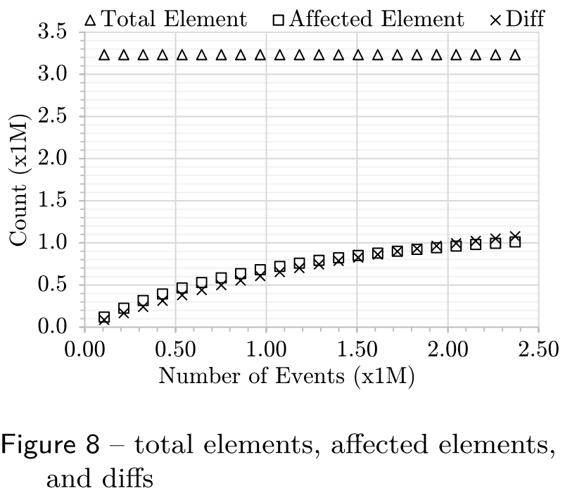
Performance Evaluation: Mixed Operations
Random Modification
Ratio
change : move : add : delete = 40 : 20 : 1 : 1

Slide 14
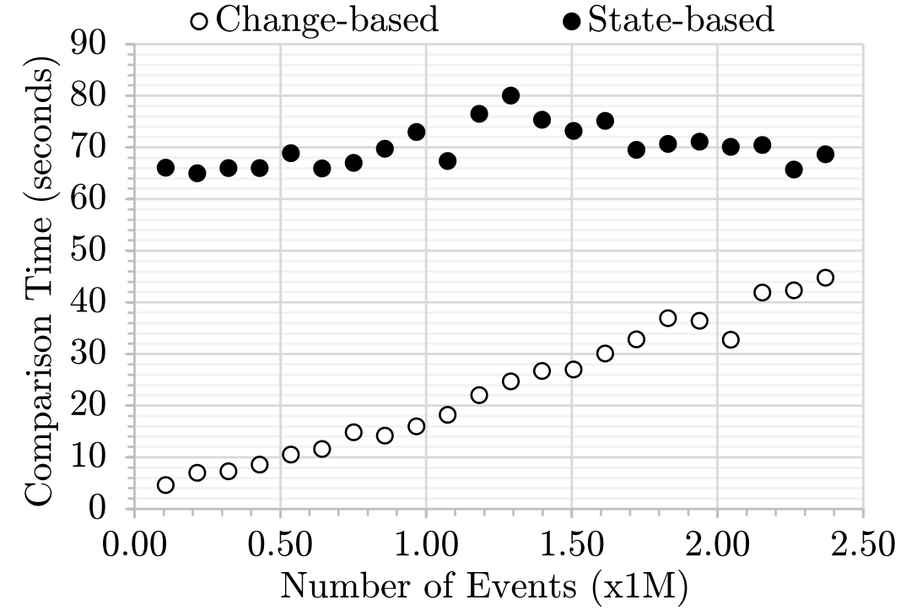
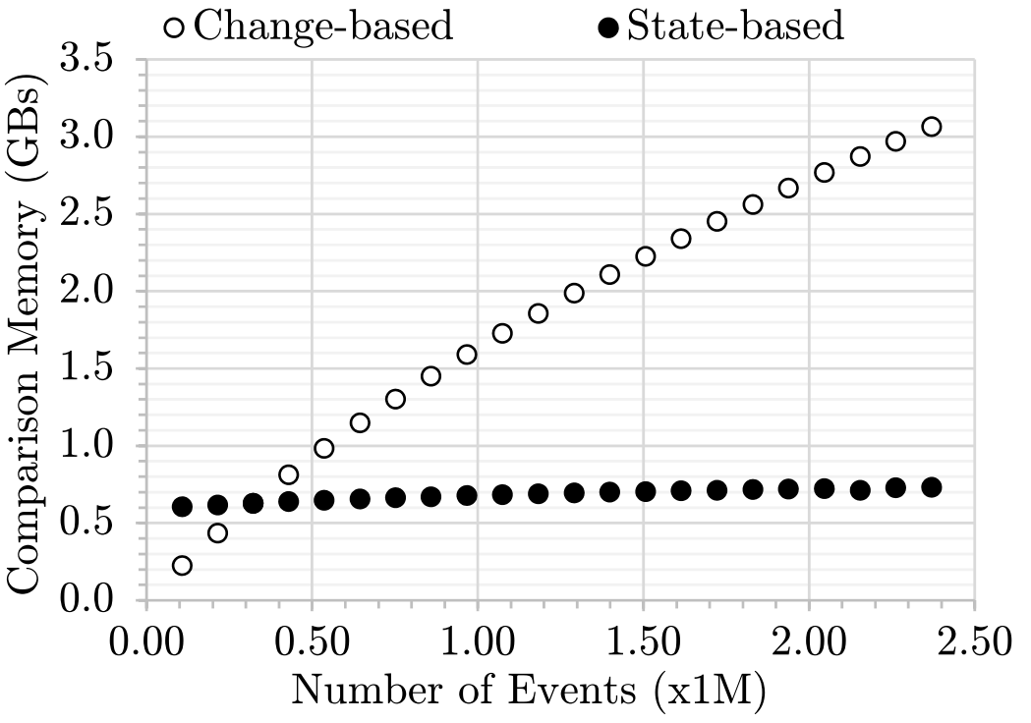
Performance Evaluation: Mixed Operations
Change-based vs. State-based Model Differencing
Comparison Time Memory Footprint

Slide 15
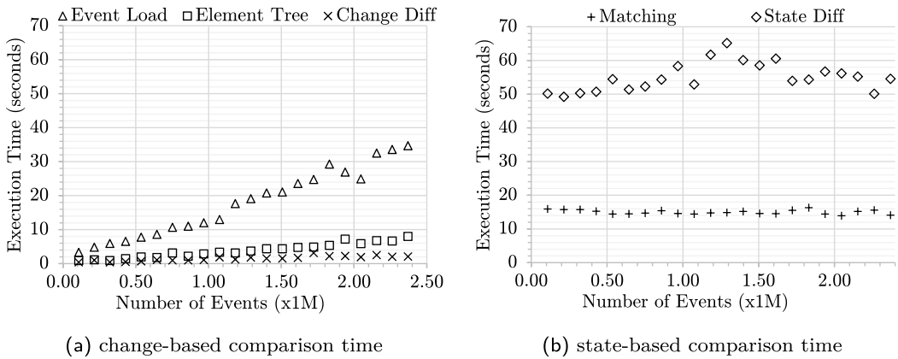
Performance Evaluation: Mixed Operations
Breakdown view of comparison time

Slide 16
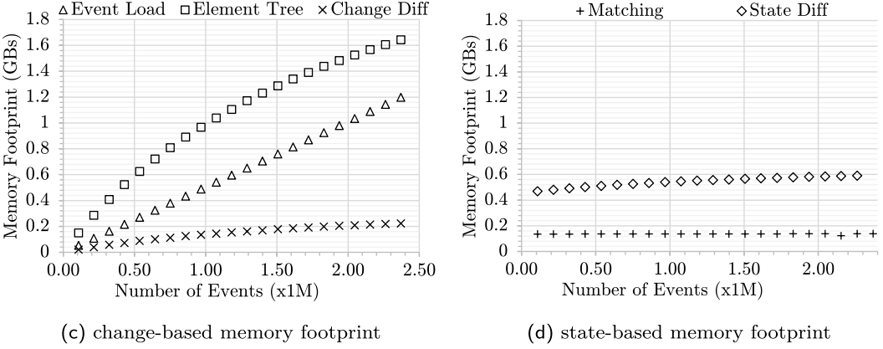
Performance Evaluation: Mixed Operations
Breakdown view of memory footprint

Slide 17
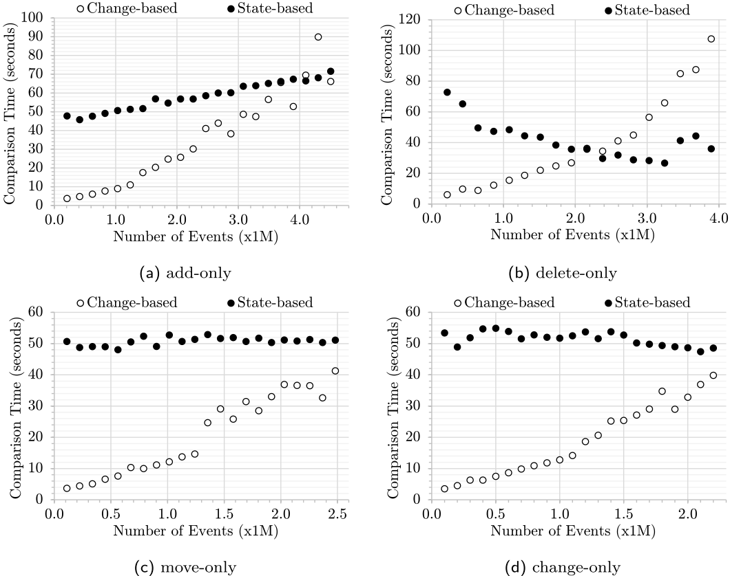
Performance Evaluation on Comparison Time: Homogenous Operations

Slide 18
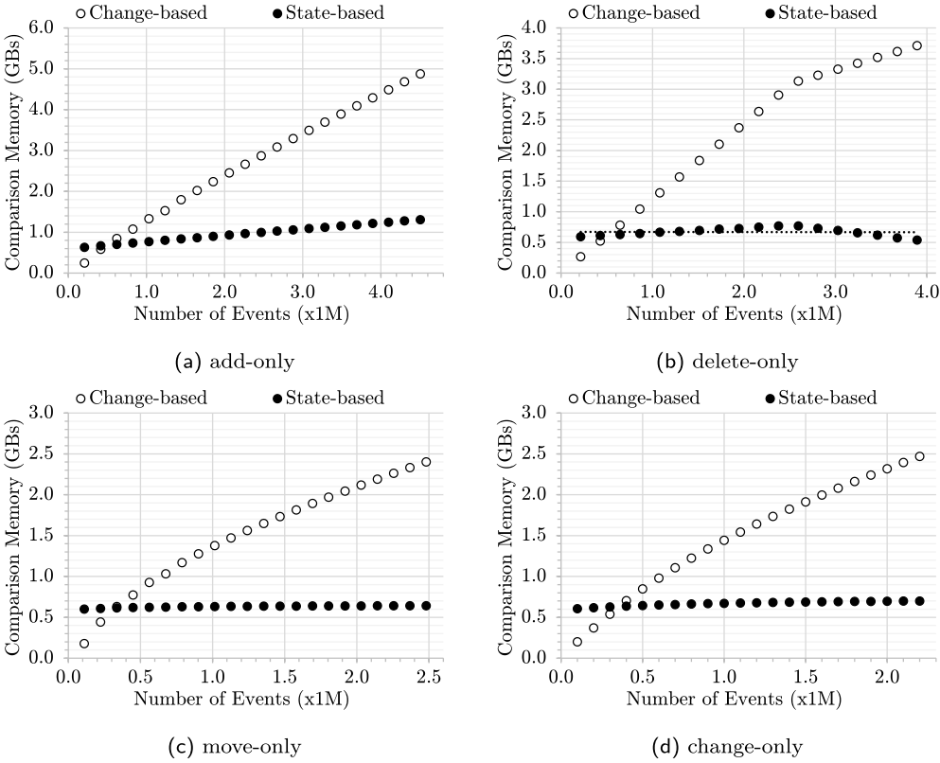
Performance Evaluation on Memory Footprint: Homogenous Operations

Slide 19
Conclusions and Future Work
Conclusions
Change-based model comparison – a novel approach to model differencing
It exploits the nature of change-based persistence; only compare the last set of changes between two models
It can compare models faster than state-based model comparison
It needs to load change events, thus may requires more memory than for the state-based approach
Arguably, diﬀ and merge operations are usually performed on smaller deltas
Future Work
Conflict detection and merging in the change-based way

