Slide 1

Progress Meeting : 09.06.2025

Slide 2
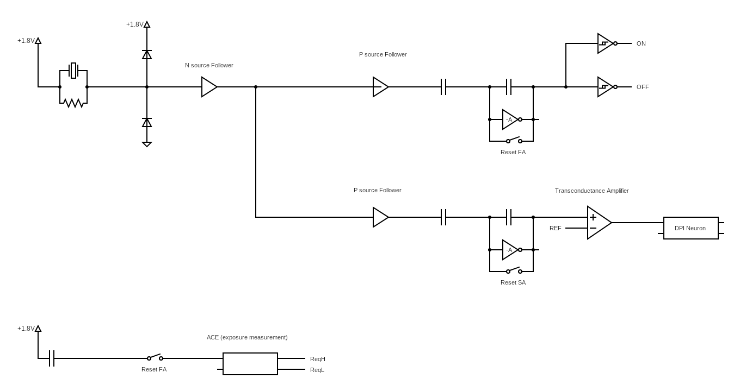
Circuit Overview
Outside of the chip

Slide 3
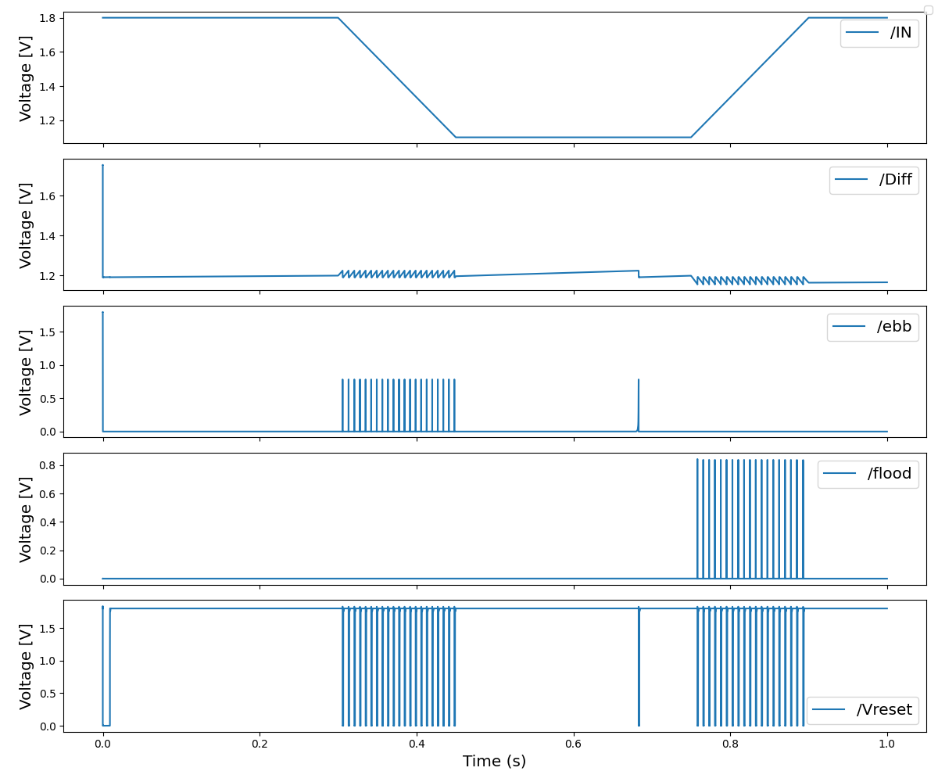
Change detector

Slide 4
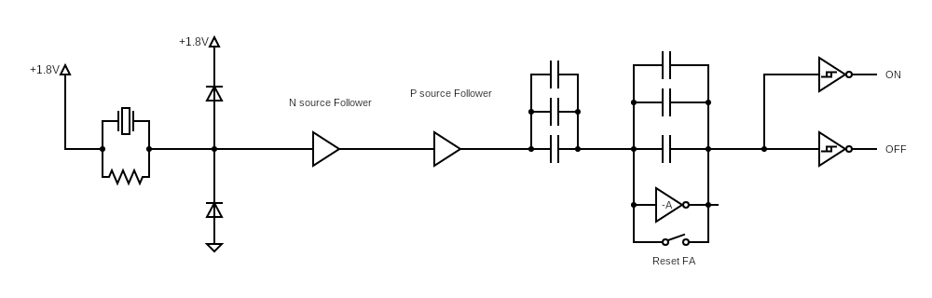
Change detector leakage
Leakage current of 50 fA

Slide 5
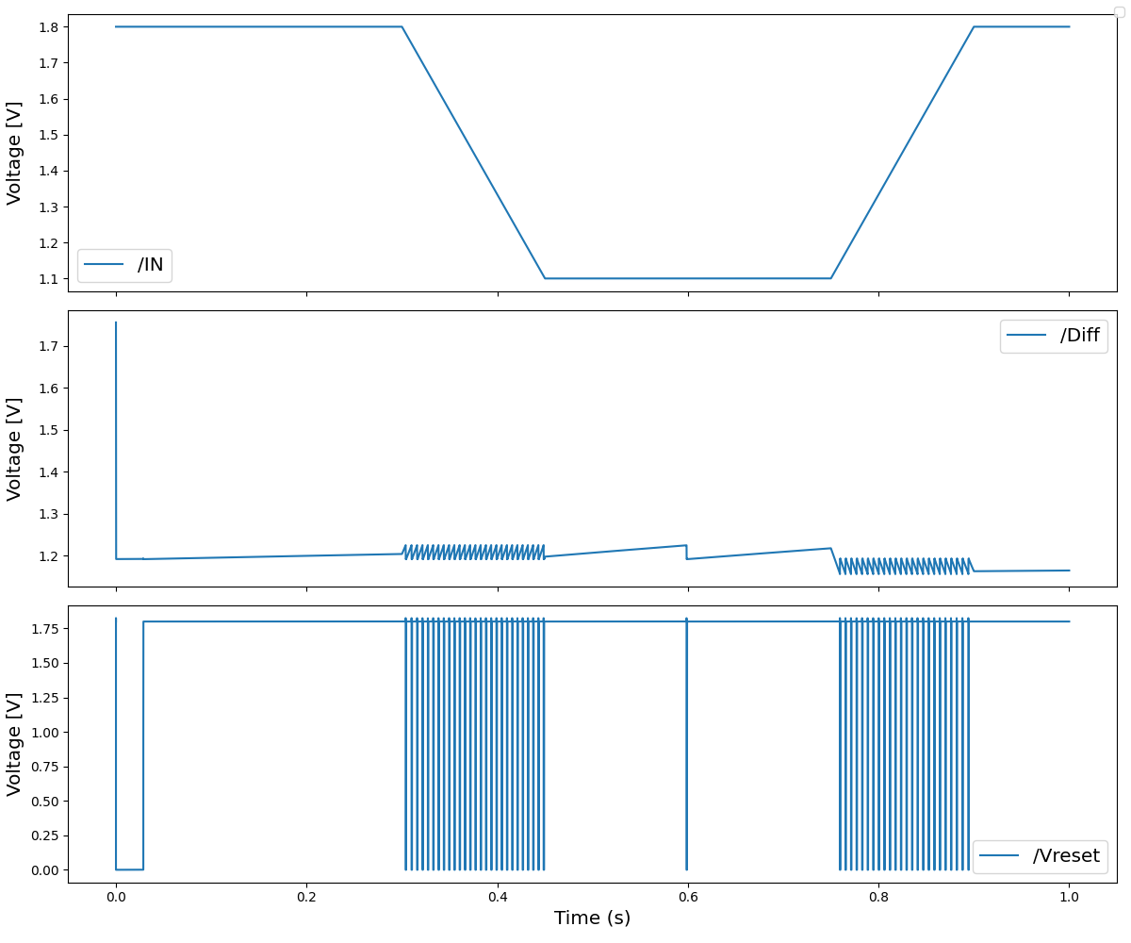
Array of capacitors leakage
Leaky spiking rate of about 1 Hz
V_{diff} has variations of 20 mV with nA of thresholds current:
I_{reset} = 10 nA
I_{ON} = 5 nA
I_{OFF} = 20 nA

Slide 6
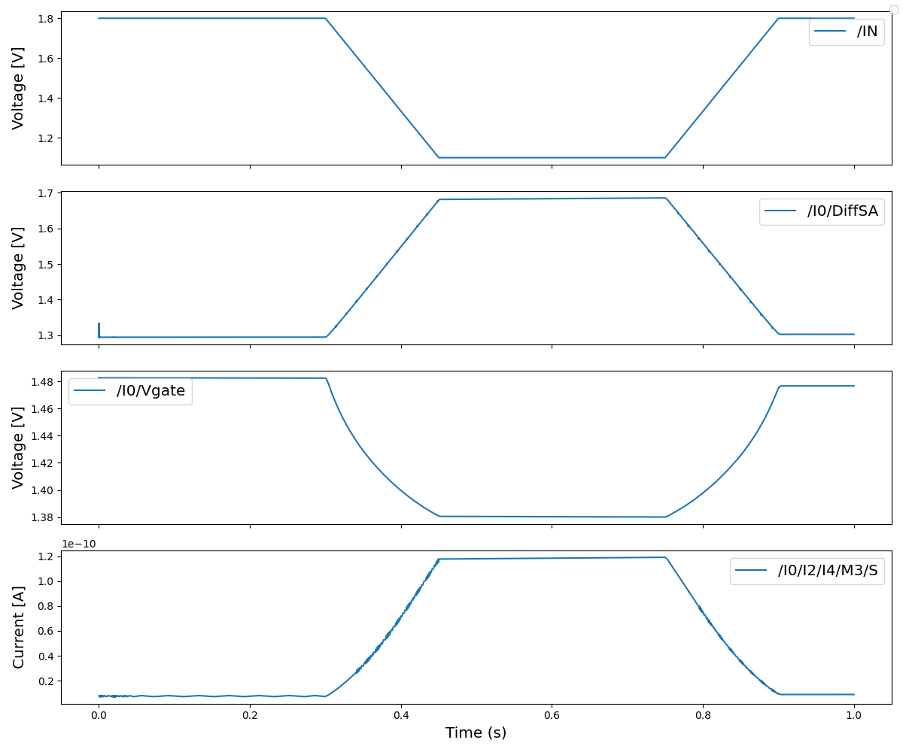
Slow Adaptive Circuit Input

Slide 7
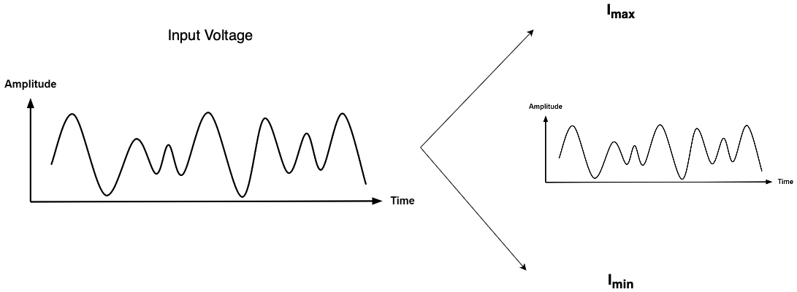
Slow Adaptive Circuit : Input scaling

Slide 8
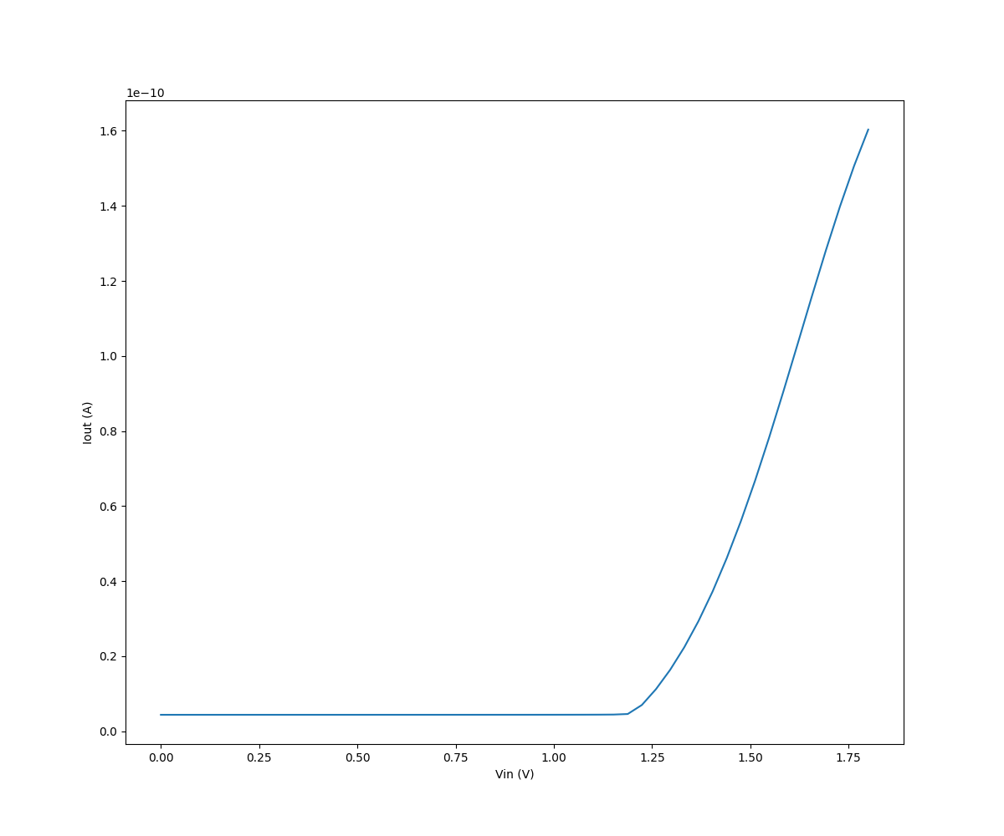
Transconductance Amplifier

Slide 9
Slow Adaptive Circuit Input

Slide 10
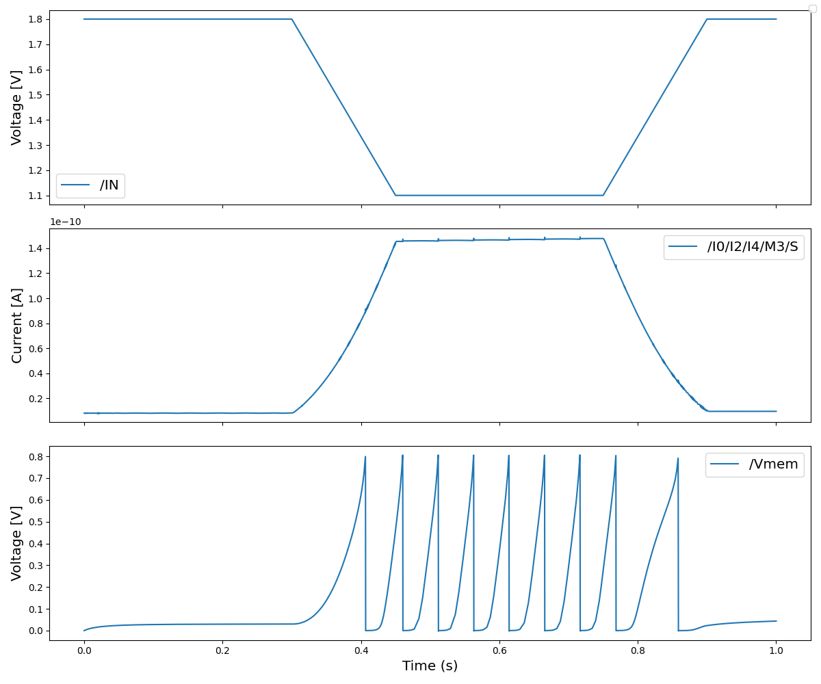
Slow Adaptive Circuit Behavior

Slide 11
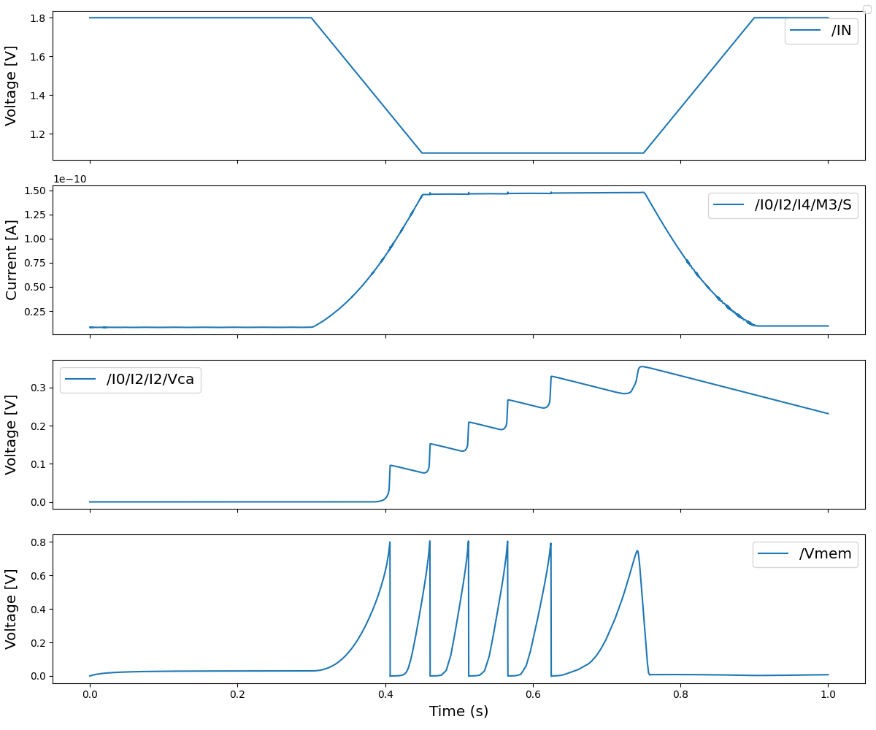
Slow Adaptive Circuit Behavior

Slide 12
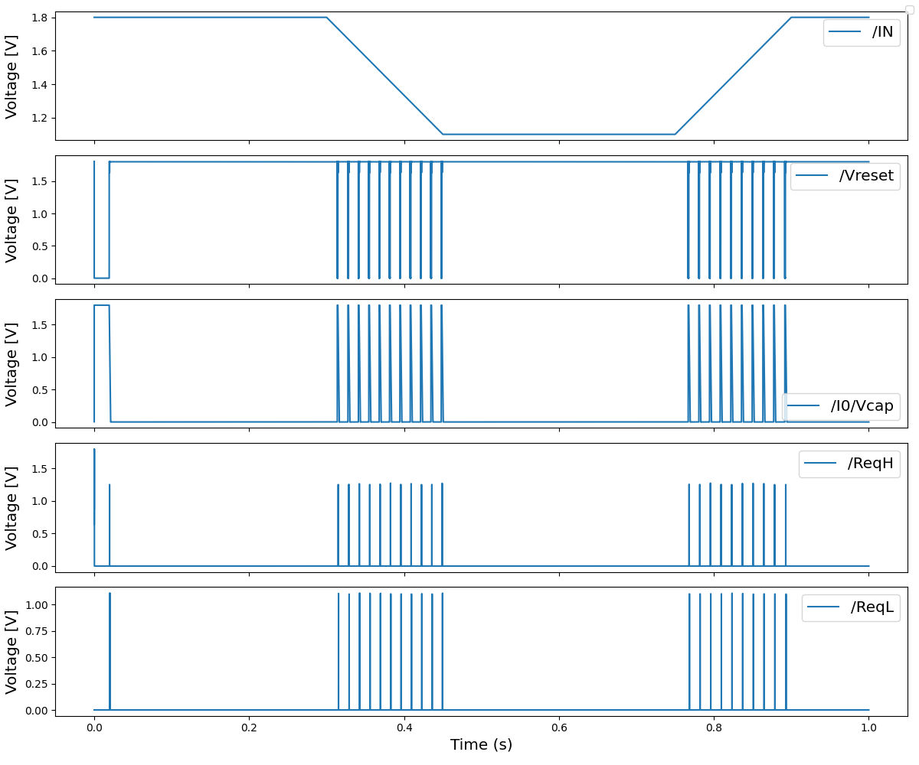
ACE circuit

Slide 13
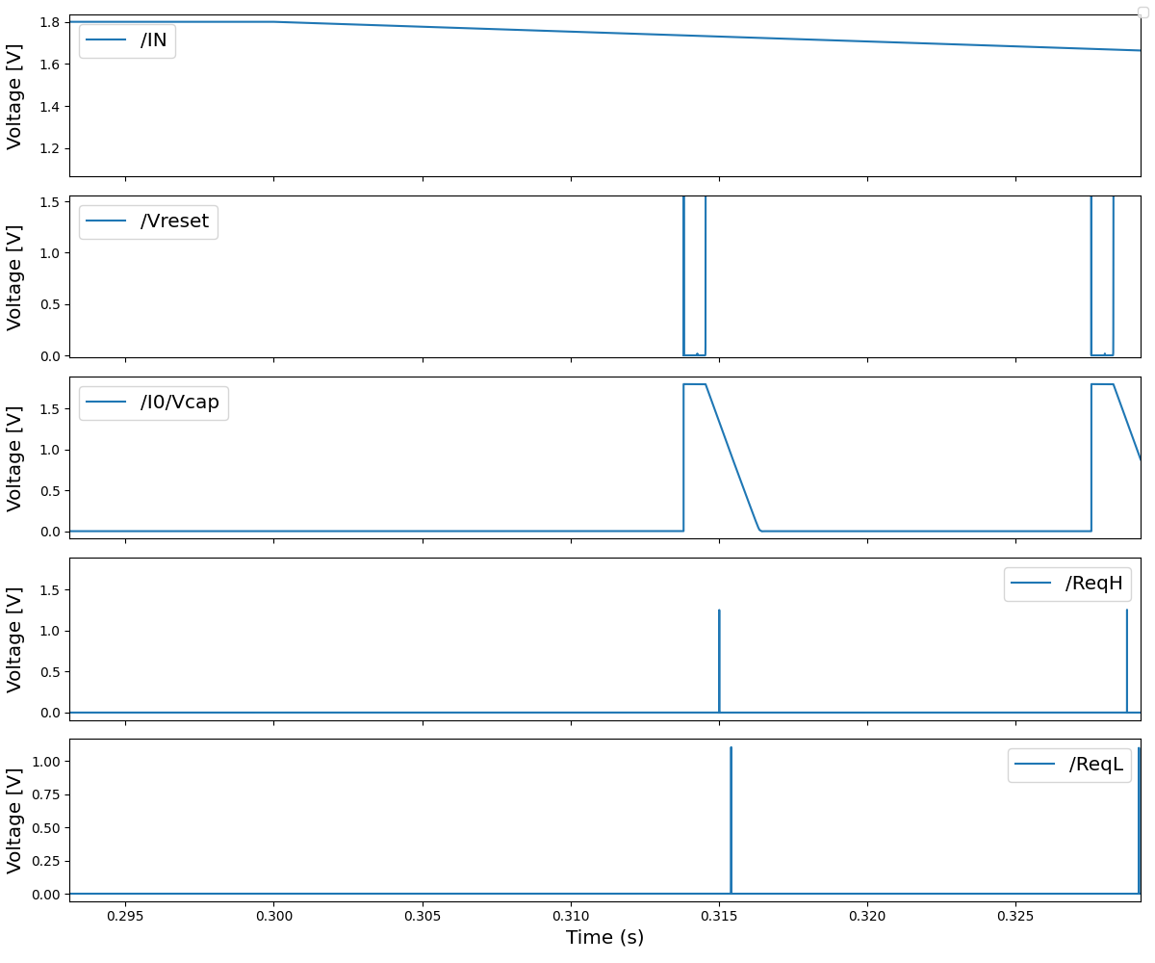
ACE circuit : Zoom-in

