Slide 1

March Monthly Meeting

Slide 2
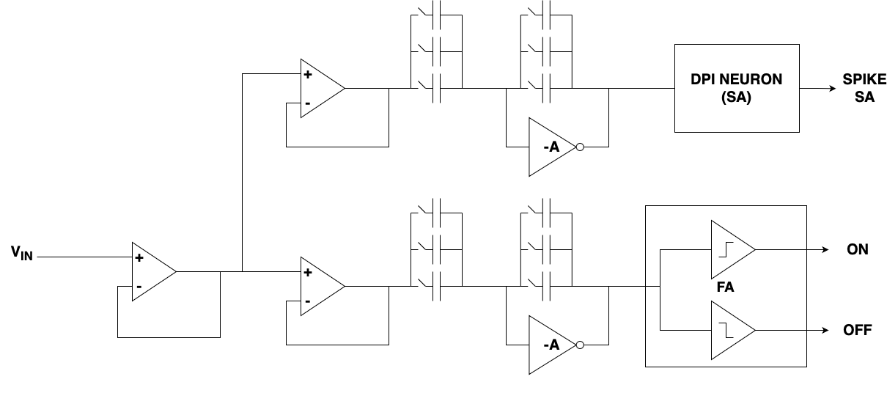
Local Processing Element : TAXEL

Slide 3
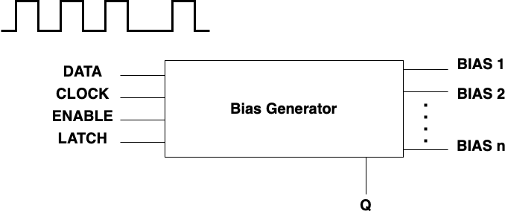
BIAS CURRENTS Generator

Slide 4
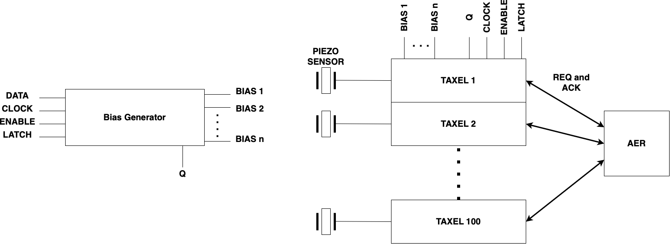
CHIP overview

Slide 5
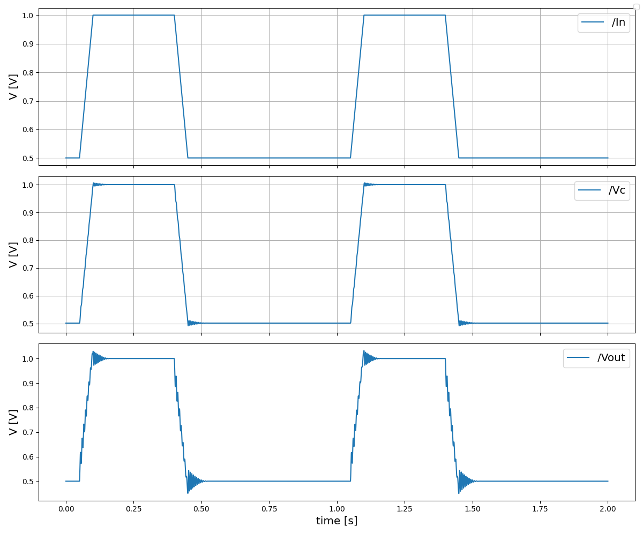
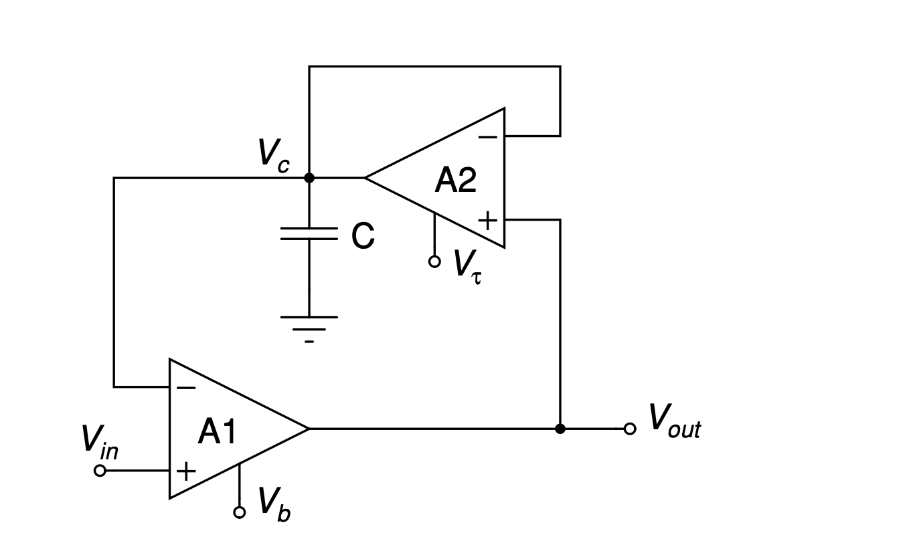
FA-II circuit

