Slide 1

SNACE Progress Meeting : March

Slide 2
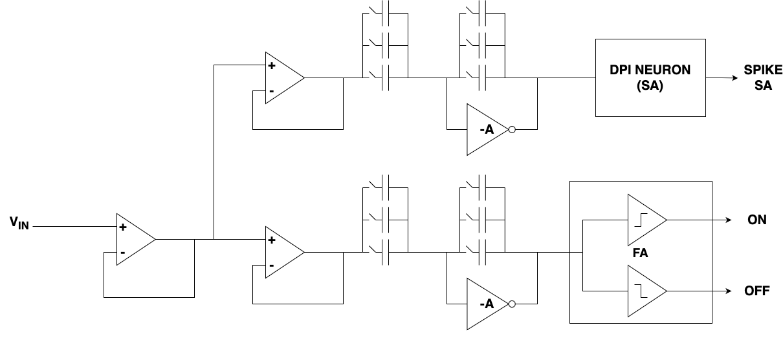
Local Processing Element : TAXEL

Slide 3
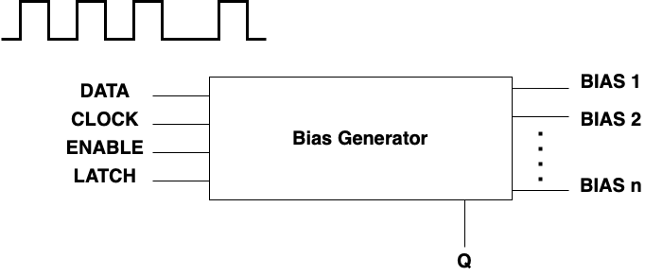
BIAS CURRENTS Generator

Slide 4
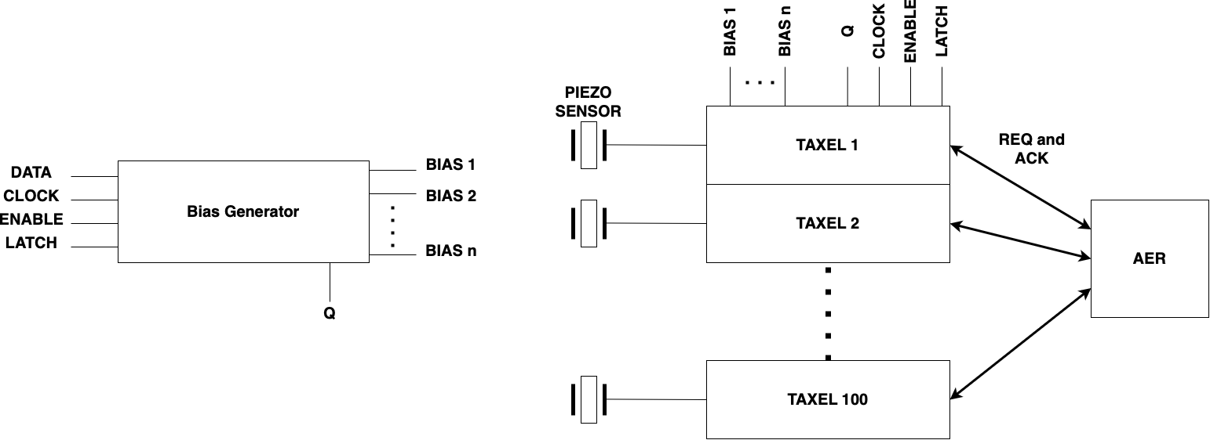
CHIP overview

