Slide 1
Progress Meeting : 21.08.25

Slide 2
01
Towards Texture Recognition : PLLs

Slide 3
Why use a PLL ?
PLL is a Phase-Locked Loop.
We want to identify the frequencies contained in the input signal in order to determine
what texture we are interacting with.
A texture is perceived as a frequency pattern over time when sliding a finger over it.
Goal : Synchronize an oscillator (output) to a reference (input signal) with frequency and phase.
It is a control loop that drives phase error toward zero between the input and output signals.

Slide 4
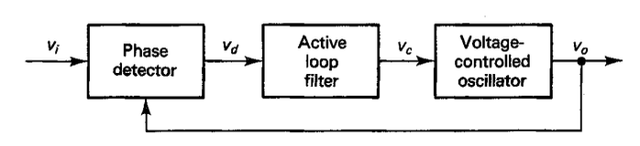
What is the PLL structure ?
Phase Detector:
Measures Phase difference -> error signal
Loop Filter:
Shapes/Filters the error to control the voltage
VCO:
Converts control input to output frequency

Slide 5


What is meant by Phase Lock ?
Phase:
Lock:
Steady state where phase error is constant (ideally converging to 0) and output frequency tracks the reference.
Phase Error:

Slide 6
How to make the PLL Neuromorphic ?
The idea would be to replace the VCO with a rich dynamic neuron.
Using a neuron able to exhibit bursting behavior with the control feedback structure,
the output of the neuron could lock into the input signal frequency robustly.
The neuron could be implemented on CMOS chip with basic buildings blocks
(low-pass filters and sigmoids). For the Phase Detector, still need to determine
the best way to implement it.

Slide 7
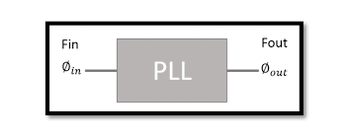
How to capture information from textures?
Use of PLLs in a parallel configuration where each has a different frequency bandwidth sensitivity.
Multiple PLLs would be locked in for multiple frequency components in the input.

