Slide 1
Project Orientation Meeting :
Design of a neuromorphic adaptive touch sensor

Slide 2
01
SENSOR PART : WHAT DIRECTION DO WE TAKE ?

Slide 3
TACTILE SENSOR TECHNOLOGY
OPTION 1:
Develop a 3D capacitive sensor (Preferable to avoid it).
OPTION 2:
Use simple capacitors skin (Easiest and most naive approach)
OPTION 3:
Use 2D planar sensor + Extension to 3D (Simeon’s idea)

Slide 4
02
ENCODING LAYER : Possible changes

Slide 5
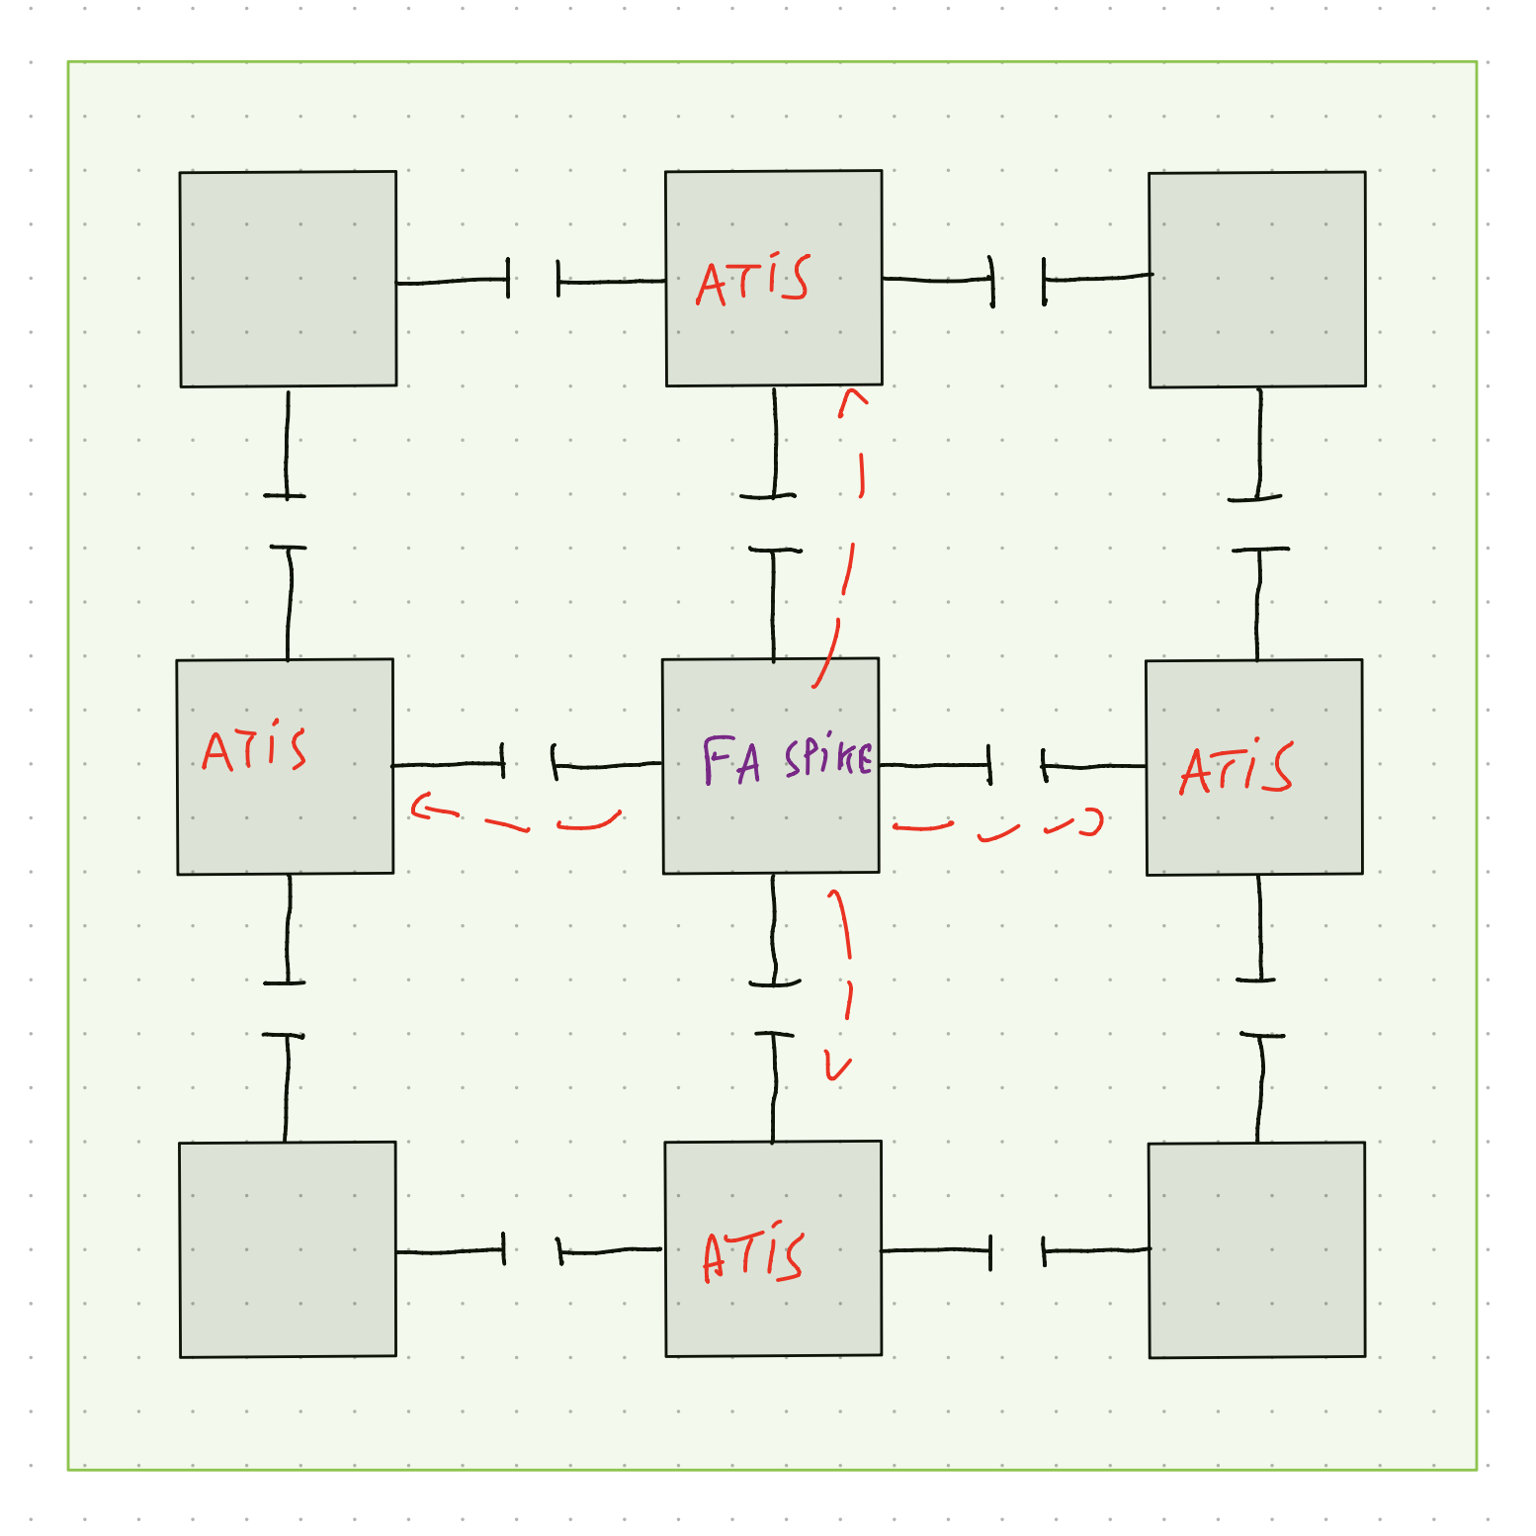
Capacitive Network Asynchronous Readout
Notes:
Frame-based readout dominates → results in high bandwidth usage and power consumption.
Centralized processing models → limit scalability and are not energy-efficient.

Slide 6
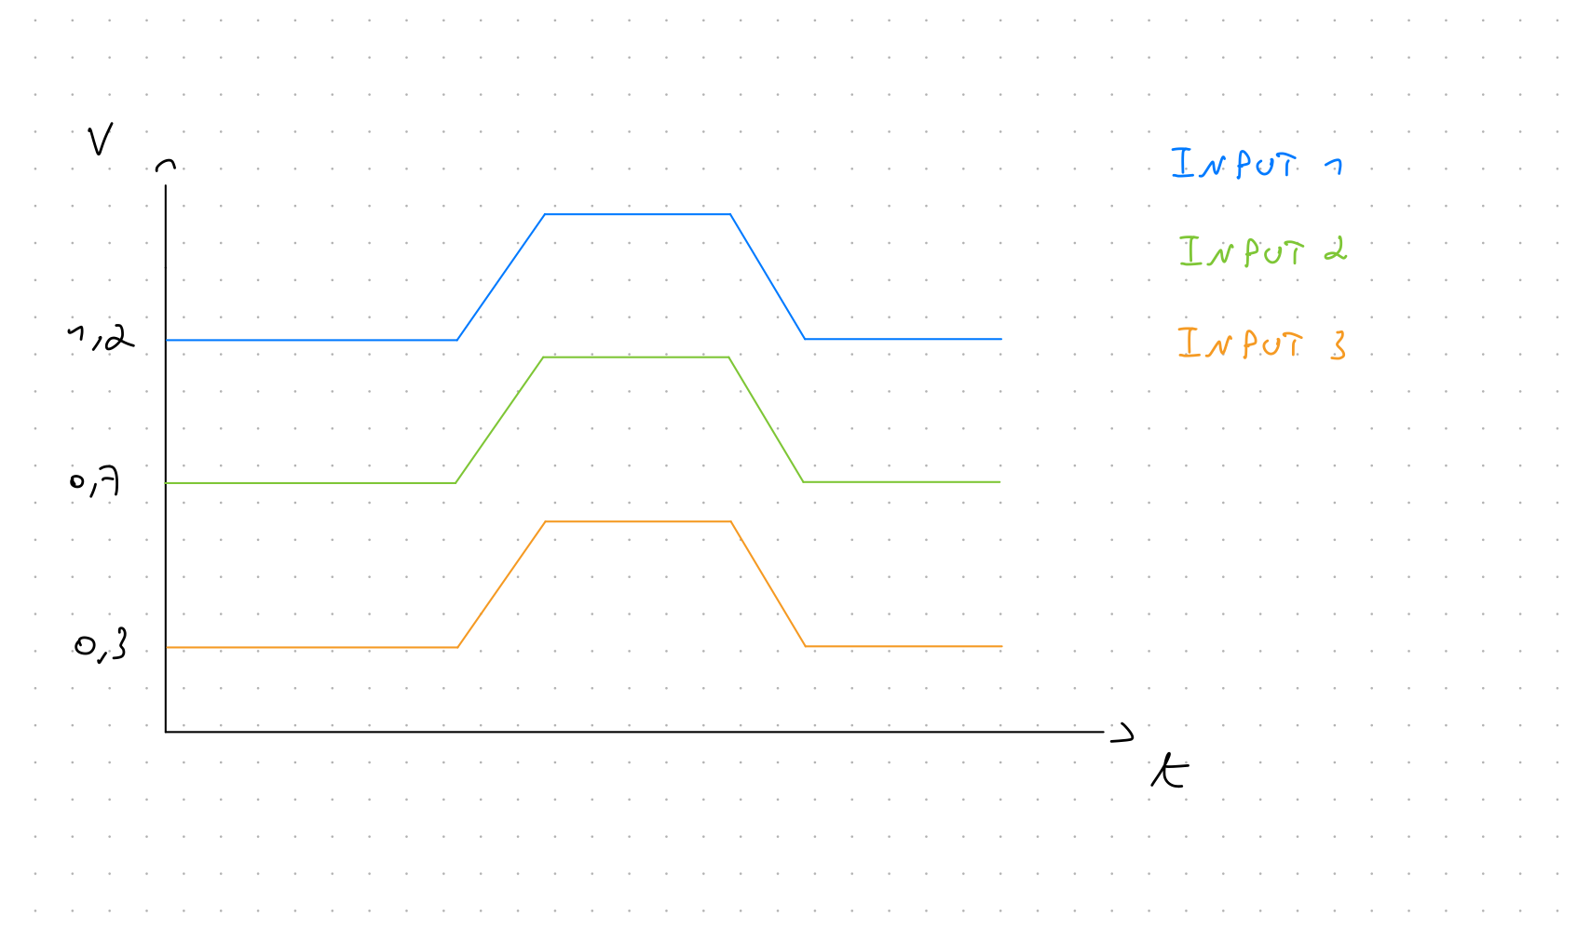
ENCODED MAGNITUDE MEANING WITH ATIS
The encoded magnitude is:
Dependent on the conditioning of the sensor.
Need for off-chip compensation.
Notes:
Frame-based readout dominates → results in high bandwidth usage and power consumption.
Centralized processing models → limit scalability and are not energy-efficient.

Slide 7
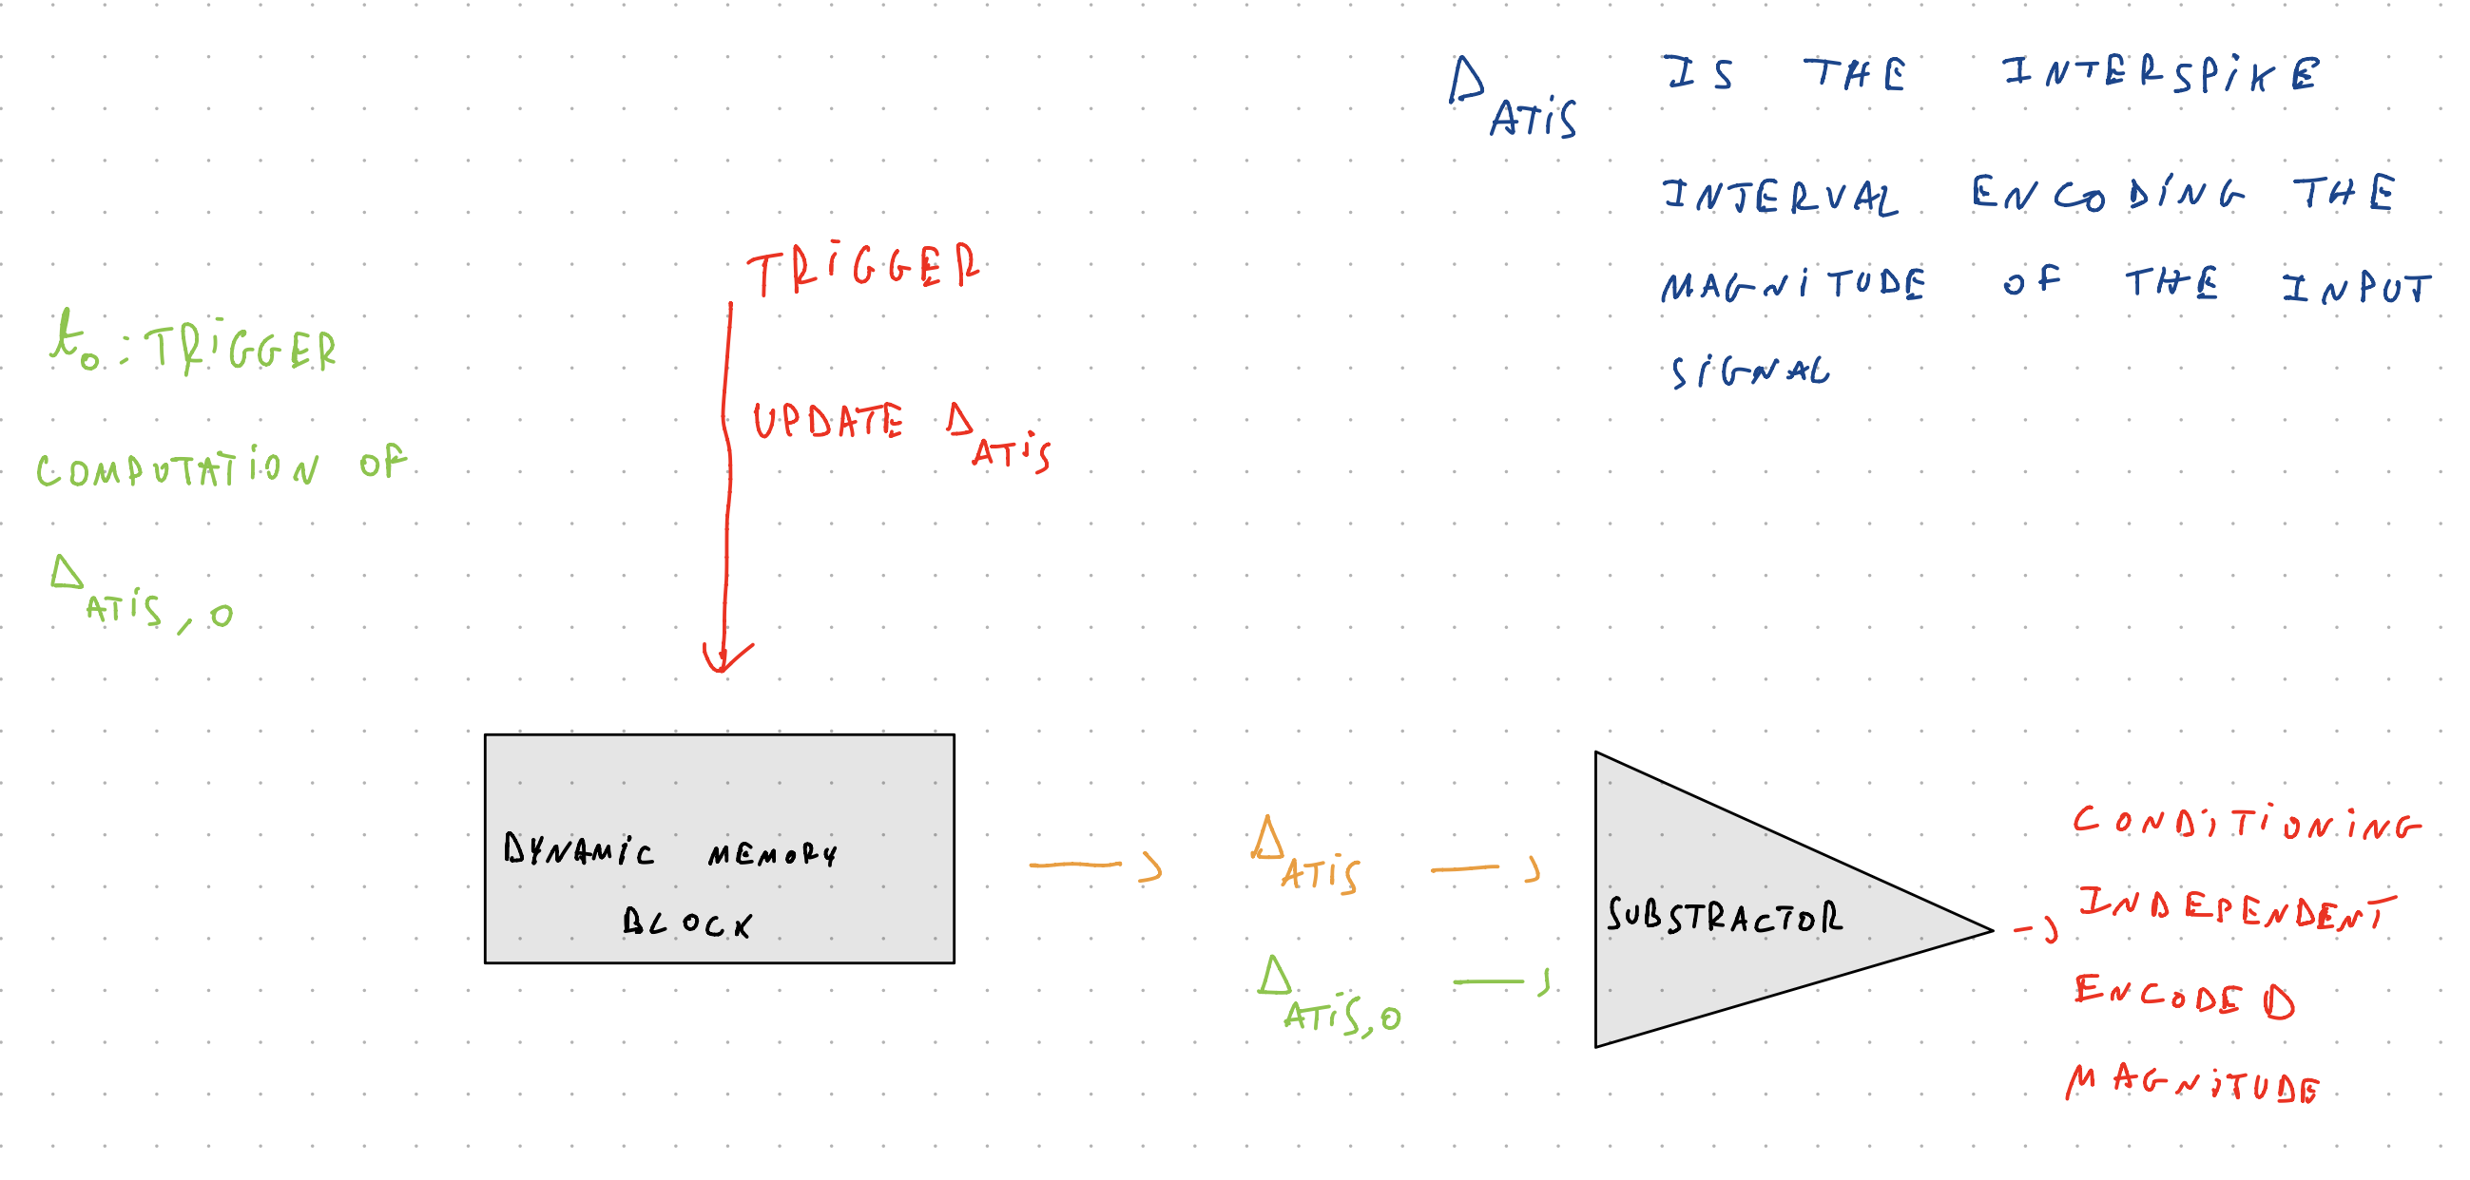
ON-CHIP CONDITIONING COMPENSATION
Notes:
Frame-based readout dominates → results in high bandwidth usage and power consumption.
Centralized processing models → limit scalability and are not energy-efficient.

Slide 8
03
PROCESSING LAYER

Slide 9
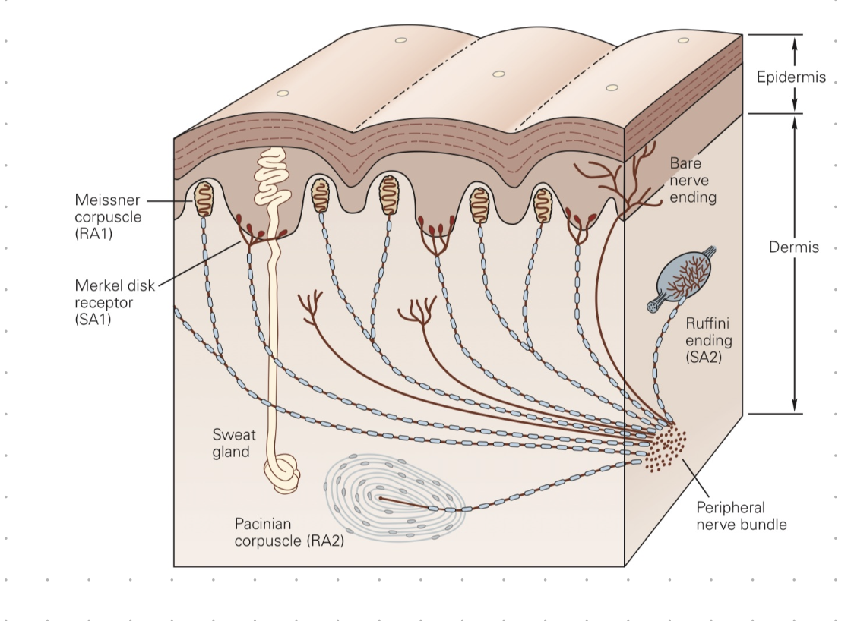
PROCESSING NEURONS
Dynamic receptive fields
Modular interconnections
Feedback mimicking adaptation
Notes:
Frame-based readout dominates → results in high bandwidth usage and power consumption.
Centralized processing models → limit scalability and are not energy-efficient.

Slide 10
PROCESSING LAYER : NEED FOR TASK MODULARITY
Multi-task compatibility
Skin sensor geometry agnostic
Dynamic and programmable interconnections
=> CROSS-BAR ARRAY CONFIGURATION
Notes:
Frame-based readout dominates → results in high bandwidth usage and power consumption.
Centralized processing models → limit scalability and are not energy-efficient.

Slide 11
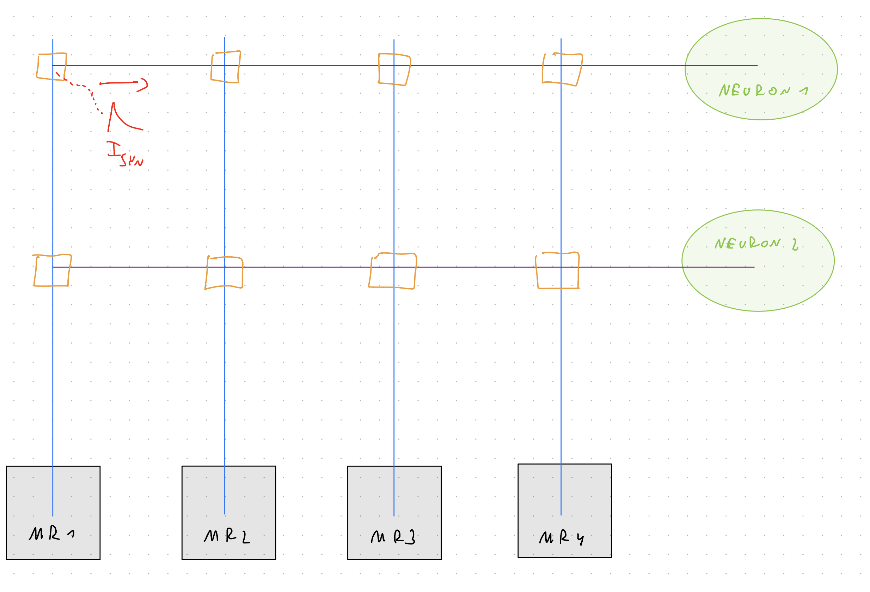
CROSS-BAR ARRAY CONFIGURATION
Notes:
Frame-based readout dominates → results in high bandwidth usage and power consumption.
Centralized processing models → limit scalability and are not energy-efficient.

Slide 12
CROSS-BAR ARRAY IMPLEMENTATION
Option 1:
Implement cross-bar array on chip.
Option 2:
Leverage micro-controller to perform DEMULTIPLEXING.
Notes:
Frame-based readout dominates → results in high bandwidth usage and power consumption.
Centralized processing models → limit scalability and are not energy-efficient.

Slide 13
Processing Layer Implementation
Focus on analog computation:
Leads to richer dynamics for task solving
Robustness to noise
Notes:
Frame-based readout dominates → results in high bandwidth usage and power consumption.
Centralized processing models → limit scalability and are not energy-efficient.

Slide 14
04
Towards Tactile Applications

Slide 15
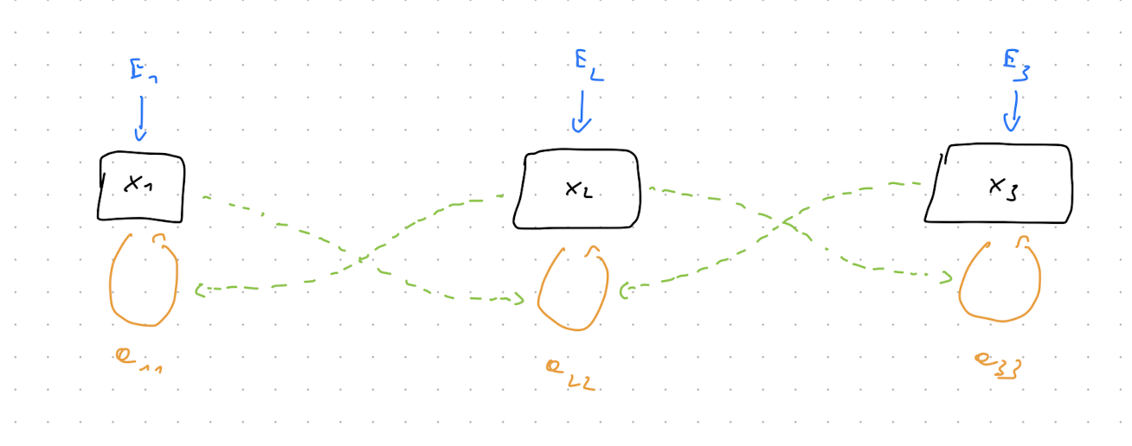
Motion Detection Task
Exploit Dendritic Computation for Spatio-Temporal Filtering
Notes:
Frame-based readout dominates → results in high bandwidth usage and power consumption.
Centralized processing models → limit scalability and are not energy-efficient.

Slide 16
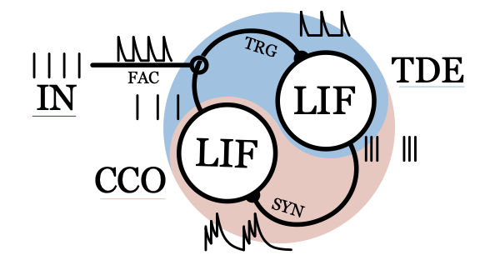
Texture Recognition Task
Use existing technology : Spiking Phase-Locked Loop Model from Elisabetta Chicca.
The Current Controlled Oscillator (CCO) tries to lock
on the input signal frequency.
Mastella, M., Tiemens, T., & Chicca, E. (2024). Texture Recognition Using a Biologically Plausible Spiking Phase-Locked Loop Model for Spike Train Frequency Decomposition. arXiv preprint arXiv:2403.09723.
Notes:
Frame-based readout dominates → results in high bandwidth usage and power consumption.
Centralized processing models → limit scalability and are not energy-efficient.

Slide 17
Texture Recognition Task
Extension to bursting neurons:
Each neuron is sensitive to a specific bandwidth.
Population of neurons that are sensitive to different bandwidths.
Overlapping bandwidths
Notes:
Frame-based readout dominates → results in high bandwidth usage and power consumption.
Centralized processing models → limit scalability and are not energy-efficient.

Slide 18
05
SNACE CONTRIBUTION

Slide 19
How to integrate Active Efficient Encoding (AEC) ?
Encoding layer already performs Efficient Encoding.
For the active encoding, need of a direct feedback connection.
=> Adaptive tuning of taxels sensitivity (via biases).
Notes:
Frame-based readout dominates → results in high bandwidth usage and power consumption.
Centralized processing models → limit scalability and are not energy-efficient.

Slide 20
AEC Implementation : Control Loop
Target of controller:
Based on two metrics, Task Performance and Energy Consumption.
Goal of the controller:
Taxels sensitivity tuning to optimize metrics.
=> Competing relationship between the metrics
Notes:
Frame-based readout dominates → results in high bandwidth usage and power consumption.
Centralized processing models → limit scalability and are not energy-efficient.

Slide 21
How to proceed ?
Characterize the relationship between Task Performance and Energy Consumption.
Error signal determination + Translation of the error into adaptation to the taxels.
What kind of controller to use ?
Notes:
Frame-based readout dominates → results in high bandwidth usage and power consumption.
Centralized processing models → limit scalability and are not energy-efficient.

Slide 22
06
THESIS ORIENTATION

Slide 23
Biology or Engineering Focus ?
Possible collaboration about prosthetics with Massimiliano Iacono and Michele Canepa for BioEthernet project.
Encode EMG signals to spike.
Might use processing layer other than SNNs.
Notes:
Frame-based readout dominates → results in high bandwidth usage and power consumption.
Centralized processing models → limit scalability and are not energy-efficient.

