Slide 1
Progress Meeting : 03.03.2025

Slide 2
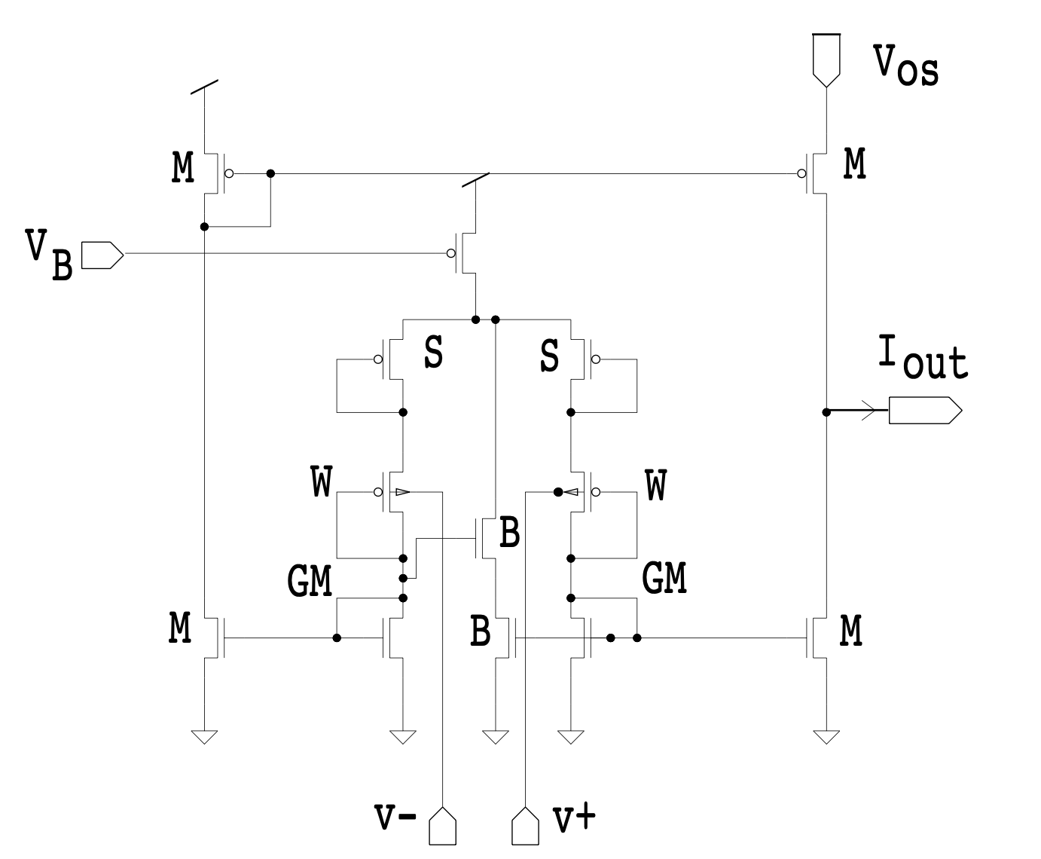
New V-to-I linear converter
Complexity of implementing it on chip (input fed to bulk of transistors) ?
V₊ is the input
V₋ is the reference voltage
Curve is tuned with ratio W/L of W and B transistors

Slide 3
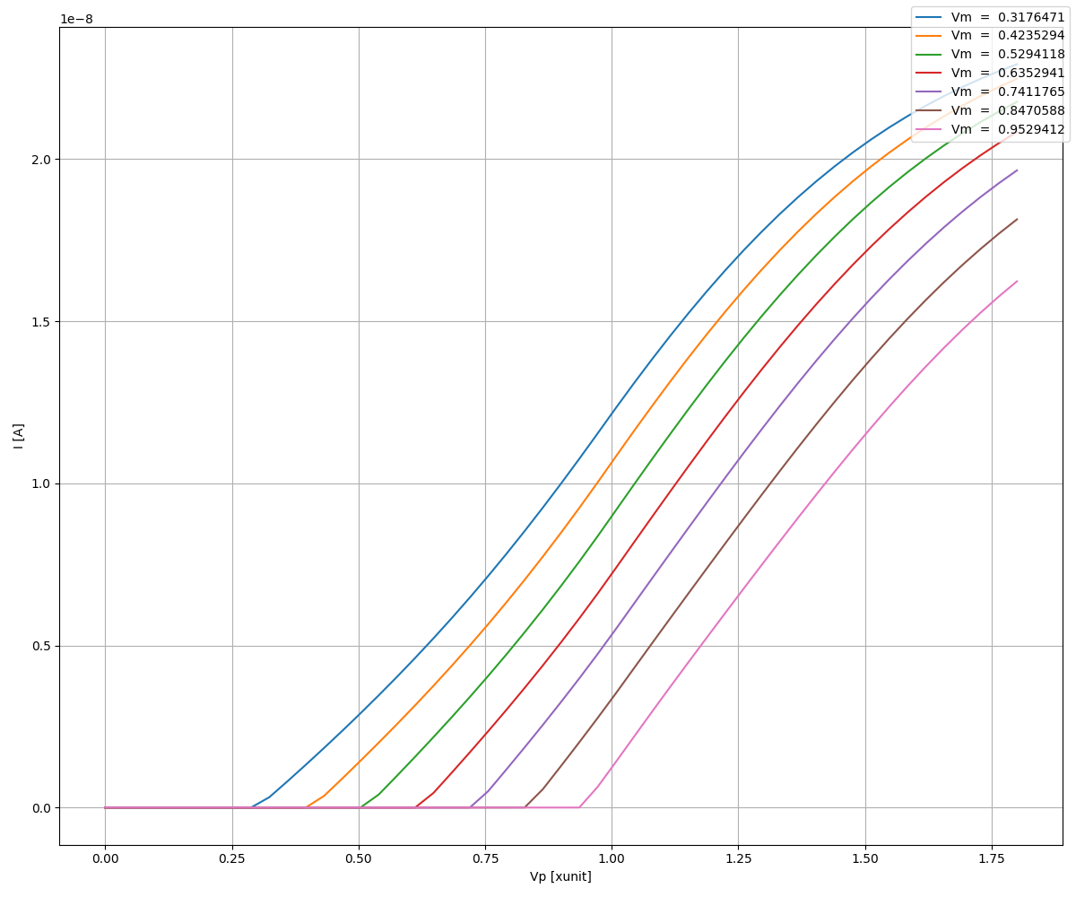
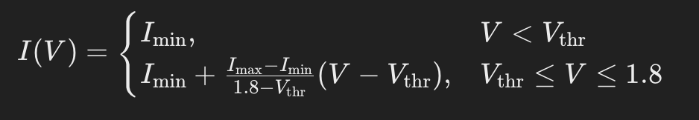
New V-to-I linear converter

Slide 4
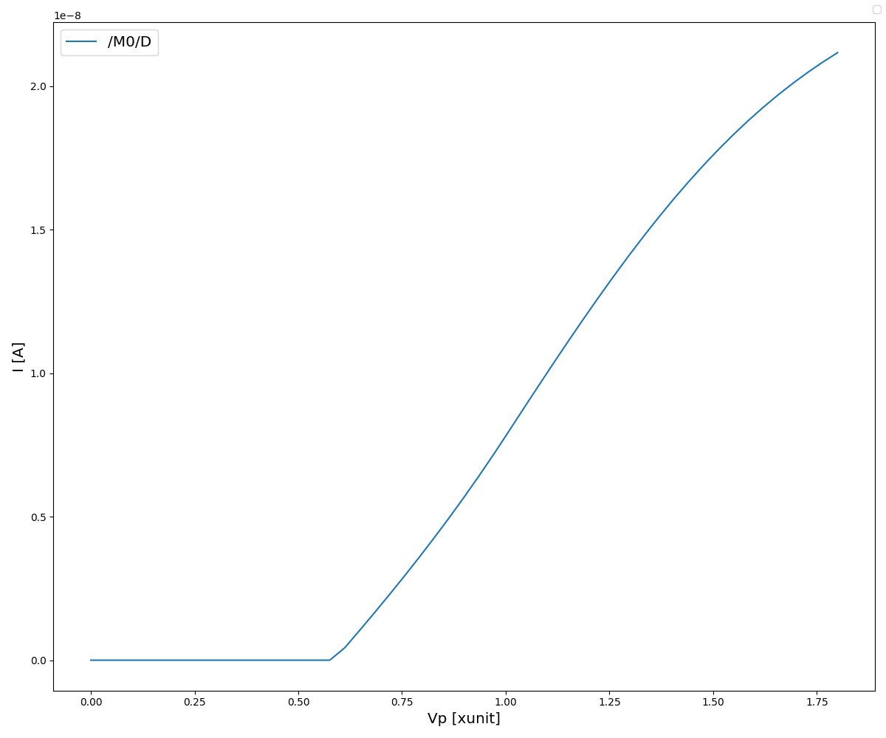
Adaptation
V_{OFF_max}
V_{OFF}
V_{ON_min}
Adaptive threshold set by output current of DPI
Need to have stable and reliable DPI gain
V_{OFF-BASE}
V_{reset} : 10nA
V_{ON-BASE}
V_{ON}

Slide 5
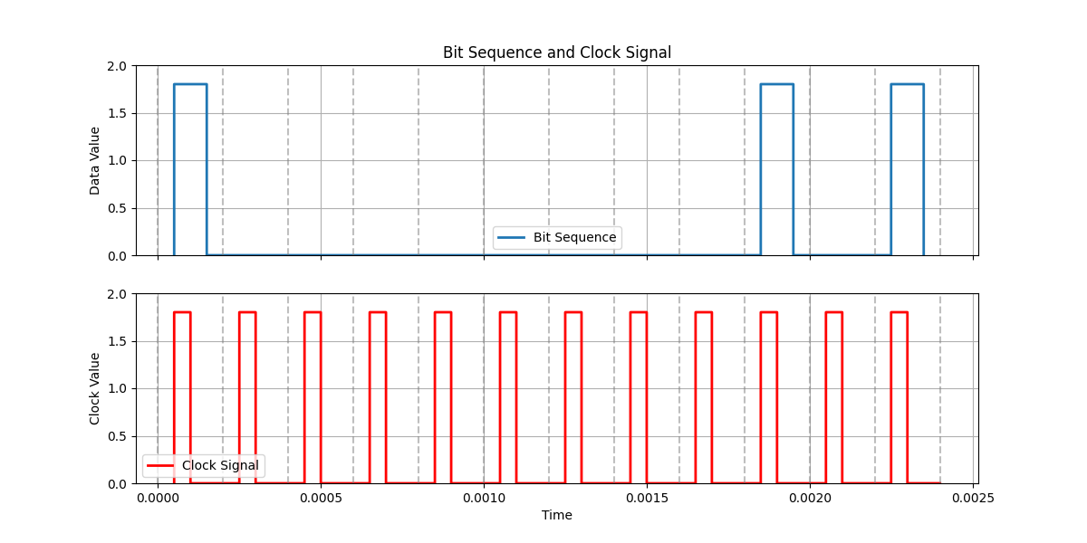
Bias Generator
c
FET type
Bias current (8 bits)
Master current (5 choices)
c
c

Slide 6
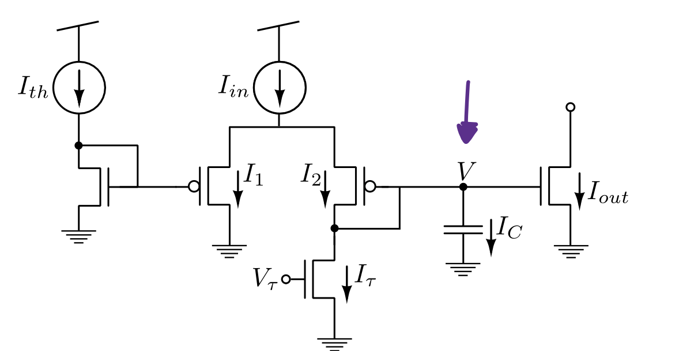
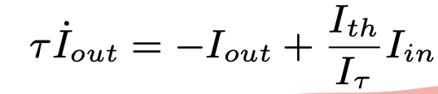
DPI gain

