Slide 1
Progress Meeting : 09.06.25

Slide 2
01
Current Literature Review

Slide 3
Principles of Neural Science, 6e | McGraw Hill Medical
Somatosensory system
Mechanoreceptors
Connection to the Central Nervous System
Dive into Dorsal Root Ganglion (DRG) neuron as well as peripheral nerve fibers
Type of mechanoreceptors and detailed functioning of their role
Transmission of sensory information from peripheral end (skin) to the CNS

Slide 4
Usefulness of Thermoreceptors
Individual TRP receptors are distinguished by their sensitivity to heat or cold, showing sharp increases in conductance to cations when their thermal threshold is exceeded.
Cold receptors are approximately 100 times more sensitive to sudden drops in skin temperature than to gradual changes (extreme sensitivity).
Unlike cold receptors, warm receptors act like thermometers as their firing rates rise monotonically with increasing skin temperature up to the threshold of pain and saturate at higher temperature.

Slide 5
Thermoreceptors Implementation in Hardware
One interesting technology is the self-heating thermistor. Negative Temp. Coefficient (NTC) Thermistor have a resistance that decreases as they heat up.
The self-heating caused by passing current depends on how efficiently the thermistor dissipates heat to its surroundings.
Circuits using these can act as resistors whose effective R changes depending on the local thermal conductivity.

Slide 6
Thermoreceptors Implementation in Hardware
Even if two materials are at the same temperature, a thermistor in contact with each will behave differently due to how efficiently each material conducts heat away from the thermistor.
When a current is passed through a thermistor, it self-heats due to power dissipation P=I²R.
The rate at which it can cools down depends on the thermal conductivity of the contacting material.
Even though both materials are at the same temperature, the steady-state temperature of the thermistor (and thus its resistance) will differ due to how well heat flows into each material.

Slide 7
Thermoreceptors Implementation in Hardware
A NTC Thermistor could be used as a sensor whose generated current would be fed into a DPI Neuron that would convert the sensed relative temperature of the material in contact and encode it into a periodic spike train.
The spiking frequency would directly be proportional to the temperature.
Using a temperature sensor, one could also encode the absolute temperature (insensitive to heat conduction) into a train of spike to collect both information. (Not though of yet)

Slide 8
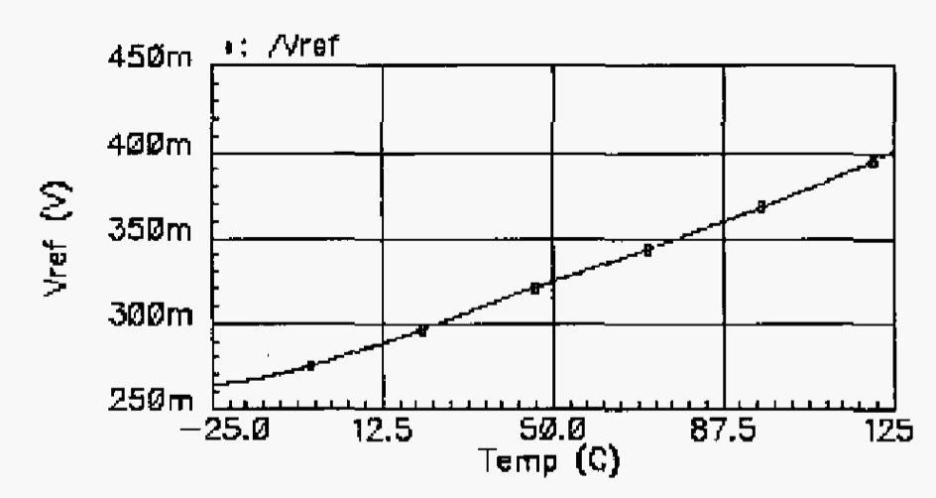
PTAT Sensor in Hardware
Use of a PTAT (proportional-to-absolute-temperature) circuit
Zhu, Z. & Yang, Y. A 0.8 V low-power CMOS PTAT voltage reference. in Proceedings of 2005 IEEE International Workshop on VLSI Design and Video Technology, 2005. 1–5 (2005). doi:10.1109/IWVDVT.2005.1504449.

Slide 9
Idea
Use of a neuromorphic PLL to infer the input signal frequency and tune adaptively the circuit biases to have a better encoding of the input signal based on its properties
Also, could use the output of the SA or ATIS circuits to change adaptively the gain of the signal amplification

Slide 10
Literature review (Next-to-Be-Read)
Liu, S.-C. Analog VLSI: Circuits and Principles. (MIT Press, 2002).
  Basic principles of VLSI circuits
Razavi, B. Design of Analog CMOS Integrated Circuits. (McGraw-Hill Higher Education, 2016).
  Basic principles of Analog CMOS
Ribar, L. & Sepulchre, R. Neuromorphic Control: Designing Multiscale Mixed-Feedback Systems. IEEE Control Systems Magazine 41, 34–63 (2021).
  Introduction to Neuromorphic Control for Mixed-Feedback Systems
Read more about neuronal biology in Principles of Neural Science, 6e | McGraw Hill Medical

