Slide 1
Progress Meeting

Slide 2
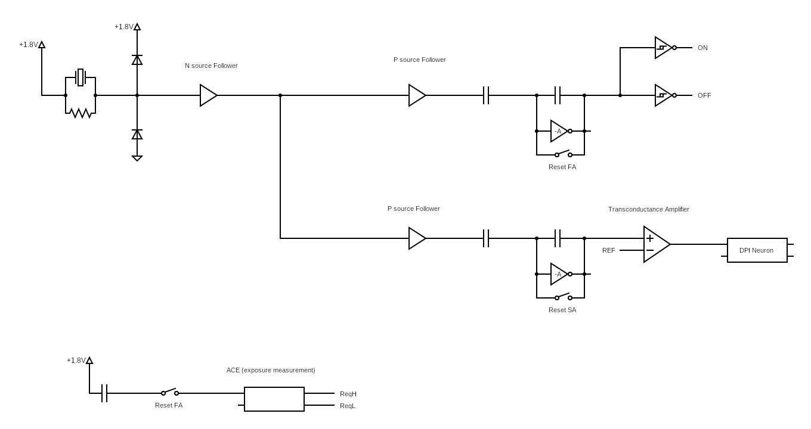
Circuit Overview

Slide 3
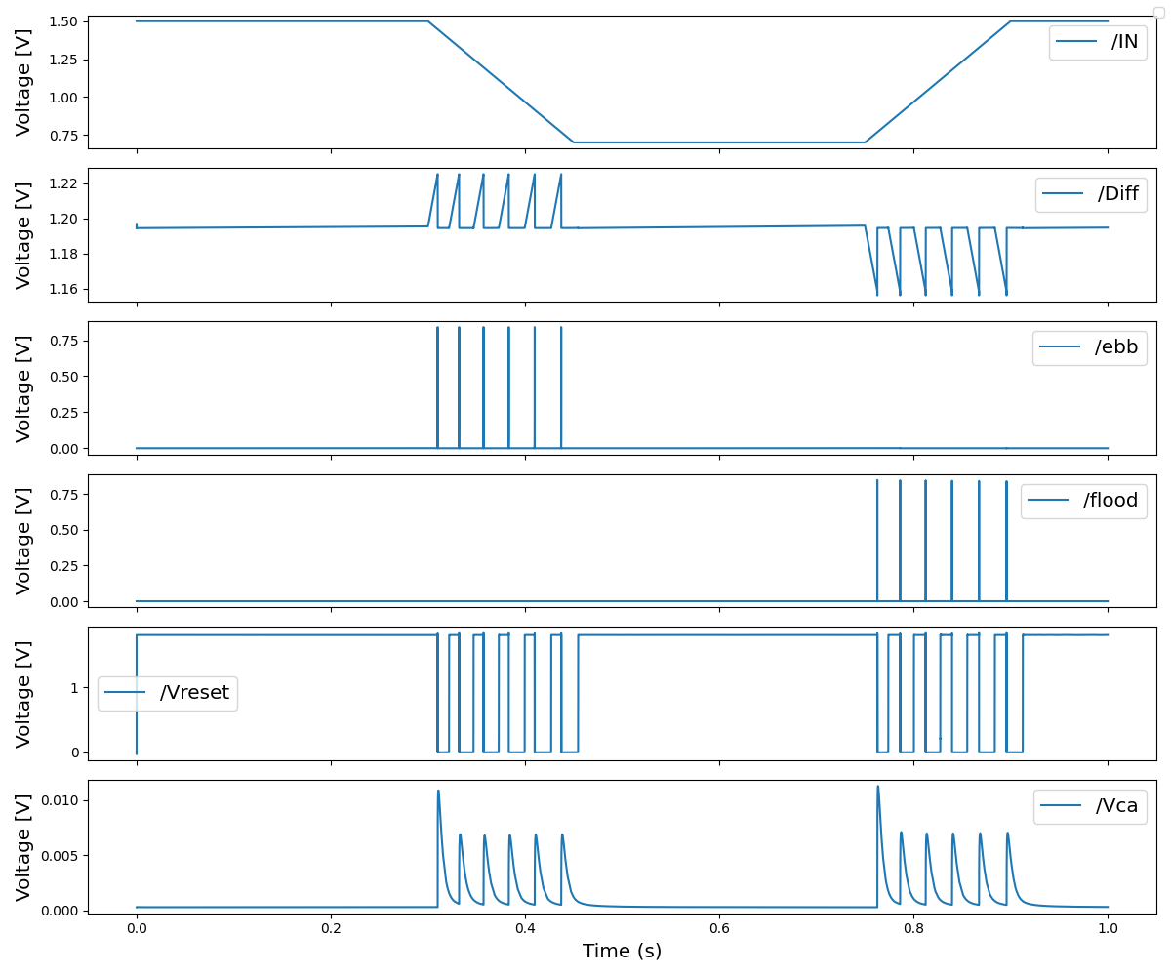
Change detector

Slide 4
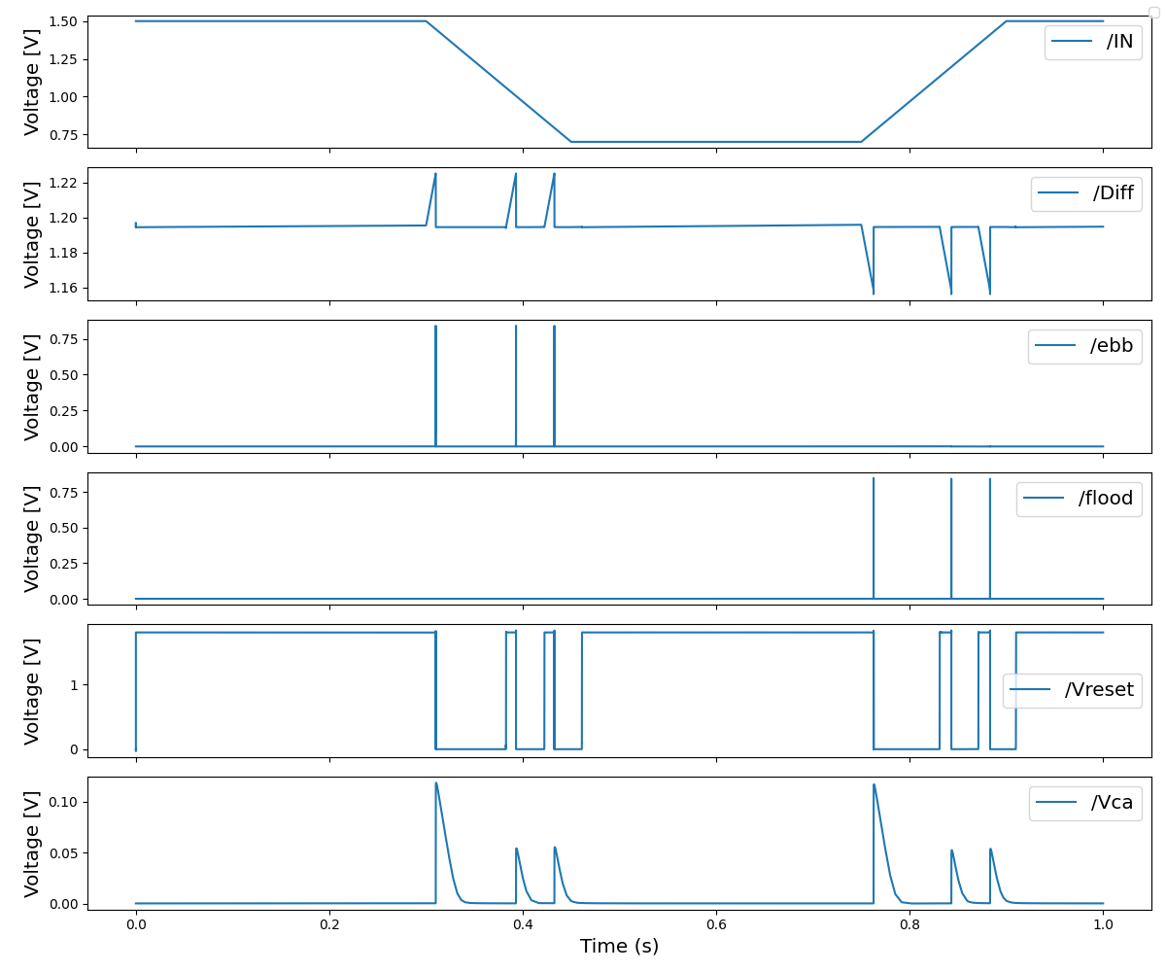
Fast adaptive circuit

Slide 5
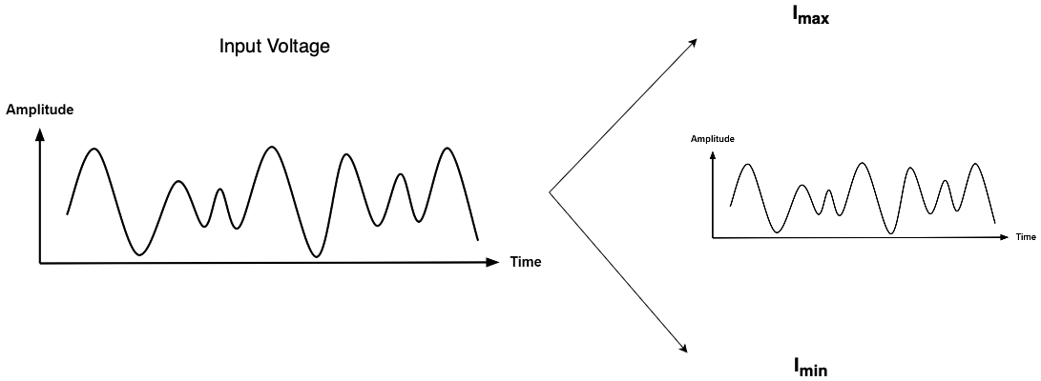
Slow Adaptive Circuit : Input scaling

Slide 6
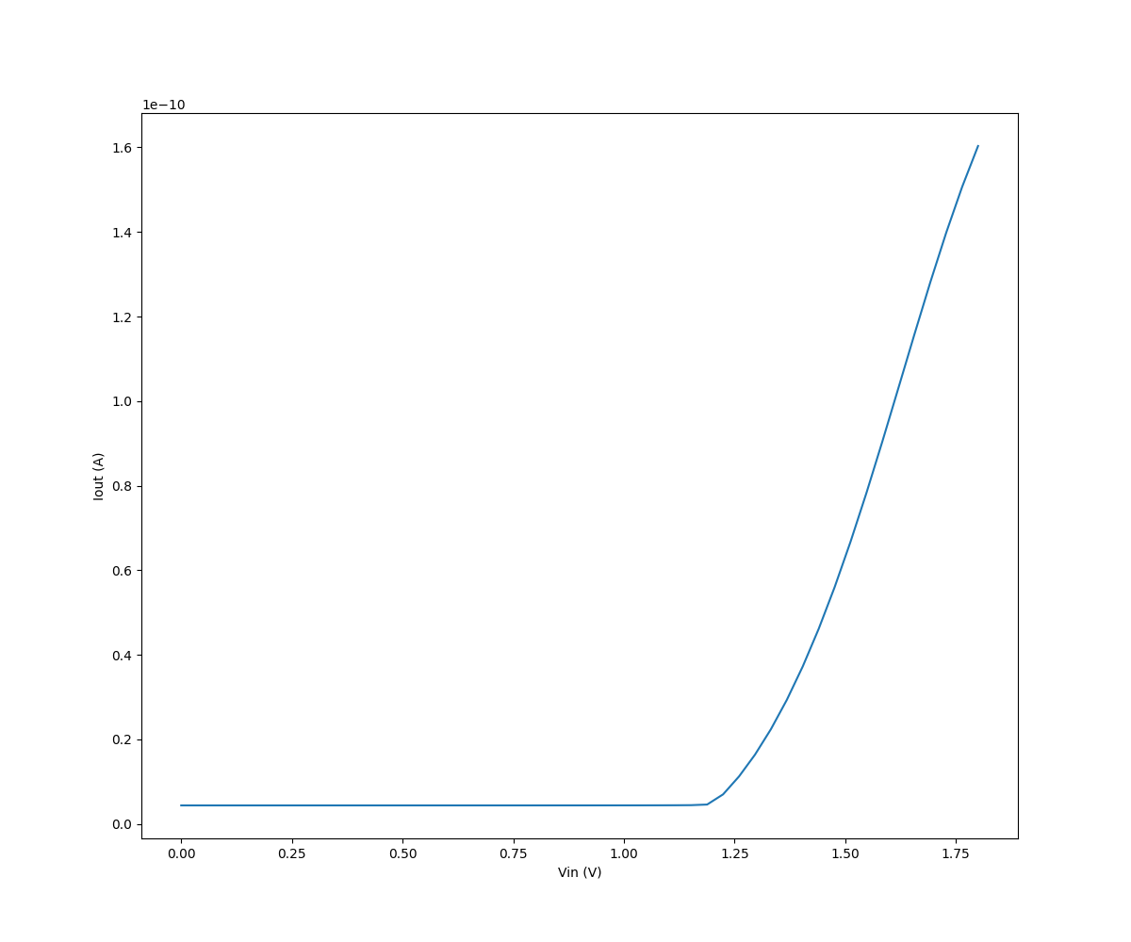
Transconductance Amplifier

Slide 7
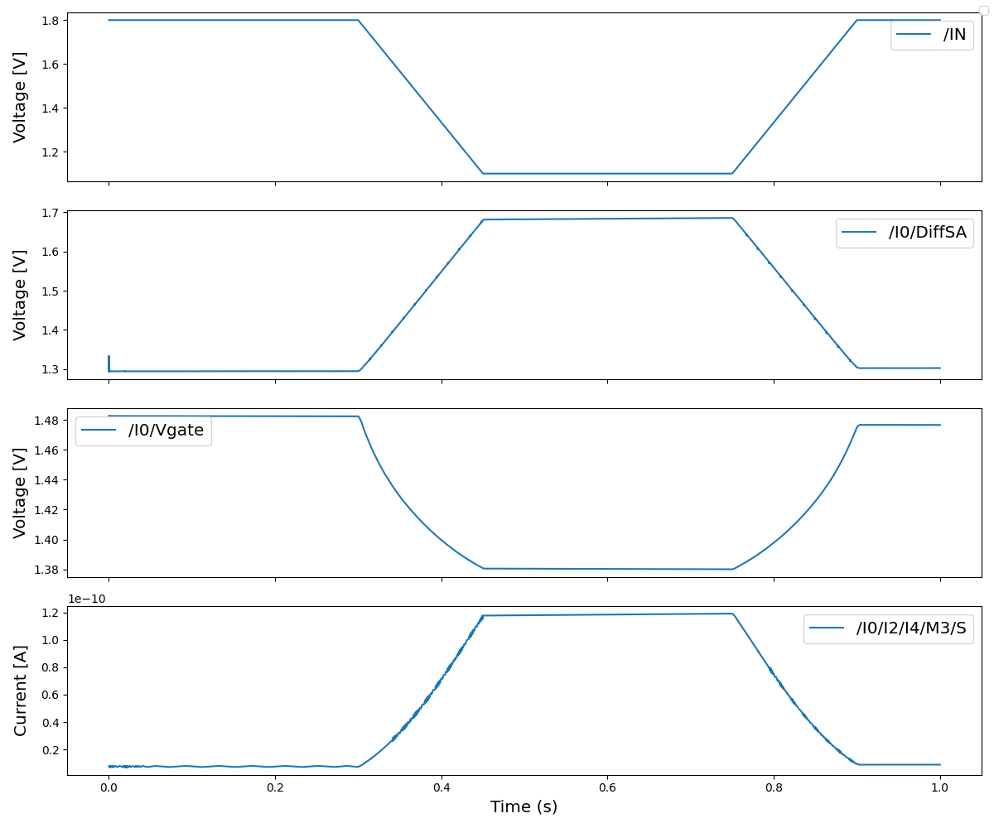
Slow Adaptive Circuit Input

Slide 8
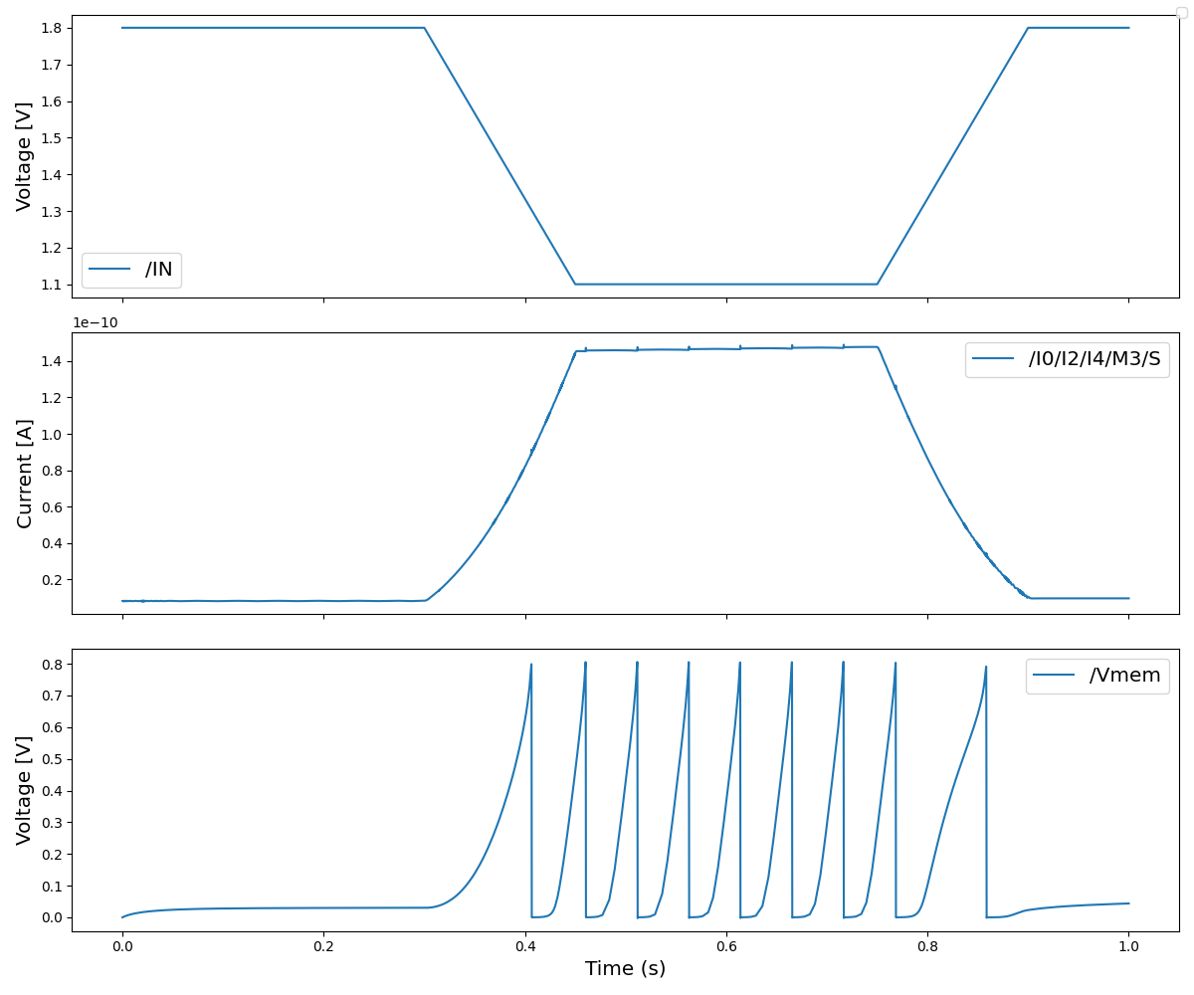
Slow Adaptive Circuit Behavior

Slide 9
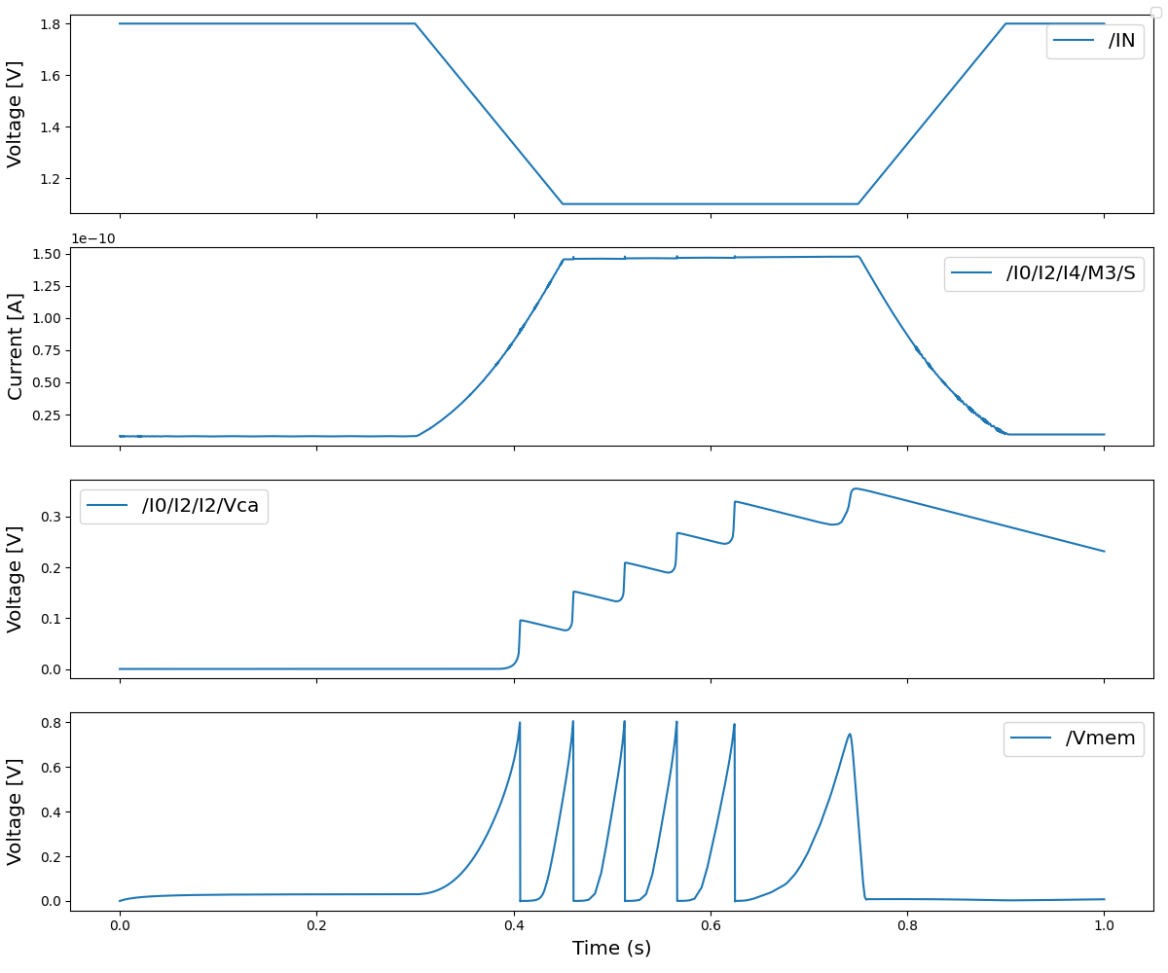
Slow Adaptive Circuit Behavior

Slide 10
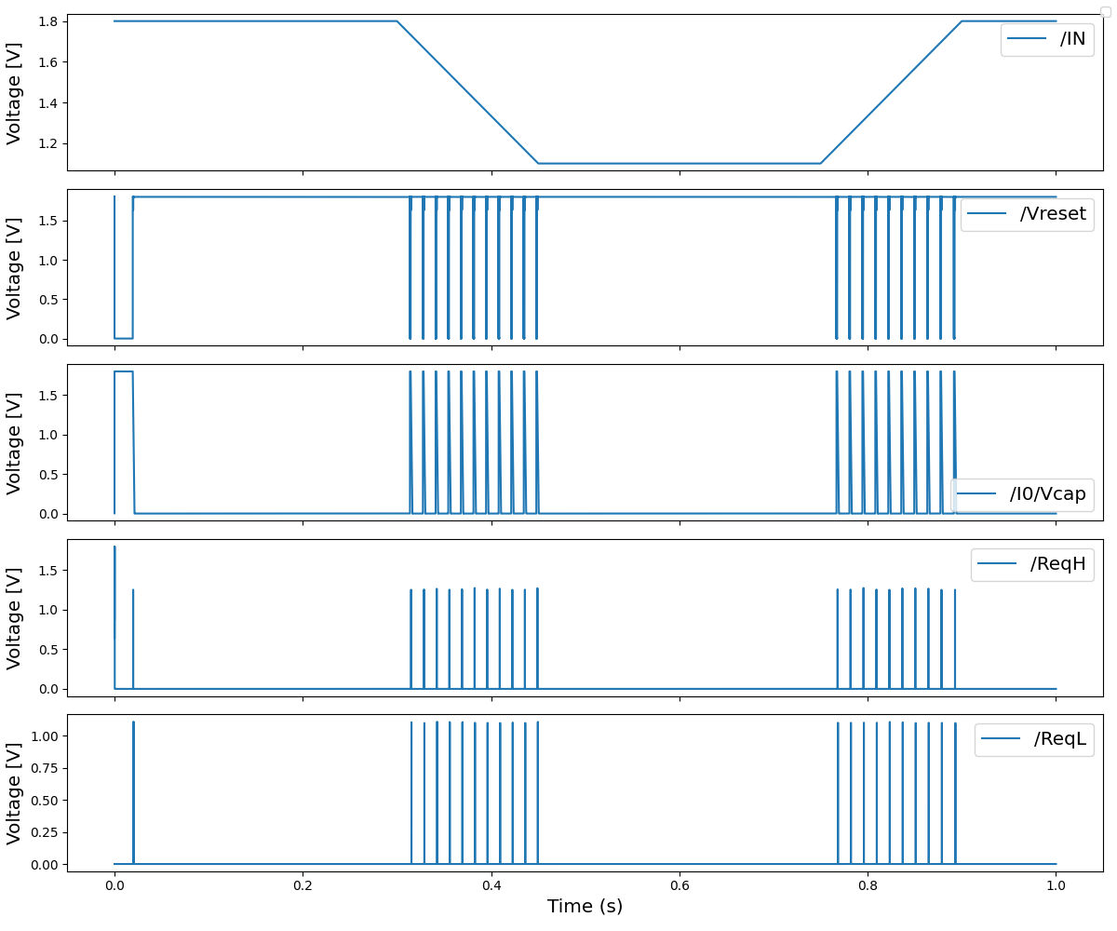
ACE circuit

Slide 11
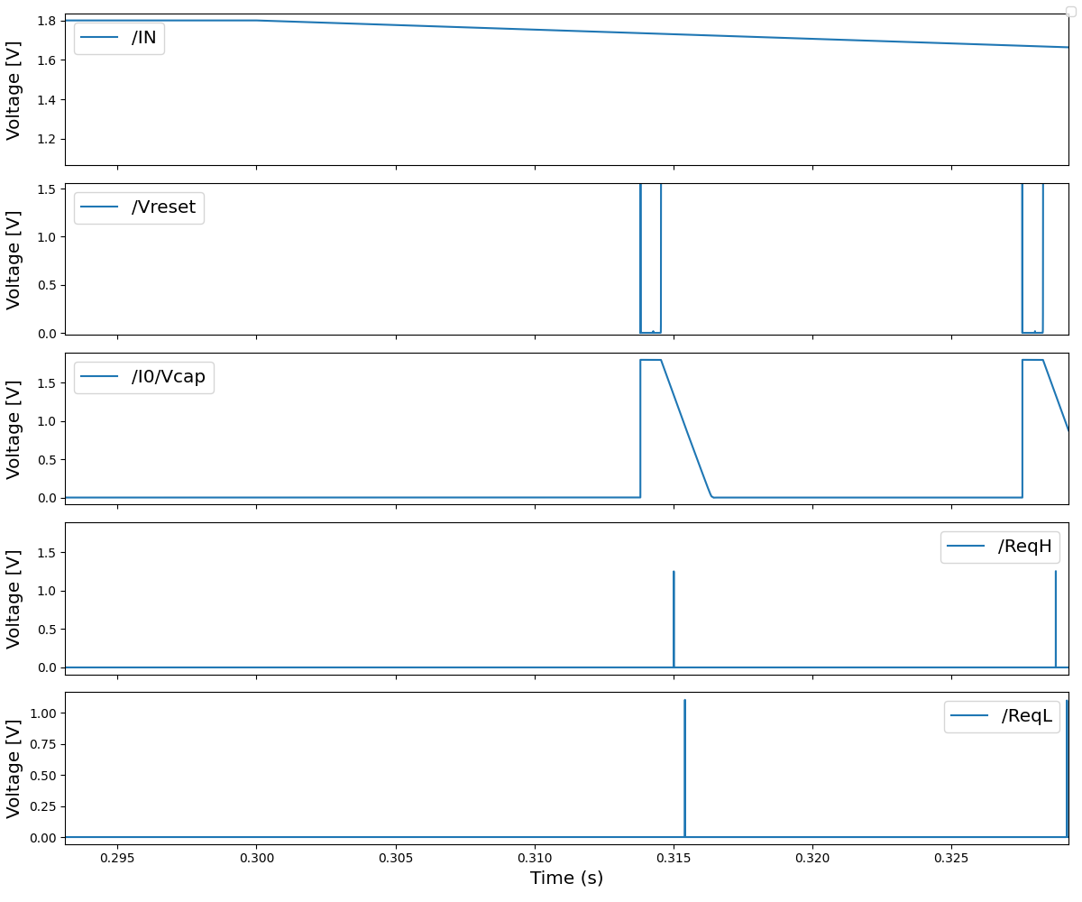
ACE circuit : Zoom-in

