Slide 1
Progress Meeting : 18.02.2025

Slide 2
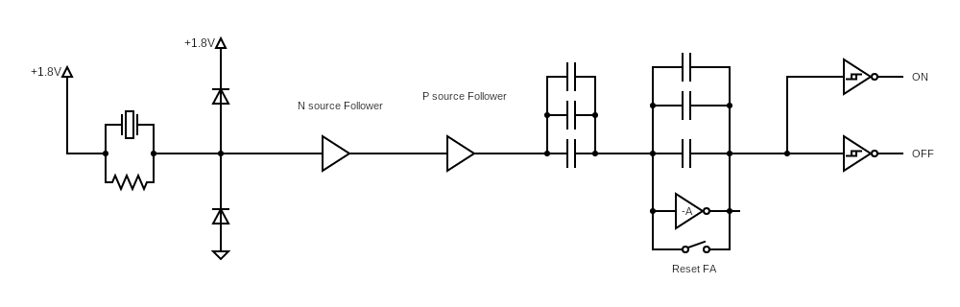
Change detector leakage
Leakage current of 50 fA

Slide 3
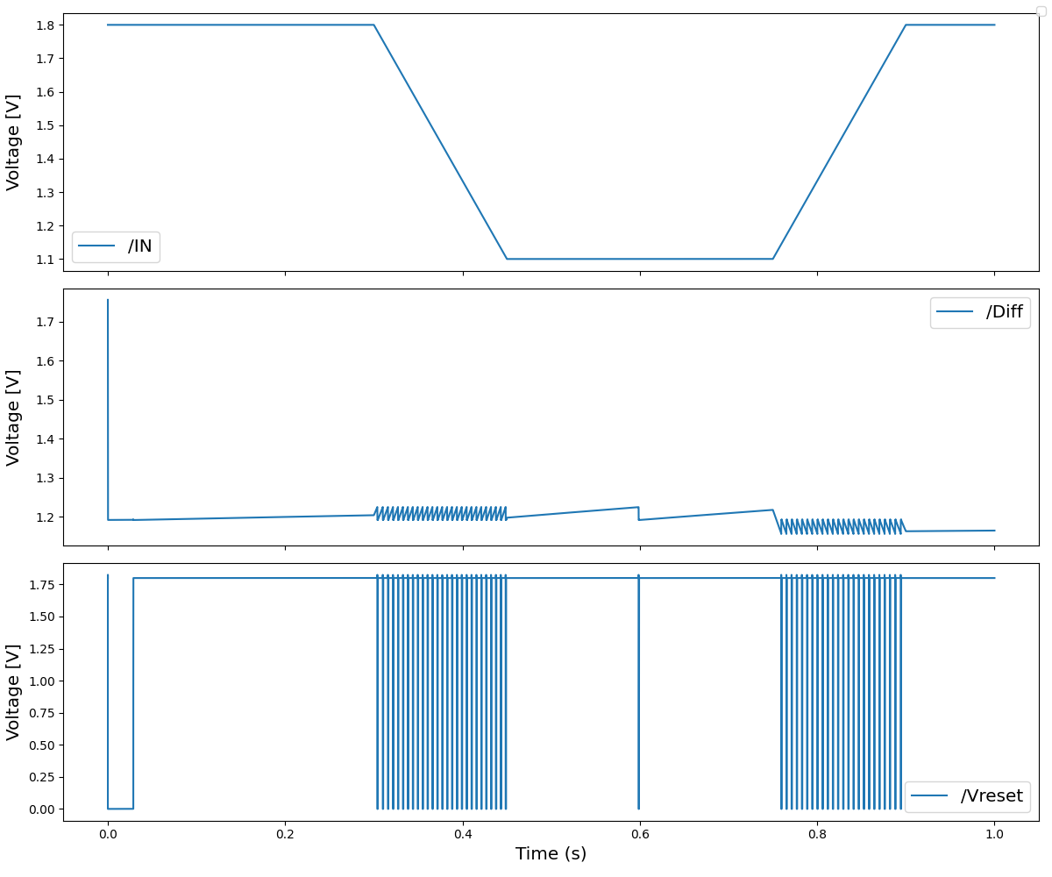
Array of capacitors leakage
Leaky spiking rate of about 1 Hz
V_{diff} has variations of 20 mV with nA of thresholds current:
I_{reset} = 10 nA
I_{ON} = 5 nA
I_{OFF} = 20 nA

Slide 4
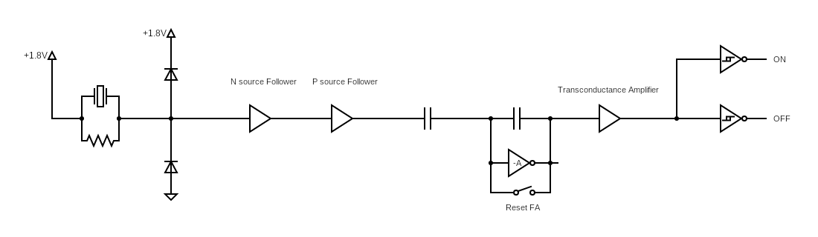
ChAnge detector improvement

Slide 5
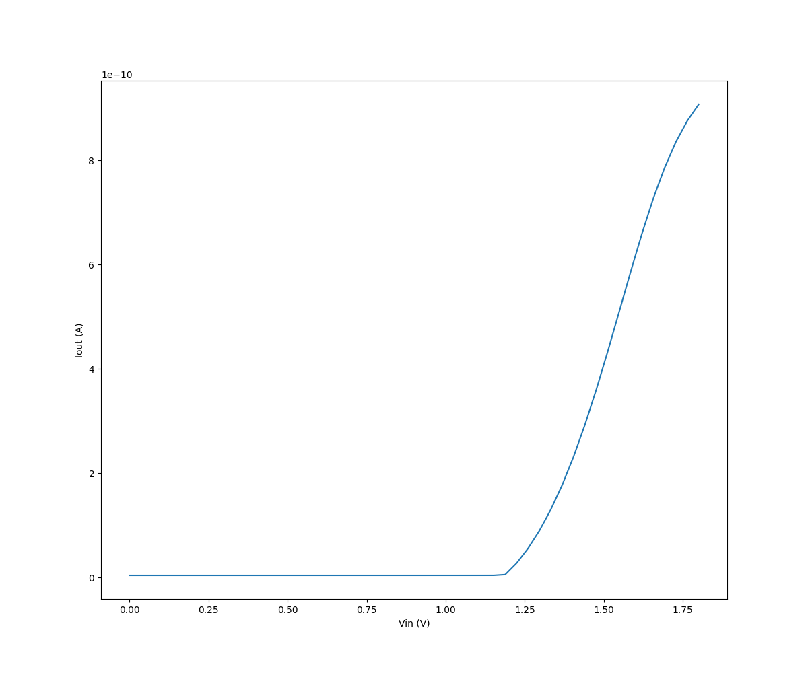
Voltage to current converter
V_{OFF} = 1.65 V : 700pA
V_{reset} = 1.5 V : 400pA
V_{ON} = 1.35 V : 150pA

Slide 6
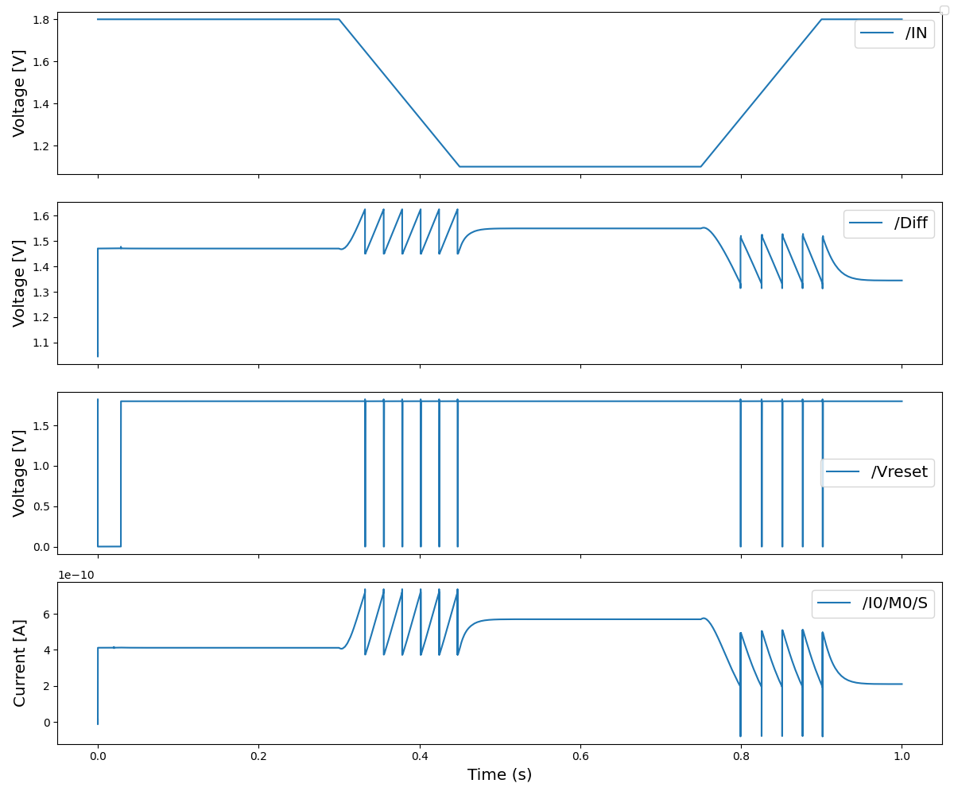
Change detector improvement
V_{diff} has now variations of up to 250 mV with pA of thresholds current

Slide 7
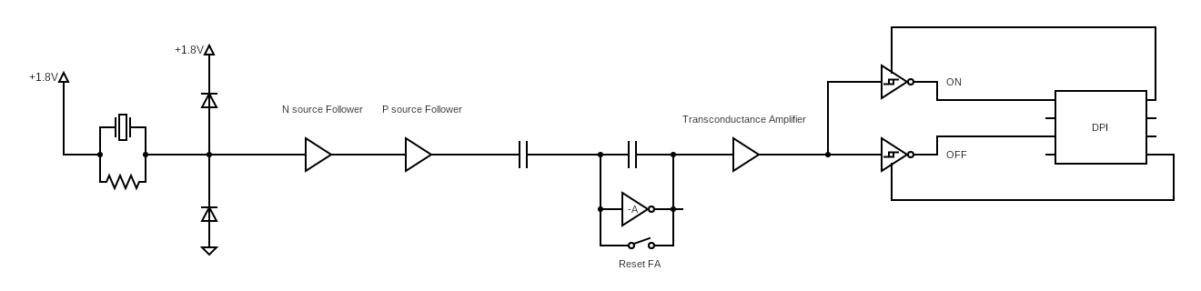
Extension to Fast Adapting circuit

Slide 8
Adaptive V-I converter
V_{OFF}
V_{OFF-BASE}
V_{reset} : 400pA
V_{ON-BASE}
V_{ON}

Slide 9
Further steps
Try developing adaptation mechanism for the change detector
Explore literature about derivative circuit
Plan a meeting with Chiara and talk with Simeon about Loris’s neuron

