Slide 1
SNACE Meeting : 27.11.25
Bio-inspired neuromorphic tactile processing
for texture recognition

Slide 2
1
Why texture perception matters ?

Slide 3
Texture is a core tactile primitive
Texture is one of the first thing we perceive from touch.
It helps with material and object recognition.
It closes the loop for stable object manipulation (inform about slip, friction).
Crucial during active exploration both by humans and robots.

Slide 4
What exactly is texture in the sense of touch ?
Texture is the surface structure felt through skin contact and motion.
It appears as spatio-temporal patterns + vibrations
Perception depends on exploration parameters: speed, force, direction.

Slide 5
2
Conventional texture processing pipeline

Slide 6
Conventional frame-based pipeline
• Tactile Sensors are sampled continuously at fixed rate.
• Raw signals form frames.
• Features are computed in time, frequency, or space.
• A classifier predicts texture from those features.
• Training is usually offline on large datasets.

Slide 7
Frame-based approach shortcomings
Results in high power consumption.
Centralized processing models → limit scalability and are not energy-efficient.
Lack of biological selectivity:
  Most systems do not distinguish dynamic (fast) and static (slow) touch signals.
Current solutions transmit raw data with minimal preprocessing.

Slide 8
3
Towards a neuromorphic approach

Slide 9
Why neuromorphic fits texture ?
Texture signals are sparse bursts, not continuous changes.
Spikes capture micro events with high timing precision.
Event encoding cuts bandwidth and power for large skins.
Can make use of neuromorphic back-ends for learning (SNNs, neuromorphic hardware)

Slide 10
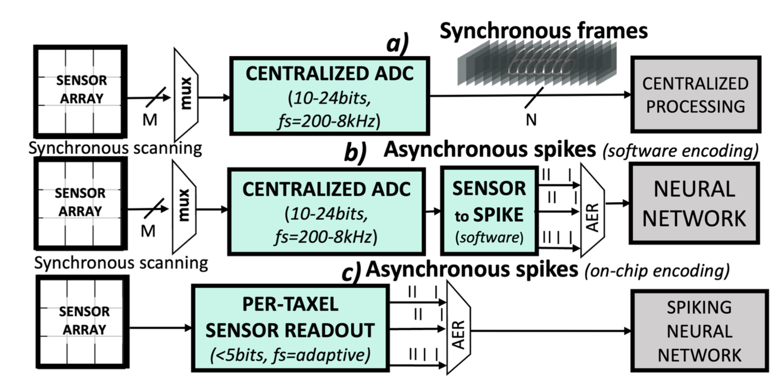
State of the Art in e-Skin Transduction
Alea, M. D. et al. A Fingertip-Mimicking 12x16 200 μm-Resolution e-Skin Taxel Readout Chip (2024).

Slide 11
4
Biological Inspiration in Tactile Sensing: Why It Matters

Slide 12
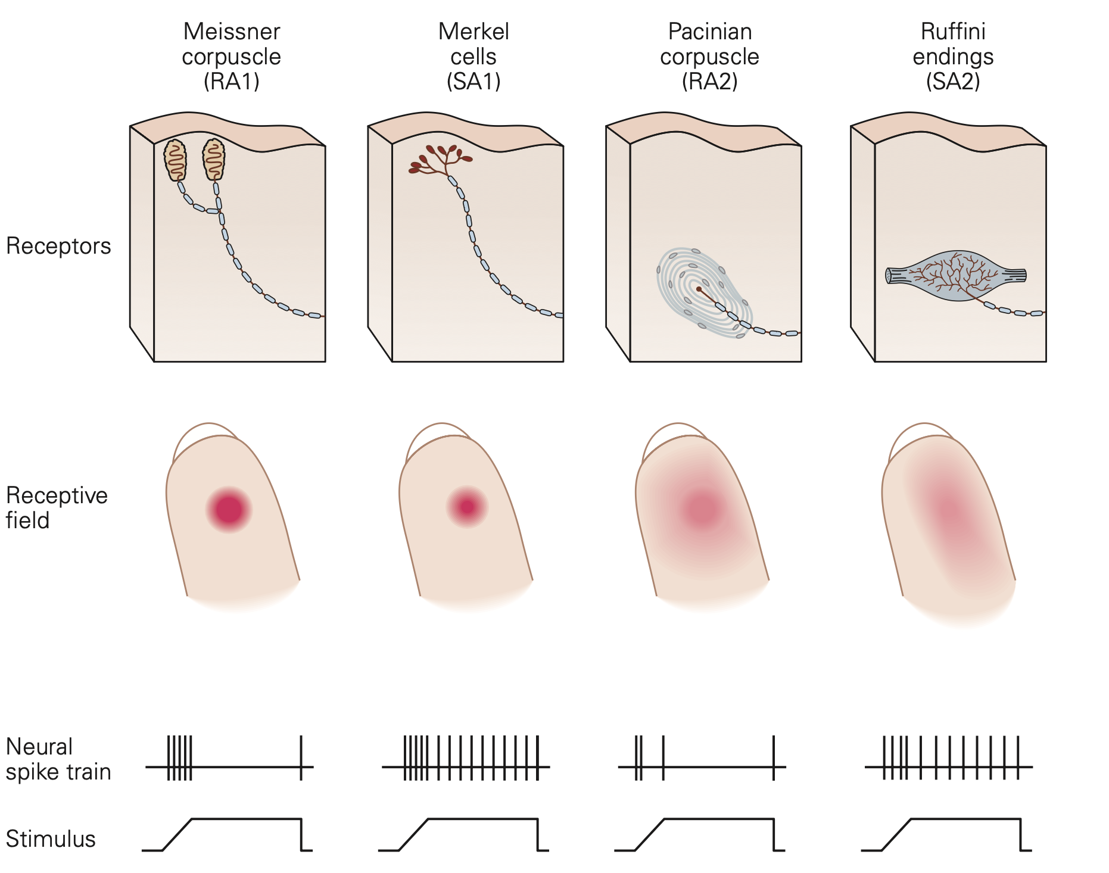
Why Mechanoreceptors Are Worth Mimicking
Biological skin uses multiple mechanoreceptors to encode different aspects of touch.
Fast-Adapting (FA) receptors respond to changes – they detect vibration, motion.
Slow-Adapting (SA) receptors respond to sustained pressure – they encode object shape, force and contact duration.
Mimicking both types enables rich temporal encoding, distinguishing dynamic touch from static touch.
Principles of Neural Science, 6e | AccessNeurology | McGraw Hill Medical.

Slide 13
5
Toward a More Complete Bio-Inspired Texture Recognition Pipeline

Slide 14
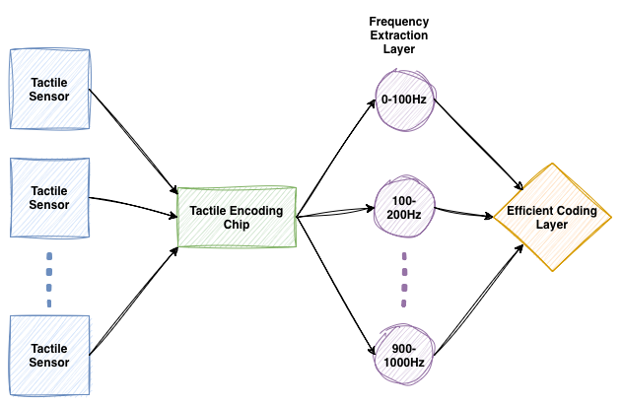
Texture Recognition System Overview

Slide 15
Tactile Encoding Chip
New biologically inspired tactile encoding chip extending the State of the Art by:
Integrating multiple mechanoreceptor models.
Performing on-chip analog-to-spike transduction at the mechanoreceptor level, with separated sensing arrays.
Reducing data redundancy through event-driven encoding.
Enabling asynchronous spike-based communication via AER.

Slide 16
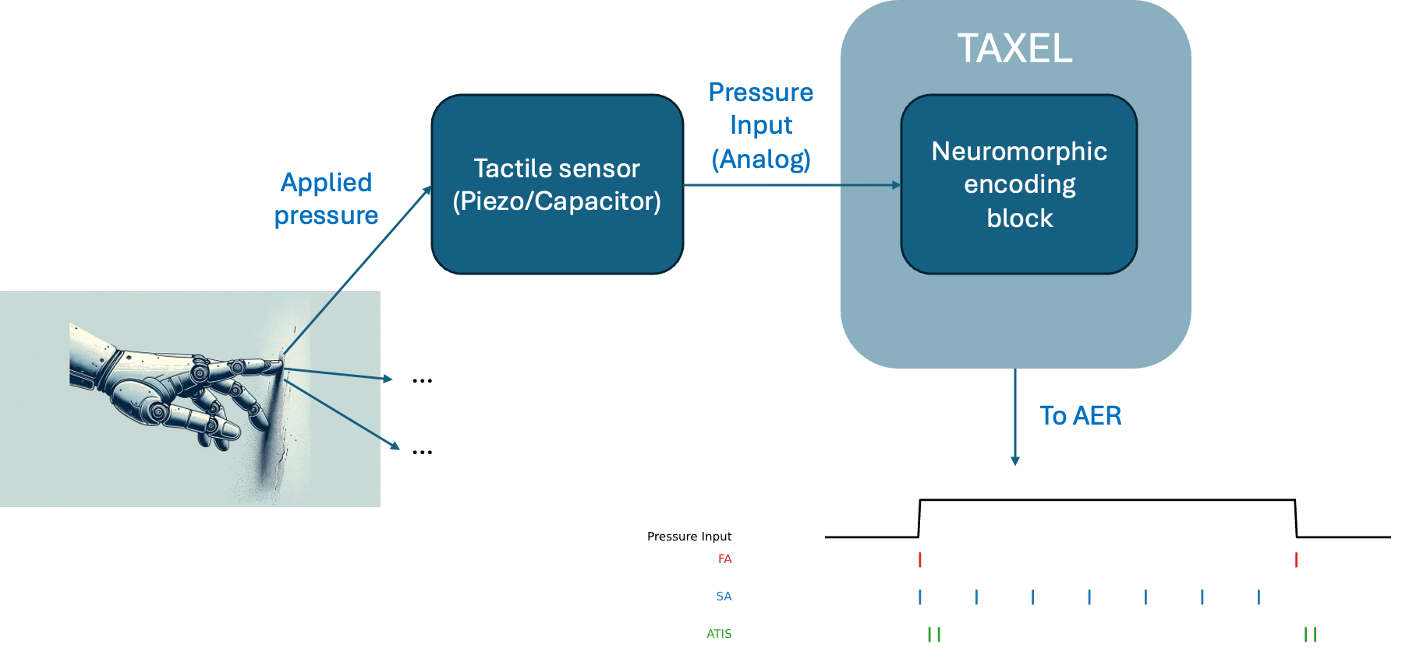
Neuromorphic Analog-to-Spike Converter: The Taxel as a Functional Unit

Slide 17
6
Neuromorphic frequency extraction

Slide 18
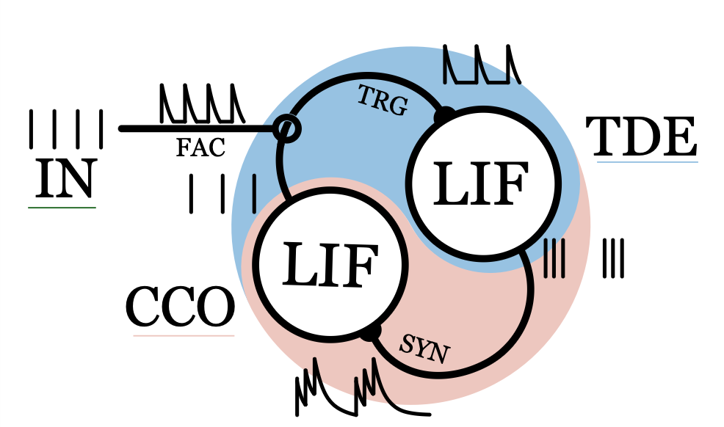
SOA in Neuromorphic Frequency Extraction
Spiking Phase-locked Loop (sPLL) system in neuromorphic hardware.
Mastella, M., Tiemens, T. & Chicca, E. Texture Recognition Using a Biologically Plausible Spiking Phase-Locked Loop Model for Spike Train Frequency Decomposition. (2024).

Slide 19
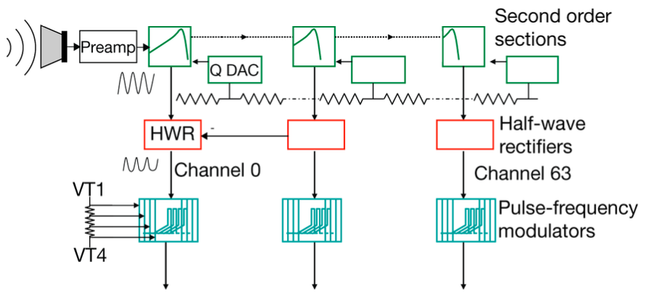
SOA in Neuromorphic Frequency Extraction
Neuromorphic Cochlea : uses cascade of filters to create bandpass filters over the hearing bandwidth.
Liu, S.-C., van Schaik, A., Minch, B. A. & Delbruck, T. Event-based 64-channel binaural silicon cochlea with Q enhancement mechanisms. (2010)

Slide 20
7
Efficient Coding Layer

Slide 21
Efficient Coding Layer
Goal:
Design a control scheme optimizing both task performance and system energy efficiency.
Active Efficient Coding:
Adapts biases/gains of lower layers via feedback using a Reinforcement Learning Framework.

Slide 22
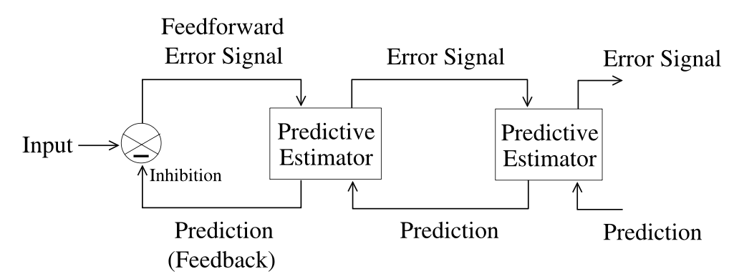
Predictive Coding Layer
Uses a hierarchical network minimizing prediction error.
Feedforward = residual error / Feedback = prediction.
Only unexpected information is propagated.

Slide 23
Predictive Coding Light framework
Concrete implementation of Predictive Coding in SNNs.
Advantages:
No residual errors propagation.
Suppresses most predictable spikes.
Concrete implementation in SNNs.
Uses inhibitory STDP (online learning).

Slide 24
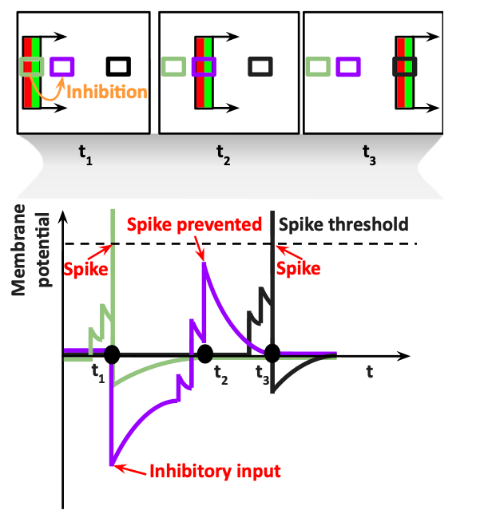
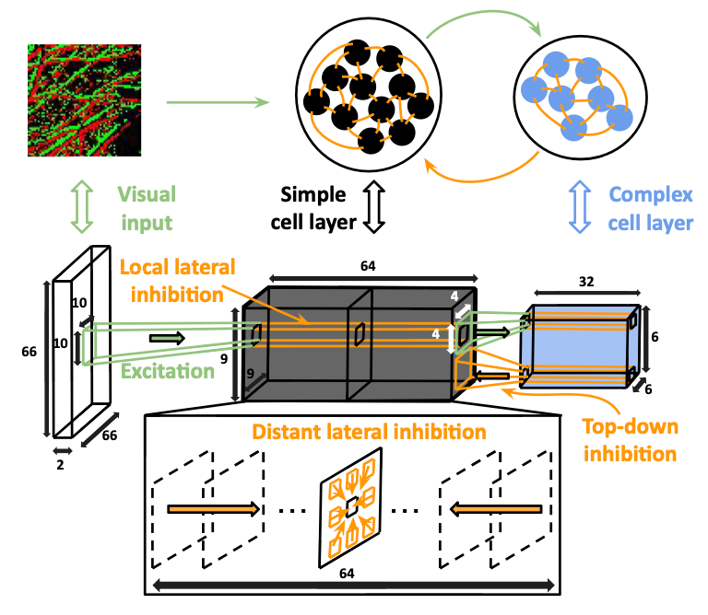
Predictive Coding Light framework
N’dri, A. W., Barbier, T., Teulière, C. & Triesch, J. Predictive Coding Light. (2025).

Slide 25
7
Combination of tactile sensing with other modalities

Slide 26
Modality Fusion
No single modality is enough for reliable real world perception and action.
When modalities are fused, the system can stay robust under uncertainty.
For robust environment exploration, multimodal perception allow to switch from one modality to another in case of occlusion in one of them.

