Slide 1

EduNova – Inclusive AI Learning Platform
Team: 404 ANF
Leader: Al Faruk Md Omor Sajeeb
“Learn your way – read, watch, listen, or visualize.”

Slide 2
Problem Statement
E-learning is one-size-fits-all
Students learn in different ways (reading, visual, audio)
Accessibility gaps for visually impaired, dyslexic, and multilingual learners

Slide 3
Our Vision
Multi-format learning: Ebook 📖, Sketch ✏️, Video 🎥, Audio 🔊
Multilingual learning (future vision) 🌍
Inclusive learning: every student can learn their way

Slide 4
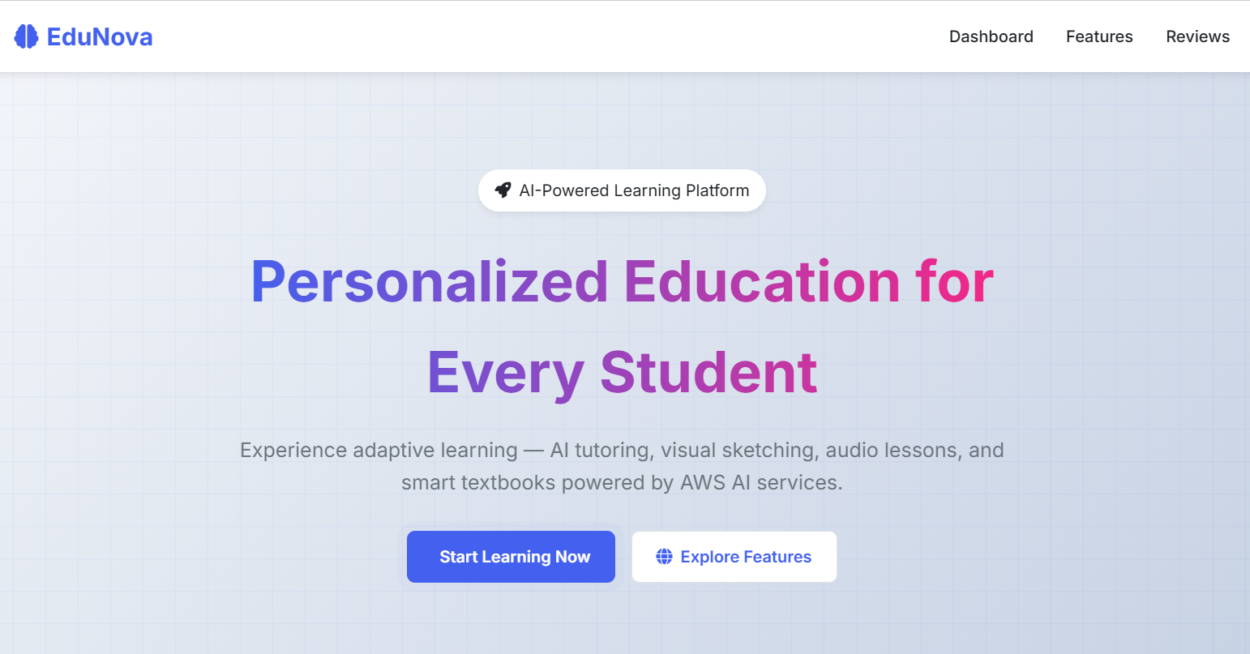
Our Web App
AI-generated e-books, sketches, videos, text and audio lessons
Easy-to-use interface, everything in one place

Slide 5
Challenges We Faced
Bedrock permissions blocked multilingual models in other regions
S3 AccessDenied errors for ebook downloads
Polly sometimes gave empty audio despite 200 OK
Time constraint → preloaded content for reliability

Slide 6
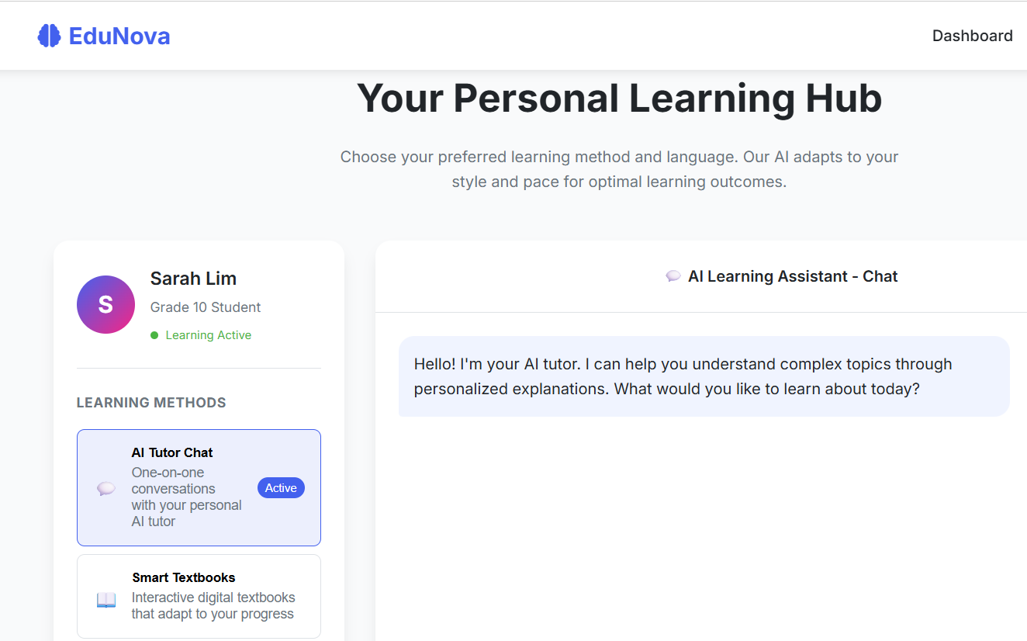
Our Solutions
Fixed S3 IAM & pre-signed URLs
Debugged Polly → ensured working audio pipeline
Selected supported models in SG region for convenience
Preloaded assets for smooth demo

Slide 7
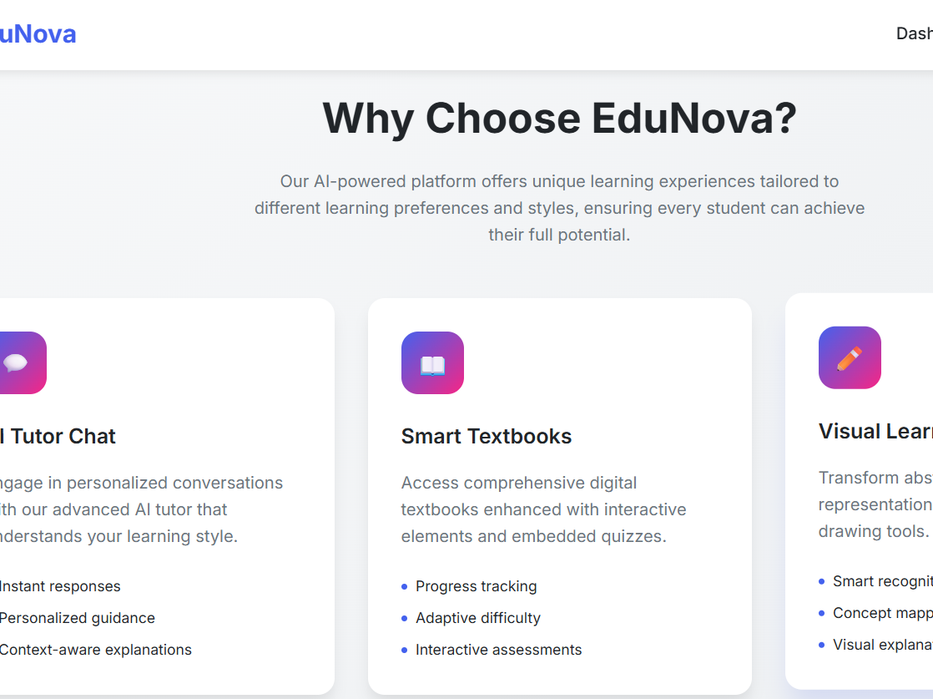
Impact
Students choose how they learn: read, watch, listen, visualize
Inclusive & accessible → supports different learning styles
Helps students with disabilities (TTS for visually impaired)
Future: multilingual → break language barriers in education

Slide 8
Future Improvements
Unlock multilingual support once permissions allow
Replace preloaded assets with real-time AI generation
Add personalization: recommend learning format
Expand platform to schools & universities

Slide 9
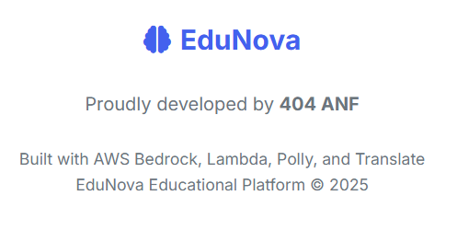
Closing
Team: 404 ANF
Leader: Al Faruk Md Omor Sajeeb
“Education for everyone, in every way, in every language.”
✨ Thank you!

