Slide 1
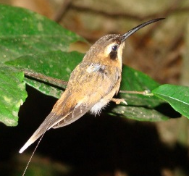
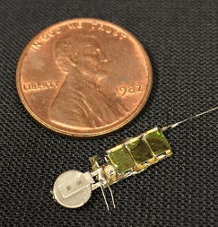
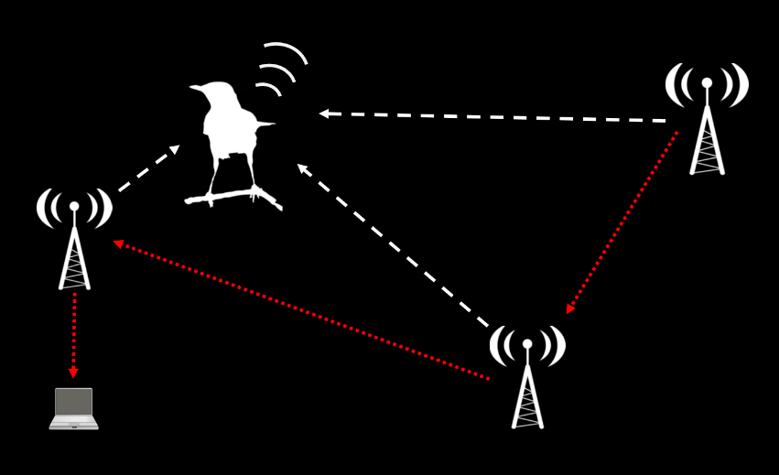
AMRUPT (Animal Movement Research Using Phase-based Trilateration)

Slide 2
This week
“Engineering design process”
AMRUPT project consultation
Obtain pertinent information for generating a proposal for this semester’s work.
Generate list of questions to help you define the problem, and to gather background information

Slide 3
Step 1: Begin planning for the design process
Khandani, 2005

Slide 4
Step 1: Begin planning for the design process
Khandani, 2005

Slide 5
Define the problem
1. Identify and establish the need
“A common tendency is to begin generating a solution to an apparent problem without understanding the problem.”
2. Develop a problem statement
“To reach a clear definition, [engineers] collect data, run experiments, and perform computations that allow a need to be expressed as part of an engineering problem-solving process.”
3. Establish explicit criteria for success
The design must collect accurate data.
The design must collect sufficiently precise data.
The design must be fast.
The design must be low cost.
The design should be safe.
The design should be simple to operate, with minimum human effort.

Slide 6
Requirements and constraints
Short range (100-300 m between receivers)
Extremely simple transmitter design (lightweight, low power)
System can operate in cluttered environments (multipath interference)
System can operate with ~50 Txers
High spatial accuracy (~5 m) triangulation results
Low cost receivers (COTS components)
Low power consumption of receivers

Slide 7
Engineering design process
Khandani, 2005

Slide 8
Gather pertinent information
1. Refine your thinking about the problem, and place it in context
Is the problem real and its statement accurate?
Is there really a need for a new solution or has the problem already been solved?
What are the existing solutions to the problem?
What is wrong with the way the problem is currently being solved?
What is right about the way the problem is currently being solved?
2. Search for information sources
Scientific encyclopedias and technical handbooks.
Primary articles
Faculty in ECE and beyond
Company websites and brochures

Slide 9
Gather pertinent information

Slide 10
Engineering design process
Khandani, 2005

Slide 11
Generate multiple solutions
Synthesize ideas from existing work
“Start with existing solutions to the problem and then tear them apart to find out what's wrong with those solutions and focus on how to improve their weaknesses.”
Brainstorming important!!
“Ideas are generated when people are free to take risks and make mistakes.”
“Brainstorming at this stage is often a team effort in which people from different disciplines are involved in generating multiple solutions to the problem.”

Slide 12
3 tiered approaches (phases)
Phase I (single frequency)
Schedule Tx/Rx
Tx from mobile-node
Rx from ground-node
Obtain Phase-difference information
Obtain ID and timestamp
Transmit phase, ID, timestamp to base station
Triangulate location

Slide 13
3 tiered approaches (phases)
Location estimate insufficiently accurate?
Phase II (multi-frequency)
Schedule Tx/Rx
MF Tx from mobile-node
Tx from mobile-node
Rx from ground-node
Obtain MF Phase-difference information
Obtain Phase-difference information
Obtain ID and timestamp
Transmit phase, ID, timestamp to base station
Triangulate location
Refine phase-difference estimates

Slide 14
3 tiered approaches (phases)
Location estimate insufficiently accurate?
Phase III (multi-frequency phase integer disambiguation)
Schedule Tx/Rx
MF Tx from mobile-node
Tx from mobile-node
Rx from ground-node
Obtain MF Phase-difference information
Obtain Phase-difference information
Obtain ID and timestamp
Transmit phase, ID, timestamp to base station
Triangulate location
Trilaterate location
Refine phase-difference estimates
Disambiguate phase integer

Slide 15
signal
Option 1
RF in
CC1310
ID out
control
Trigger
LNA
Local Oscillator
ADC
DF Algorithm running on RaspberryPi
Antenna 1
1
2
Watson-Watt pair 1
3
LNA
4
Antenna 2
I
I/Q
Antenna 3
LNA
Q
1
Watson-Watt pair 2
2
LNA
Demodulator
&
IF Mixer
3
Antenna 4
4
Notes:
TDOA

Slide 16
signal
Option 2
control
Local Oscillator
I/Q 1
Antenna 1
LNA
RF Switch
CC1310
Watson-Watt pair 1
Antenna 2
LNA
I/Q 2
I/Q 1-4,
RSSI 1-4, ID
DF Algorithm running on RaspberryPi
LNA
SPI
Antenna 3
I/Q 3
Watson-Watt pair 2
AOA,
RSSI,
ID,
Time
Antenna 4
LNA
I/Q 4
Notes:
TDOA

Slide 17
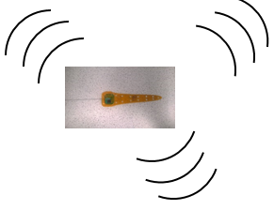
TRX 1
Automated phase-based telemetry receiver system
TRX 2
Local
Oscillator
Local
Oscillator
Antenna 1
Low Noise
Amplifier
CC1310 1
Antenna 1
Low Noise
Amplifier
CC1310 1
Antenna 2
Low Noise
Amplifier
CC1310 2
DF Algorithm running on RaspberryPi
Antenna 2
Low Noise
Amplifier
CC1310 2
DF Algorithm running on RaspberryPi
Antenna 3
Low Noise
Amplifier
CC1310 3
Antenna 3
Low Noise
Amplifier
CC1310 3
Antenna 4
Low Noise
Amplifier
CC1310 4
Antenna 4
Low Noise
Amplifier
CC1310 4
GPS
RxTx communication protocol
Compass
Energy harvesting
Time-keeping,
coordination w/txrs
coordination w/ rxrs
localization of receivers
Orienting antenna elements
TRX3
TRX4
Local
Oscillator
Local
Oscillator
Antenna 1
Low Noise
Amplifier
CC1310 1
Antenna 1
Low Noise
Amplifier
CC1310 1
Antenna 2
Low Noise
Amplifier
CC1310 2
DF Algorithm running on RaspberryPi
Antenna 2
Low Noise
Amplifier
CC1310 2
DF Algorithm running on RaspberryPi
Antenna 3
Low Noise
Amplifier
CC1310 3
Antenna 3
Low Noise
Amplifier
CC1310 3
Antenna 4
Low Noise
Amplifier
CC1310 4
Antenna 4
Low Noise
Amplifier
CC1310 4

Slide 18
Mobile-to-Ground Node Communication Protocol
5 + X s
5 min – (5 + X s)
Tx
Rx from mobile nodes
5 s
X (?) s
Ground node
(acquire or sleep mode)
Tx countdown signal (5 s)
Tx commands
e.g. timestamp & checksum
e.g. timestamp & checksum
0.0000
Y IDs
Y commands
*Will need a data upload mode too
Checksum (opt.)
Global time
Sleep command
Y
Sleep length
X
Listen for tags
X
Y
X
N
Default?
N
Special commands for Y tags
*Give mobile nodes way to check that they have a good link
*All mobile nodes sync’d here
*Keeps all mobile nodes from TXing when system isn’t monitoring
*Default mode just has any tag within range of sync signal transmit at its scheduled time
*Special commands allow a subset of tags to be told to go to sleep, switch to different mode (e.g. to upload sensor data on different channel), etc.
Notes:
Mobile node diagram to follow. Mobile nodes should sleep just under 5 s (ensuring they will hear a ground node transmission at least once if it is in range), then wake long enough to receive a single countdown signal from a ground node. Once they have received a countdown signal, and the checksum demonstrates a good link, update global time (it will have drifted over the last 5 min), then listen for rest of commands. Once commands received use global time, received command, and (assuming the command includes a simple transmit instruction) pre-programmed transmission time delay to send ID during the ground node’s ~5 min RX period.

Slide 19

TRX 1
Automated phase-based telemetry receiver system
TRX 2
Local
Oscillator
Local
Oscillator
Antenna 1
Low Noise
Amplifier
CC1310 1
Antenna 1
Low Noise
Amplifier
CC1310 1
Antenna 2
Low Noise
Amplifier
CC1310 2
DF Algorithm running on RaspberryPi
Antenna 2
Low Noise
Amplifier
CC1310 2
DF Algorithm running on RaspberryPi
Antenna 3
Low Noise
Amplifier
CC1310 3
Antenna 3
Low Noise
Amplifier
CC1310 3
Antenna 4
Low Noise
Amplifier
CC1310 4
Antenna 4
Low Noise
Amplifier
CC1310 4
GPS
RxTx communication protocol
Compass
Energy harvesting
Time-keeping,
coordination w/txrs
coordination w/ rxrs
localization of receivers
Orienting antenna elements
Node-to-node VHF uplink
TRX3
Trilateration algorithm
Uses RSSI?
Machine learning w/ calibration beacons?
TRX4
Local
Oscillator
Bluetooth / VHF uplink to central hub
Local
Oscillator
Antenna 1
Low Noise
Amplifier
CC1310 1
Antenna 1
Low Noise
Amplifier
CC1310 1
Antenna 2
Low Noise
Amplifier
CC1310 2
DF Algorithm running on RaspberryPi
Antenna 2
Low Noise
Amplifier
CC1310 2
DF Algorithm running on RaspberryPi
Antenna 3
Low Noise
Amplifier
CC1310 3
Antenna 3
Low Noise
Amplifier
CC1310 3
Antenna 4
Low Noise
Amplifier
CC1310 4
Antenna 4
Low Noise
Amplifier
CC1310 4

Slide 20
Engineering design process
Khandani, 2005

Slide 21
Analyze and select a solution
1. Systematic analysis of design solutions
Functional analysis – will it function the way it should?
Mechanical/Strength analysis – is it physically durable?
Manufacturability/Testability – can it be produced easily? Is it overly complex?
Product safety and liability – will it be safe for the user?
Economic and market analysis – is it affordable / cost-effective?
Regulatory and Compliance – is it legal (think about FCC regulations)?
2. The decision process: how to choose among the options?
Think about using a decision matrix:
Functionality: 30 %
Cost: 20 %
Complexity: 20 %
Safety: 20 %
Use of standard parts: 10 %
A | B | C
25 | 30 | 15
20 | 15 | 20
10 | 20 | 20
20 | 20 | 20
5 | 10 | 5
A | B | C
25 | 30 | 15
20 | 15 | 20
10 | 20 | 20
20 | 20 | 20
5 | 10 | 5
80 | 95 | 80

Slide 22
Engineering design process
Khandani, 2005

Slide 23
Test and implement the solution
1. Prototyping
Simulations and simplified models to evaluate if you’re on the right track. Help define what other considerations may be need to be met before getting too far.
2. Documentation (!!!!)
“One of the most important activities in design is documenting your work, clearly communicating the solution to your design problem so someone else can understand what you have created.”

Slide 24

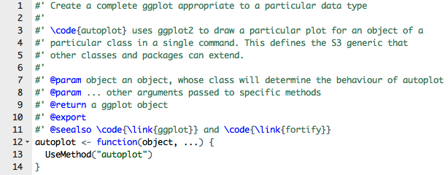
Good documentation is essential!
“ReadMe”file
In-line comments

Slide 25
Test and implement the solution
1. Prototyping
Simulations and simplified models to evaluate if you’re on the right track. Help define what other considerations may be need to be met before getting too far.
2. Documentation (!!!!)
“One of the most important activities in design is documenting your work, clearly communicating the solution to your design problem so someone else can understand what you have created.”
3. Testing and verification
Without proper testing at all stages in the process, you may find yourself making costly mistakes later.
Standardized test sets to evaluate functionality across semesters

Slide 26
Engineering design process
Define the AMRUPT Problem
Project Proposal
Khandani, 2005

