Slide 1

Angular 2
By Gediminas Katilevičius

Slide 2
About Angular2
It's a Framework that uses its predecessors ideology, but completely refactored, faster and lots more
Easier and more functional
Component programming
ES6
Rxjs
Built in directives
Style scoping
Long awaited features
Zone.js
Server side rendering
Optimized for performance
Open source
More info about Angular2 features:
https://angular.io/features.html

Slide 3
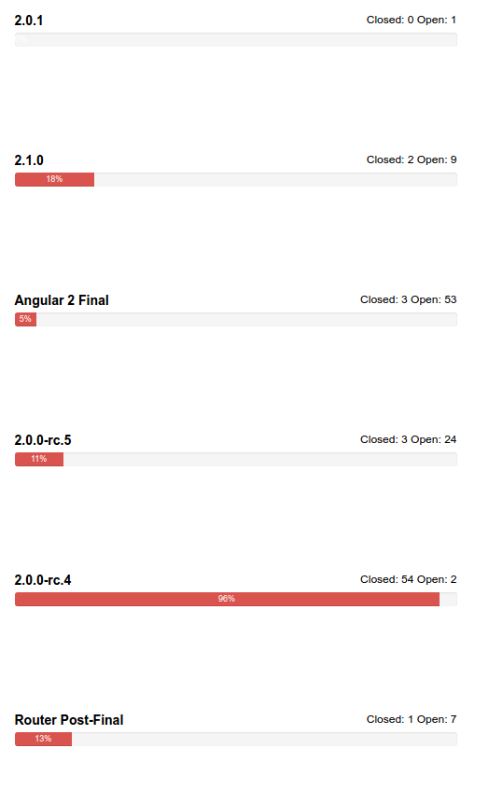
When?

Slide 4
What's old?
Old ideology: lots of built in directives (ngFor, click, ngInit, …)
Creating custom directives, controllers, services

Slide 5
What's new?

Slide 6
Key features
Typescript or Dart (closer to none javascript documentation)
ES6
Component based programming
Better profiling, error reporting
Server side rendering

Slide 7
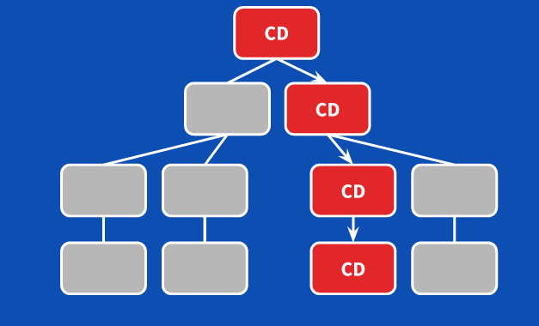
Change detection
Application state change can be detected by event, xhr or timer
ApplicationRef listens to ngZone onTurnDone() and performs tick()
Each component has its own change detector.
Performs hundreds of thousands of checks within a couple of milliseconds

Slide 8
New bootstrap proccess
Old angular
<div ng-app="ngAppStrictDemo"
New angular
export function ngApp() {
return bootstrap(App, [
...HTTP_PROVIDERS,
provideRouter(routes)
]);
}

Slide 9
Angular universal
https://github.com/angular/universal-starter

Slide 10
Using with Jquery libs
https://gist.github.com/PizzaBrandon/5709010

Slide 11
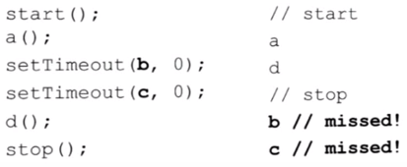
Zone.js

Slide 12
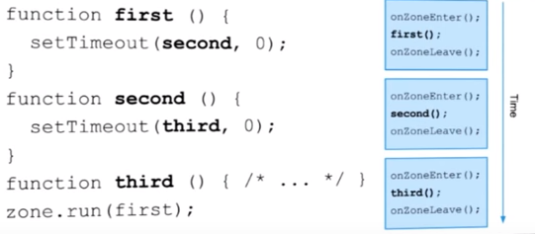
Zone.js

Slide 13
Components
@Component({
selector: 'app', // <app></app>
directives: [
...ROUTER_DIRECTIVES,
ArticleCategories,
ProductCategories
],
moduleId: __filename,
templateUrl: 'app.template.html'
})
export class App {
showCategories: boolean;
getStyle() {
if(this.showCategories){
return "yellow";
} else {
return "";
}
}
}

Slide 14
Built in directives and template functions
One way binding: {{data}}
Two way binding: [(target)] = "expression"
<div *ngFor="let hero of heroes">{{hero.fullName}}</div>
*ngIf="currentHero"
[style.font-size]="isSpecial ? 'x-large' : 'smaller'"
[class.special]="isSpecial"
[ngClass]="setClasses()"
setClasses() {
let classes = {
saveable: this.canSave, // true
modified: !this.isUnchanged, // false
special: this.isSpecial, // true
};
return classes;
}

Slide 15
Asterisk
The * is a bit of syntactic sugar that makes it easier to read and write directives that modify HTML layout with the help of templates. NgFor, NgIf, and NgSwitch all add and remove element subtrees that are wrapped in <template> tags.

Slide 16
Dependency injection
constructor(
private articlesCategoriesService: ArticlesCategoriesService,
private router: Router
) {}

Slide 17
Routing
1. create router outlet in component template:
<router-outlet></router-outlet>
2. create routes in app.routes.ts
{ path: 'productCategories', component: ProductList },
{ path: '', component: Home},
{ path: 'category', component: Category }
3. create route links:
<a [routerLink]="['/productCategories']">{{ category.name }}</a>
4. or redirect from function:
onCategorySelect() {
this.router.navigate(['/category']);
}

Slide 18
Reactive extensions (rxjs)
The Reactive Extensions for JavaScript (RxJS) is a set of libraries for composing asynchronous and event-based programs using observable sequences and fluent query operators that many of you already know by Array#extras in JavaScript.

Slide 19
Rxjs Promises
1. import {Http, Response} from '@angular/http';
import 'rxjs/add/operator/toPromise';
2. create data object model
3. public getCategories(): Promise<ProductCategory[]> {
return this.http.get(this.apiUrl)
.toPromise()
.then(response => response.json());
}

Slide 20
Style scoping
1. Native - uses Shadow DOM root
2. None - prints styles in head
3. Emulated – creates identifiers for scope

