Slide 1
A Story of a ticket collector who finally became a trophy collector

Slide 2
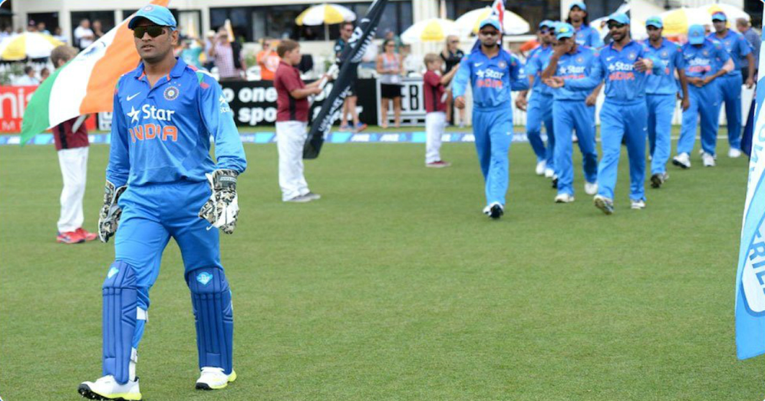
M.S.Dhoni
Captain Team India (2007 – 2014)

Slide 3
INTRODUCTION.
Full name: Mahendra Singh Dhoni
Also known as: Mahi
Born: July 7,1981
Favorite Game: Football
Debut Against: Bangladesh
 First job : Ticket collector

Slide 4
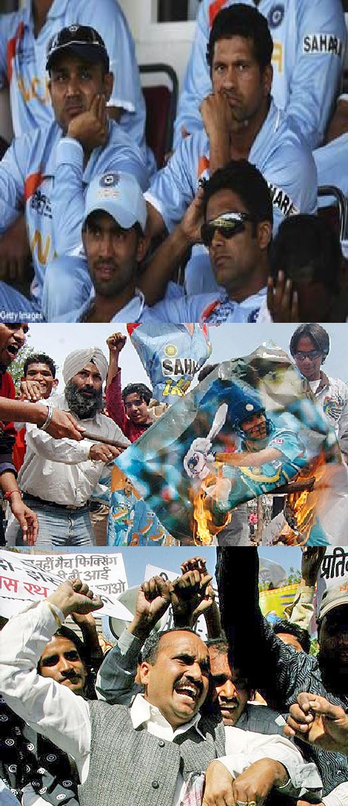
Loss of World Cup
2007
Disappointed Team
Angry Fans
Protests Against Team India
Change was the Demand

Slide 5
Why MSD as a leader?
Face the challenge without fear
Be unique
Decision Making
Cool under pressure

Slide 6
Leadership Characteristics
Motivation
High Energy
Integrity
Intelligence
Stability

Slide 7
Dhoni a born leader
Never Captained any domestic side Before
Natural Abilities
Sets Challenging Objectives for himself
Enjoy working with People

Slide 8
Democratic Approach towards the Game
Listening to other
Working with the Team
Encourage Participation
Giving Opportunity to youngster
Respect

Slide 9
New Era for Indian Cricket
World T20 2007
Test Team of the Year 2010-2011
ODI World Cup 2011
India whitewash Australia in a tests series.
Indian Premier League
Winner IPL with Chennai Super kings (twice)
Winner Champions League T20 in 2011

Slide 10
AWARDS AND ACHIEVEMENTS.
MTV Youth Icon Award 2006.
MTV Youth Icon Award 2007.
Rajiv Gandhi Khel Ratna Award in 2007/08
Padma Shri in 2009.
ICC ODI player of the year 2009.
Doctorate Degree from De Montfort University of United Kingdom.

Slide 11
What we can learn from Dhoni:
Isolate yourself at Critical Times.

Slide 12
Calmness and Patience is a Virtue, Cultivate them

Slide 13
Give chance to the Non-Stars to show their talent on the big Stage.

Slide 14
 Live the Moment, Self-belief and Coach

Slide 15
Accept the defeat from the front, Enjoy the success from the back

Slide 16
