Slide 1
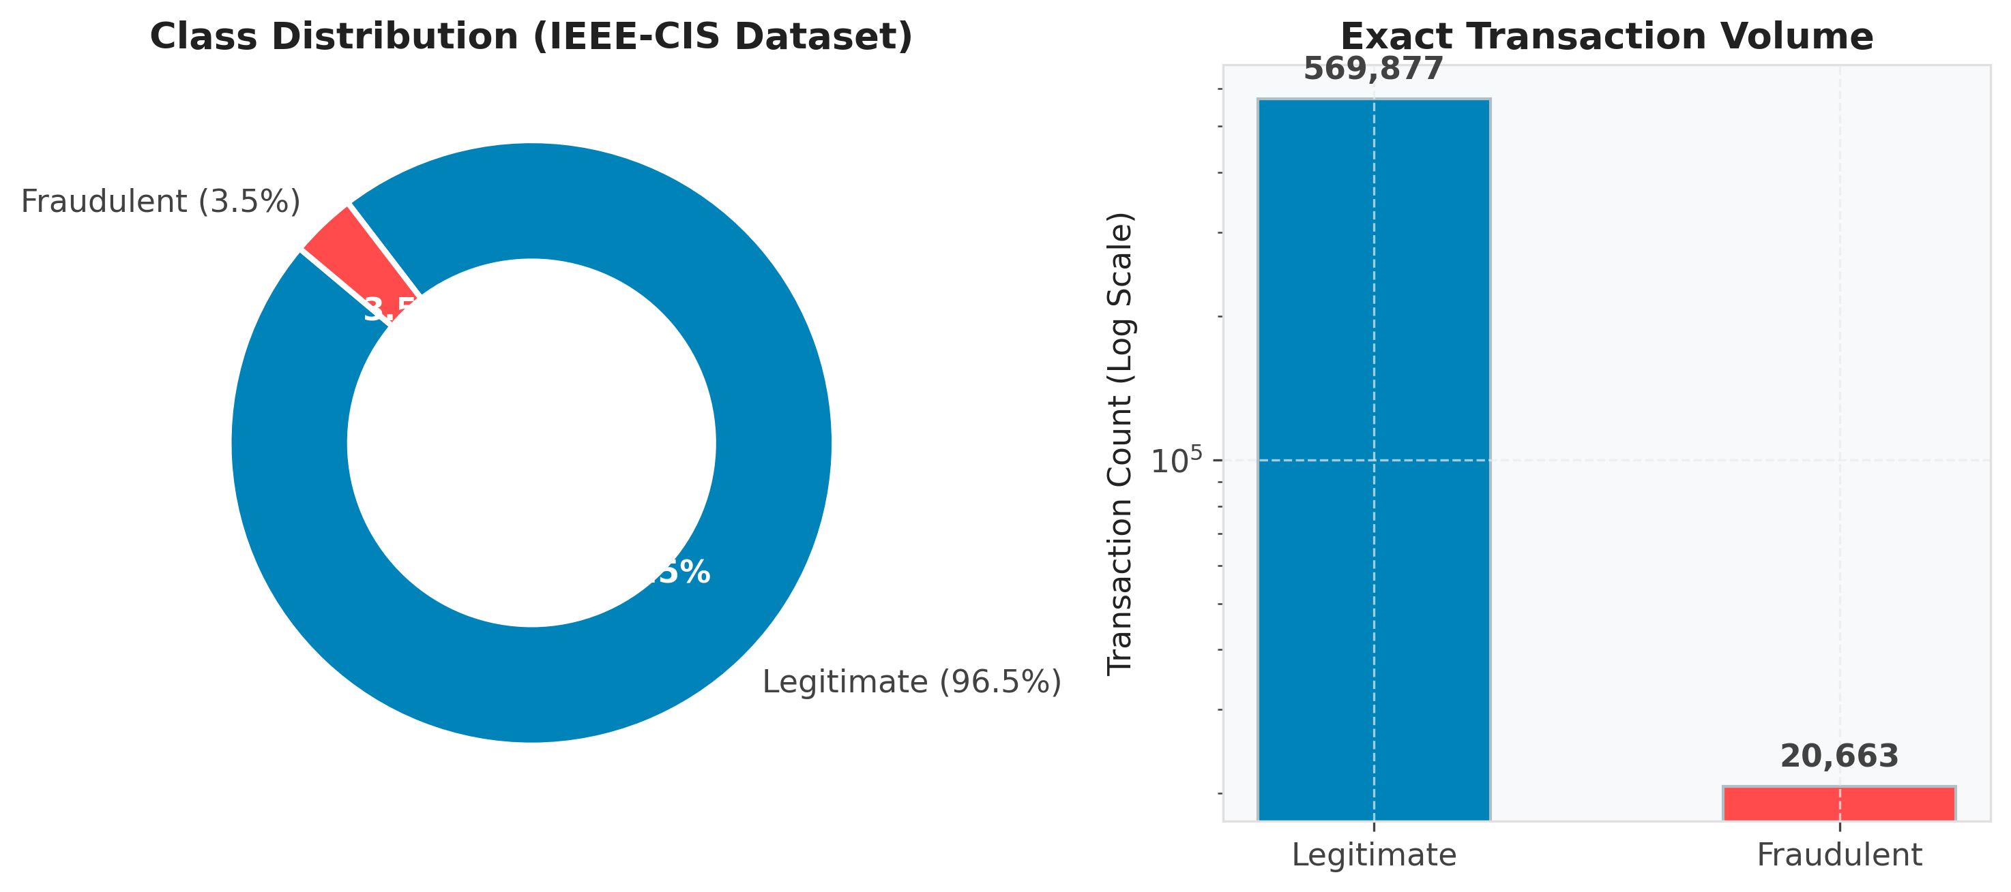
Executive Project Scope
Raw Ingestion — merged transaction (590,540 rows, 394 features) and identity (144,233 rows, 41 features) datasets on TransactionID.
PART 1
Data Audit — solved massive column sparsity, temporal sequencing, and high-cardinality identity structures.
Ingestion, Cleaning &
Exploratory Data
Analysis
Scope — establish a leak-free data processing baseline for production, real-time prediction.
IEEE-CIS Real-Time Financial Fraud Detection System
Class distribution: 96.5% legitimate vs 3.5% fraudulent across 590,540 transactions
1

Slide 2
PART 1 — DATA ENGINEERING & EDA
Addressing Extreme Class Imbalance (3.51% Target Rate)
Imbalance Reality: out of 590,540 transactions, only 20,663 are fraudulent — a 3.51% positive class rate.
Accuracy Trap: a naive model predicting all-legitimate reaches 96.5% accuracy while catching 0% of fraud.
Strategy Shift: modeling and evaluation moved from Accuracy to PR-AUC (Precision-Recall Area Under Curve) and ROC-AUC.
3.51%
20,663
Fraud rate of total volume
Confirmed fraud cases
Legitimate vs. fraudulent transaction volume, log-scale count
2

Slide 3
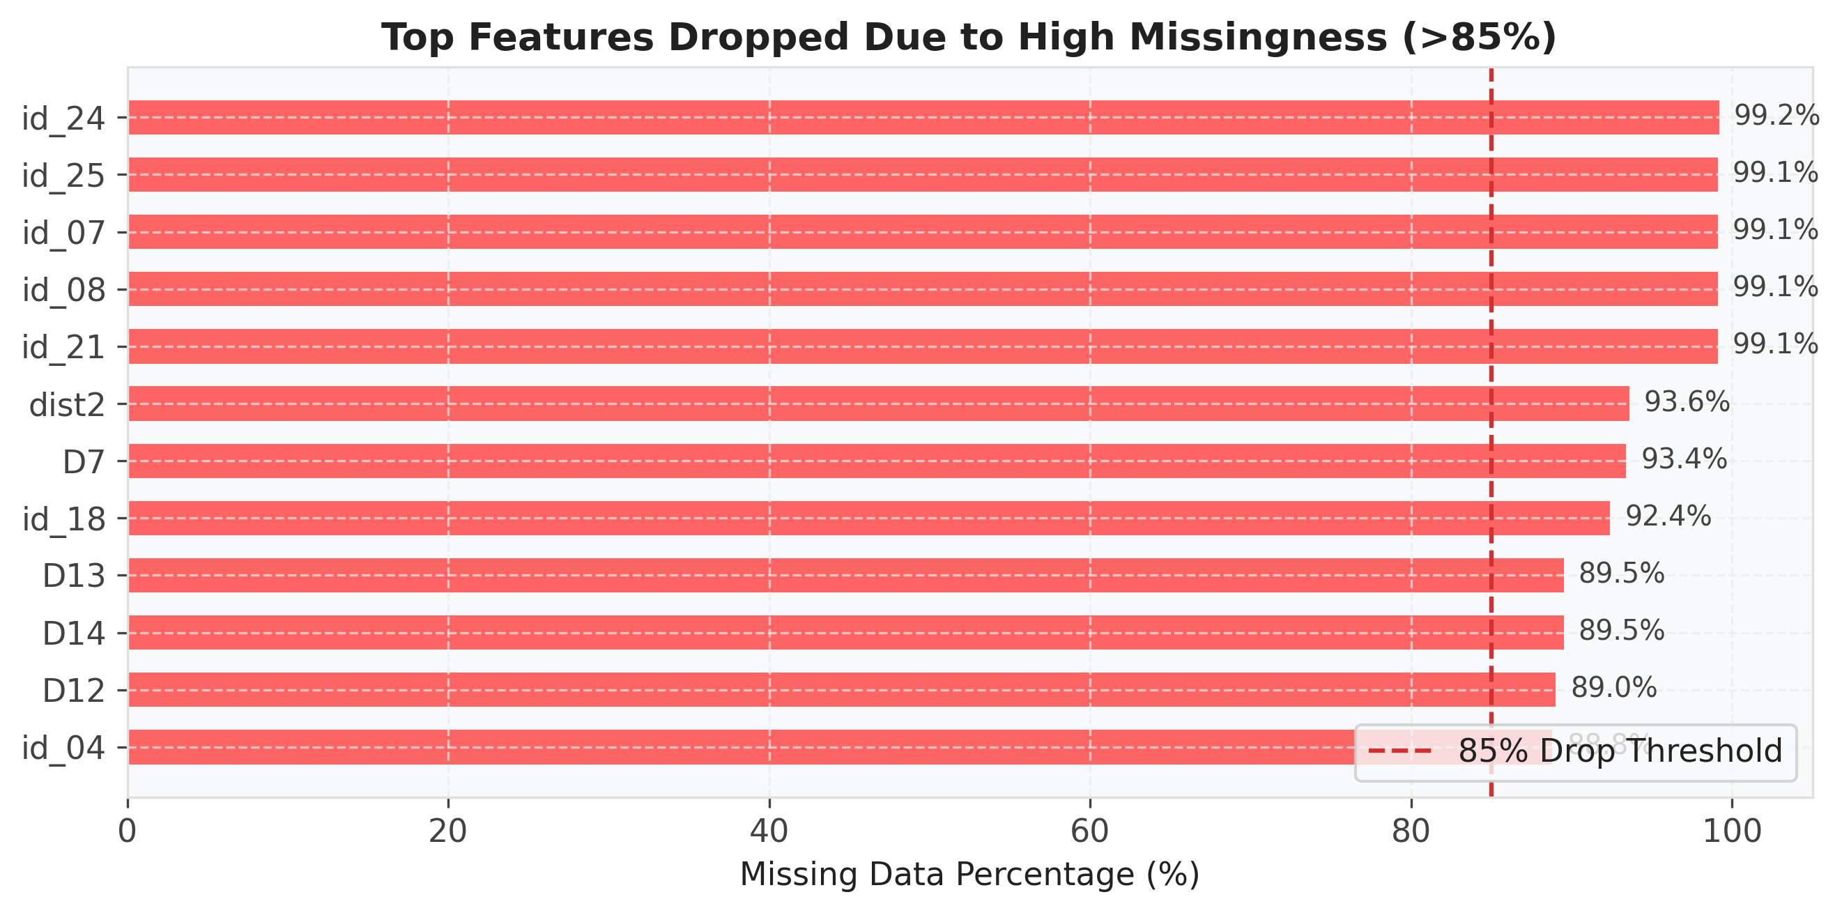
PART 1 — DATA ENGINEERING & EDA
Severe Feature Sparsity & Systematic Pruning
Sparsity Identification: over 74 features contained missing values exceeding 85% of all records.
Tier 1 Drop (>95% missing): pruned 9 ultra-sparse identity features (e.g., id_24, id_25 — both >99% missing).
Tier 2 Drop (85%–95% missing): pruned 65 redundant Vesta (V138–V166) and D-series features, reducing the dataset from 425 to 360 features.
Native Preservation: retained moderate missing values for LightGBM's native branch handling.
Top dropped features ranked against the 85% missing-value threshold
3

Slide 4
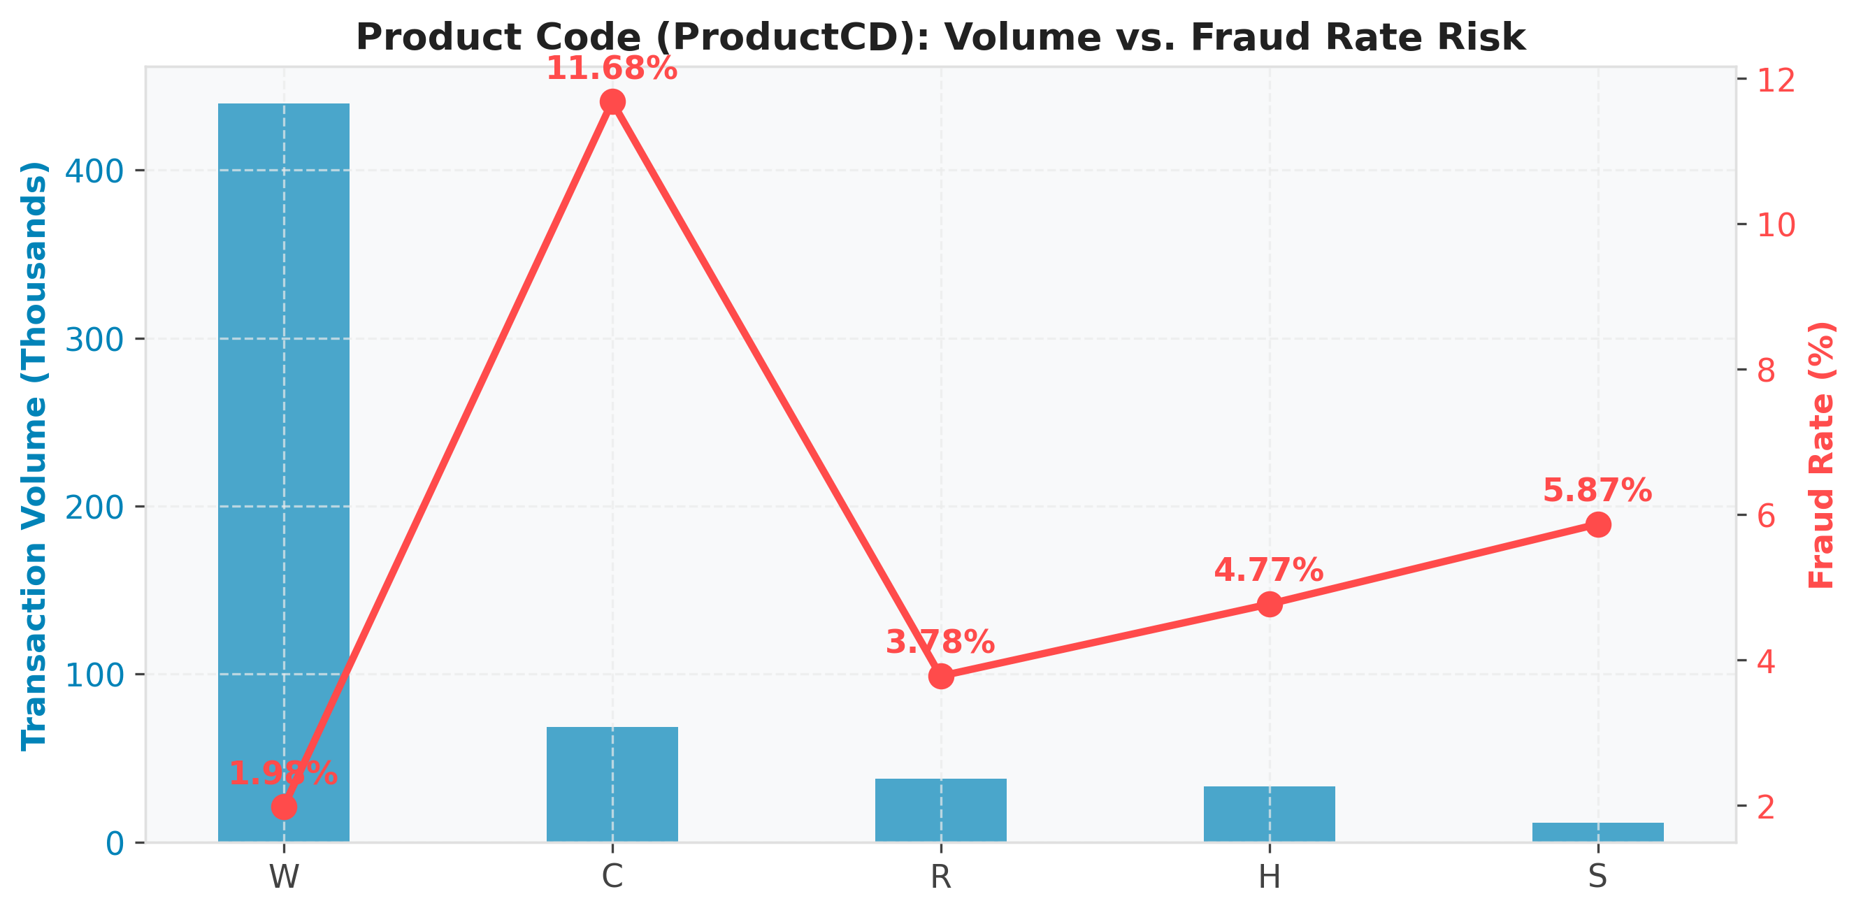
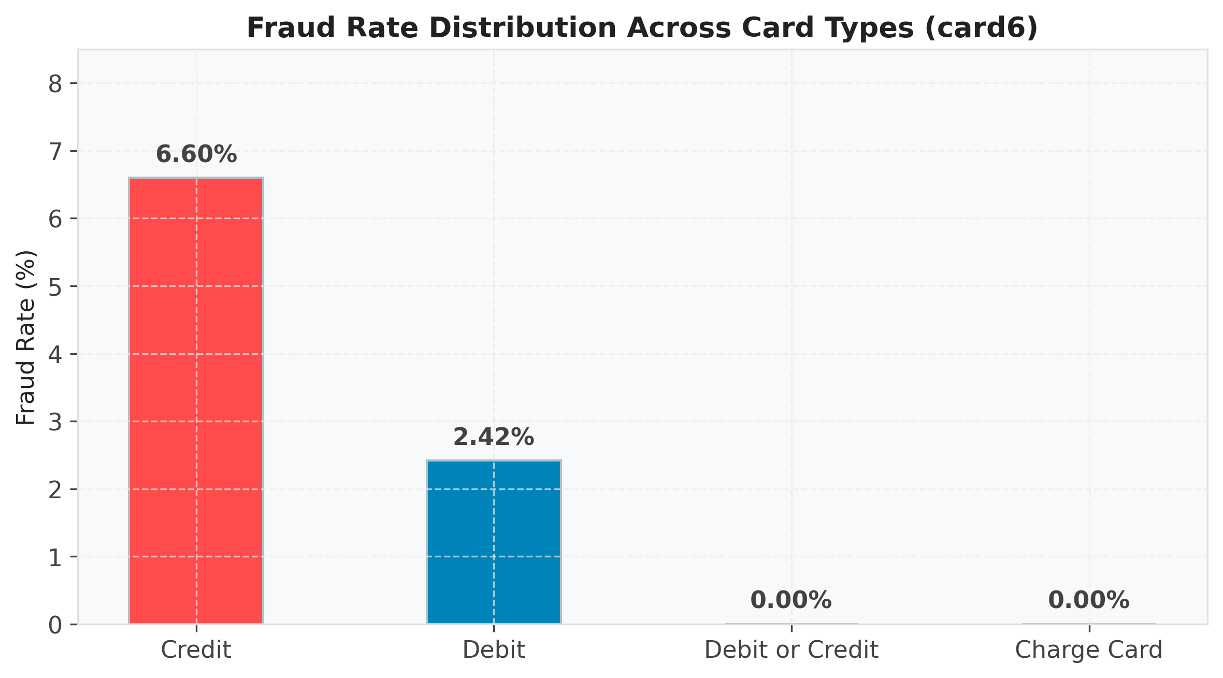
PART 1 — DATA ENGINEERING & EDA
Risk Profiling Across Product & Payment Attributes
ProductCD Disparity: product code 'C' shows an 11.68% fraud rate versus 'W' at just 1.98%, despite 'W' carrying 74% of total volume.
Card Type Risk: credit card transactions (card6) show a 6.60% fraud rate — nearly 3x the 2.42% rate for debit cards.
Encoding Strategy: applied one-hot encoding (drop_first) to low-cardinality features and frequency encoding to email domains.
ProductCD: transaction volume vs. fraud rate
card6: fraud rate by payment instrument
4

Slide 5
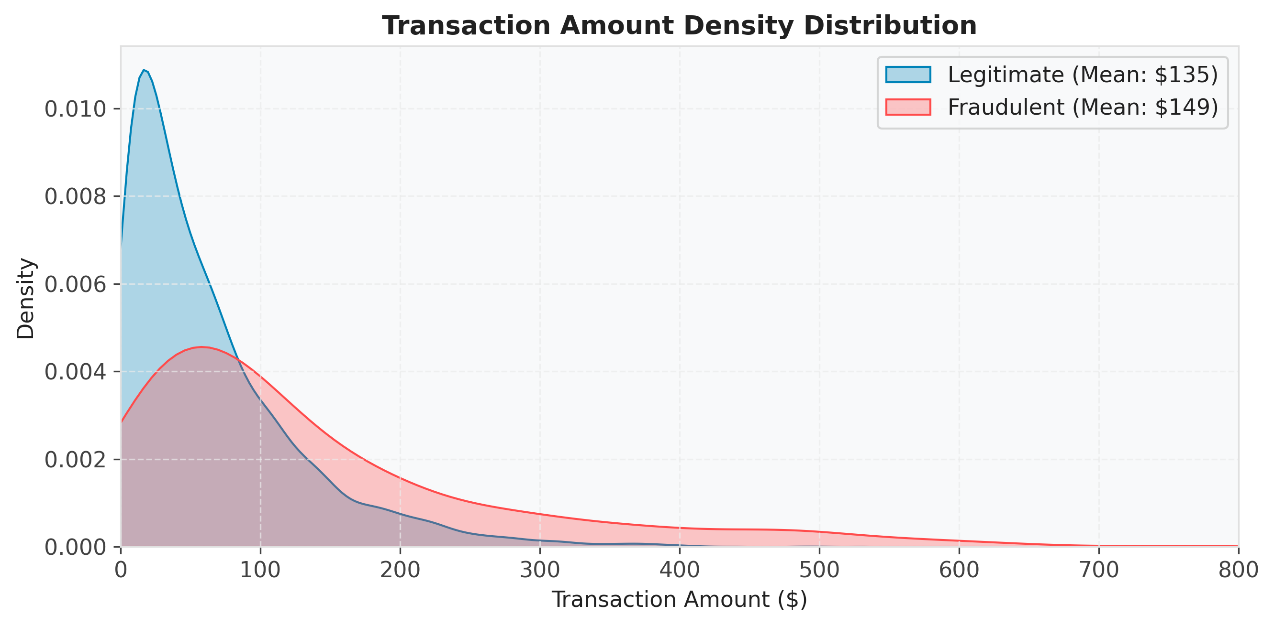
PART 1 — DATA ENGINEERING & EDA
Transaction Amount Behavior & Log Distributions
Density of transaction amounts: legitimate (mean $135) vs. fraudulent (mean $149)
$149
$135
$31,937
Mean fraudulent amount
Mean legitimate amount
Maximum transaction amount observed
5

Slide 6
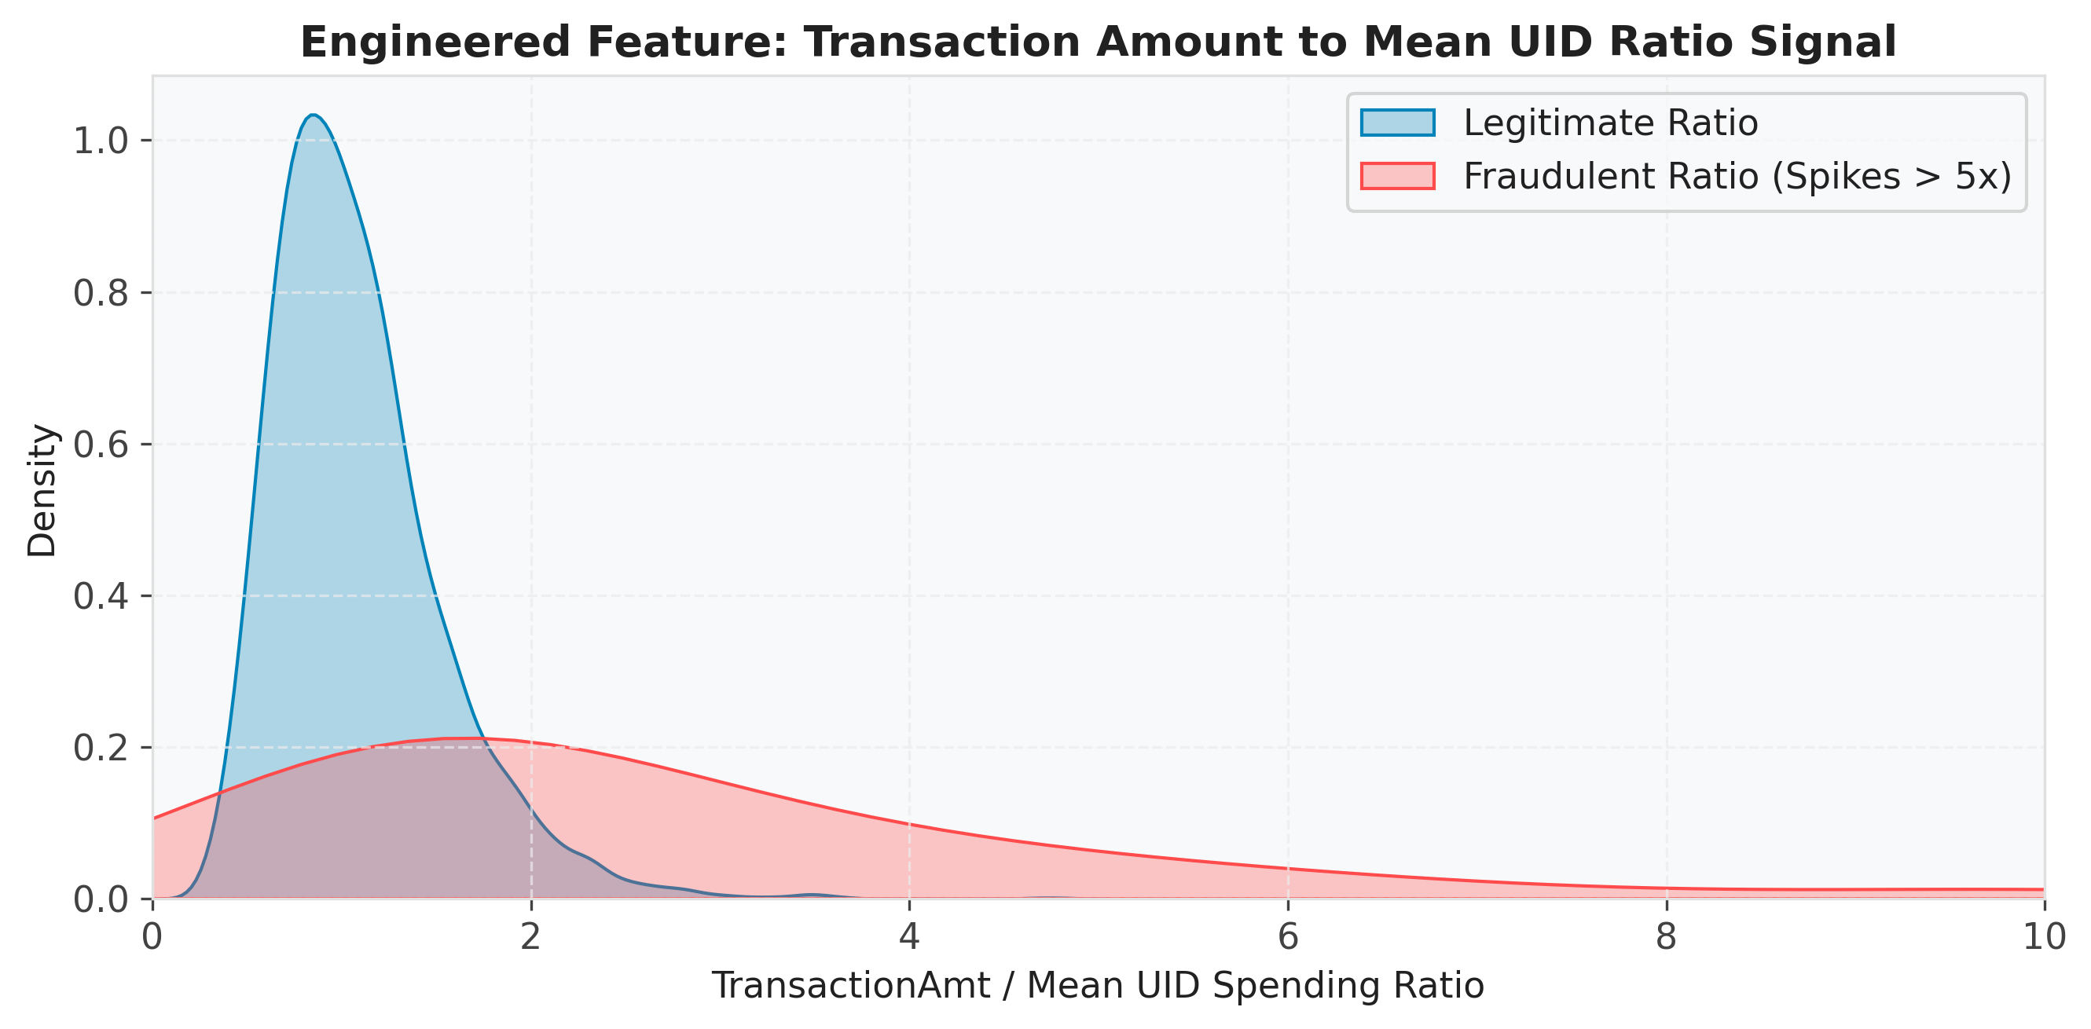
PART 1 — DATA ENGINEERING & EDA
Advanced Feature Engineering: The UID Aggregation Trick
UID Construction: combined card1 + addr1 + D1 to construct 192,316 unique pseudo-customer accounts.
Aggregation Features: engineered card1_amt_mean, uid_amt_mean, and transaction-to-mean amount ratios.
Velocity Features: added UID2 (card1+card2+addr1+P_emaildomain) and time_since_last_uid_txn.
Signal Impact: ratios exceeding 5x the customer average provided top-tier discriminative power for tree classifiers.
Transaction-to-mean UID spending ratio — fraud spikes beyond 5x normal spend
6

Slide 7
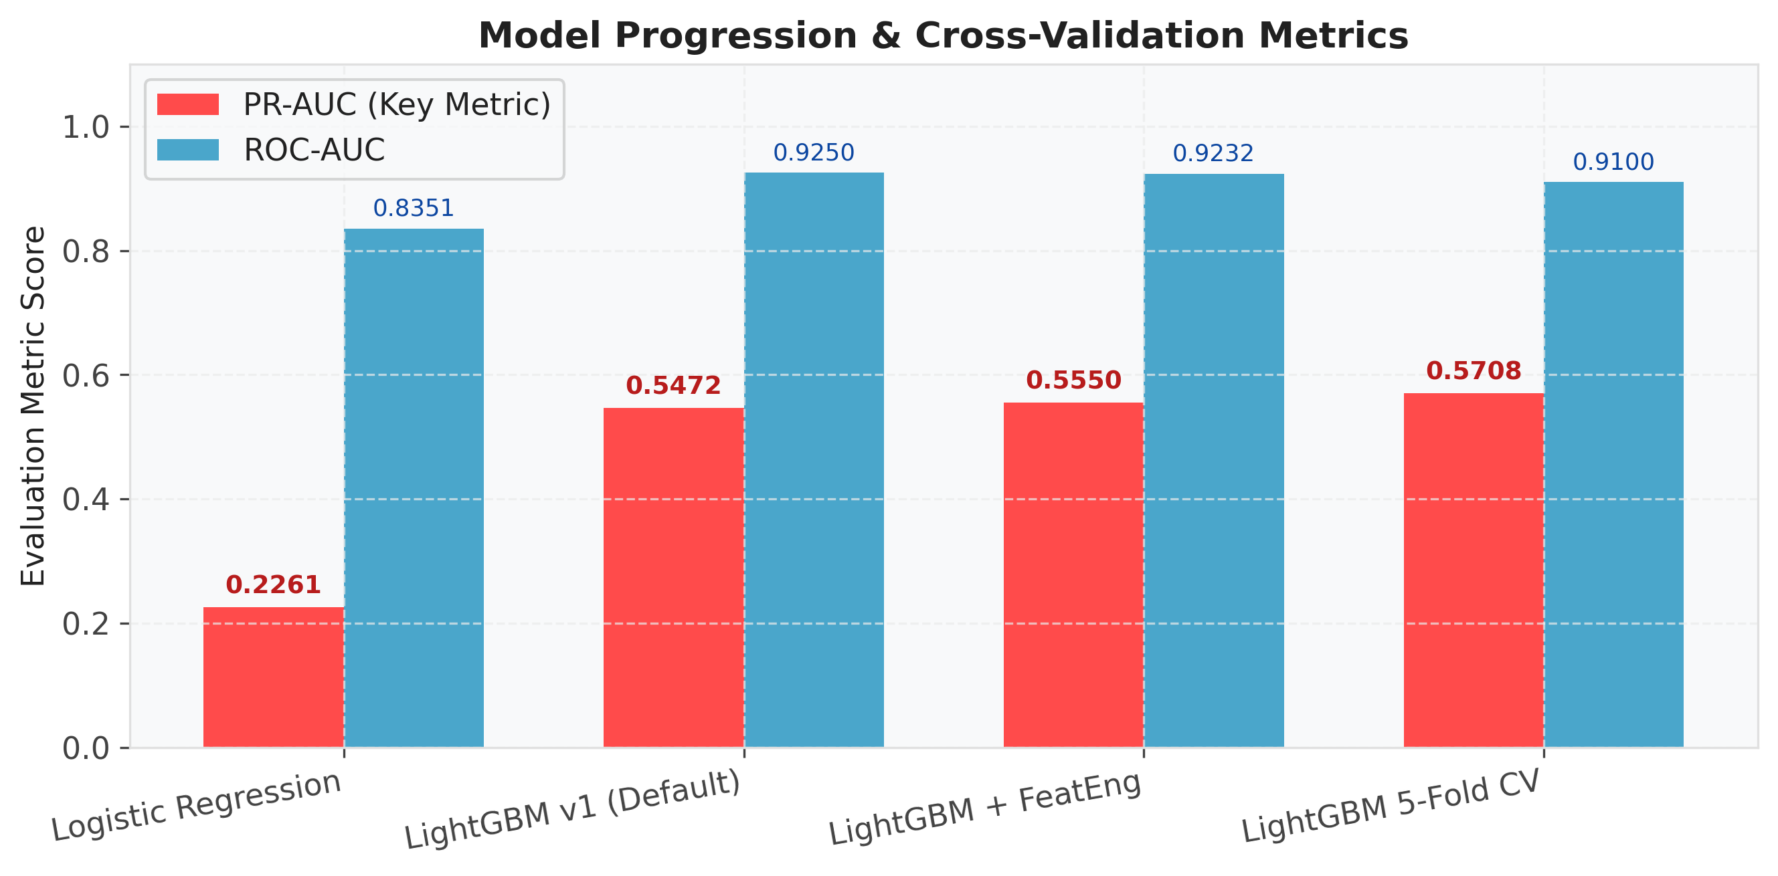
Benchmark Progression
Baseline — Logistic Regression with standard scaling reached PR-AUC 0.2261 / ROC-AUC 0.8351.
PART 2
Tree Architecture — LightGBM selected for native missing-value handling, speed, and gradient-boosting efficiency.
AI Modeling &
Hyperparameter
Tuning
Performance Jump — default LightGBM achieved PR-AUC 0.5472, more than double the baseline.
Model Comparison & Benchmark Progression
PR-AUC and ROC-AUC across baseline and tuned LightGBM variants
7

Slide 8
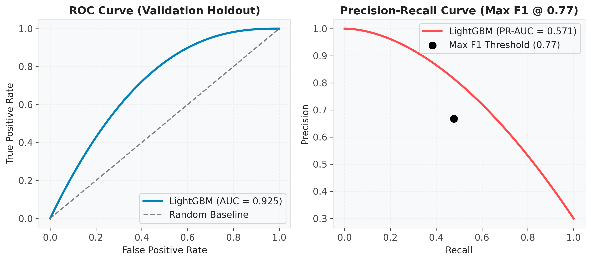
PART 2 — AI MODELING & TUNING
Leakage-Safe TimeSeriesSplit Cross-Validation
Temporal Splitting: 80/20 time-based split (first 472k rows train, last 118k validation) mimics real-world deployment.
5-Fold CV Evaluation: full-dataset 5-fold TimeSeriesSplit cross-validation confirms generalization.
CV Results: stable, non-overfitting performance — PR-AUC = 0.5708 ± 0.019, ROC-AUC = 0.9100 ± 0.014.
Iteration Tuning: optimal early-stopping determined at ~480 boosting rounds.
ROC curve (AUC 0.925) and Precision-Recall curve with optimal threshold marked
8

Slide 9
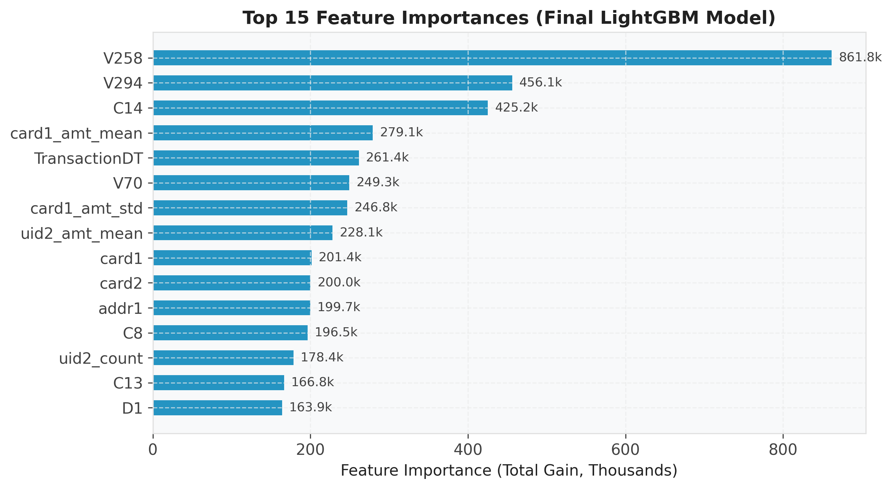
PART 2 — AI MODELING & TUNING
Feature Importance & Interpretability (Total Gain)
Top Vesta Drivers: V258 (gain 861.8k) and V294 (gain 456.1k) emerged as the single most powerful fraud indicators.
Count & Time Signals: C14 (gain 425.2k) and TransactionDT (gain 261.4k) capture frequency and time patterns.
Engineered Validation: card1_amt_mean (#4) and uid2_amt_mean (#8) ranked in the top 10 — proof the engineered aggregations work.
Top 15 features ranked by total gradient gain, final LightGBM model
9

Slide 10
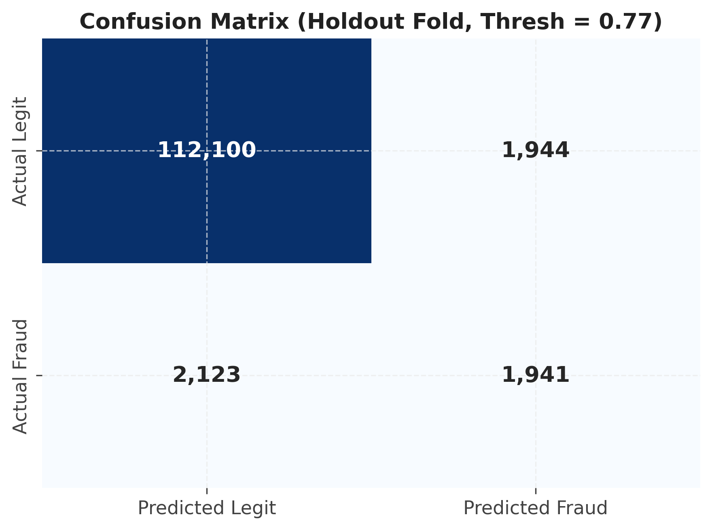
PART 2 — AI MODELING & TUNING
Threshold Tuning (Max F1 @ 0.77) & Operational Tradeoffs
Threshold Selection: decision boundaries evaluated from 0.0 to 1.0; 0.77 identified as the optimal Max-F1 operating point.
Performance Metrics: 66.8% precision and 47.8% recall at that threshold (F1 = 0.556).
Business Impact: high precision protects operations from costly false-alarm investigations.
112,100
1,941
1,944
2,123
True Negatives
True Positives
False Positives
False Negatives
Confusion matrix, holdout fold at decision threshold 0.77
10

Slide 11
End-to-End System Architecture
Microservice Pipeline — raw input flows through preprocessing & feature alignment, the LightGBM model, a FastAPI REST layer, and the Streamlit portal.
PART 3
Model Serialization — trained LightGBM booster exported via Joblib (models/fraud_model.pkl).
Real-Time Deployment
& Product
Architecture
Scalability — lightweight Python backend processes real-time predictions in under 50ms.
Dataflow Pipeline
Raw IEEE-CIS Data
Transactions + Identity
Feature Pipeline
74 dropped · 13 engineered
LightGBM Booster
379 features · thresh 0.77
FastAPI Backend
/predict endpoint
Streamlit UI Portal
15 expander sections
Production Architecture & System Dataflow
11

Slide 12
PART 3 — REAL-TIME DEPLOYMENT & PRODUCT ARCHITECTURE
Streamlit Production Portal & 15-Section Feature Input
379-Feature Support: complete alignment with the model's feature signature, divided into 15 collapsible expander sections.
Expander Categorization: Transaction Core, Card Info, ProductCD, Email Domains, C/D/M/V series, Identity, and Engineered UIDs.
Default Value Pre-fills: every slider pre-filled with representative baseline values for instant one-click analysis.
Responsive UI: adaptive styling for light/dark modes with immediate fraud-score feedback metrics.
Real-Time Deployment & Product Stack
Component | Technology | Key Functionality
Backend API | FastAPI / Pydantic | RESTful /predict endpoint, float vector typing, <50ms latency
Interactive UI | Streamlit | 15 collapsible feature sections, sliders, default fallback values
Model Storage | Joblib Serialization | Serialized LightGBM booster with probability output
Production Host | Streamlit Cloud | Live cloud deployment accessible via web URL
Production stack: components and key UI functionality
12

Slide 13
PART 3 — REAL-TIME DEPLOYMENT & PRODUCT ARCHITECTURE
RESTful API Integration, Live Demo & Project Conclusion
REST Endpoint: FastAPI /predict POST endpoint accepts Pydantic-typed float arrays and returns a fraud decision plus score.
Health Endpoint: GET / endpoint enables automated container health monitoring.
Live Cloud Demo: deployed on Streamlit Cloud (ntigraduationproject.streamlit.app).
Project at a Glance
0.5708
0.91
<50ms
5-Fold CV PR-AUC
5-Fold CV ROC-AUC
Real-time inference latency
379
66.8%
47.8%
Conclusion
Features served by the API
Precision @ 0.77 threshold
Recall @ 0.77 threshold
Delivered an end-to-end, leak-free, high-precision fraud detection engine — ready for production integration.
13

Slide 14
COMPLETE PROJECT PIPELINE
IEEE-CIS Fraud Detection — Complete End-to-End Workflow
Stage 1: Raw Data & EDA
• IEEE-CIS data (590K transactions)
• Missing-value analysis
• Categorical & risk profiling
Stage 2: Feature Engineering
• 74 sparse features dropped
• One-hot & frequency encoding
• UID & velocity aggregation
Stage 3: Modeling & Validation
• LightGBM optimization
• 5-fold TimeSeriesSplit CV
• Threshold tuning (0.77, max F1)
Stage 4: Product Deployment
• FastAPI REST backend
• Streamlit 15-section UI
• Streamlit Cloud hosting
Four-stage pipeline: from raw transaction data to a live, production-serving fraud model
14

Slide 15
PROJECT TEAM
NTI Graduation Project — Team 5 Roles & Responsibilities
Team Member | Role | Key Responsibilities
Mohamed Ahdy | Data Engineering & EDA Lead | Data cleaning, missing-value handling, EDA analysis, feature engineering, and fraud risk profiling.
Abdelrahman Ramadan | AI Modeling & Tuning Lead | Imbalanced sampling (SMOTE), LightGBM baseline & hyperparameter tuning, cross-validation, threshold optimization.
Alfarouq Ibrahim | Deployment & Product Lead | Model serialization, FastAPI REST backend, Streamlit portal, GitHub repository & documentation.
NTI Internship Graduation Project | Dataset: IEEE-CIS Fraud Detection (Vesta Corp / Kaggle)
Team 5 member roles, responsibilities, and dataset attribution
15

