Slide 1
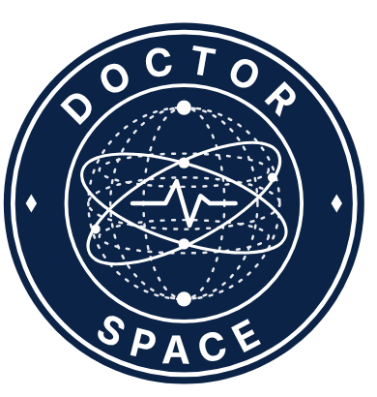
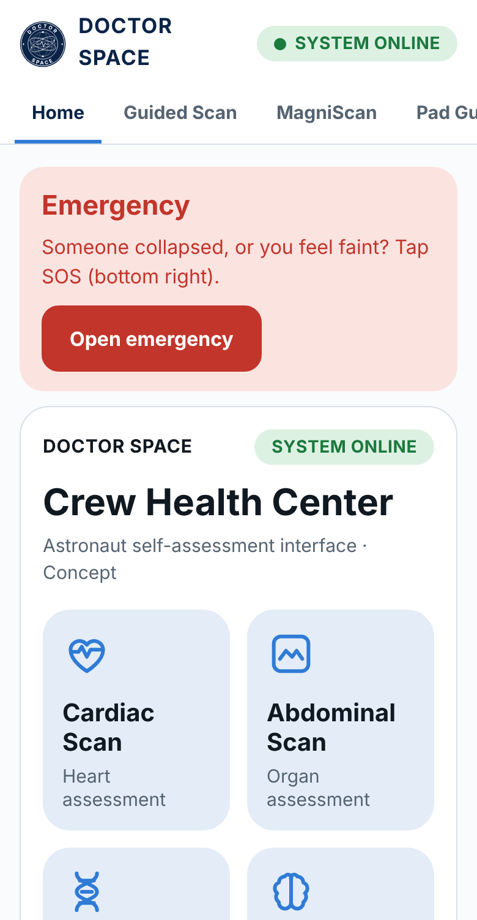
DOCTOR SPACE
Crew Health Center
A magnetic-pad ultrasound guide that lets a crew member who is not a doctor check the heart and belly, read the result, and know the next step.
Team: DOCTOR SPACE
Member: Alfathitamara Oktalia Sasti
Challenge: DOCTOR SPACE
NASA Space Apps Challenge 2026

Slide 2
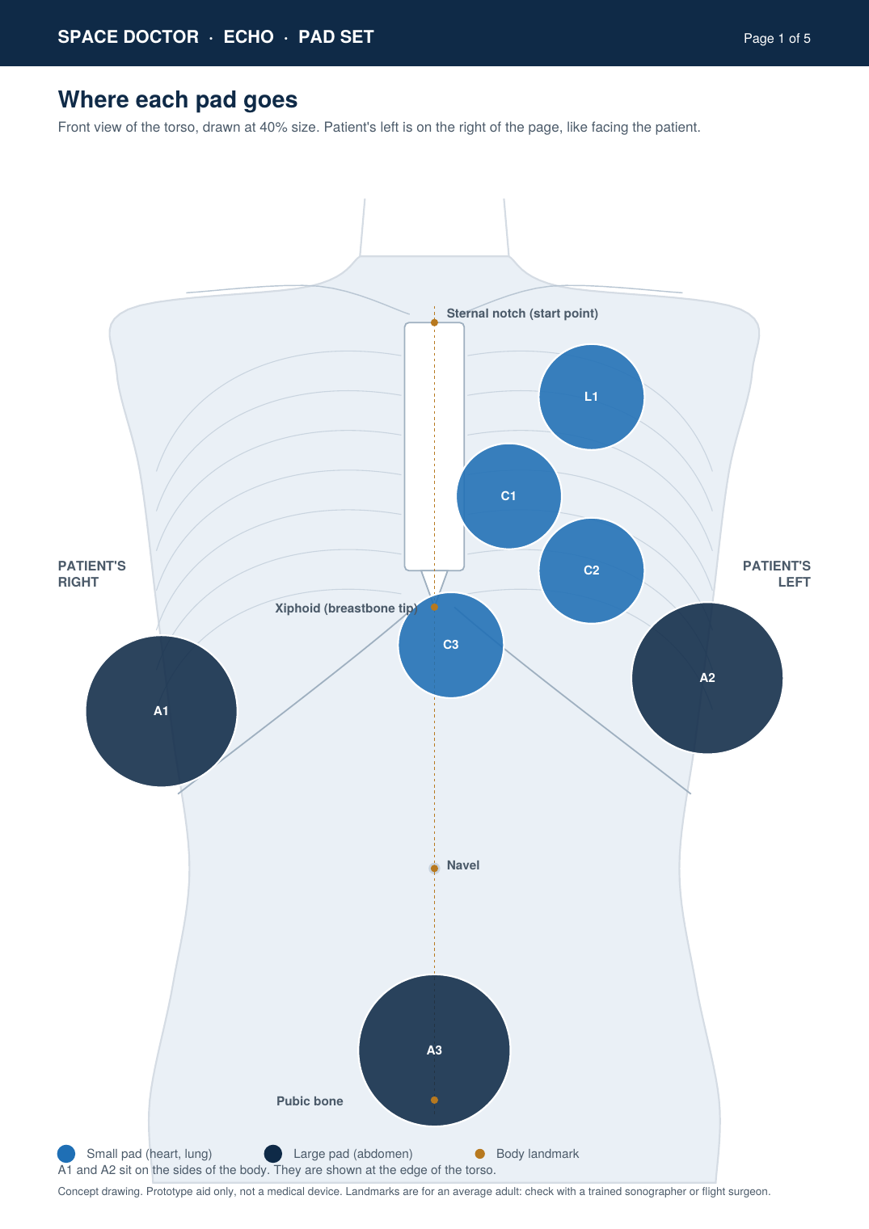
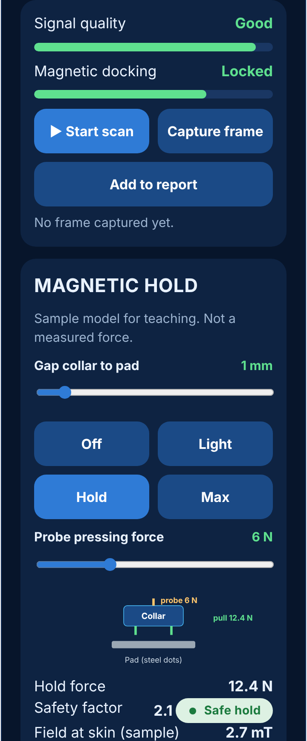
Wearable magnetic ultrasound
DOCTOR SPACE
2 / 7
Magnets hold the probe in the right place. The crew member does not have to find it by feel.
■ The gap. On a long mission a doctor may be days from Earth, and a doctor may not be on board at all.
■ Sticker pads. A printed sheet of anatomical pads goes on the skin. Each pad has a window for the probe and a few steel dots.
■ Magnetic collar. Small magnets in a collar on the probe dock to the steel dots. They hold position and angle, not pressure.
■ Same spot every time. Pads stay on, so today’s image can be compared with the last one.
■ Low cost to try. Printed sheet, steel dots, small magnets. A first prototype fits on a table.
MagniScan hold model: gap, force and field at skin, with a safety factor shown.
Concept prototype. Simulated data and illustrations. Not a validated medical device.

Slide 3
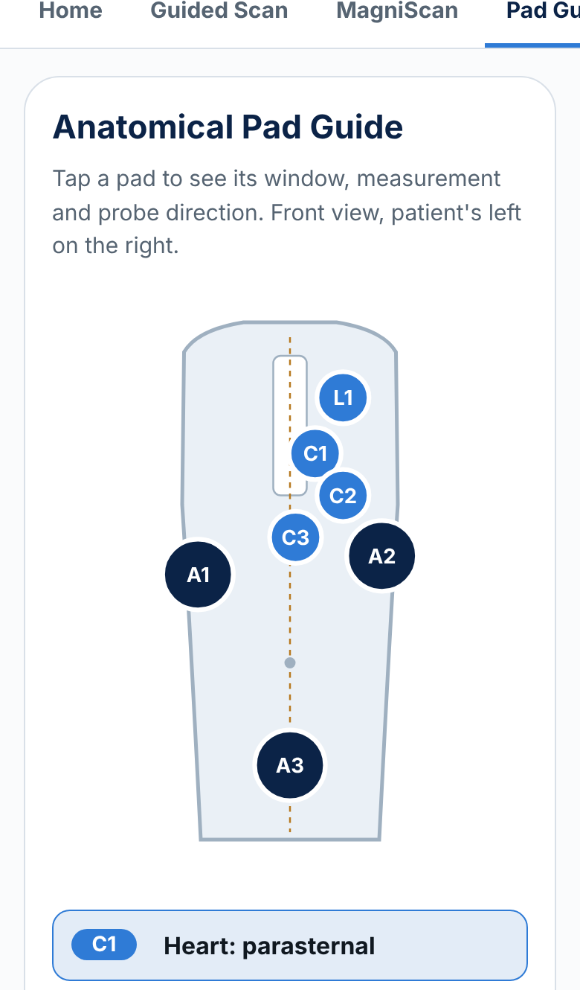
Where the probe goes
DOCTOR SPACE
3 / 7
Seven pads cover the heart, lung and belly. Each one has a landmark that anyone can find.
C1 / C2 / C3
Heart: beside the breastbone, under the left nipple line, and just under the breastbone.
L1
Lung: between the ribs, just below the collarbone. Sliding is normal.
A1 / A2
Belly: right and left flank, for liver, kidney and spleen.
A3
Pelvis: just above the pubic bone, for the bladder.
How a crew member places a pad
1 Measure from the notch at the base of the throat. 2 Mark the spot. 3 Stick the pad and turn the arrow toward the head. 4 Dock the probe collar. 5 The app shows the pad on screen and asks what you see.
Sample positions for an average adult. A trained sonographer should confirm each window before real use.

Slide 4
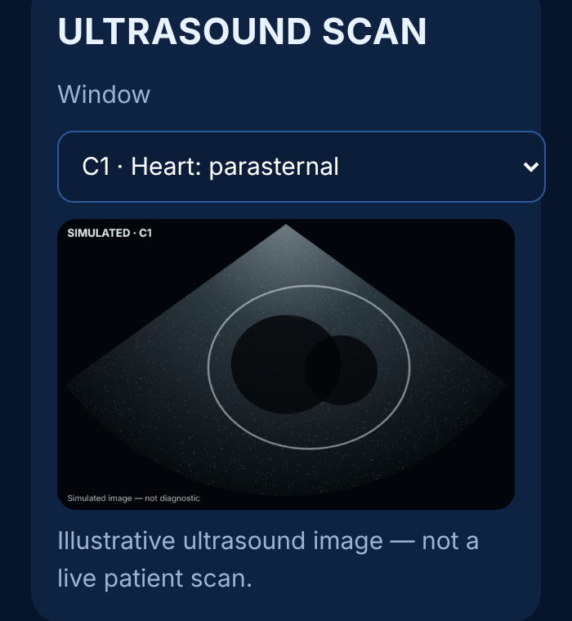
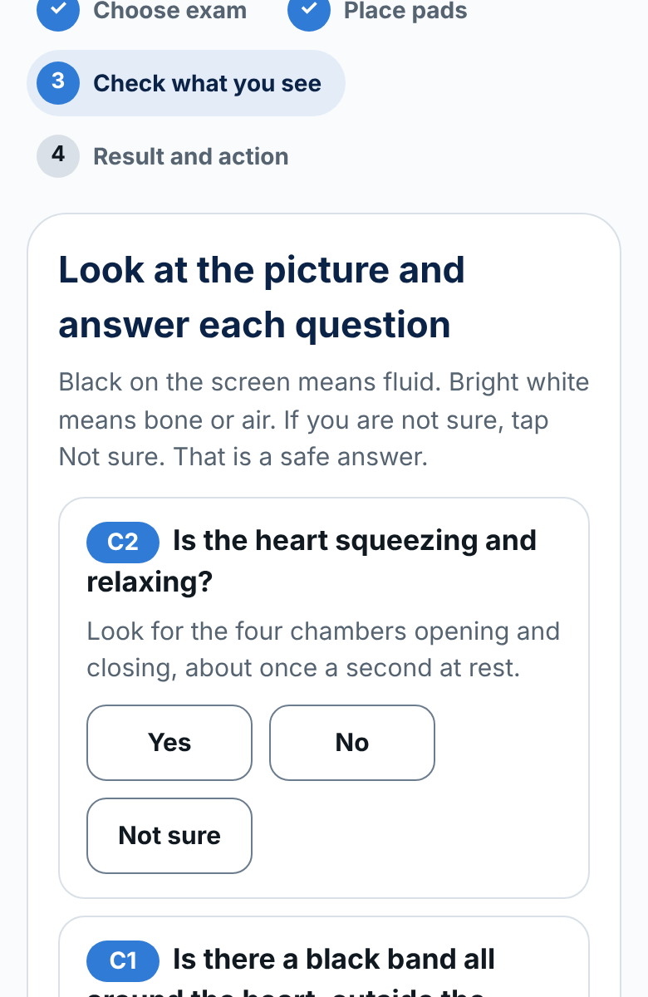
Ultrasound simulation
DOCTOR SPACE
4 / 7
Crew can practise on the ground and in flight. The picture and the questions are the same.
■ Pick a window. Heart, lung or belly pad.
■ Look at the picture. Black is fluid. Bright is bone or air.
■ Answer in plain words. Yes, No or Not sure. Not sure is treated as a concern.
■ Flip a frame. Capture and add it to the report.
Every image is labelled simulated. The questions follow the same four-view order a trained operator would use: heart motion, fluid around the heart, vein size, lung sliding.
Concept prototype. Simulated data and illustrations. Not a validated medical device.

Slide 5
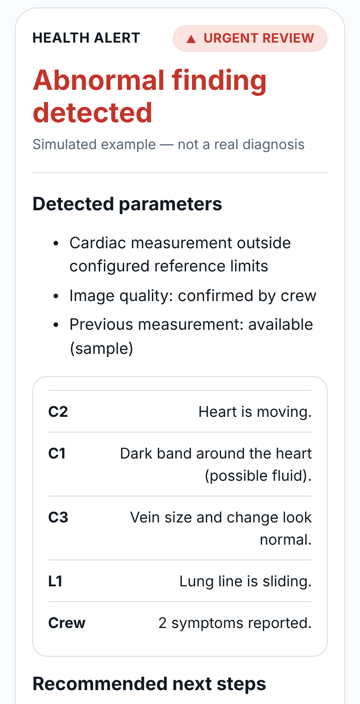
HEALTH ALERT
DOCTOR SPACE
5 / 7
The app turns the answers into one clear result: normal, review, or urgent.
NORMAL
All four views look normal and no symptoms.
REVIEW
One concern, one “not sure”, or a symptom. Send to the flight surgeon.
URGENT
No heart movement, two or more findings, or a finding plus a symptom.
What the crew member sees
■ The result, with each pad and what was seen at it
■ Recommended next steps in order
■ A button to send the report and alert to the flight surgeon
■ The locked medical kit, only if the result is urgent
The app never chooses a drug or a dose. The ground team gives the order.
Concept prototype. Simulated data and illustrations. Not a validated medical device.

Slide 6
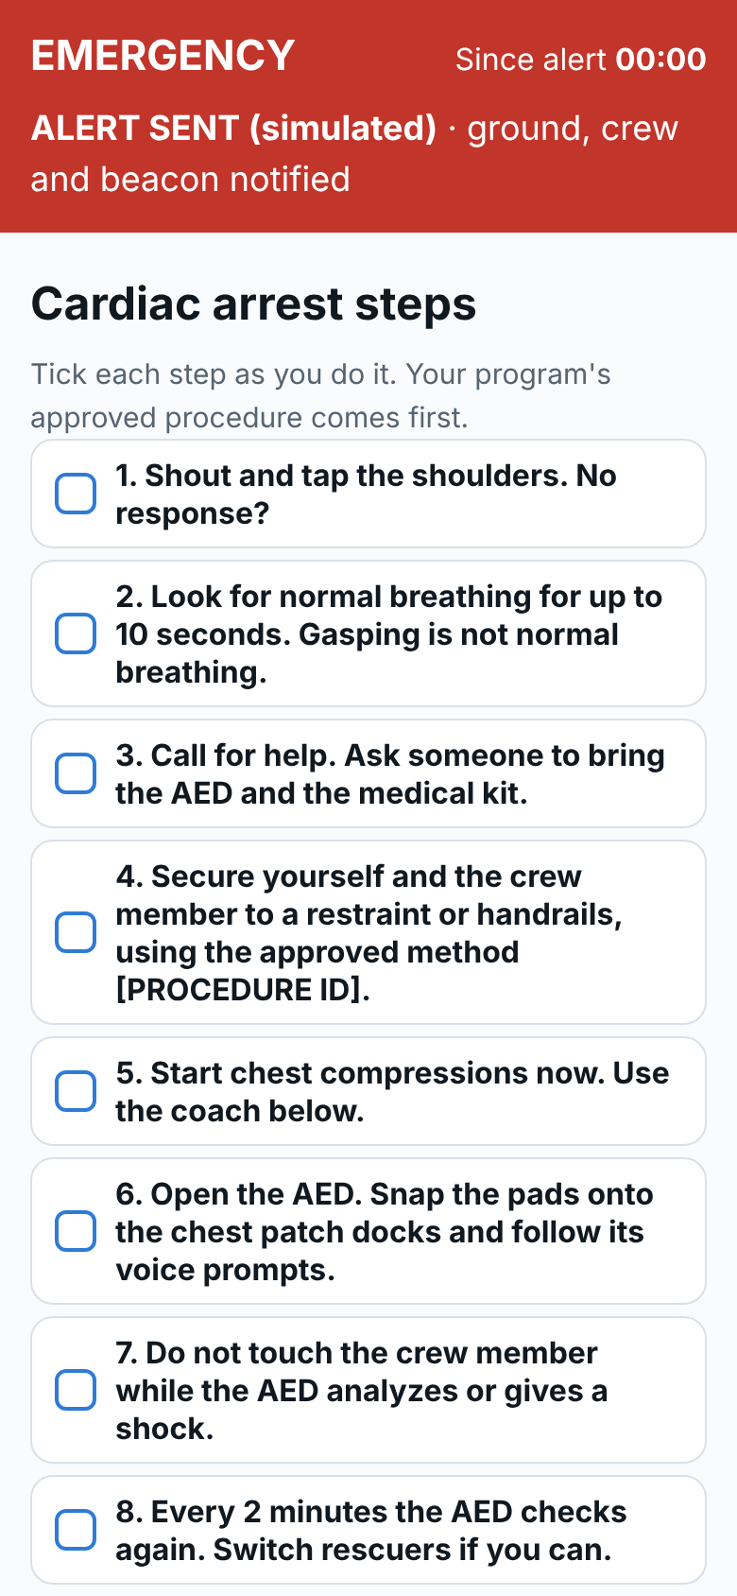
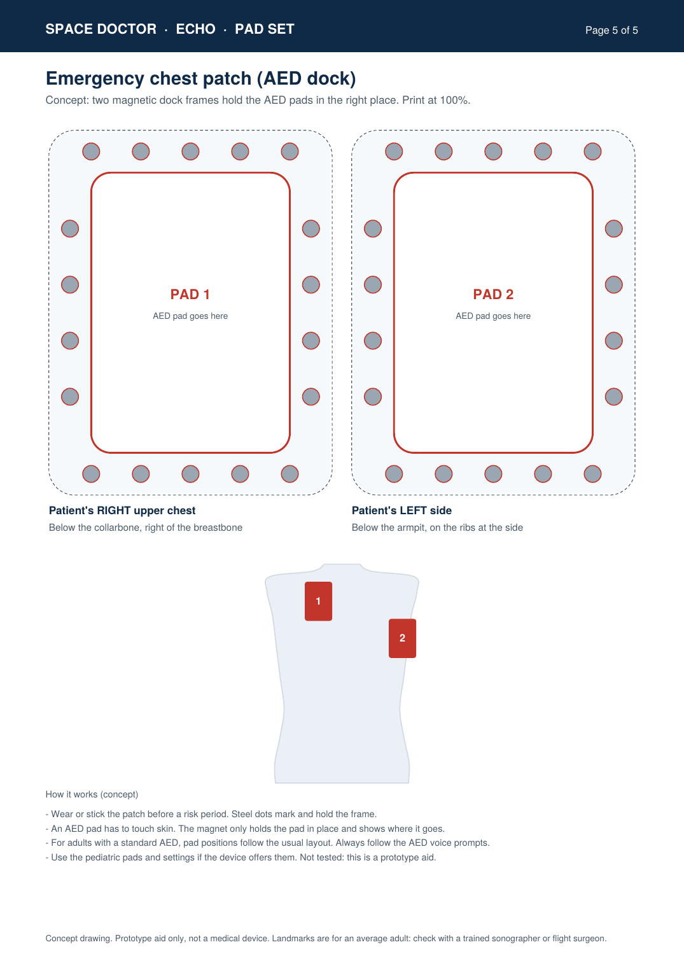
Guidance for the astronaut
DOCTOR SPACE
6 / 7
One button for a collapse. Plain steps for someone who has never done it.
■ SOS button. Always on screen. 10 seconds to cancel, then ground and crew are alerted.
■ CPR coach. Checklist, then a compression coach: about 100 to 120 per minute, 5 to 6 cm deep, with microgravity methods.
■ AED chest patch. Two magnetic frames hold the AED pads at the right chest positions. Snap the pads in and follow the voice.
■ Locked kit. Opens only after a second person authorises it and a five-item check is ticked.
■ Wellness vitals. Compares heart rate, temperature and blood pressure with the astronaut’s own baseline, not an Earth average.
Concept prototype. Simulated data and illustrations. Not a validated medical device.

Slide 7
Thank you
Doctor Space gives a crew member without medical training a way to look, understand, and act.
Impact
■ Space: a health backup for crews far from Earth
■ Earth: remote clinics and first responders can use the same pad guide
■ Free, offline, runs in any browser
■ Next: test with a sonographer, then with real crew data
How NASA resources made it possible
■ NASA Human Research Program: five hazards of spaceflight shaped the scope (distance, isolation, closed environment)
■ NASA / ISS studies on ultrasound, body temperature and heart rate set the baseline idea
■ [NASA DATASET USED] feeds the CSV import
Live app: https://alfathitamara.github.io/doctor-space/
Built with help from AI tools (code, text, graphics). Illustrations and sample data are simulated. Not a validated medical device.

