Slide 1
Single Page JS Applications
Applicazioni Internet
Ingegneria Informatica
Antonio Servetti servetti@polito.it
Internet Media Group http://media.polito.it
Dip. di Automatica ed Informatica
Politecnico di Torino http://www.polito.it

Slide 2
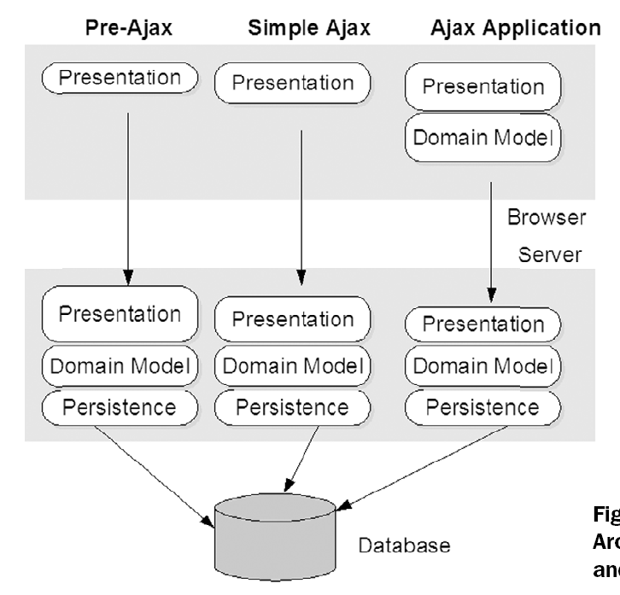
Redefining web app. architecture
Three tier architecture
Presentation-tier (View)
Business-tier (Controller)
Data-tier (Model)
Pre Ajax
Action is taking place on the server
Browser is a dumb terminal
Reference:

Slide 3
Redefining web app. architecture
Three tier architecture
Presentation-tier (View)
Business-tier (Controller)
Data-tier (Model)
Simple Ajax
Server controls all aspects of the workflow
Browser rearranges DOM, presentation tier starts to get thicker (and smaller on the server)
Reference:

Slide 4
Full AJAX
Client-side
Browser JS gets complex
It handles part of the business model (flow control)
It tends to communicate to its b.m. rather than directly to the server
Server-side
Its business model provides a coarser-grained facade to handle main use cases
Manages data persistence
Reference:

Slide 5
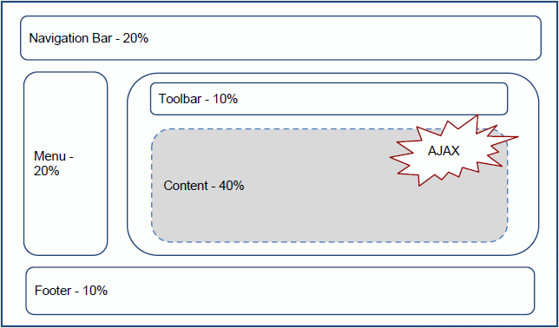
Single-page applications
In an SPA the appropriate resources are dynamically loaded and added to the page as necessary
The page does not reload at any point in the process, nor does transfer control to another page
Reference:

Slide 6
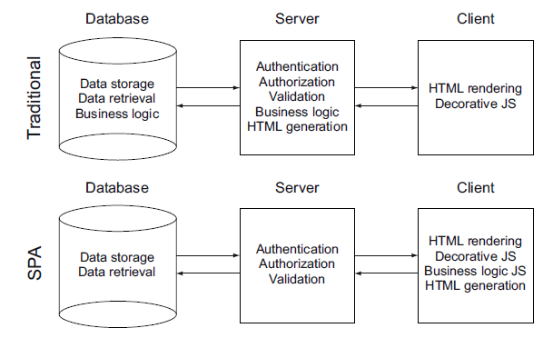
Single-page applications
In an SPA the appropriate resources are dynamically loaded and added to the page as necessary
The page does not reload at any point in the process, nor does transfer control to another page
Reference:

Slide 7
Single-page applications
SPAs instead of changing the page, change a view inside the same page.
When a user navigates to a new view, additional content is requested using an XHR to a server-side REST API
The typical SPA consists of smaller pieces of interface representing logical entities all of which have their own UI, business logic and data.
E.g. shopping basket
Reference: Single page apps in depth, http://singlepageappbook.com

Slide 8
New problems and solutions
Problems
Mimic static addresses (http://mysite.com/...) and manage browser history
Handle Ajax callbacks
Mix HTML strings and Javascript
Solutions
Routing (http://mysite.com/#/...)
Model – View – Controller paradigm (on the client-side)
Templating (Javascript-HTML)
Reference:

Slide 9
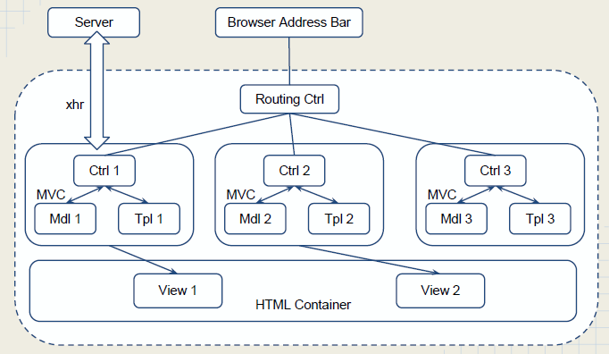
SPA architecture
Reference: /

Slide 10
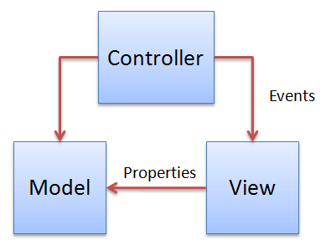
MVC paradigm
MVC provides clean separation of concerns
Data (Model)
Talks to the server using RESTful architecture
Presentation (View)
Specific elements of the User Interface
Is generated from a Template
One model might have multiple views
User input (Controller)
Glue between model and view
Handles user interactions
Might perform business logic role
Note: the role of controller greatly varies in frameworks
Reference:

Slide 11
JS MVC frameworks
Major players (mainly MV*)
AngularJS
Backbone
Ember
Dojo
JavascriptMVC
Knockout
Note: MVC comes from server side architecture, when ported to client side with user interaction the controller element needs to be adapted.
Reference:

Slide 12
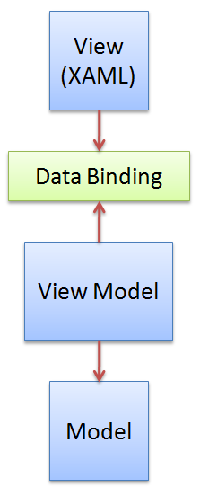
JS MVVM
Model View View-Model
Separate design (presentation) work and development work: reusable components , multiple views for the same model/controller
Here the view is active, contains:
events, behaviours, data bindings
ViewModel as a "simple" controller
Liaison between model and view (es. format the date in the model to be shown in the view)
Helps maintaining the state of the view
Manipulate the model as the results of actions on the view
Trigger events in the view itself
Reference: http://www.codeproject.com/Articles/100175/Model-View-ViewModel-MVVM-Explained

Slide 13
AngularJS
Overview
The library reads in HTML that contains additional custom tag attributes;
It then obeys the directives in those custom attributes, and
Binds input or output parts of the page to a model represented by standard JavaScript variables.
The values of those JavaScript variables can be manually set, or retrieved from static or dynamic JSON resources.
The framework adapts and extends traditional HTML to better serve dynamic content through two-way data-binding that allows for the automatic synchronization of models and views.
Version 1.0 released December 2012
Reference: http://en.wikipedia.org/wiki/AngularJS

Slide 14
AngularJS - Motivation
Developed by Google + great community
REST easy
MVVM to the rescue: model talks to view-model objects which listen for changes in the model
Data binding and dependency injection: all happens auto-magically
You can ask for your dependencies as parameters in AngularJS service functions
Extends HTML: you can operate your HTML like XML with the use of directives to trigger behaviors
Makes HTML your Template.
Enterprise-level Testing
Why Angular Video: http://www.youtube.com/watch?v=GzOnGv_8KSo
Reference: http://net.tutsplus.com/tutorials/javascript-ajax/3-reasons-to-choose-angularjs-for-your-next-project/

Slide 15

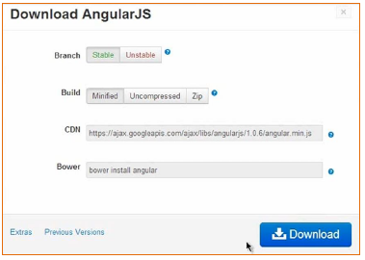
AngularJS - Download
http://angularjs.org/
<script src="angularjs.js"> </script>
Reference:

Slide 16
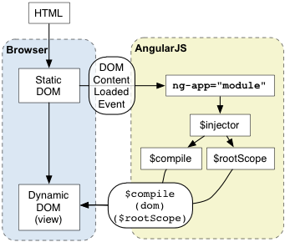
Bootstrap
Angular initializes automatically
It looks for the ng-app directive which designates your application root.
Then:
loads the module associated with the directive
creates the application injector
compiles the DOM
Reference: http://docs.angularjs.org/guide/bootstrap

Slide 17
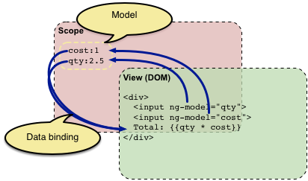
Example
The HTML file is called a "template".
Angular parses and processes this new markup from the template using the so called "compiler".
The loaded, transformed and rendered DOM is then called the "view".
Reference: http://docs.angularjs.org/guide/concepts

Slide 18
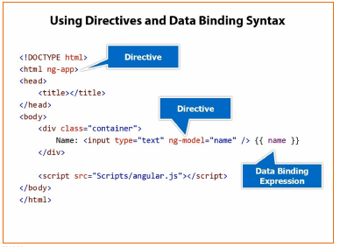
Directive, filters, data binding
Directive:
Directives are markers on a DOM element that tell AngularJS's HTML compiler to attach a specified behavior to that DOM element
<html ng-app>
Data binding:
Data-binding is the automatic synchronization of data between the model and view components.
{{ name }}
Filters:
A filter formats the value of an expression for display to the user. {{ name | uppercase }}
Reference:

Slide 19
Directives
ng-app
It initialized the AngularJS App (more later)
ng-model
Adds a property up in the memory called “name” into what’s called “the scope”.
<!DOCTYPE html>
<html data-ng-app="">
<head> <title>Angular-js data binding</title> </head>
<body> Name: <br />
<input type="text" data-ng-model="name" /> {{ name }}
<script type="text/javascript" src="angular.min.js"></script>
</body> </html>
Reference:

Slide 20
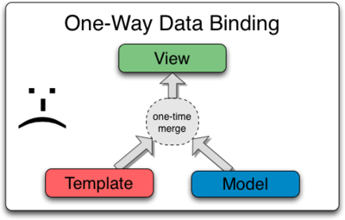
The model
Most templating systems bind data in only one direction: they merge template and model components together into a view
Reference: http://docs.angularjs.org/guide/databinding

Slide 21
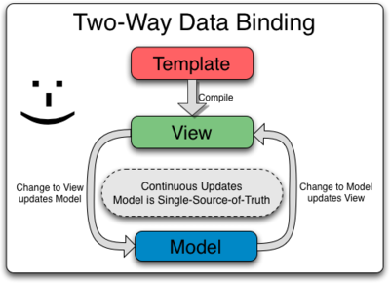
Two-way data binding
AngularJS enables "live view" because any changes to the view are immediately reflected in the model, and any changes in the model are propagated to the view
Reference: http://docs.angularjs.org/guide/databinding

Slide 22
More on directives
ng-init
Sets initialization data that I want to bind to and display
ng-repeat
instantiates a template once per item from a collection
ng-src
Delays img src intepretation to get handled by angular
<div class="container"
data-ng-init="names=['Barbara', 'Antonio', 'Cristina']">
<h3>Loop through names with ng-repeat</h3>
<ul>
<li data-ng-repeat="name in names">{{name}}</li>
</ul>
{{names | json}}
</div>
Reference: http://docs.angularjs.org/api/

Slide 23
Using filters
Keep formatting into presentation (not logic)
Examples: uppercase, orderBy, currency (see API)
Syntax
{{ expression | filter }}
{{ expression | filter1 | filter2 }}
{{ expression | filter1:argument1 }}
<ul>
<li data-ng-repeat="name in names | orderBy:'toString()'">
{{name | uppercase}}
</li>
</ul>
Reference: http://docs.angularjs.org/api/

Slide 24
More on filters
The filter filter
Selects a subset of items from array and returns it as a new array
{{ filter_expression | filter:expression:comparator }}
<div class="container" data-ng-init="persons = [ {name: 'Barbara', city: 'Cuneo'}, {name: 'Antonio', city: 'Torino'}, {name: 'Cristina', city: 'Milano'} ]">
<h3>Loop through names with ng-repeat</h3>
Filter by: <input type="text" data-ng-model="searchText"/>
<ul>
<li data-ng-repeat="person in persons | filter:searchText | orderBy:'name'"> {{person.name}} - {{person.city | uppercase}}
</li>
</ul>
{{names | json}}
</div> // app5.html
Reference: http://docs.angularjs.org/api/

Slide 25
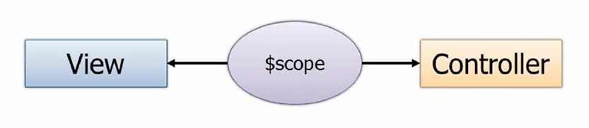
View, controllers and scope
The Controller drives things.
It’s going to control ultimately what data gets bound into the view, i.e. prepares data for the view.
If the View passes up data to the controller it will handle passing off maybe to a service which then updates a back-end data store.
The view doesn’t have to know about the controller, and the controller definitely doesn’t want to know about the view.
$scope is the glue (ViewModel) between a controller and a view
You’ll see that the view can know about the controller because there’s a directive for that if you’d like to use it but the controller itself, to make it testable and a few things – loosely coupled and modular and all that good stuff – shouldn’t know anything about the view. In fact you should be able to define a controller that you can bind to different views. Maybe you have a mobile view, you have a desktop view or whatever it may be.
Reference:

Slide 26
Create a controller
The scope is automatically bound into the view once the view knows about its controller
<!-- was data-ng-model="customer ..." -->
<div class="container" data-ng-controller="SimpleController">
<script>
// dependency injection
function SimpleController($scope) {
$scope.persons = [
{name: 'Barbara', city: 'Cuneo'},
{name: 'Antonio', city: 'Torino'},
{name: 'Cristina', city: 'Milano'}
];
}
</script> // app5.html
Reference:

Slide 27
The controller
A controller is a JavaScript function
It contains data
It specifies the behavior
It should contain only the business logic needed for a single view.
Reference:

Slide 28
The scope
It's an object that refers to the application model
It's an execution context for expressions like {{ todo.name }}
Scopes are arranged in hierarchical structure which mimic the DOM structure of the application
Scopes can watch expressions and propagate events
$rootScope
Every application has a single root scope. All other scopes are descendant scopes of the root scope.
Reference:

Slide 29
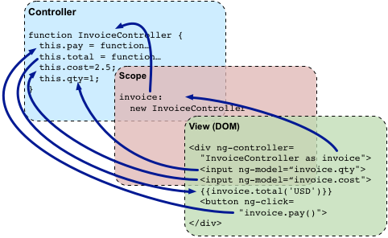
The controller-scope-view
Reference:

Slide 30
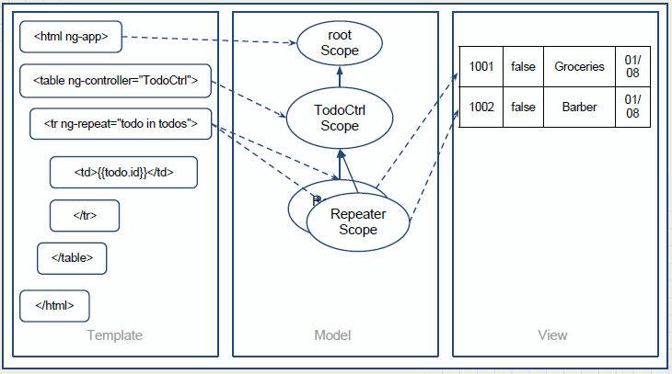
The controller-scope-view
Reference:

Slide 31
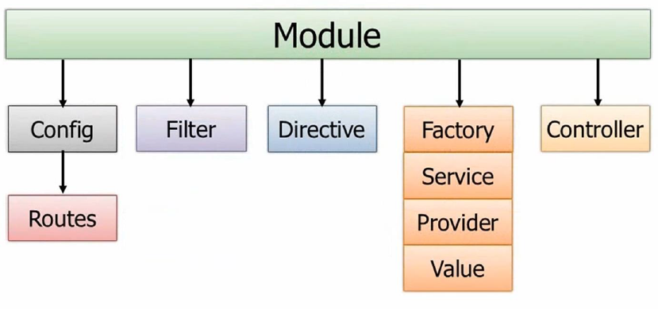
Modules
Module are containers
It is a place where you can collect and organize components in a modular way
A service module, a directive module, a filter module, …
And an application level module which depends on the above modules, and which has initialization code.
Reference:

Slide 32
Create a module
The scope is automatically bound into the view once the view knows about its controller
<html data-ng-app="myApp">
<div class="container" data-ng-controller="SimpleController">
<script>
var myApp = angular.module('myApp', []);
myApp.controller('SimpleController', function ($scope) {
$scope.persons = [
{name: 'Barbara', city: 'Cuneo'},
{name: 'Antonio', city: 'Torino'},
{name: 'Cristina', city: 'Milano'}
];
});
</script> // app6.html
Reference:

Slide 33
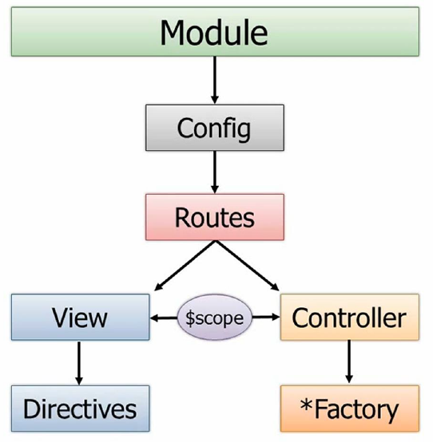
Modules, routes and factories
So a module can have something off of it called a config function and it can be defined to use different routes.
If you have different views and those views need to be loaded into the shell page then we need a way to be able to track what route we’re on and what view that’s associated with and then what controller goes with that view and how we do all of that marrying together of these different pieces
Reference:

Slide 34
Routing
When you define a route in AngularJS you can define two things on that route – two of the key things, I should say.
One of those is the view. So what view when that route such as “unit.org/orders” then maybe go to “orderspartial.html” or “ordersfragment.html” or whatever you want to call it.
Then that view needs a controller. Instead of hard-coding the controller into the view – which works and you can certainly do it: I showed that in the previous section – we can actually go in and do this on our own through the route. This is the way I would definitely recommend you do it.
A given controller would then of course have access to the scope object which then the view will bind to. I talked about that a little bit earlier.
And then controllers rather than having all the functionality to get the data and update the data and perform CRUD operations and things like that, in a more real life application they’ll call out to factories or… I put a star there because you might have services, providers or even values you want to get. There are a lot of different ways you can access data. Even resources.
On the views we of course then have directives and filters and those types of things.
Reference:

Slide 35
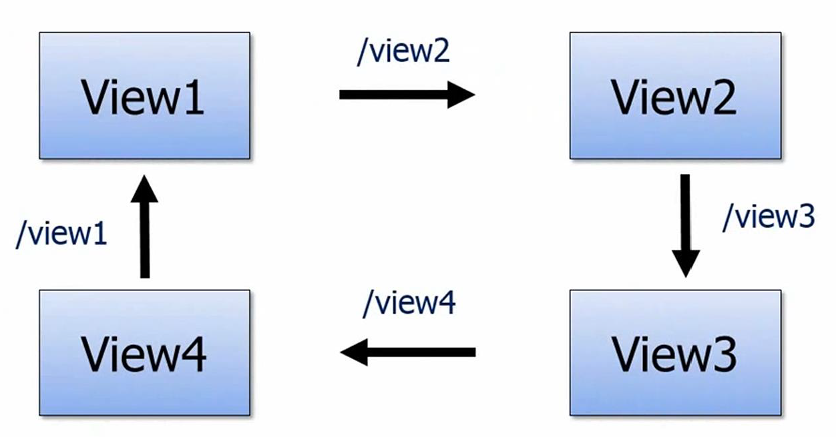
Routing
Load different views into the single-page-app
Reference:

Slide 36
Create routes
New dependency ngRoute in angular-route.js
<html data-ng-app="myApp">
<!-- ng-view handles loading partials into it based upon routes -->
<div data-ng-view=""></div>
<script type="text/javascript" src="angular.js"></script>
<script type="text/javascript" src="angular-route.js"></script>
<script>
var myApp = angular.module('myApp', ['ngRoute']);
myApp.config( ['$routeProvider',
function ($routeProvider) {
$routeProvider
.when('/',
{ controller: 'SimpleController', templateUrl: 'viewA7.html'})
.when('/viewB',
{ controller: 'SimpleController', templateUrl: 'viewB7.html'})
.otherwise( { redirectTo: '/' });
}]);
</script> // app7.html
Reference:

Slide 37
Create views
"partials" are loaded in the view
<div class="container">
<h3>View A</h3>
Filter by:
<input type="text" data-ng-model="searchText"/>
<ul>
<li data-ng-repeat="person in persons | filter:searchText | orderBy:'name'">
{{person.name}} - {{person.city | uppercase}}
</li>
</ul>
{{persons | json}}
</div>
<div class="container">
<h3>View B</h3>
<ul>
<li data-ng-repeat="person in persons | orderBy:'city'">
{{person.city | uppercase}} - {{person.name}}
</li>
</ul>
{{persons | json}}
</div>
Reference:

Slide 38
Pass parameters in route URLs
$routeParams
The $routeParams service allows you to retrieve the current set of route parameters.
/person/:personId (href = #/)
Then in the controller $routeParams.personId has the route value
// Given:
// URL: http://server.com/index.html#/Chapter/1/Section/2?search=moby
// Route: /Chapter/:chapterId/Section/:sectionId
//
// Then
$routeParams ==> {chapterId:1, sectionId:2, search:'moby'}
Reference:

Slide 39
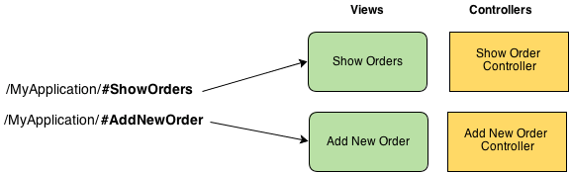
Each view its controller
$scope.message = …
{{ message }}
Reference:

Slide 40
Providers
Providers are objects that provide (create) instances of services and expose configuration APIs that can be used to control the creation and runtime behavior of a service.
In case of the $route service, the $routeProvider exposes APIs that allow you to define routes for your application.
Note: Providers can only be injected into config functions.
Reference:

Slide 41
Challenge
Modify the application such that
One view filters persons by name
The other view filters persons by city
Reference:

Slide 42
Modify the model
The controller has to provide a method to add, delete, modify a record
Name: <input type="text" data-ng-model="newPerson.name" /><br />
City: <input type="text" data-ng-model="newPerson.city" /><br />
<button ng-click="addPerson()">Add</button>
myApp.controller('SimpleController', function ($scope) {
// data
$scope.persons = [
// ...
];
// behaviour
$scope.addPerson = function () {
$scope.persons.push(
{ name: $scope.newPerson.name, city: $scope.newPerson.city});
};
}); // app8.html
Reference:

Slide 43
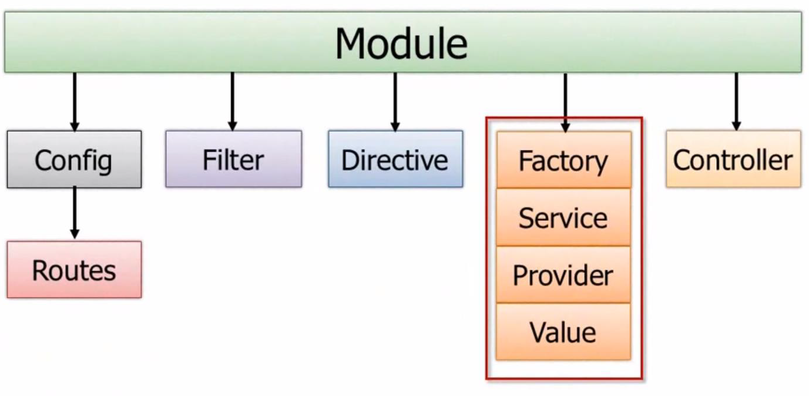
Provider, factory, service
Encapsulate data functionality into
Factory, Service, Provider, Value
instead than in multiple controllers that manage user interaction (not model behaviour)
e.g. person's get/set/check
Reference:

Slide 44
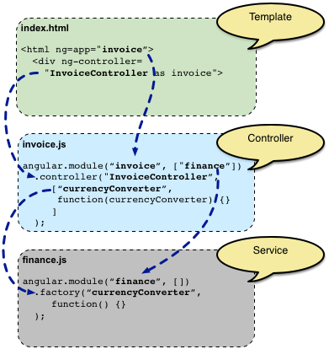
Provider, factory, service
Encapsulate data functionality into
Factory, Service, Provider, Value
instead than in multiple controllers that manage user interaction (not model behaviour)
e.g. person's get/set/check
Reference:

Slide 45
Provider, factory, service
Difference: the way in which they create the object that goes and gets the data.
Factory
you create an object inside of the factory and return it
Service
you have a function that uses this to define a function
Provider
you define $get that is used to get the data
Value
it is like a config value
Reference:

Slide 46
Create a factory
A factory for "persons"
myApp.factory( 'simpleFactory', function () {
var persons = [ /* ... */ ];
var factory = {};
factory.getPersons = function () { return persons; }
factory.postPerson = function (p) { persons.push(p); }
return factory; // return the factory !
});
// dependence injection, just put the name of the factory
myApp.controller('SimpleController', function ($scope, simpleFactory) {
$scope.persons = [];
init();
// private function
function init() { $scope.persons = simpleFactory.getPersons(); }; // ...
}); // app9.html
Reference:

Slide 47
HTTP service
The $http uses the XMLHttpRequest object or JSONP to communicate with a server.
The $http API is based on the deferred/promise APIs exposed by the $q service.
Details
takes a single argument: a configuration object
returns a promise with two methods: success and error
The .then method
register callbacks that will receive an object representing the response
Reference:

Slide 48
HTTP service
Shortcuts methods
.get, .post, .put, .head, .delete, .jsonp
$http({method: 'GET', url: '/someUrl'}).
success(function(data, status, headers, config) {
// this callback will be called asynchronously
// when the response is available
}).
error(function(data, status, headers, config) {
// called asynchronously if an error occurs
// or server returns response with an error status.
});
CALLBACKs
Reference:

Slide 49
Get a resource
Shortcuts methods
.get, .post, .put, .head, .delete, .jsonp
var myApp = angular.module('myApp', []);
myApp.controller('SimpleController', function ($scope, $http) {
$http.get('/persons.json').success(function(data) {
$scope.persons = data;
});
});
Reference:

Slide 50
Building a REST application
Server.js (Nodejs)
CRUD: Create, read, update and delete
Read collection: GET /persons
Read item: GET /persons/:id
Add item: POST /persons
Update item: POST /persons/:id (or PUT)
REST: Representational state transfer
Presented with a network of Web pages (a virtual state-machine), the user progresses through an application by selecting links (state transitions), resulting in the next page (representing the next state of the application) being transferred to the user and rendered for their use.
Reference:

Slide 51
Building a REST application
angular.module('customersApp')
.controller('customersController', ['$scope', 'dataFactory',
function ($scope, dataFactory) {
$scope.status;
$scope.customers;
$scope.orders;
getCustomers();
function getCustomers() {
dataFactory.getCustomers()
.success(function (custs) {
$scope.customers = custs;
})
.error(function (error) {
$scope.status = 'Unable to load customer data: ' + error.message;
});
}
$scope.updateCustomer = function (id) {
var cust;
for (var i = 0; i < $scope.customers.length; i++) {
var currCust = $scope.customers[i];
if (currCust.ID === id) {
cust = currCust;
break;
}
}
dataFactory.updateCustomer(cust)
.success(function () {
$scope.status = 'Updated Customer! Refreshing customer list.';
})
.error(function (error) {
$scope.status = 'Unable to update customer: ' + error.message;
});
};
$scope.insertCustomer = function () {
//Fake customer data
var cust = {
ID: 10,
FirstName: 'JoJo',
LastName: 'Pikidily'
};
dataFactory.insertCustomer(cust)
.success(function () {
$scope.status = 'Inserted Customer! Refreshing customer list.';
$scope.customers.push(cust);
}).
error(function(error) {
$scope.status = 'Unable to insert customer: ' + error.message;
});
};
$scope.deleteCustomer = function (id) {
dataFactory.deleteCustomer(id)
.success(function () {
$scope.status = 'Deleted Customer! Refreshing customer list.';
for (var i = 0; i < $scope.customers.length; i++) {
var cust = $scope.customers[i];
if (cust.ID === id) {
$scope.customers.splice(i, 1);
break;
}
}
$scope.orders = null;
})
.error(function (error) {
$scope.status = 'Unable to delete customer: ' + error.message;
});
};
$scope.getCustomerOrders = function (id) {
dataFactory.getOrders(id)
.success(function (orders) {
$scope.status = 'Retrieved orders!';
$scope.orders = orders;
})
.error(function (error) {
$scope.status = 'Error retrieving customers! ' + error.message;
});
};
}]);
angular.module('customersApp')
.factory('dataFactory', ['$http', function($http) {
var urlBase = '/api/customers';
var dataFactory = {};
dataFactory.getCustomers = function () {
return $http.get(urlBase);
};
dataFactory.getCustomer = function (id) {
return $http.get(urlBase + '/' + id);
};
dataFactory.insertCustomer = function (cust) {
return $http.post(urlBase, cust);
};
dataFactory.updateCustomer = function (cust) {
return $http.put(urlBase + '/' + cust.ID, cust)
};
dataFactory.deleteCustomer = function (id) {
return $http.delete(urlBase + '/' + id);
};
dataFactory.getOrders = function (id) {
return $http.get(urlBase + '/' + id + '/orders');
};
return dataFactory;
}]);
Reference: http://weblogs.asp.net/dwahlin/archive/2013/08/16/using-an-angularjs-factory-to-interact-with-a-restful-service.aspx

Slide 52
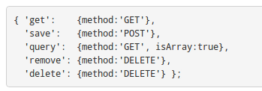
Resource object
AngularJS Resource
A factory which creates a resource object that lets you interact with RESTful server-side data sources.
It has methods with high-level behaviors, no need to interact with the low level $http service.
Requires the ngResource module to be installed.
Reference:

Slide 53
Resource object
No more callbacks
$scope.persons = simpleFactory.query();
What’s happening here is that AngularJS assigned a reference (an object or an array, depending on the expected return type), which will get populated at some point in the future when the server requests returns. In the meantime, the object will remain empty.
Since the most common flow with AngularJS apps is to fetch data from the server, assign it to a variable, and display it in the template, this shortcut is nice. In your controller code, all you have to do is make the server-side call, assign the return value to the right scope variable, and let the template worry about rendering it when it returns
Reference:

Slide 54
Create a resource
Dependency on ngResource
<script type="text/javascript" src="angular-resource.js"></script>
<script>
var myApp = angular.module( 'myApp', ['ngRoute', 'ngResource']);
</script>
myApp.factory( 'simpleFactory', function ($resource) {
return $resource('/persons');
});
myApp.controller('SimpleController', function ($scope, simpleFactory) {
$scope.persons = [];
(function init() {
// the factory it is now a resource
$scope.persons = simpleFactory.query();
})();
// ...
}); // app10.html
Reference:

Slide 55
Complete service
Retrieve the item
<button ng-click="curPerson($index);">{{$index}}</button>
{{person.name}} - {{person.city | uppercase}}
myApp.factory( 'simpleFactory', function ($resource) {
return $resource('/persons/:personId');
});
myApp.controller('SimpleController', function ($scope, simpleFactory) {
// ...
$scope.curPerson = function(id) {
$scope.selPerson = simpleFactory.get({personId: id});
};
// ...
}); // app11.html
Reference:

Slide 56
Complete service
Modify the model on the server using POST
Id: {{selPersonId}}<br/>
<button ng-click="updatePerson(selPersonId);">Save</button><br/>
myApp.factory( 'simpleFactory', function ($resource) {
return $resource('/persons/:personId');
});
myApp.controller('SimpleController', function ($scope, simpleFactory) {
// ...
$scope.updatePerson = function(id) {
$scope.selPerson.$save({personId: id}); // updates the item
$scope.persons = simpleFactory.query();
}
// ...
}); // app12.html
Reference:

Slide 57
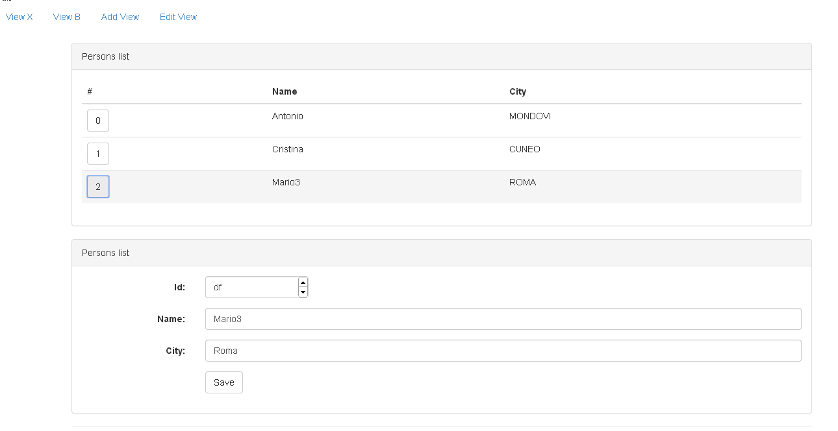
Twitter Bootstrap
app.html
Reference:

Slide 58
Tools
JS IDE: Webstorm (JetBrains)
SPA boilerplate: angular-seed
Reference:

Slide 59
Bibliography
AngularJS in 60 Minutes
Video: http://www.youtube.com/watch?v=i9MHigUZKEM
Single page apps in depth
http://singlepageappbook.com/
Slides
http://www.slideshare.net/bolshchikov
Books
"AngularJS", O'Reilly, 2013
Reference documentation
http://angularjs.org
Ch.8 Recipes (Servers & Login)

