Slide 1
PLSc analysis
K-fold1 = 1623 individuals
X = 68 Desikan-killiany atlas regions
Y = 28 Acapulco volumes + group columns

Slide 2
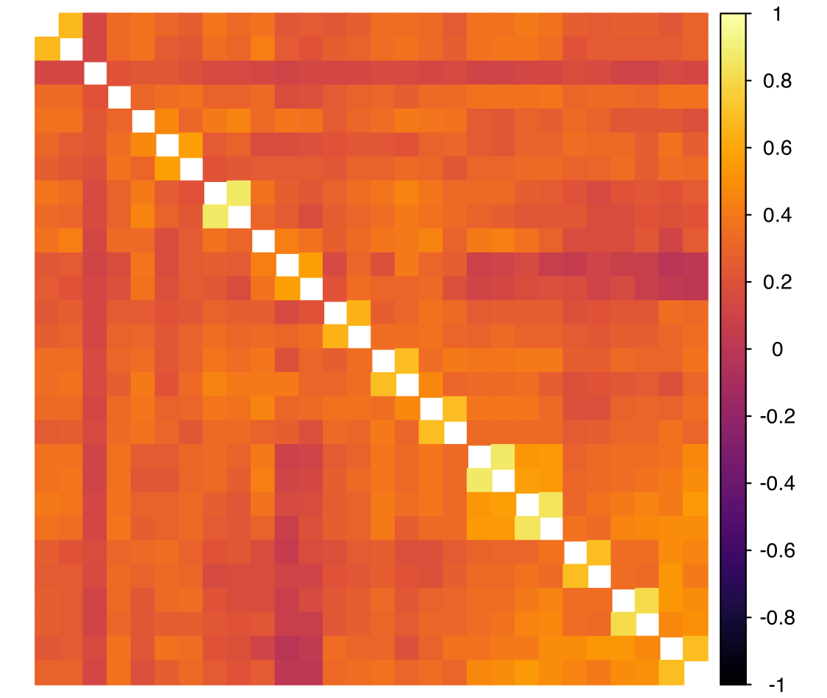
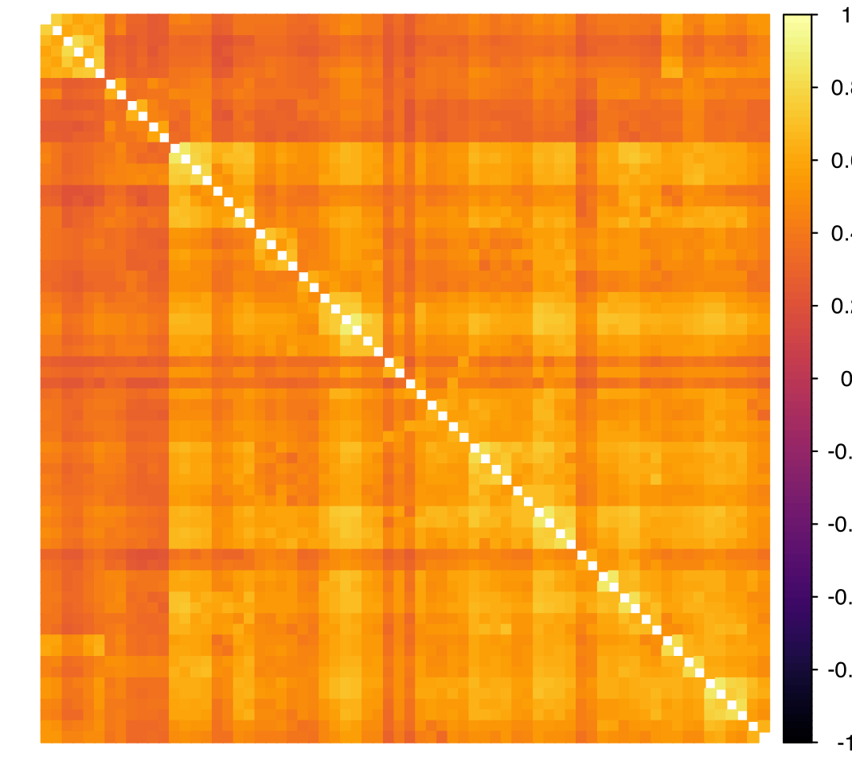
Correlation coefficients
Acapulco Volumes
DK Volumes

Slide 3
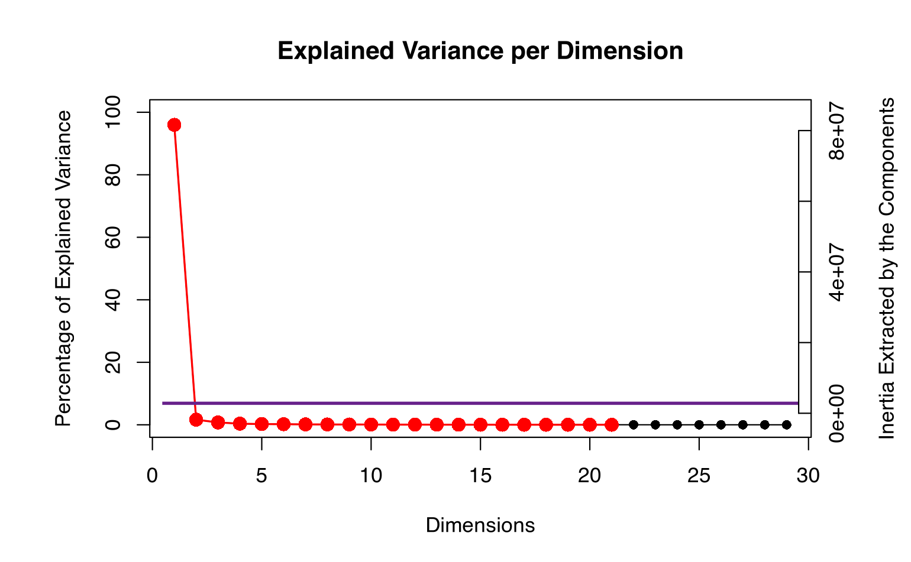
Version 1: HC vs all SUDs
1 Ev variable group column was included:
Control Group vs all SUDs ([0,1])

Slide 4
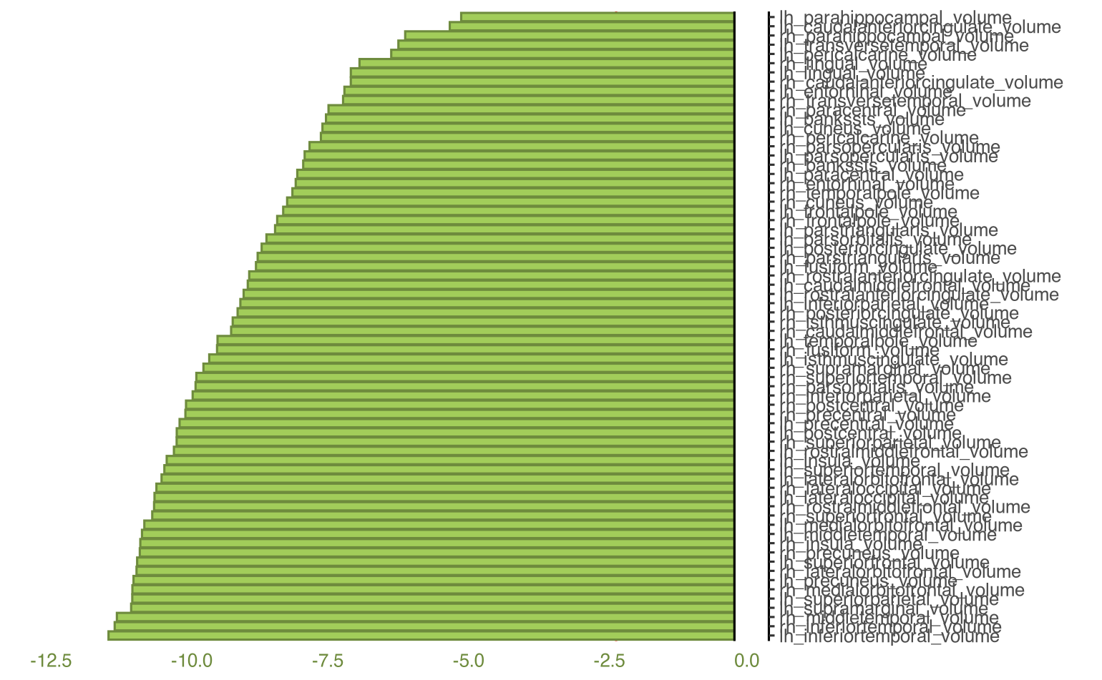
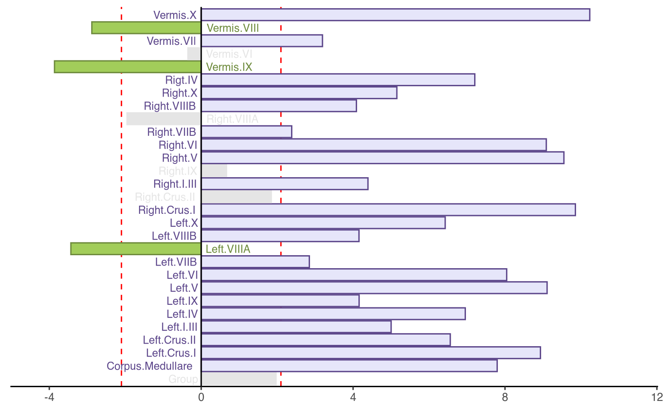
Bootstrap ratios PLSc
DK volumes
Acapulco volumes

Slide 5
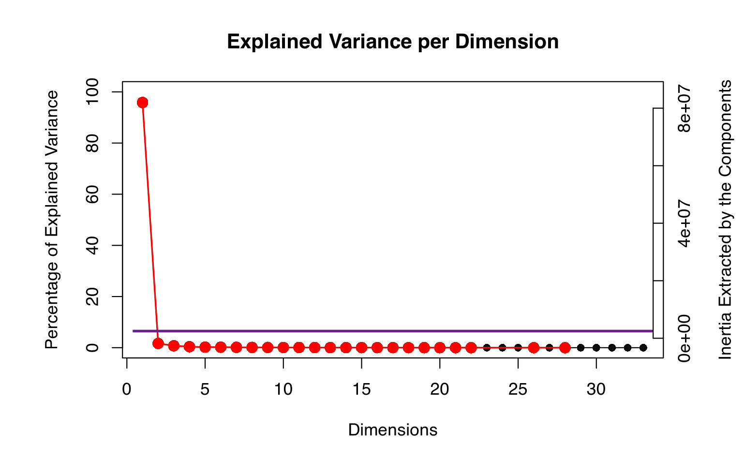
Version 2: Substances PLSc
6 group columns were included:
Controls
Alcohol
Amphetamine
Cocaine
Cannabis
Nicotine

Slide 6
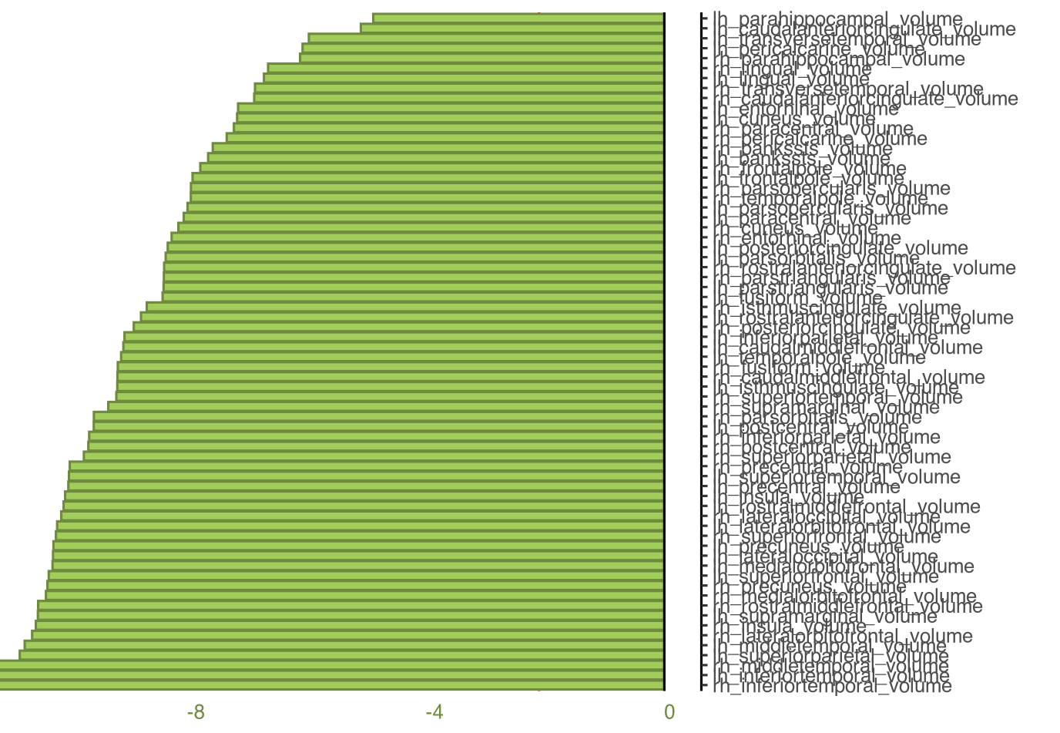
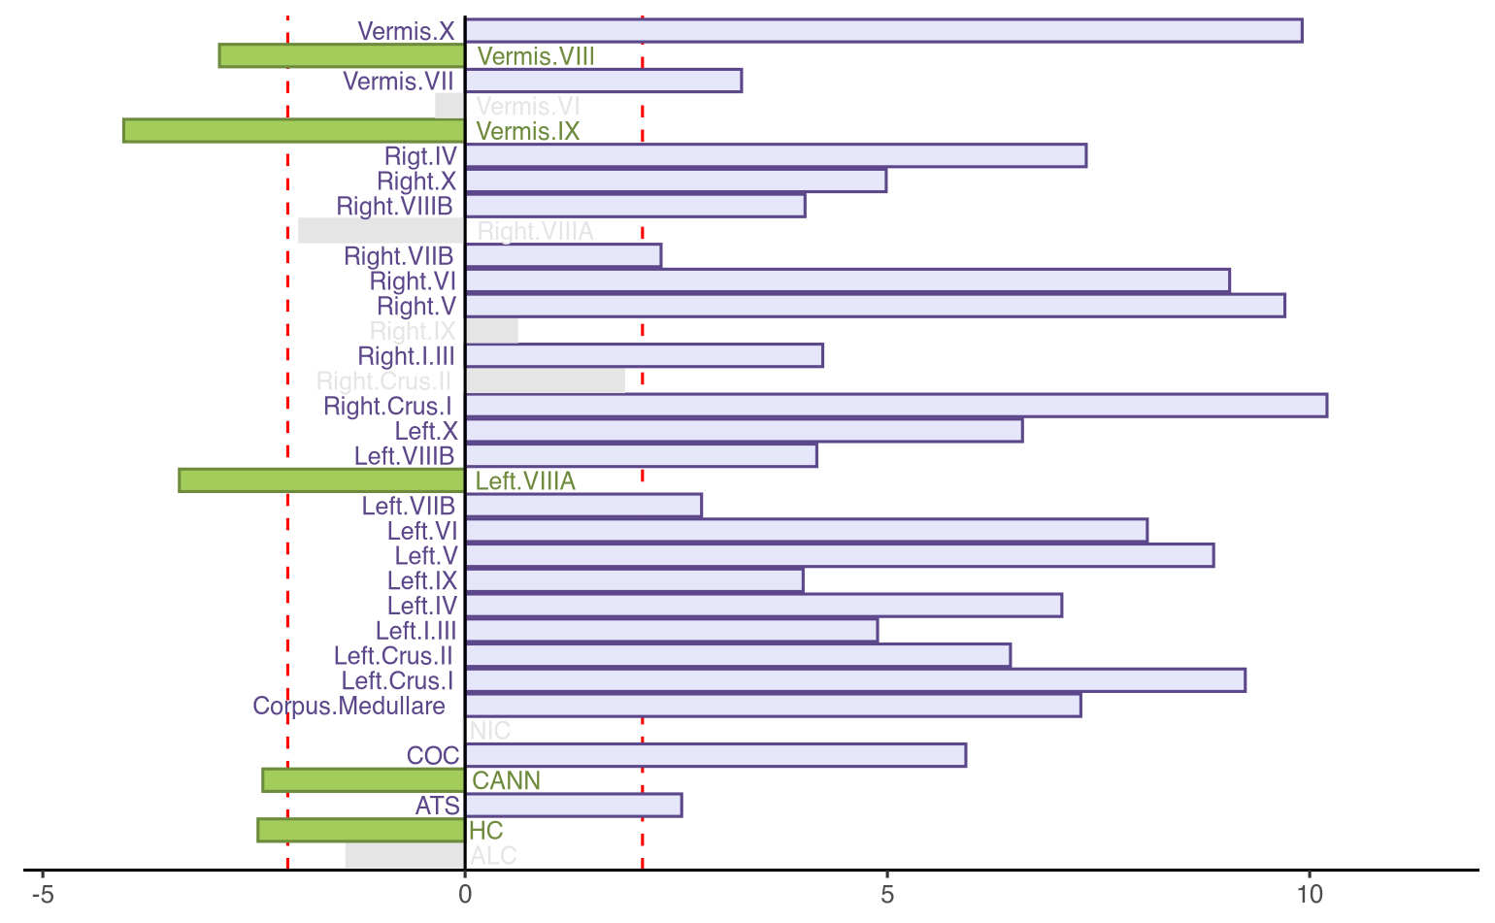
Bootstrap ratios PLSc
DK volumes
Acapulco volumes

Slide 7
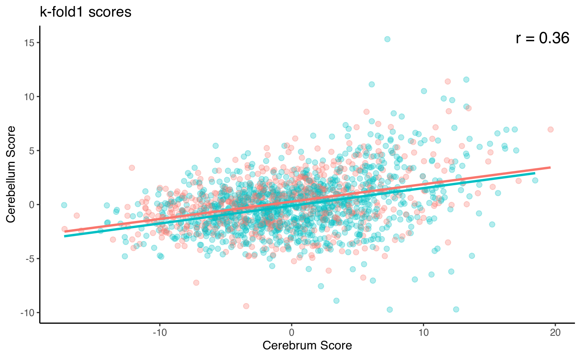
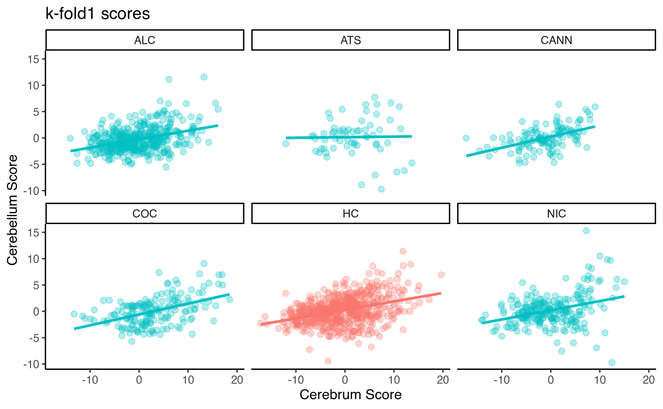
First Latent Variable Scores

