Slide 1

FUNDAMENTALS OF DATABASE SYSTEMS
LESSON 1: INTRODUCTION
University of Engineering and Technology,
Vietnam National University in Hanoi (UET-VNU)

Slide 2
COURSE OVERVIEW

Slide 3
Contents
Part 1: Theory (60%)
Basic concepts
The ER modeling
The relational database model
Functional dependency, Normalization
Part 2: Practice (40%: attendance, assignments, tests)
MySQL, week 2-15

Slide 4
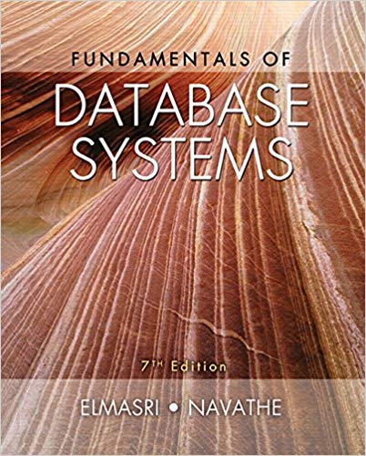
Readings
Ramez Elmasri & Shamkant B. Navathe, Fundamentals of Database Systems, 7th Edition, Pearson 2015.

Slide 5
10 hottest IT positions 2019
No. | Area | Salary/year | No. of job openings
1 | Data Scientist | $108 000 | 6 510
2 | DevOps Engineer | $106 000 | 4 657
3 | Data Engineer | $100 000 | 4 739
4 | Software Engineer | $104 000 | 49 007
5 | Security Engineer | $102 000 | 4 683
6 | Project Manager | $75 000 | 30 107
7 | Product designer | $100 000 | 2 158
8 | Java developer | $85 000 | 6 636
9 | Solution Architect | $127 000 | 6 969
10 | Data analyst | $60 000 | 5 456
[Glassdoor.com]
[Glassdoor.com, 2019]

Slide 6
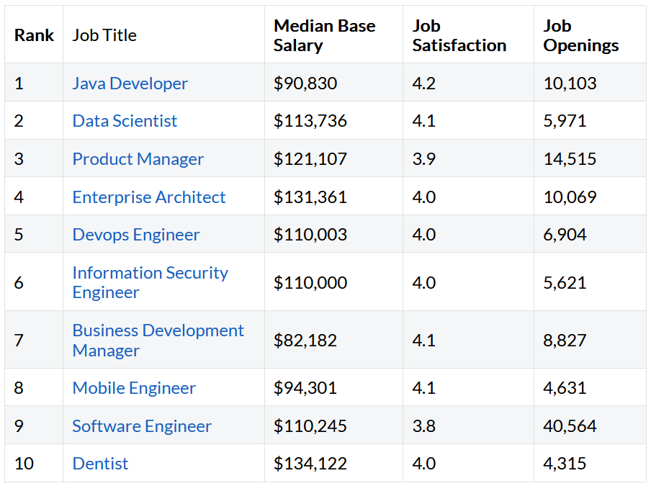
Top 10 Best Jobs in America for 2021

Slide 7
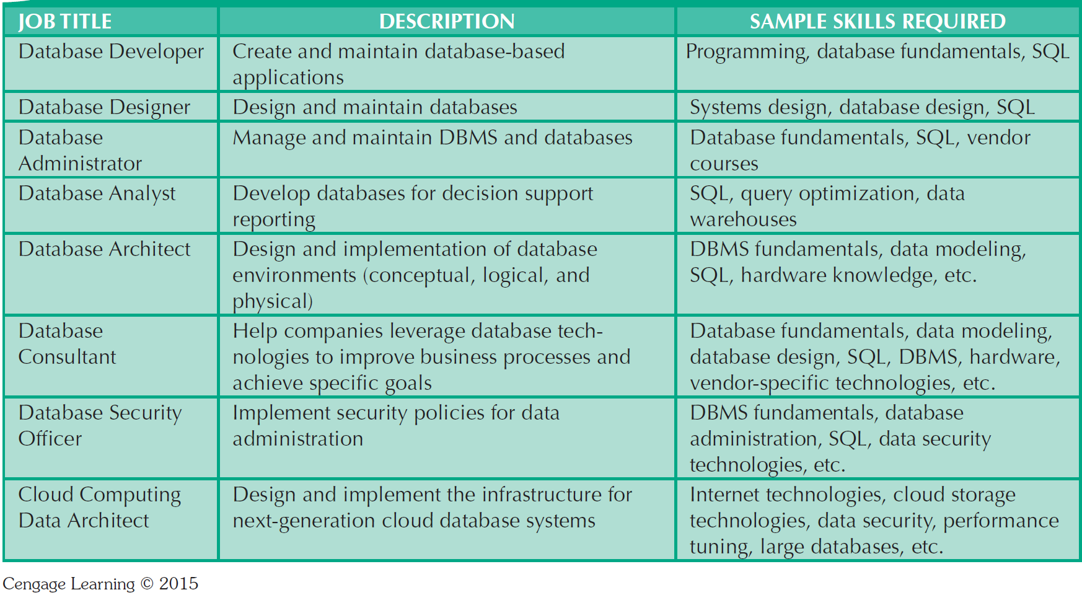
Database Career Opportunities

Slide 8
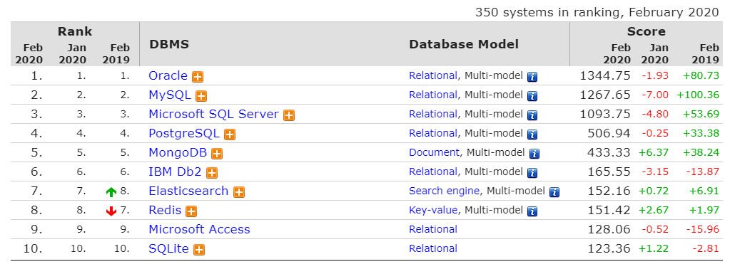
Top 10 DBMS 2020
Notes:
Some of the popular NoSQL database used by big websites (Google, Facebook, Twitter, Lindle) are (check from https://stackshare.io/facebook/facebook):
Hadoop Hbase (Twitter)
MongoDB
Cassandra (Facebook,)
Redis (Twitter)
Amazon’s DynamoDB (Linkedln)
Google’s BigTable
The main reasons for using these NoSQL databases are:
Ability to handle unlimited data: Imagine the amount of data generated by 1 billion users of Facebook, Google etc.
Real time Data Stream processing needs: These all websites are on top of their game in real-time feeds and machine learning.
Use of commodity hardware to run NoSQL database: None of these websites want to get locked into specialized hardware from an infra-structure company.

Slide 9
Top 10 DBMS 2022
According to DB-Engines ranking, as of March 2022
1. Oracle
2. MySQL
3. Microsoft SQL Server
4. PostgreSQL
5. MongoDB
6. Redis
7. IBM DB2
8. Elasticsearch
9. Microsoft Access
10. SQLite

Slide 10

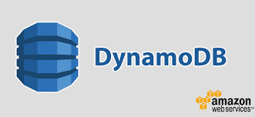




Các HQT CSDL dùng bởi Google, Facebook, Twitter…
[stackshare.io]
Notes:
Some of the popular NoSQL database used by big websites (Google, Facebook, Twitter, Lindle) are (check from https://stackshare.io/facebook/facebook):
Hadoop Hbase (Twitter)
MongoDB
Cassandra (Facebook,)
Redis (Twitter)
Amazon’s DynamoDB (Linkedln)
Google’s BigTable
The main reasons for using these NoSQL databases are:
Ability to handle unlimited data: Imagine the amount of data generated by 1 billion users of Facebook, Google etc.
Real time Data Stream processing needs: These all websites are on top of their game in real-time feeds and machine learning.
Use of commodity hardware to run NoSQL database: None of these websites want to get locked into specialized hardware from an infra-structure company.

Slide 11
BASIC CONCEPTS

Slide 12
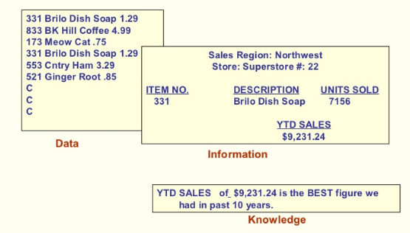
Data – Information Examples

Slide 13
Data vs. Information
Data
Information
Raw facts
  Raw data - Not yet been processed to reveal the meaning
Building blocks of information
Data management
  Generation, storage, and retrieval of data
Produced by processing data
Reveals the meaning of data
Enables knowledge creation
Should be accurate, relevant, and timely to enable good decision making

Slide 14
Evolution of File System Data Processing
Manual File Systems
Accomplished through a system of file folders and filing cabinets
Computerized File Systems
Data processing (DP) specialist: Created a computer-based system that would track data and produce required reports
File System Redux: Modern End-User Productivity Tools
Includes spreadsheet programs such as Microsoft Excel

Slide 15
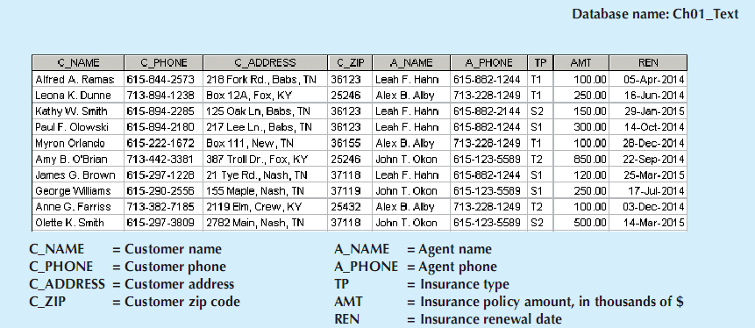
Contents of a simple Customer file

Slide 16
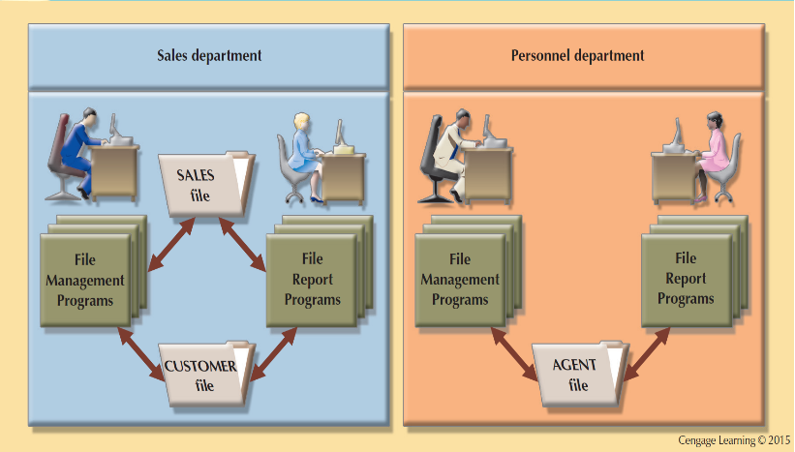
A Simple File System example
Notes:
See an example of an AGENT file @Figure 1.6 on the page 16(44).

Slide 17
Problems with File System Data Processing
Lengthy development times
Difficulty of getting quick answers
Complex system administration
Lack of security and limited data sharing
Extensive programming

Slide 18
Database
Shared, integrated computer structure that stores a collection of:
  End-user data - Raw facts of interest to end user
  Metadata: Data about data, which the end-user data are integrated and managed
    Describe data characteristics and relationships
Database management system (DBMS)
  Collection of programs
  Manages the database structure
  Controls access to data stored in the database

Slide 19
Role of the DBMS
Intermediary between the user and the database
Enables data to be shared
Presents the end user with an integrated view of the data
Receives and translates application requests into operations required to fulfill the requests
Hides database’s internal complexity from the application programs and users

Slide 20
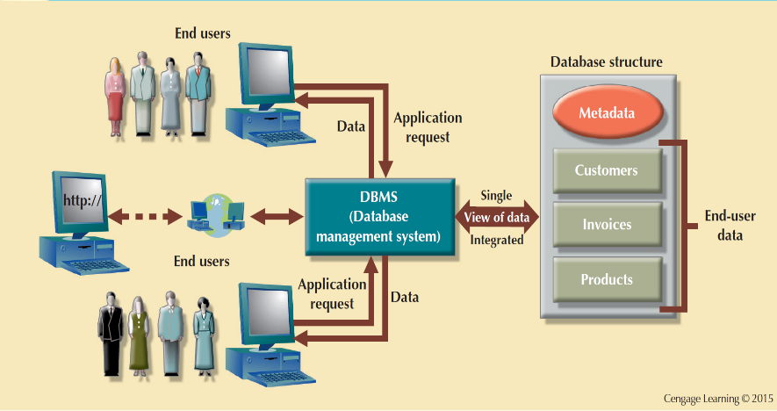
The DBMS Manages the Interaction between the End User and the Database

Slide 21
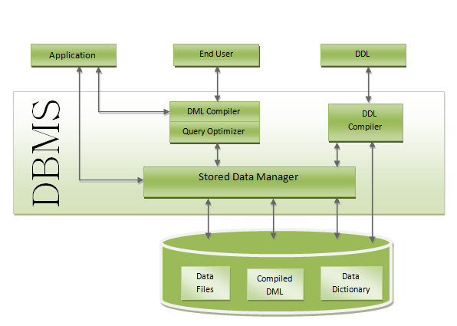
Components of DBMS

Slide 22
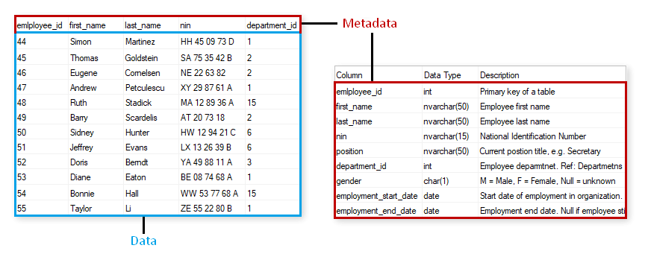
Meta data

Slide 23
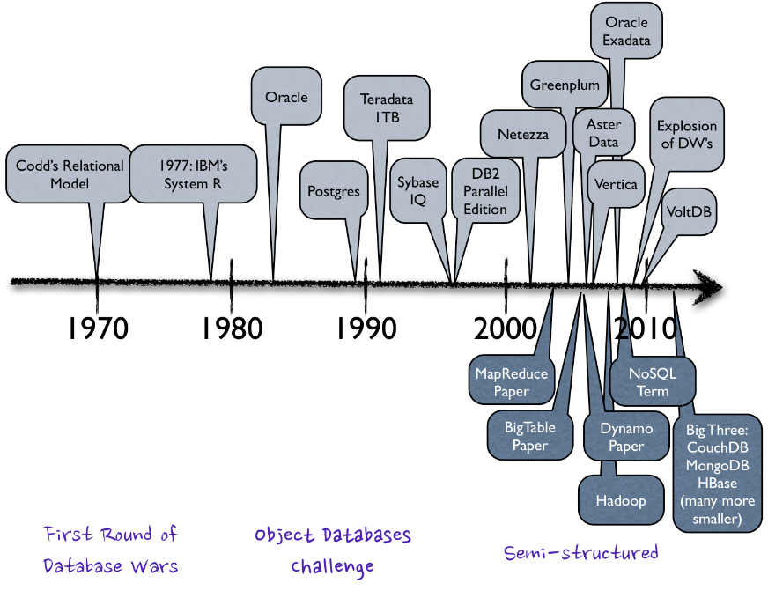

Slide 24
Advantages of the DBMS
  Better data integration and less data inconsistency
    Data inconsistency: Different versions of the same data appear in different places
  Increased end-user productivity
  Improved:
  Data sharing
  Data security
  Data access
  Decision making
Data quality: Promoting accuracy, validity, and timeliness of data

Slide 25
Types of Databases
Single-user database: Supports one user at a time
  Desktop database: Runs on PC
Multi-user database: Supports multiple users at the same time
  Workgroup databases: Supports a small number of users or a specific department
  Enterprise database: Supports many users across many departments

Slide 26
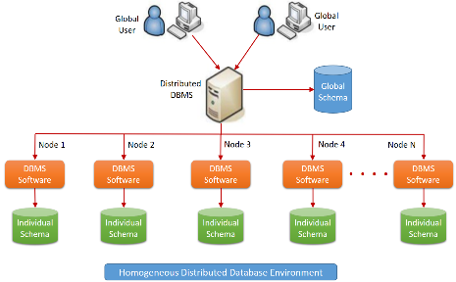
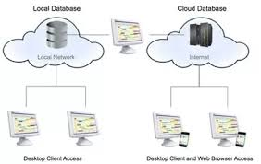
Types of Databases
Centralized database: Data is located at a single site
Distributed database: Data is distributed across different sites
Cloud database: Created and maintained using cloud data services that provide defined performance measures for the database

Slide 27
Types of Databases
General-purpose databases: Contains a wide variety of data used in multiple disciplines
Discipline-specific databases: Contains data focused on specific subject areas

Slide 28
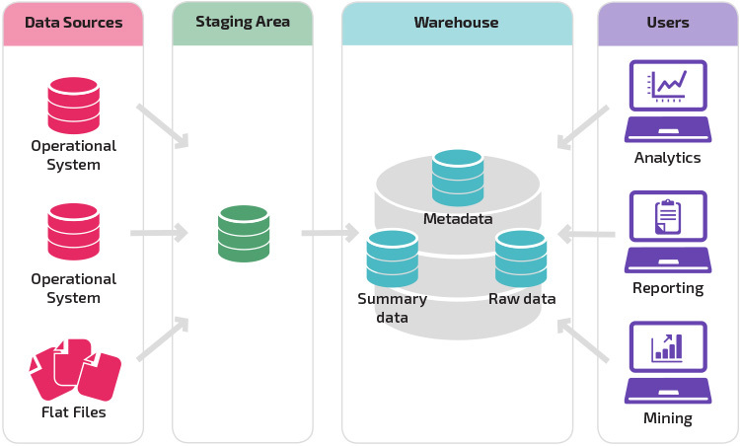
Types of Databases
Operational database: Designed to support a company’s day-to-day operations
Analytical database: Stores historical data and business metrics used exclusively for tactical or strategic decision making
  Data warehouse: Stores data in a format optimized for decision support

Slide 29
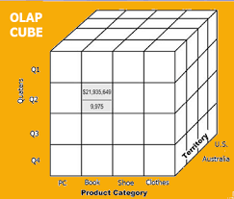
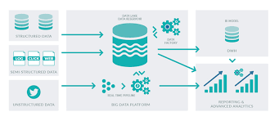
Types of Databases
Business intelligence: Captures and processes business data to generate information that support decision making
Online analytical processing (OLAP)
  Enable retrieving, processing, and modeling data from the data warehouse

Slide 30
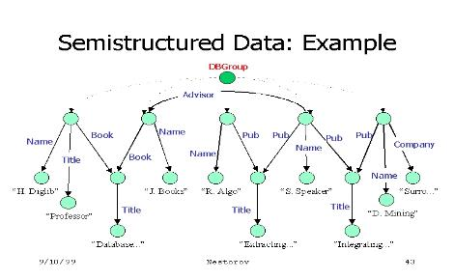
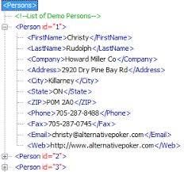
Types of Databases
Unstructured data: It exists in their original state
Structured data: It results from formatting
  Structure is applied based on type of processing to be performed
Semi-structured data: Processed to some extent
Extensible Markup Language (XML)
  Represents data elements in textual format
Notes:
In semi-structured data, the entities belonging to the same class may have different attributes even though they are grouped together, and the attributes' order is not important.

Slide 31
Database Design
Focuses on the design of the database structure that will be used to store and manage end-user data
Well-designed database
  Facilitates data management
  Generates accurate and valuable information
Poorly designed database causes difficult-to-trace errors

Slide 32
Database Systems
Logically related data stored in a single logical data repository
  Physically distributed among multiple storage facilities
  DBMS eliminates most of file system’s problems
Current generation DBMS software:
    Stores data structures, relationships between structures, and access paths
    Defines, stores, and manages all access paths and components

Slide 33
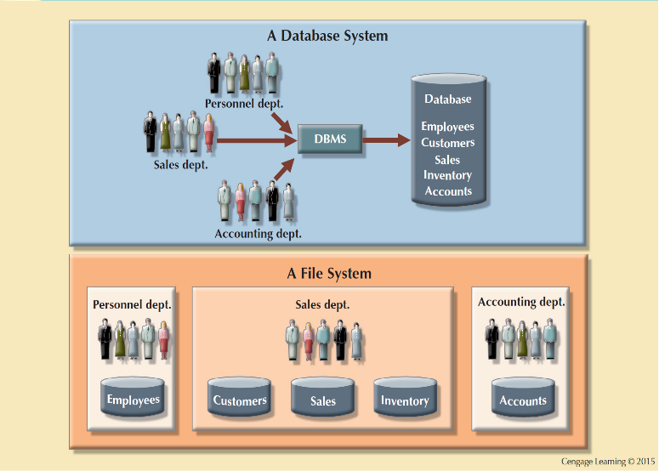
Contrasting Database and File Systems

Slide 34
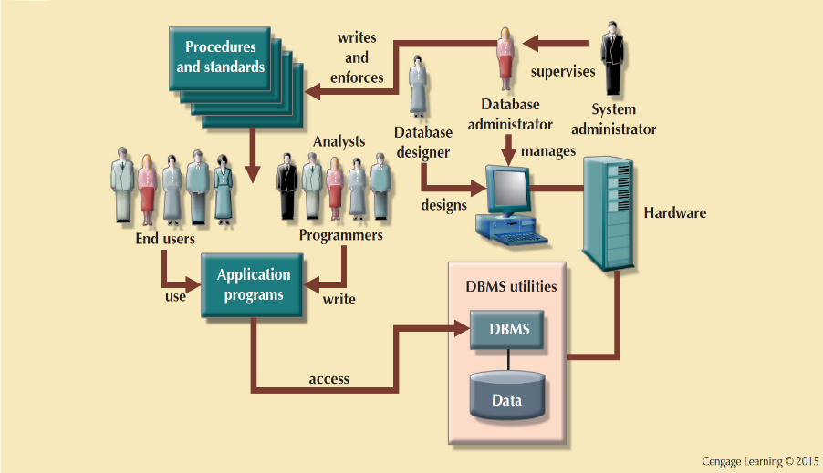
The Database System Environment
Notes:
From a general management point of view, the database system is composed of the five major parts shown in Figure 1.9: hardware, software, people, procedures, and data.
Let’s take a closer look at the five components shown in Figure 1.9:

Slide 35


