Slide 1
Star wars Tower defense
Funcional
1 player
Co-op
Funcional
instructions

Slide 2
instructions
Funcional
mouse
keyboard
Estos botones abrirán un video de tutorial para cada caso

Slide 3
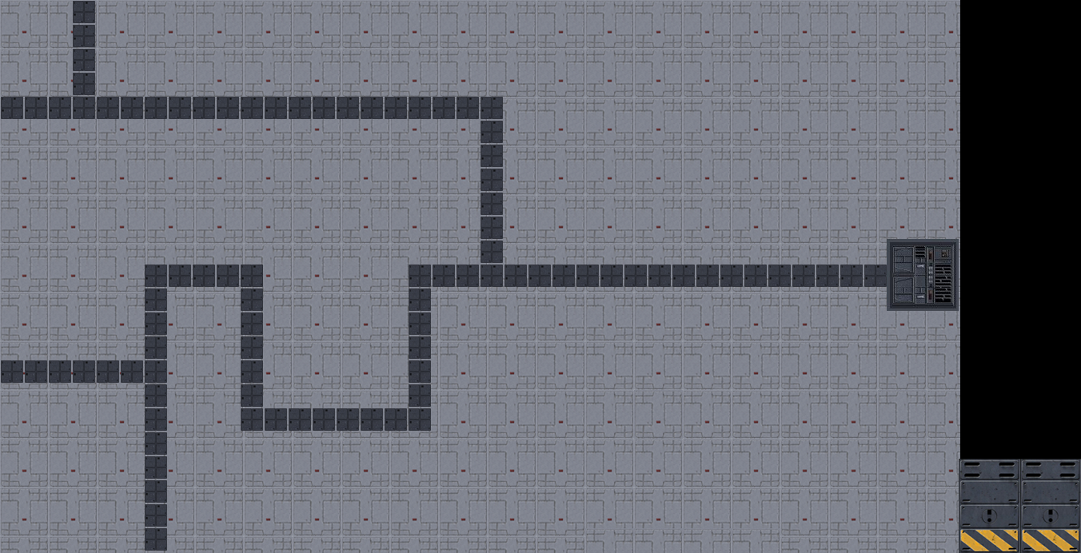
Select map
Funcional
easy
medium
hard
Extreme

Slide 4
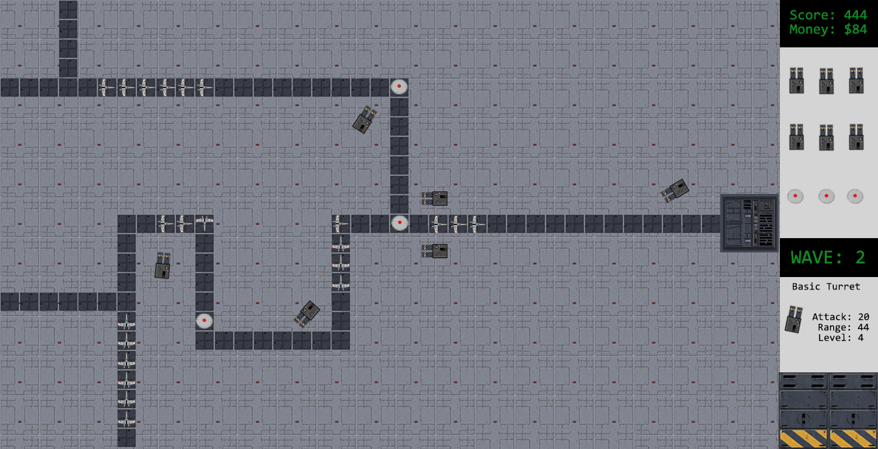

Slide 5
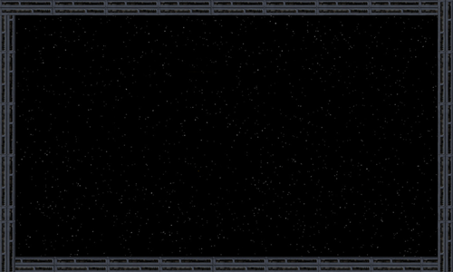
Pause
Press “i” for instructions
Press “m” to mute music
Press “f” to mute sounds
Press “q” to quit
Press “s” to save state
Press “L” to load state

Slide 6
Congratulations
You cleared
x waves
Score: 12345

