Slide 1
AOP
increase modularity by allowing the separation of cross-cutting concerns
adding additional behavior to existing code without modifying the code itself.

Slide 2
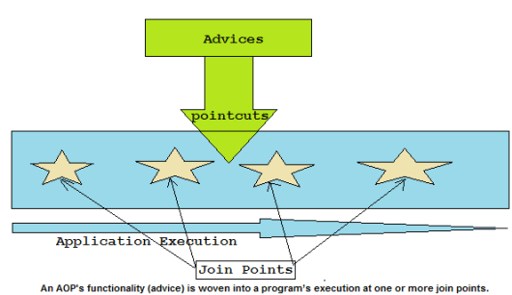
Aspect

Slide 3
Criticism:
control flow is obscured, the code in question has no indication that an advice will be applied,
means that the advice is not visible from intercepted piece of code.

Slide 4
public void Method1()
{
Log.Info("[Method1] started ");
// method logic
Log.Info("[Method1] end");
}
public void Mthod2()
{
Log.Info("[Method2] started ");
// method logic
Log.Info("[Method2] end");
}
public void Method3()
{
Log.Info("[Method3] started ");
// method logic
Log.Info("[Method3] end");
}
public void Method()
{
Log.Info("[PROCESS] started ");
try
{
// method logic
Log.Info("[PROCESS] end");
}
catch (Exception ex)
{
LogException(ex));
throw;
}
}

Slide 5
Log.Info($"[{method.name}] started ");
Interceptor
try { interceptedMethod(); }
public void Method(params...)
{
// method logic
}
Intercepted code
catch (Exception ex) { ... }
Interceptor
Log.Info($"[{method.name}] end");

Slide 6
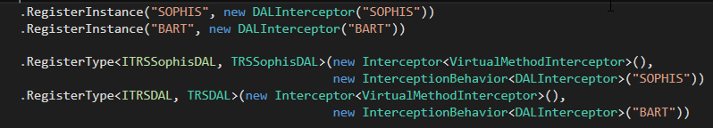
AOP depend on (based, implemented over) IOC (DI)
- Sprint.Net,
- Castle Windsor,
- Unity
Unity and System.ServiceModel(for WCF) offer ready-to-use classes for Interception.
Unity: (inside container)
- InterfaceInterceptor
- VirtualMethodInterceptor
ex:
ServicesContainerManager()
WCF: (inside wcf pipeline)
- IInterceptionBehavior, IParameterInspector

Slide 7
Two ways:
BeforeCall(), AfterCall(). ex: IParameterInspector (WCF)
Full Interception,
ex: MethodInterceptor, InterfaceInterceptor
DALInterceptors, WCF interceptors

Slide 8
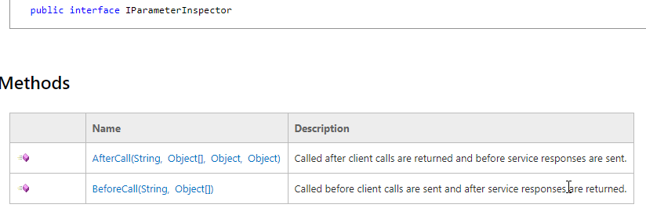
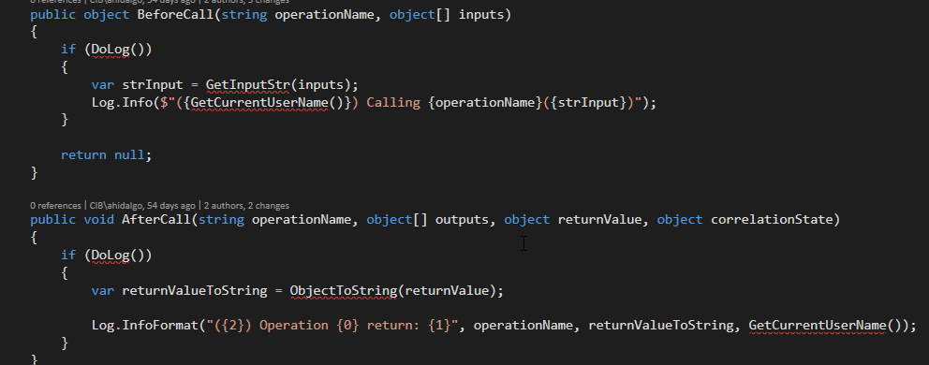
Two ways:
BeforeCall(), AfterCall(). ex: IParameterInspector (WCF)

Slide 9
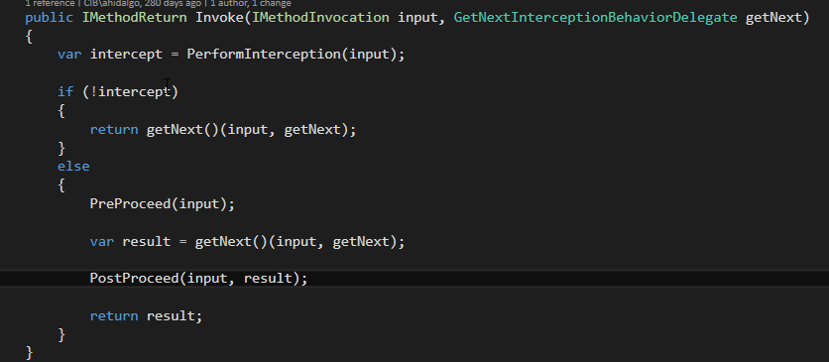
Full Interception,
ex: ex: DALInterceptor : MethodInterceptor , all WCF interceptors

Slide 10
ex Logs:
DALInterceptor:
INFO 2018-06-01 10:02:51,752 PreProceed: Execution of query on DB started...
INFO 2018-06-01 10:02:52,174 PostProceed: returns: 11968 items
WebService : LoggingOperationInvoker

Slide 11
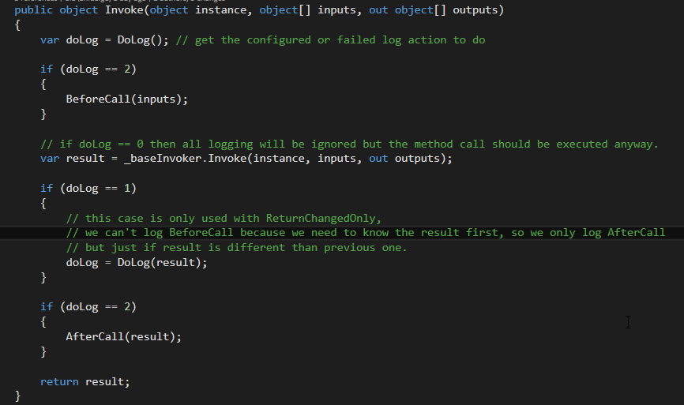
Complex Logic Logs: LoggingOperationInvoker

