Slide 1

Blazor : Full-stack web development with C#

Slide 2
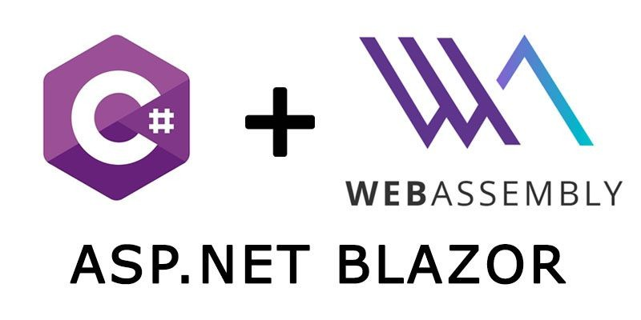

Slide 3
MOZILLA
GOOGLE
asm.js
PNaCL
subset of JavaScript as a compiler target
Portable Native Client: binary format for the web
joint effort aimed at providing
a cross-browser compiler target
WebAssembly
Wasm Browser support: https://caniuse.com/#feat=wasm

Slide 4
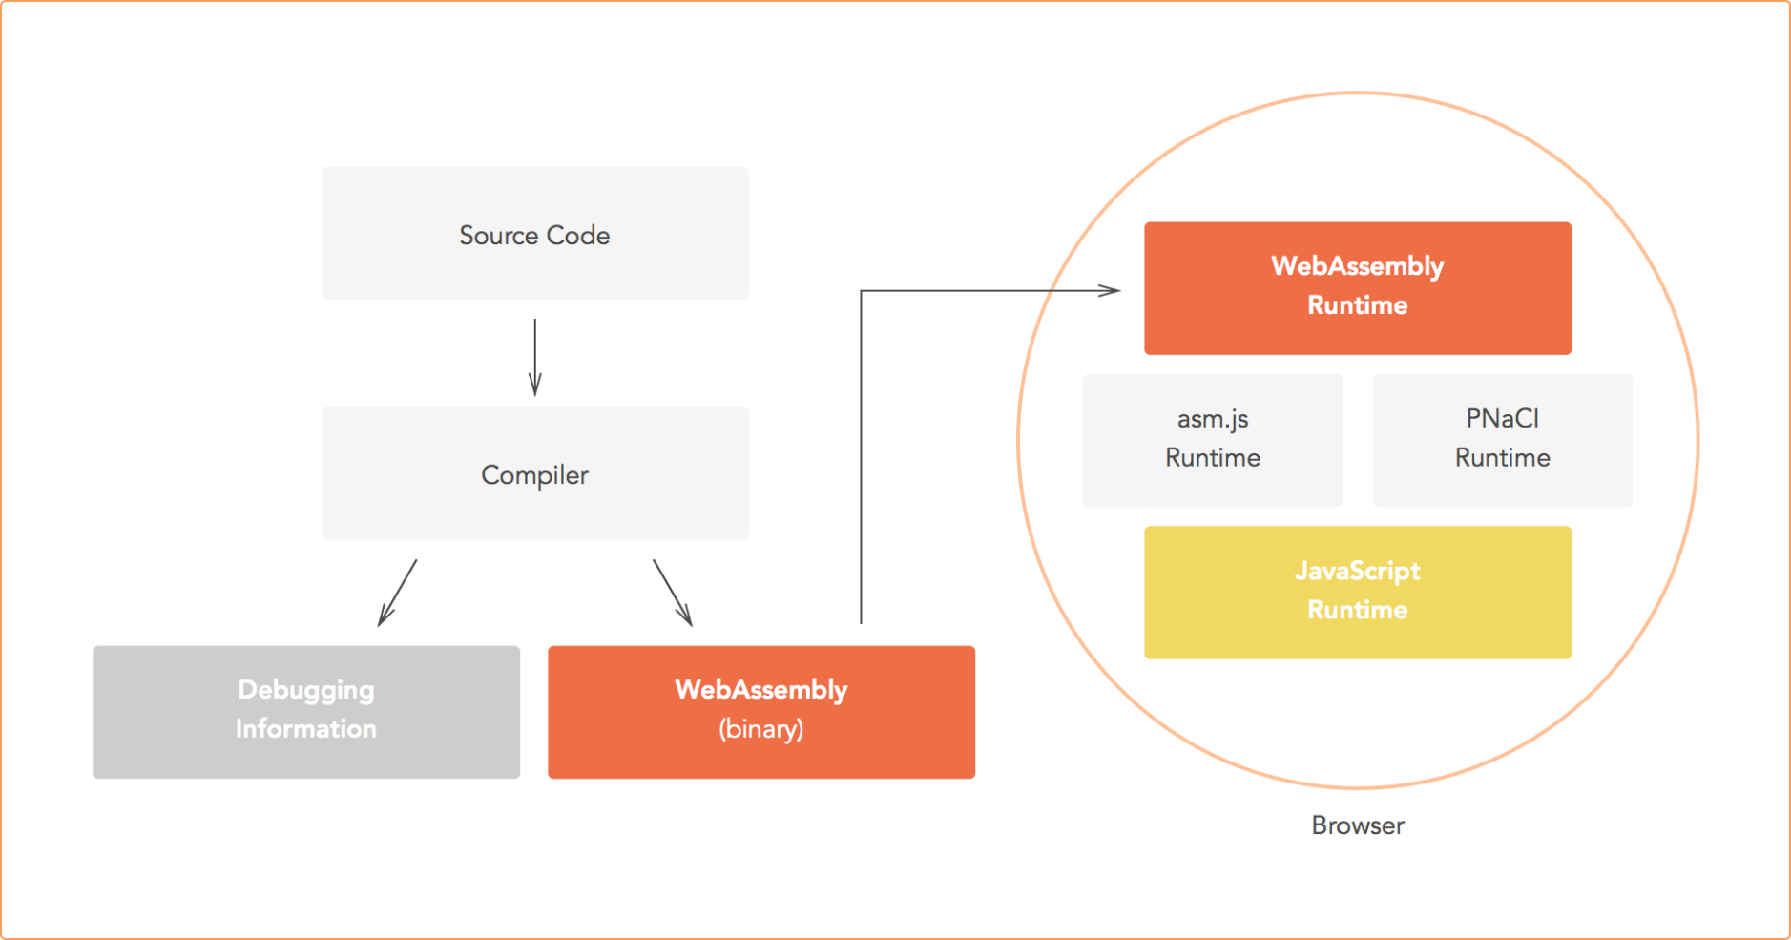
Develop an app (write the source code in any language that can be compiled to WebAssembly).
Use a compiler to turn the source code into WebAssembly bytecode (and potentially into assembly-code if required).
Load the bytecode in a browser and run it.
Source code: What a developer writes.
Compiler: An application that turns source code into assembly, bytecode or machine code (what other apps or hardware run).
Assembly: A low-level source-like language specific to a machine or an application.
Bytecode: A low-level binary representation of code that can be run by other applications.
Machine code: A binary representation of code that can be run directly by hardware.

Slide 5
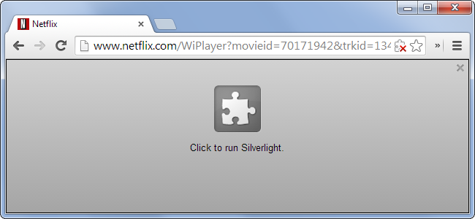
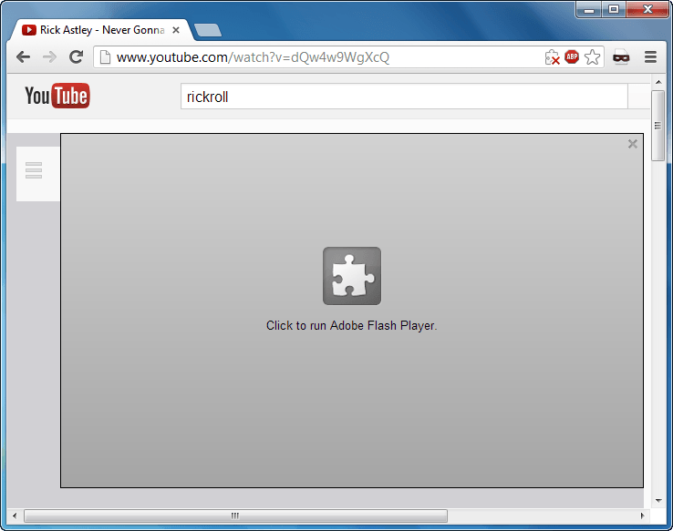
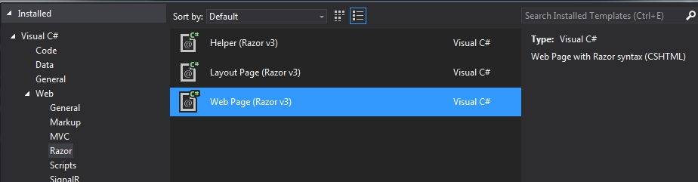

Slide 6
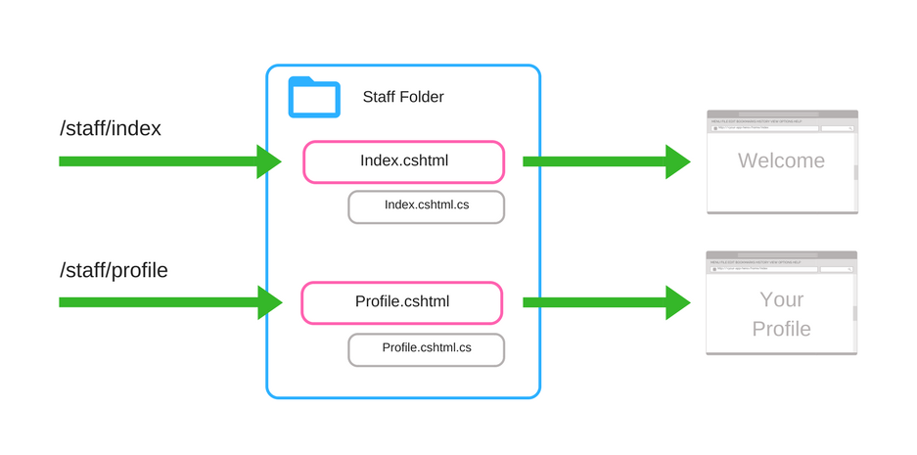


RAZOR – MVVM (Model-View-ViewModel
Browser + Razor = Blazor!
Q/ Angular ??
MVC (Model-View-Controller)
StaffController.cs
Views\Staff
/staff/index
GET – Index
Index.cshtml
/staff/profile
GET – Profile
Profile.cshtml
List.cshtml
Edit.cshtml

Slide 7
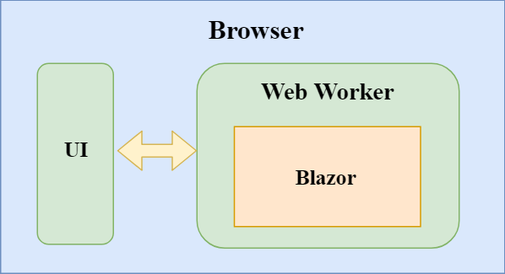
Blazor Full Client-Side
C#

Slide 8
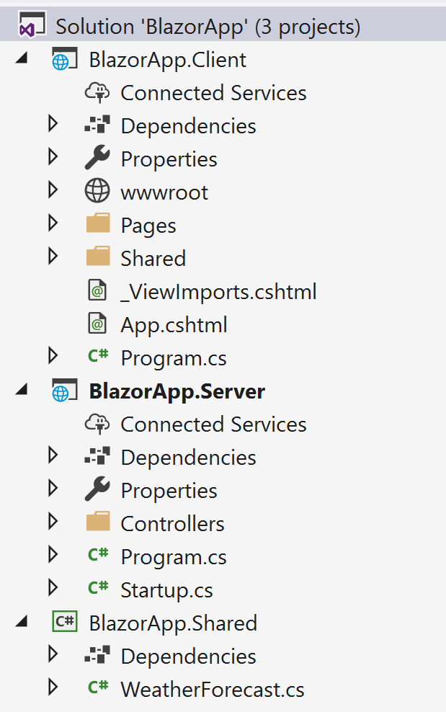
Blazor Full-Stack
Blazor.Client: Full Client-Side app
C#
Shared Project
http response:
common DTO
Shared Project
Blazor.Server: classic webapi
Blazor.Server
WebAPI
http requests
Shared Project

Slide 9
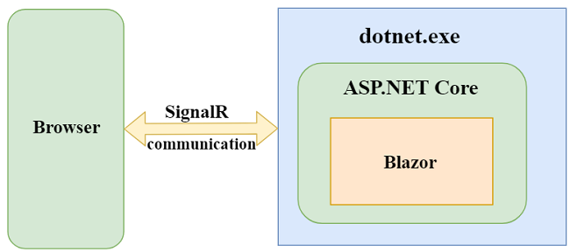
Blazor Full Server-Side
C#

Slide 10
https://blazor.net/docs/get-started.html
Full Client
Install templates
Create project with template
sample pages
Testing
Counter: Code in Client Side
Counter: Move code to code behind
FetchData
dotnet build
dotnet run
https://github.com/aspnet/Blazor/wiki/FAQ

Slide 11
ServerSide-SignalR
Counter : stop server
Server Data: can call DB operations. Can update UI with server event + UI bind
Server Data Client: same as before but with inline code
Composed Server Data: use child components and bind to events on parent
Synchro Data: synchro data on 2 browser using IOC-SynchroDataService
Synchro Data RX: use Linq RX over events
Blockchain sample: composition, synchro data using IOC-BlockchainService
C# JS interop
The Reactive Extensions (Rx) is a library for composing asynchronous and event-based programs
using observable sequences with LINQ-style query operators and Schedulers
Rx = Observables + LINQ + Schedulers

