Slide 1
A blockchain is a decentralized, distributed and incorruptible digital ledger that is used to record transactions across many computers.

Slide 2
Distributed | network of computers (node)
Decentralized | Each node contains full copy
Incorruptible | cryptographically verified and secure
Block | contains a ledger(registry) with a list of transactions
Chain | Each block is linked to previous one
Public
Anyone can inspect transactions
No single entity controls
Not centrally stored
Data Monarchy vs Data Democracy

Slide 3
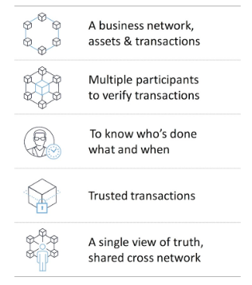
Not a transaction processing system replacement
Not a distributed database replacement
Not a messaging replacement
Not need when there is no business network
Not just about currency
Not necessarily anonymous

Slide 4
Smart Contracts
Transaction Persistance (DB)
Consensus Rules
P2P Network Protocol

Slide 5
Hash
Deterministic — for any input into the cryptographic hash function, the resulting output will always be the same.
Fast — Computing the output of the hash function, given any input, is a relatively fast process (doesn’t need heavy computation)
Unique — Every input into the function should result in a completely random and unique output (in other words, no two inputs result in the same output)
Irreversible — Given an output of a hash function, the original input is unable to be obtained

Slide 6
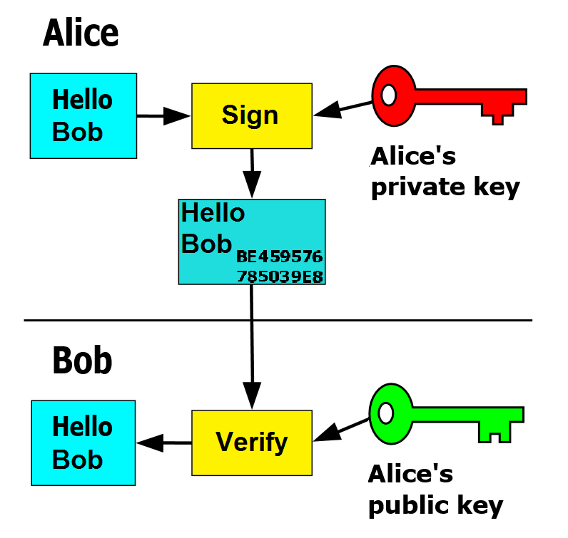
Digital Signatures
Only you can sign BUT anyone can verify
Private-Public keys algorith:
RSA
ECDSA (eliptic curve)

Slide 7
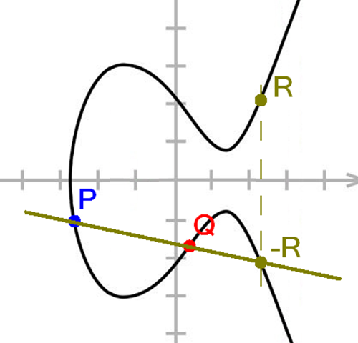
Digital Signatures
RSA:
2 prime numbers, big keys, long iteration, demand energy
and computational power
(not good for small devices and future better hardware can decrypt it)
ECC:
256-bit ECC key can be considered equivalent to a 3072-bit RSA key
You can compute how much energy is needed to break a cryptographic algorithm and compare that with how much water that energy could boil. This is a kind of a cryptographic carbon footprint. By this measure, breaking a 228-bit RSA key requires less energy than it takes to boil a teaspoon of water. Comparatively, breaking a 228-bit elliptic curve key requires enough energy to boil all the water on earth. For this level of security with RSA, you'd need a key with 2,380 bits.

Slide 8

Nov 01, 2008 : BITCOIN
by Satoshi Nakamoto
“Cryptocurrency is to blockchain, what email is to internet”.

Slide 9
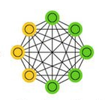
Bitcoin Nodes
Super
Node
Ligth
Node
redistribution
24/7
publics
Simplified Payment Verification (SPV)
Only block headers (to validate transactions)
Full Node
Miner
validation
full copy of chain
transactions
block creation

Slide 10
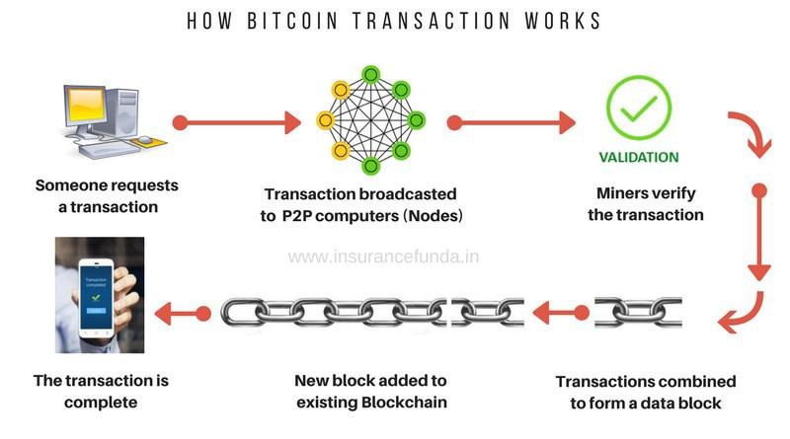

Slide 11


Mine incentive
Block->Transaction Fees + Reward
Reward= BTC 50, 25@block210000, 12,5@block420000…0@block6930000
fees
fees
fees

Slide 12
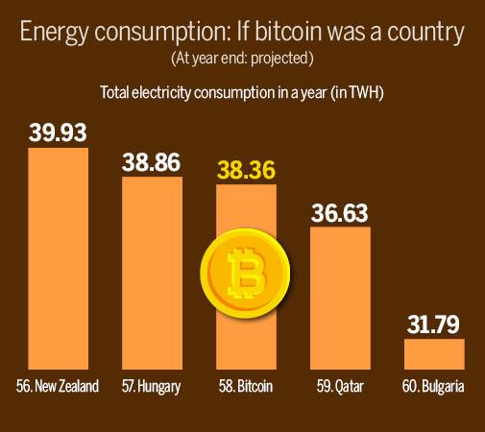
Mine = resolution of POW (Proof of Work)

Slide 13
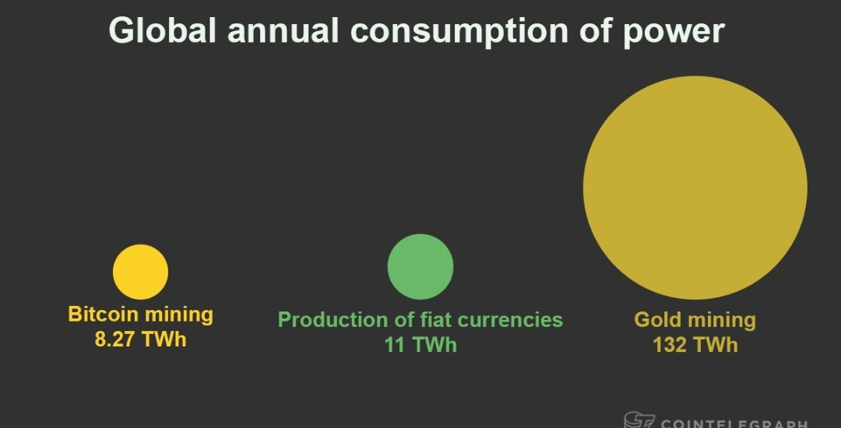
Mine = resolution of POW (Proof of Work)

Slide 14
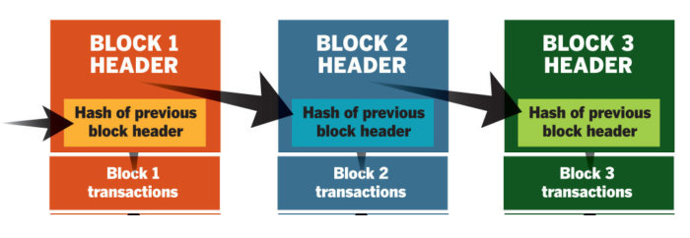

Slide 15
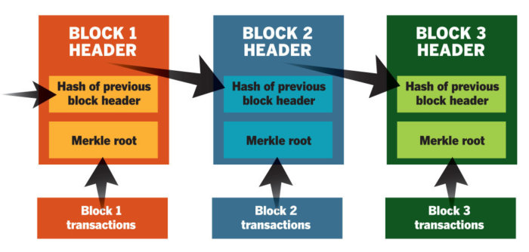

Slide 16
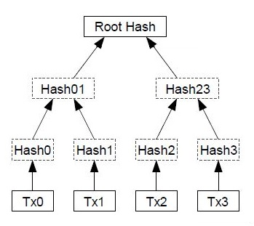
Merkle Tree

Slide 17
The block header
The block header is a summary of the contents of the block itself. It contains the following six components:
The version of software the Bitcoin client is running
The timestamp of the block
The root of its containing transactions' merkle tree
The hash of the block before it
A nonce
The target
header =
{
v: 1.0,
t: 2018-08-31-10-05-59,
m: merkleroot,
h: previous_hash,
n: nonce?,
T: target
}
PoW : Hash(Header + Nonce) < Target
while ((Hash(Header + Nonce) > Target))
{
Nonce++
}
Hash
Target
Target
Target

Slide 18
POW Difficult adjustment
Time to produce 2016 blocks in last 2 weeks
New Target =
CurrentTarget x
20160 ( minutes in 2 weeks)
Source code:
.NET, Line 71
https://github.com/stratisproject/StratisBitcoinFullNode/blob/master/src/Stratis.Bitcoin.Networks/BitcoinMain.cs
C++, Line89
https://github.com/bitcoin/bitcoin/blob/78dae8caccd82cfbfd76557f1fb7d7557c7b5edb/src/chainparams.cpp

Slide 19
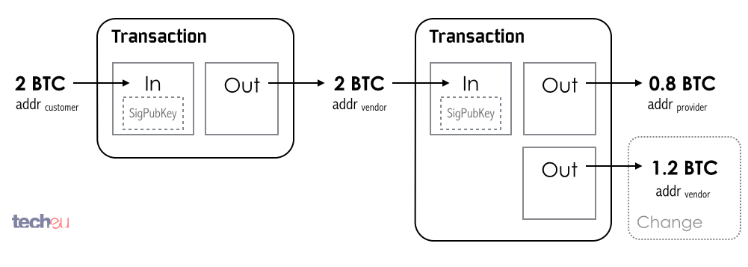
UTXO:
Unspent Transaction Output
SignTx
SignTx
block 5021
block 7203

Slide 20
Transaction sample:
http://tapi.qbit.ninja/transactions/781464f497dca89c40ed9c8329c80045a92bc822ef4b81ff30b9bff67a5201d0?format=Json
"spentCoins": [
{
"transactionId": "94b56c61e3cee09bc8c18fe22dc695e59b80aea5c0fe1a1c31d64cd09dc6af6d",
"index": 0,
"value": 110000000,
"scriptPubKey": "76a914fcee50923049799b8679b3b779bac762087d367f88ac",
"redeemScript": null
}
],
"receivedCoins": [
{
"transactionId": "781464f497dca89c40ed9c8329c80045a92bc822ef4b81ff30b9bff67a5201d0",
"index": 0,
"value": 50000000,
"scriptPubKey": "76a914d3a689bc36464b9d74e1721fd321d4686eae594e88ac",
"redeemScript": null
},
{
"transactionId": "781464f497dca89c40ed9c8329c80045a92bc822ef4b81ff30b9bff67a5201d0",
"index": 1,
"value": 59990000,
"scriptPubKey": "76a914fcee50923049799b8679b3b779bac762087d367f88ac",
"redeemScript": null
}

Slide 21
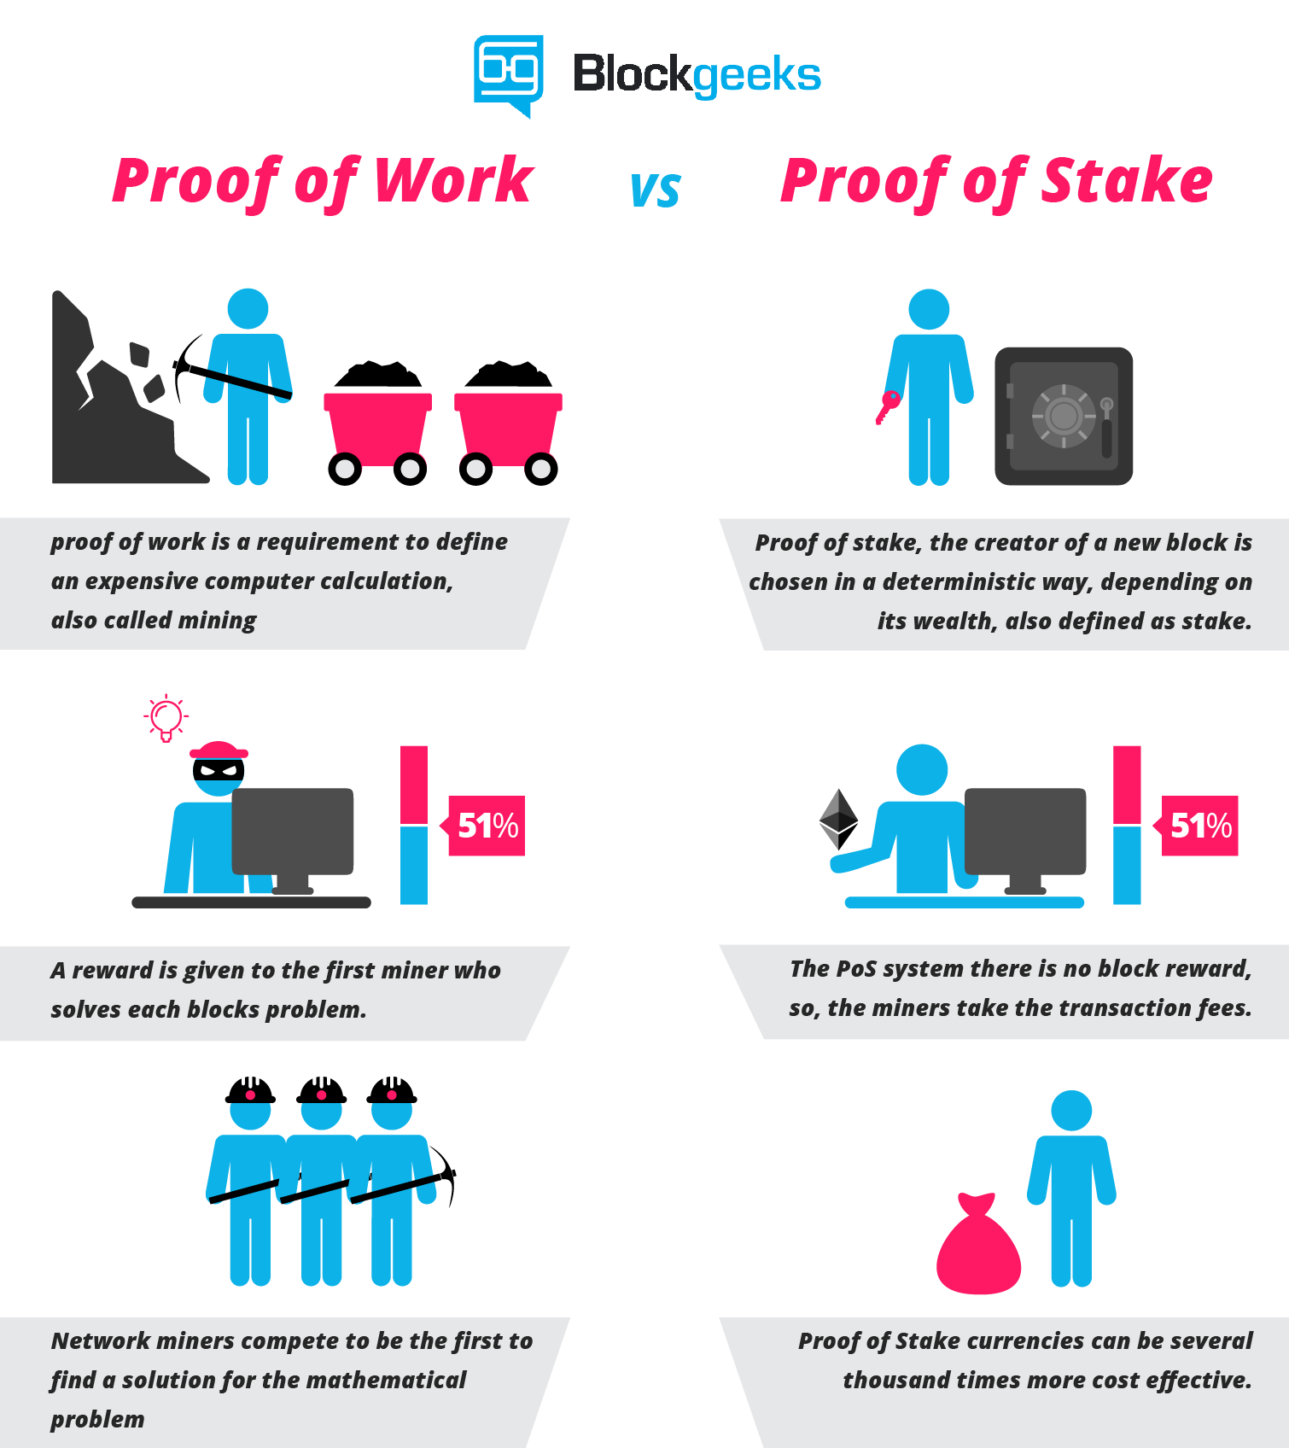
POS (Proof of Stake)

Slide 22
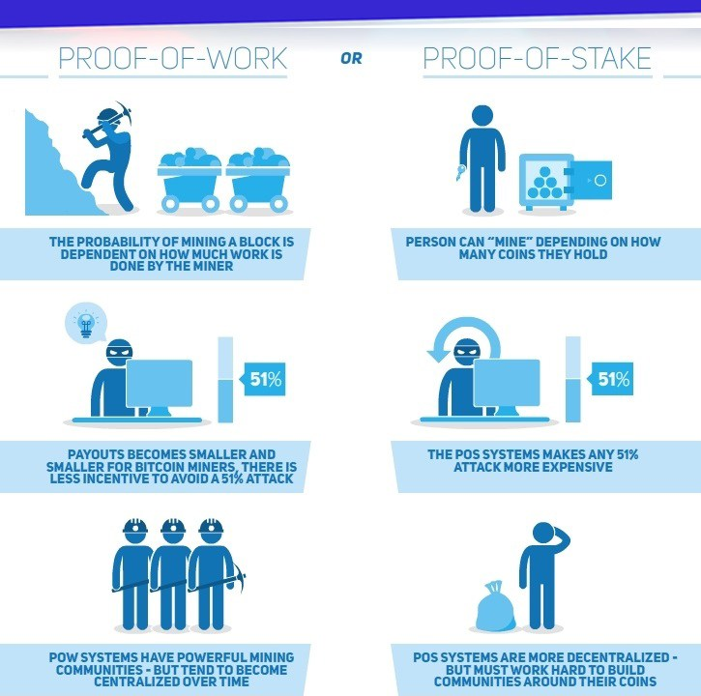
POS (Proof of Stake)

Slide 23
Double spend
51% attack

Slide 24
Code !!!
C# code <-> Python code ??
Play with 1 blockchain
Play with 2 nodes
Synch nodes
Bitcoin transaction on BlockExplorer ??

Slide 25
Extras
https://steemit.com/cryptocurrency/@killjoy/the-different-proofs-of-crypto-currency
https://www.investinblockchain.com/periodic-table-cryptocurrencies/
https://hackernoon.com/consensuspedia-an-encyclopedia-of-29-consensus-algorithms-e9c4b4b7d08f
Blockchain Explorer:
https://testnet.blockchain.info/address/n4aL4nx7SjzdvNeqf8MhXFJkVLgo85LxNc

