Slide 1
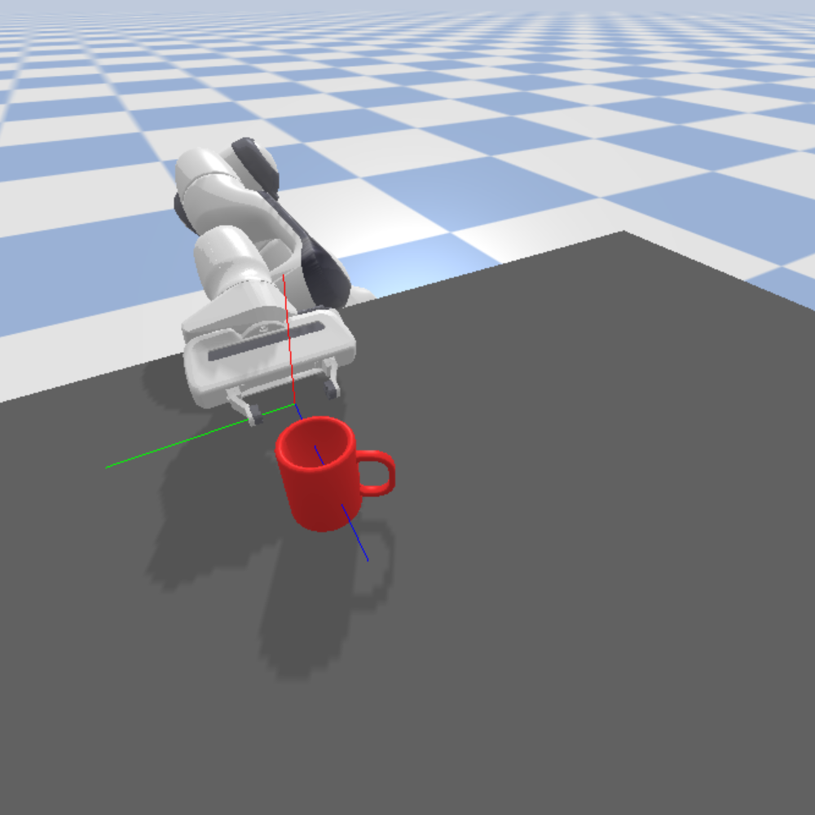
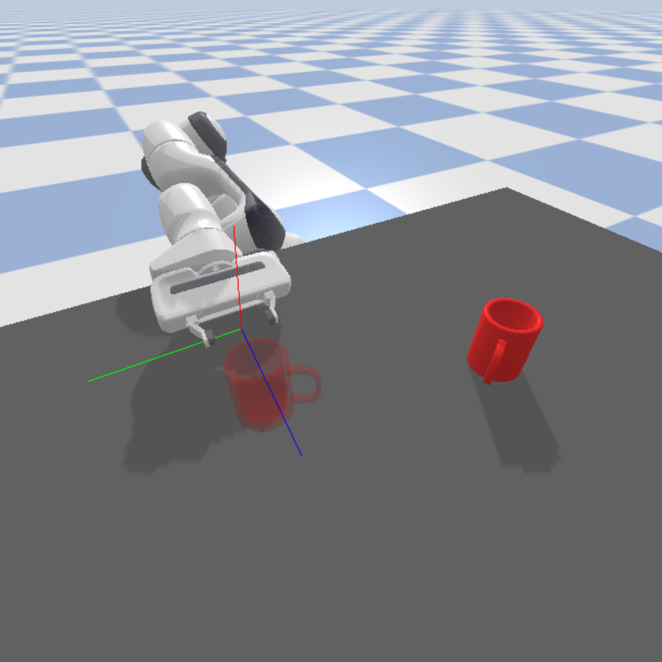
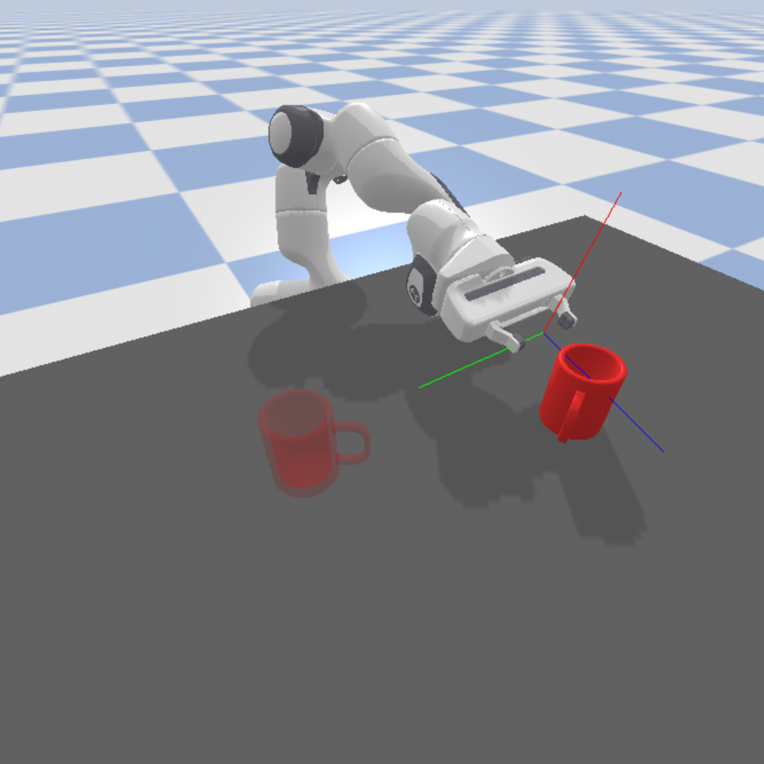
Demonstration
New environment
Adjust accordingly

Slide 2
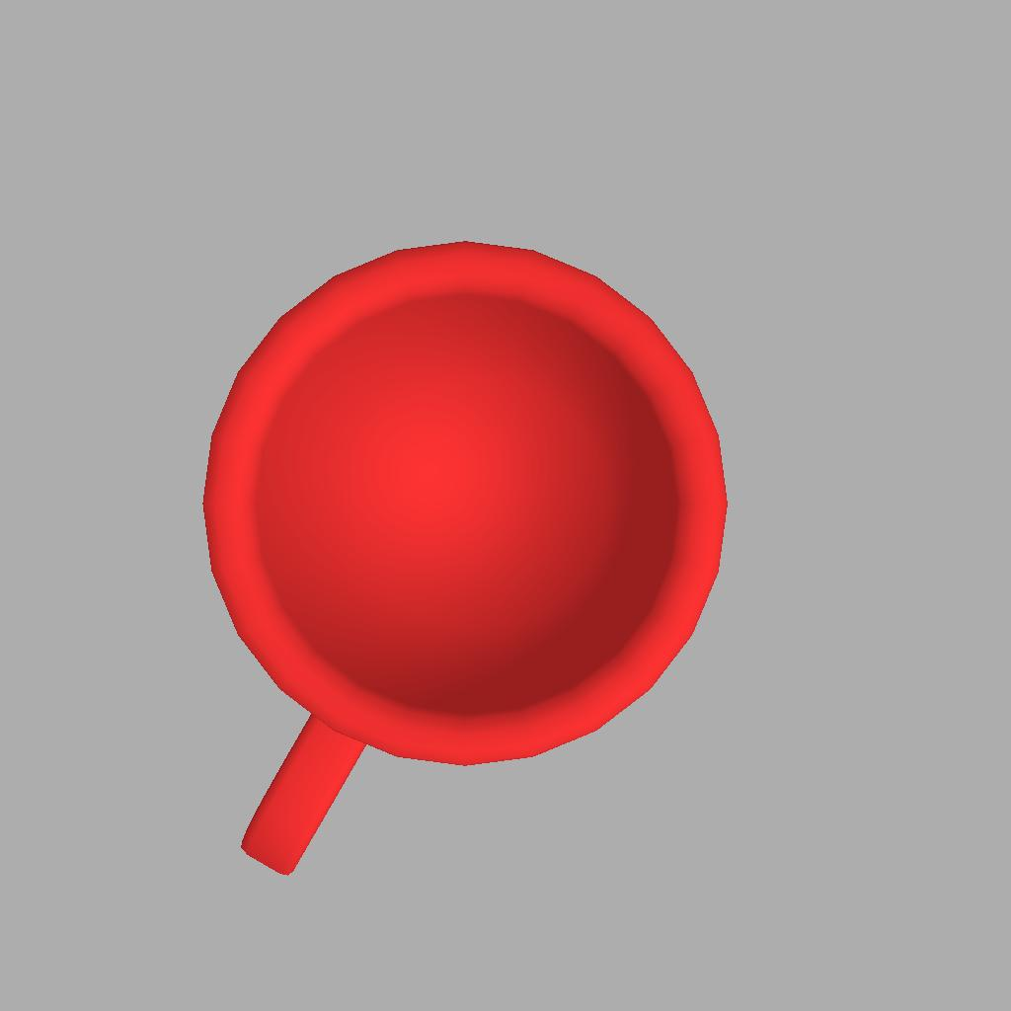
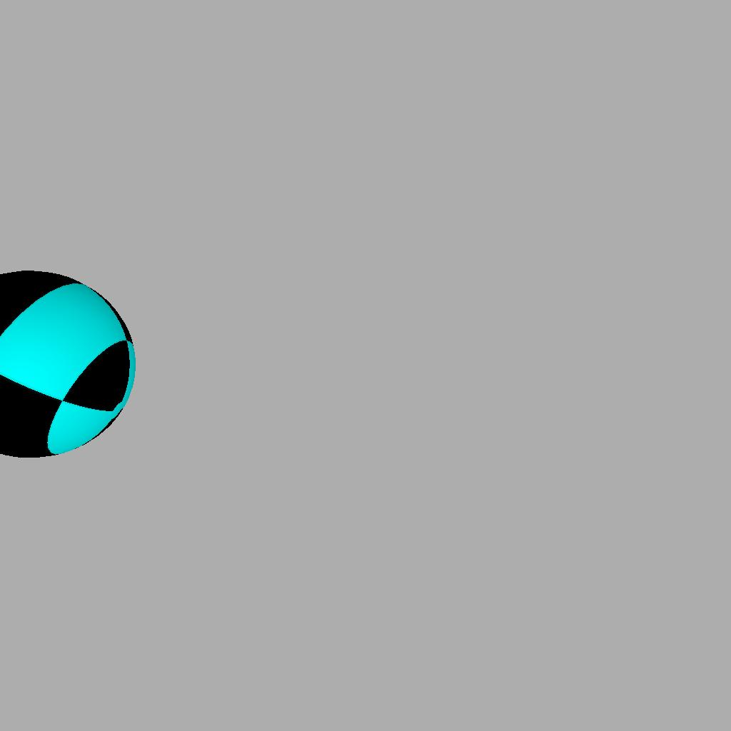
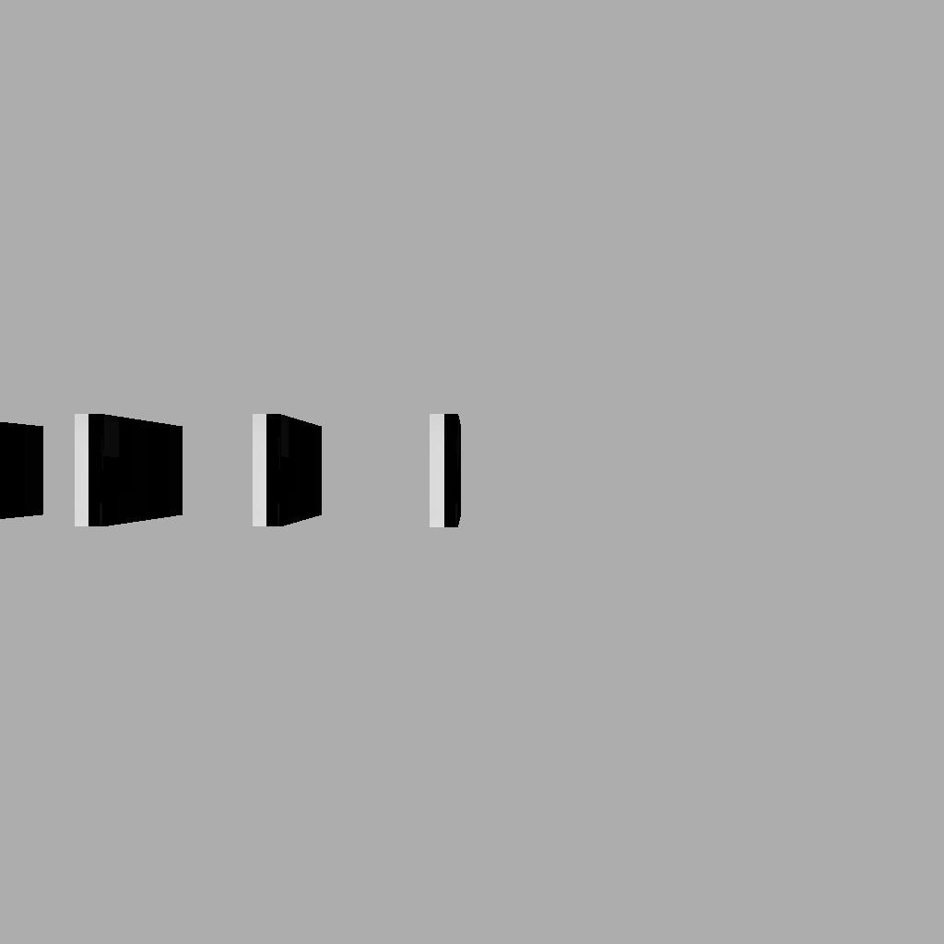
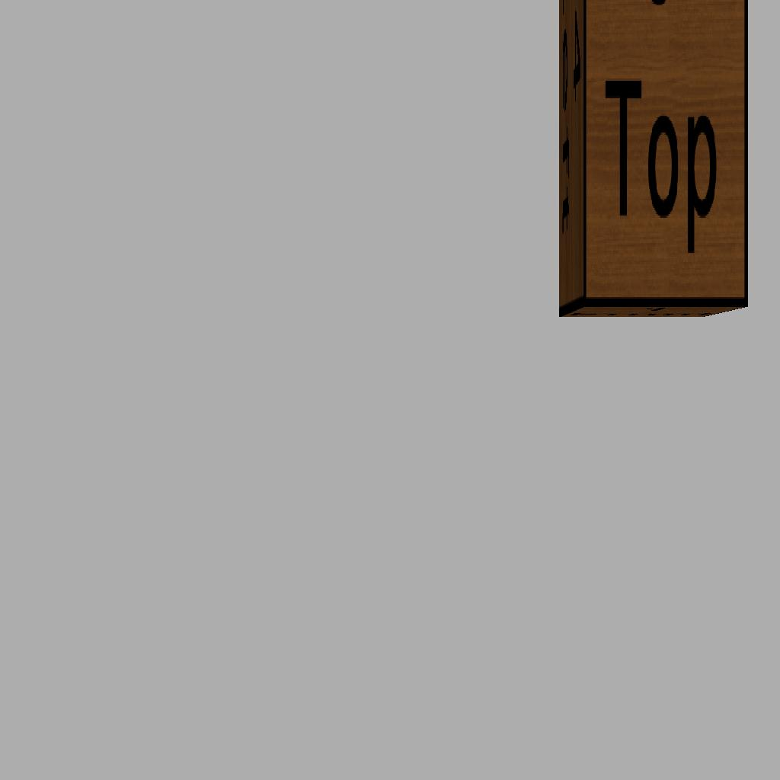
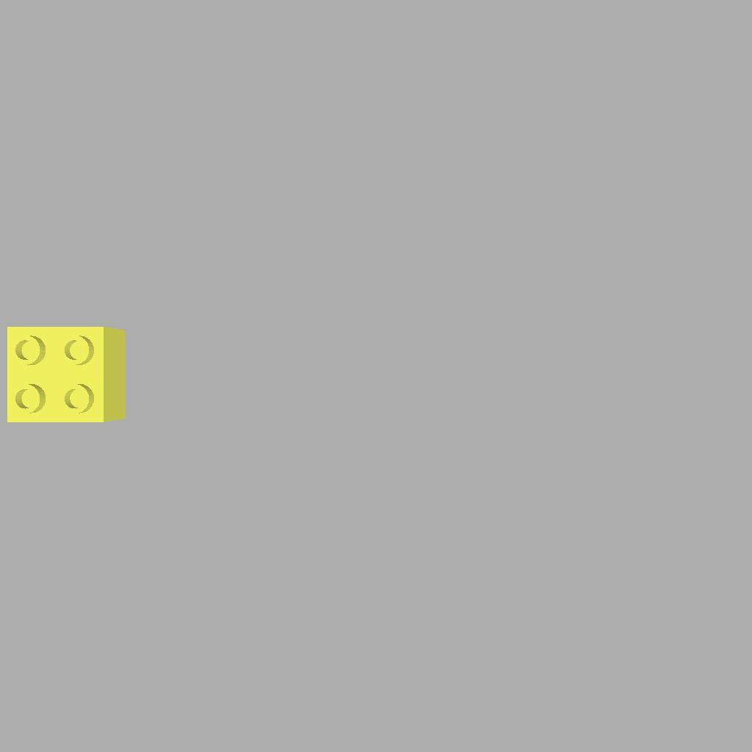
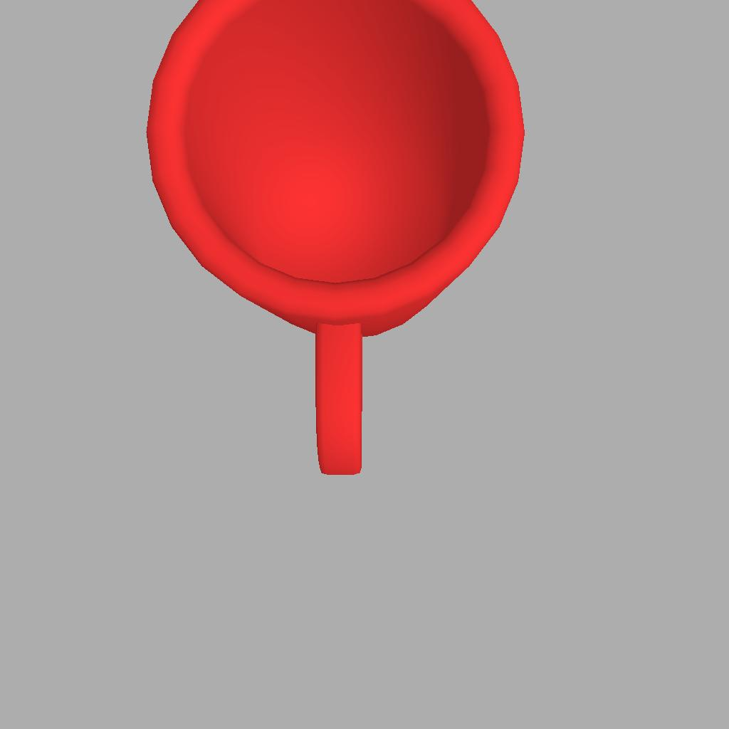
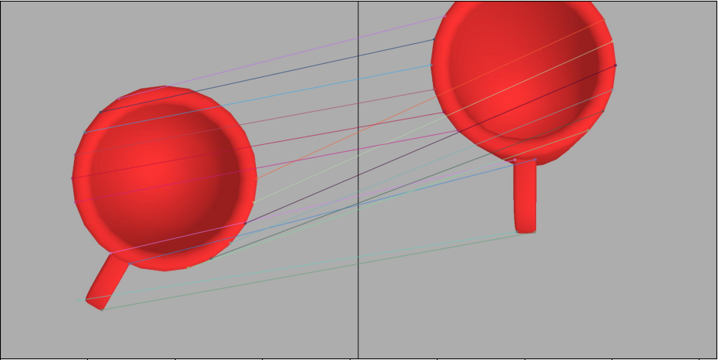
Training Demonstration Corpus
Demonstration
images
Demonstration
Trajectories
Live image
Execute Plan
End effector offset
Demo. Selection
Keypoint Matching
Calculate offset
Closest demonstration match
Trajectory Transfer

Slide 4
Ground truth keypoint
Correct Z (depth) value
Small X,Y pixel deviation
Large Z value deviation

