Slide 1

Lightweight One-shot Imitation Learning
Final Year Project
Alfie Chenery

Slide 2
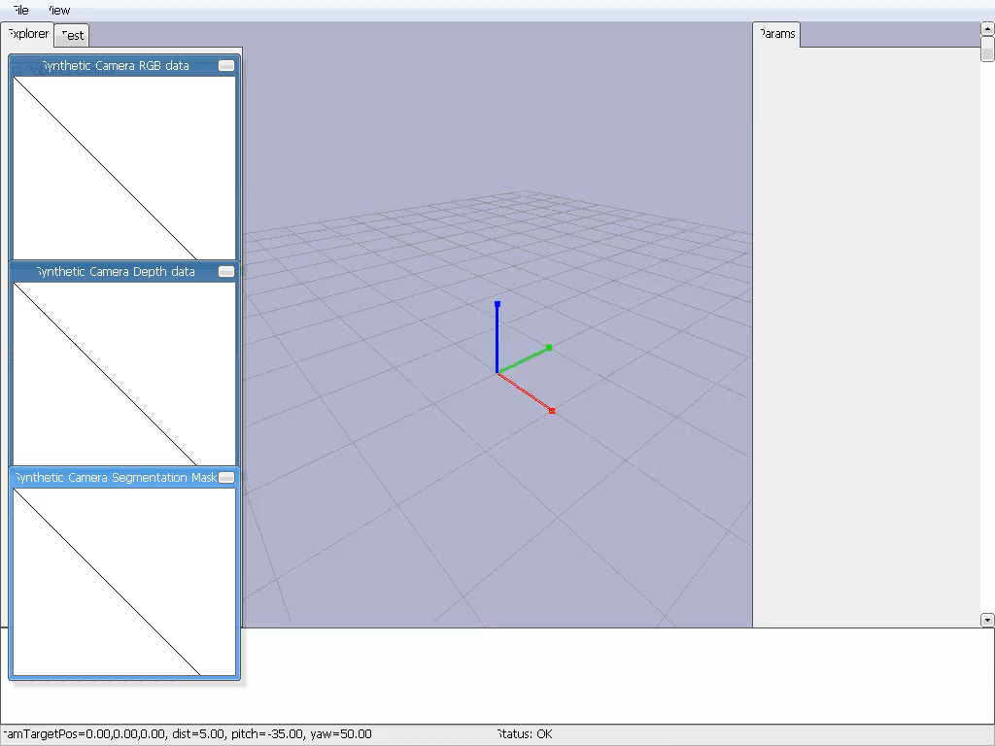
The Problem

Slide 3
The Problem

