Slide 1
Dr.Fit
Alfie Nurse COMP1004 project

Slide 2
Contents
Project Vision and Background
Project Plan and Sprints
UML Models
Initial Prototype
Issues/Challenges faced

Slide 3
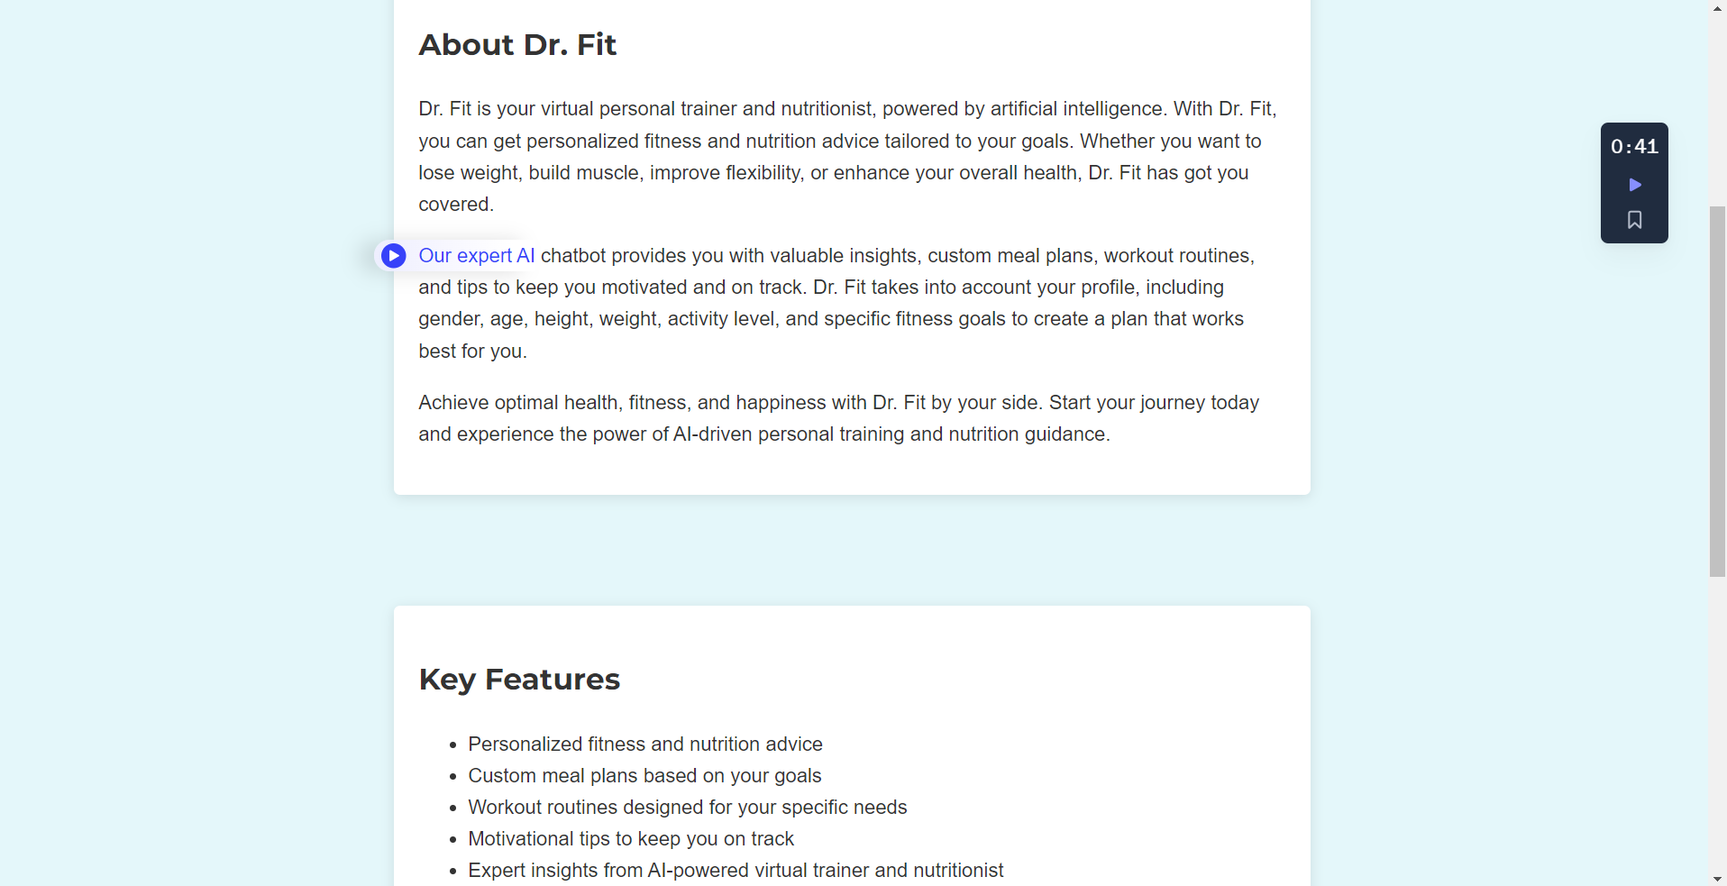
Project Vision and Background
My project, named 'Dr. Fit,' is a website that offers AI-based health advice. Users register with their username, email, and password. Additionally, they provide their gender, age, height, weight, fitness goal, determination level (reflecting the commitment they're willing to invest in their fitness goal), current activity level, and BMR type. The BMR type is for calculating the user's Basal Metabolic Rate (BMR)

Slide 4
Project Plan and Sprints
Sprint 1
Sprint 2
Sprint 3
- [x] ‘Pre-Design’ how registration will work
- [x] Learn HTML, CSS, JavaScript
- [x] Learn how OpenAI API works
- [x] Research on functions for calculating time taken for running or cycling
- [x] Design relevant HTML files for different parts of the website
- [x] Create relevant .bat files used for project development
- [x] Create website Icon picture
- [x] Create .env file
- [x] create function_call.py for function calling by the AI/Dr.Fit
- [x] create all calculations required by the AI for calculating health for the user

Slide 5
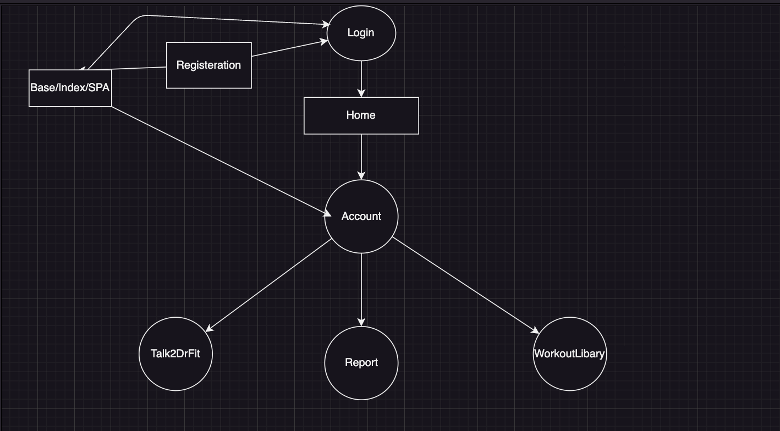
UML Model
First, the user is taken to a login page, where they either log in or register a new account, which'll, after logging in, direct them to a home page. On the home page, the user's health calculations and details will be displayed. This acts as a home page. The circles in this UML diagram act as functionality, whereas the rectangles represent the physical pages. The 3 bottom functionalities are: 1. To talk to DrFit, where he advises you and the API itself performs function calls, known as function calls, to further calculate data for you; 2. The workout library acts as a place where you can create workouts; and 3. The report is the general report for achieving your goals set out by DrFit. I try to make the SPA the rooted design of the project.

Slide 6
Issues and challenges faced
Learning OpenAI API
Learning Web Development with Flask Flamework(Python)
Learning DrawIO
Learning CSS
Learning SQLite3 Database Management
A reflective account considering the challenges and lessons learned throughout the project development process:
Creating a website with this level of functionality came with lots of debugging I needed to overcome, where I would have problems with Python(Flask) blueprints as well as prompt-engineering DrFit to be be the type of AI I wanted it to be; furthermore, I had great difficulty learning how to incorporate function-calling functionality into the AI, as this was a new thing at the time I implemented it, thus had to follow instructions directly from OpenAI’s documentation! Also, I had quite a few problems thus required extra revision of SQLite3.

