Slide 1
Dr.Fit
Alfie Nurse COMP1004 project

Slide 2
Contents
Project Vision and Background
Project Plan and Sprints
UML Models
Initial Prototype
Issues/Challenges faced

Slide 3
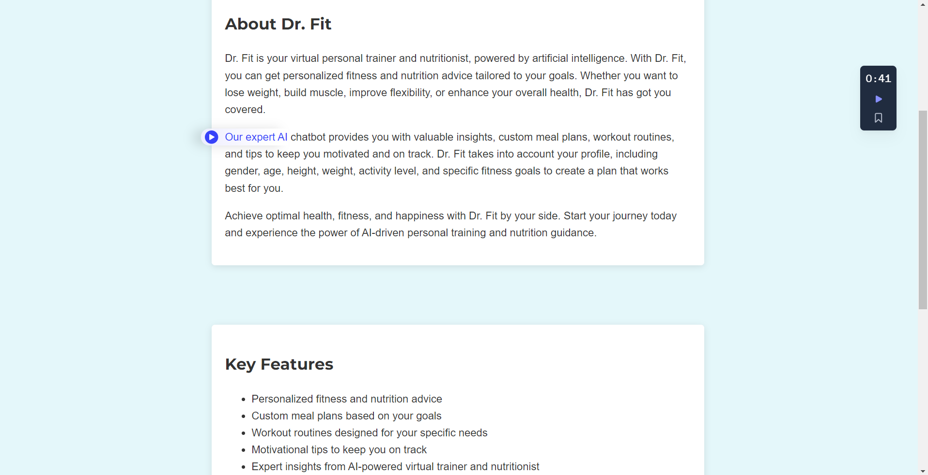
Project Vision and Background
My project, named 'Dr. Fit,' is a website that offers AI-based health advice. Users register with their username, email, and password. Additionally, they provide their gender, age, height, weight, fitness goal, determination level (reflecting the commitment they're willing to invest in their fitness goal), current activity level, and BMR type. The BMR type is for calculating the user's Basal Metabolic Rate (BMR)

Slide 4
Project Plan and Sprints (Until now, I will improve this as the final submission date approaches.)
Sprint 1
Sprint 2
Sprint 3
- [x] ‘Pre-Design’ how registration will work
- [x] Learn HTML, CSS, JavaScript
- [x] Learn how OpenAI API works
- [x] Research on functions for calculating time taken for running or cycling
- [x] Design relevant HTML files for different parts of the website
- [x] Create relevant .bat files used for project development
- [x] Create website Icon picture
- [x] Create .env file
- [x] create function_call.py for function calling by the AI/Dr.Fit
- [x] create all calculations required by the AI for calculating health for the user

Slide 5
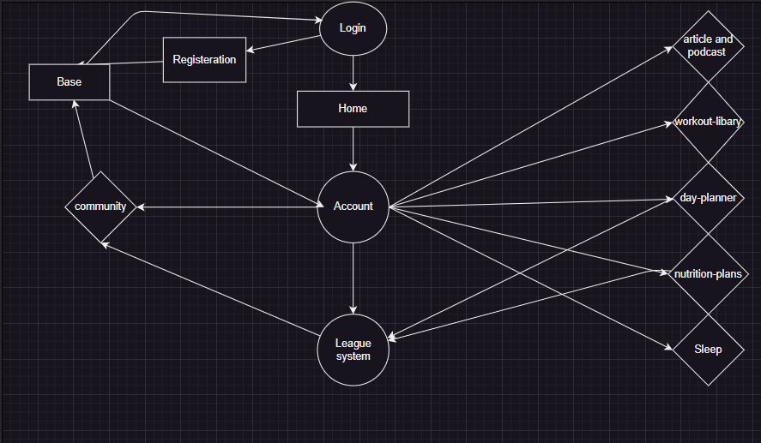
UML Model

Slide 6
Issues and challenges faced
Learning OpenAI API
Learning Web Development with Flask Flamework(Python)
Learning DrawIO
Learning CSS
Learning SQLite3 Database Management

