Slide 1

Analysis of CT Scans of Lungs with COVID
Objective: Build a model that can predict whether a patient has COVID or not by their CT scans and explore how the model makes its predictions.
Notes:
Image source: Microsoft 365 content library
A simple title page design uses minimal elements to create a professional look. Choose a clear, bold font for the title to ensure readability. Incorporate ample white space and subtle colors, keeping the design uncluttered and focused for a strong first impression.

Slide 2

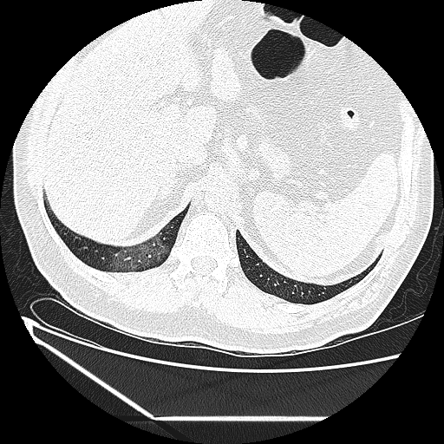
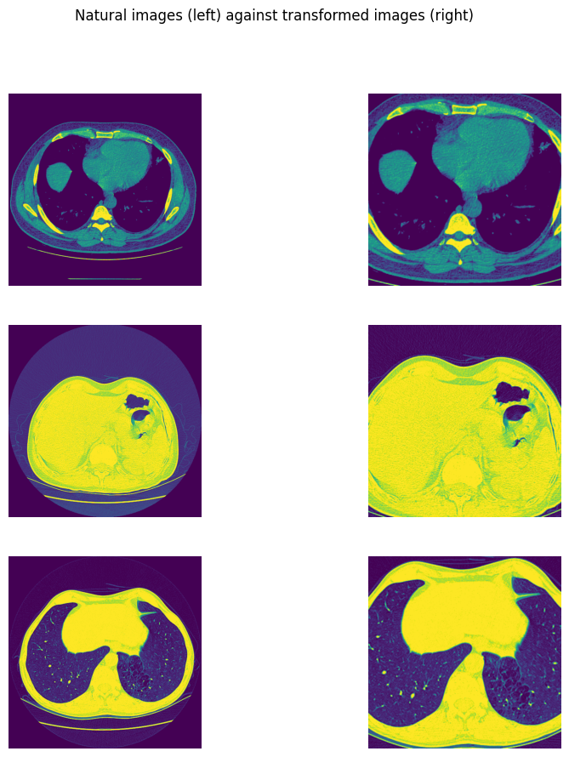
The Dataset
Dataset consisted of CT Scans of lungs of patients with COVID (7495) and without COVID (944)
Images of varying size and file types
Images were also cropped so that the lungs were the focal point of them

Slide 3
CNN Structure
3 convolutional layers, each with a dropout and a ReLU activation between them
Input data had one channel and was of size 512x512
Layer | Output channel | Kernel Size | Stride
1 | 32 | 8 | 4
2 | 64 | 7 | 4
3 | 64 | 4 | 3
Two fully connected layers with intervening size of 512 and a single output
Predicts probability of COVID
Other structures were tried

Slide 4
Model Training
Imbalance of samples, weighted sampler
Data augmentation used:
  Random Horizontal Flip
  Random Vertical Flip
  Random rotation (-15 deg, 15 deg)
Uses Adam optimisation with a L2 regularisation
Loss function: Binary Cross Entropy
Validation dataset seemed unhelpful

Slide 5
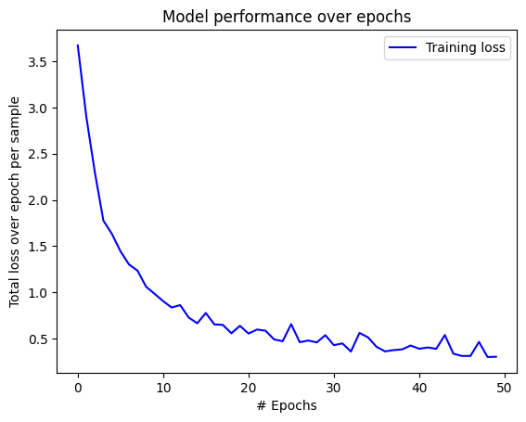
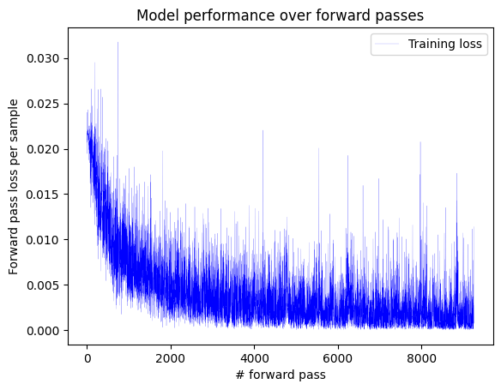
Model Evaluation
Accuracy and precision in the range of 96-99%
Large part of accuracy could be attributed to imbalance in data
Test performed on a reduced test datset
Accuracy and precision remained unchanged

Slide 6
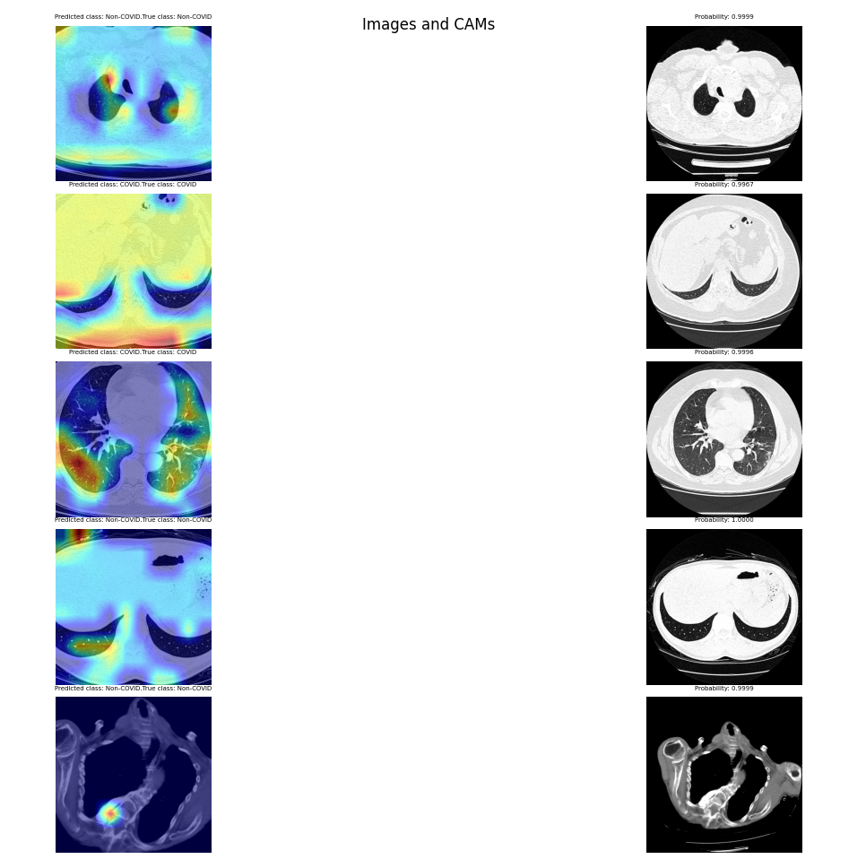
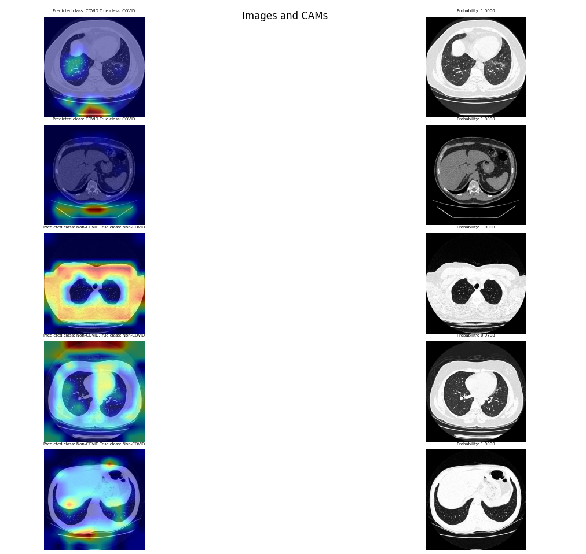
Model Visualisation
Grad-CAM heatmaps were generated
In initial training, images were not cropped
The model focused on irrelevant parts of the image
Model was retrained on cropped images
Left shows images with cropping. Right shows images without cropping

Slide 7

Technical Challenges
Despite cropping, for some images the model still paid attention to the very edges of the images
Variance in images made the heatmaps difficult to interpret
Cleaning data to make it consistent was difficult

