Slide 1
Dynamic Programming- Matrix chain multiplication

Slide 2
UQ June 2022
UQ June 2022
UQ June 2023
UQ June 2023

Slide 3
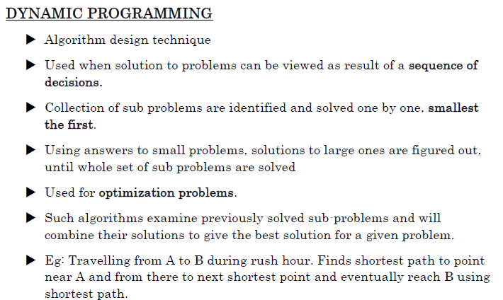

Slide 4
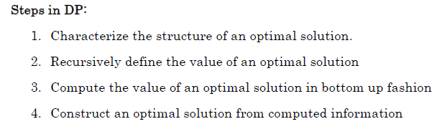

Slide 5
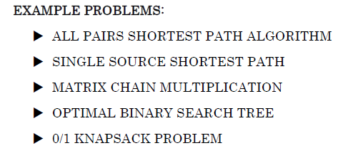


Slide 6
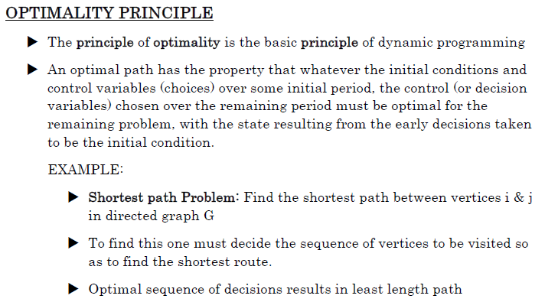

Slide 7
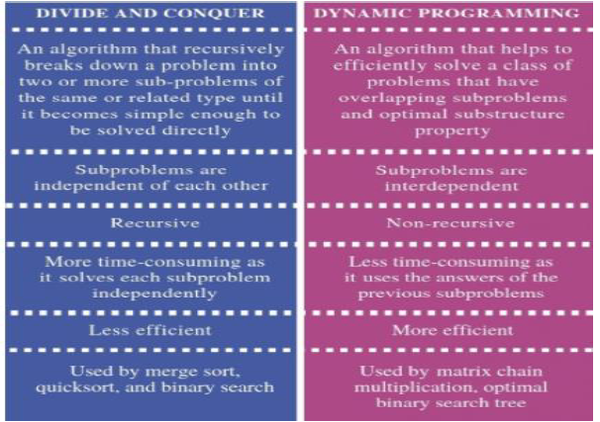

Slide 8
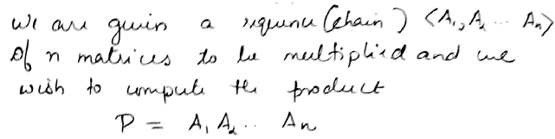
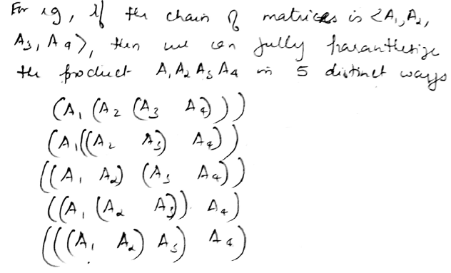
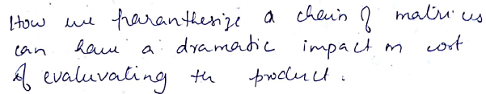
Optimal Matrix Multiplication(Matrix chain multiplication)

Slide 9
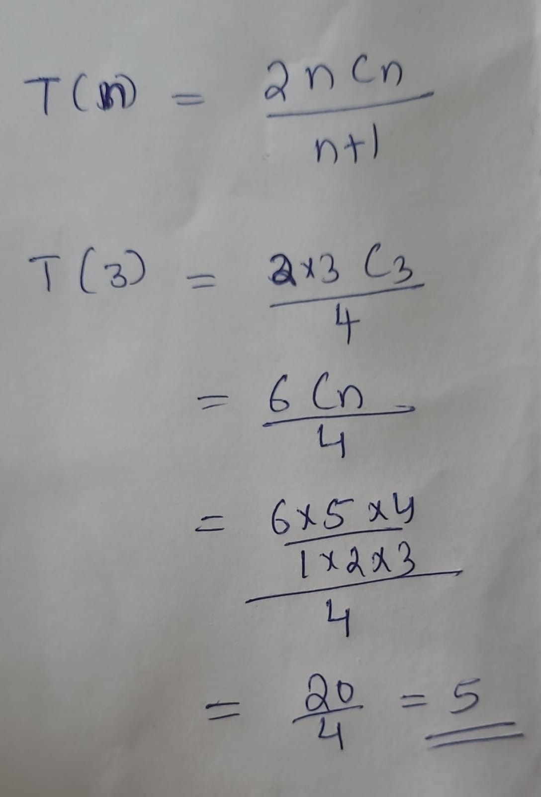
Finding –no.of paranthesization possible
If No.of matrices =4, take n=3 (ie n-1 )
Catalan Equation

Slide 10
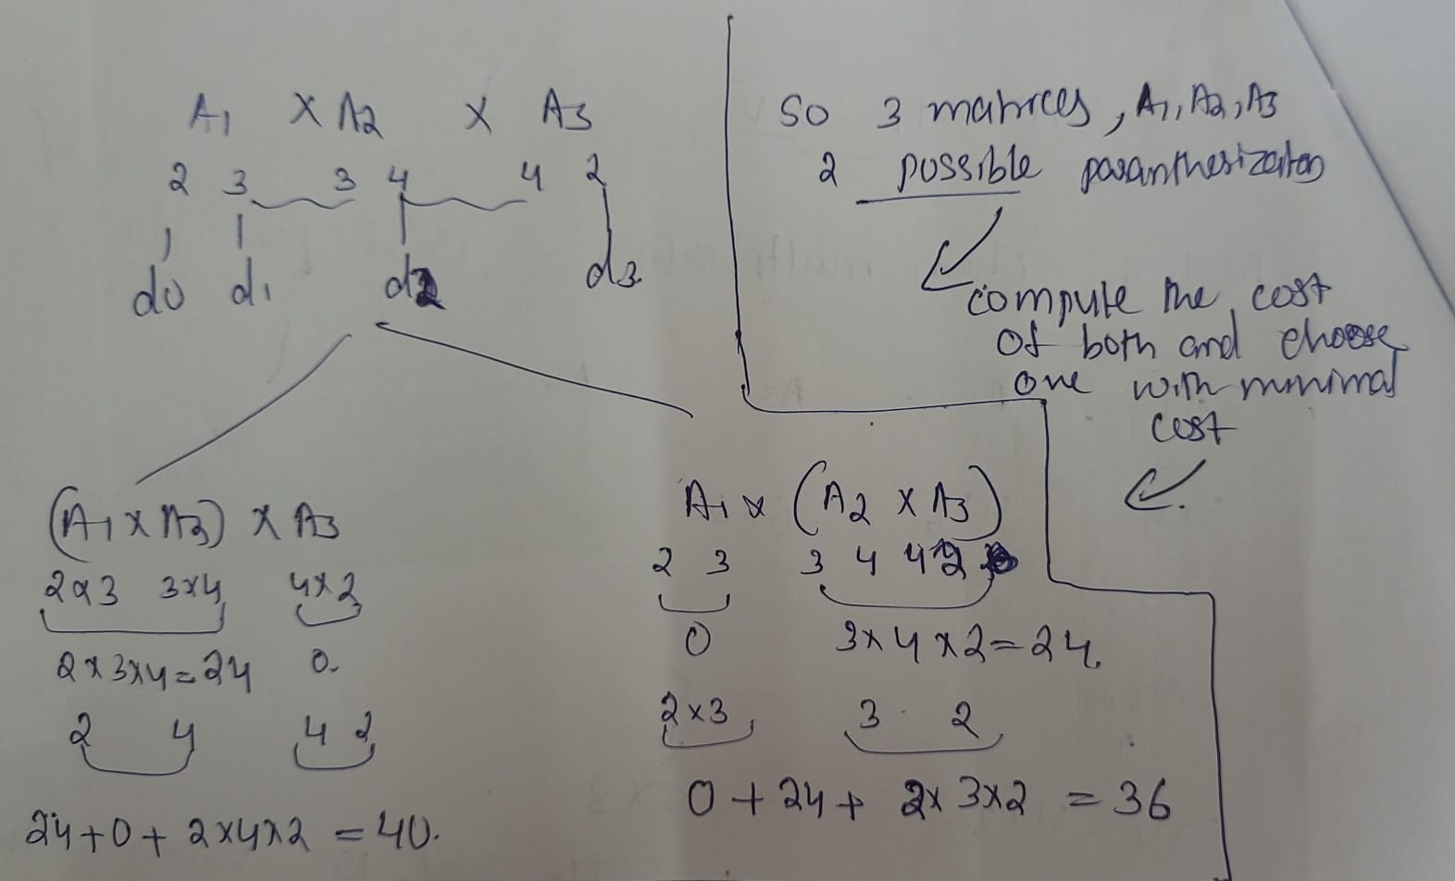

Slide 11
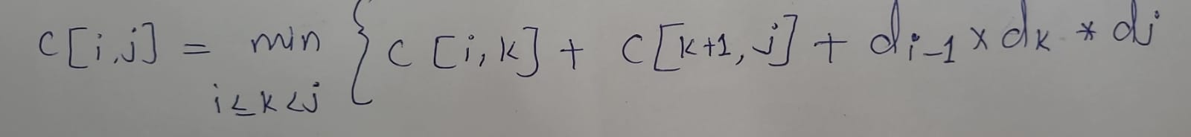
Matrix chain multiplication
If a chain of matrices are there for multiplication, first of all find out which multiplication or paranthesization to be performed, so that total efforts for multiplication should be minimal.
Ie how the paranthesization to be done such that the efforts requires for multiplication should be less.ie matrix chain multiplication problem.
In Dynamic programming we should try all possible paranthesization and pick out one with lesser effort.
If we have more no.of matrices, we need some formulae to find out best paranthesization

Slide 12
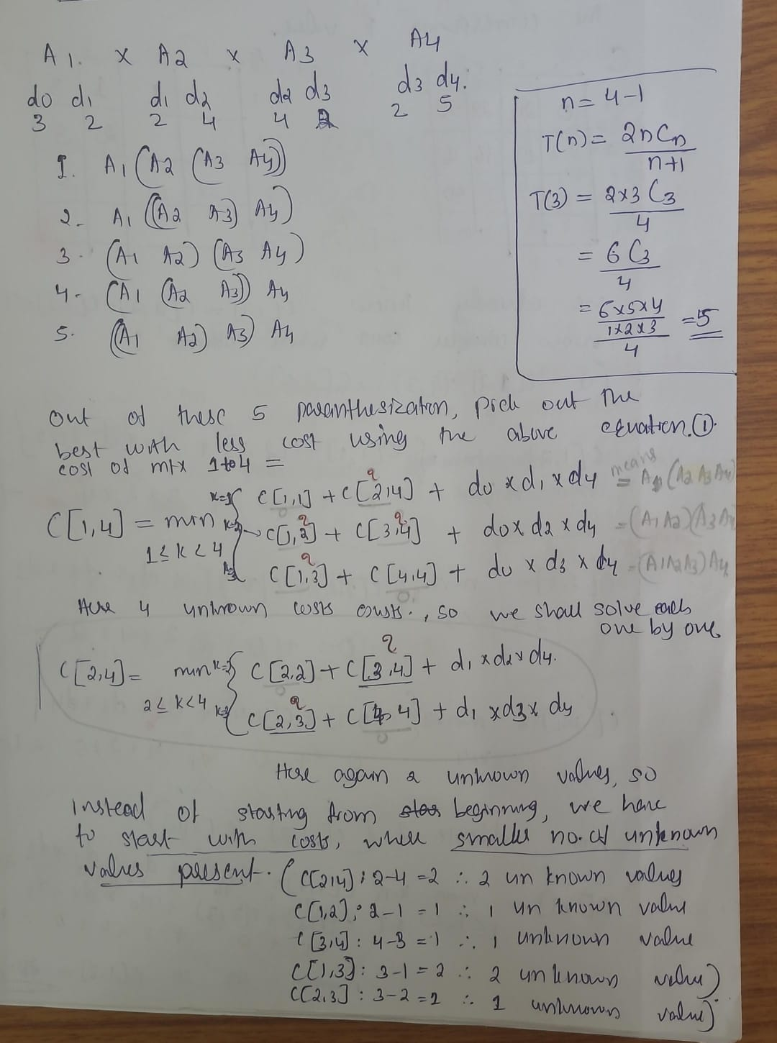

Slide 13
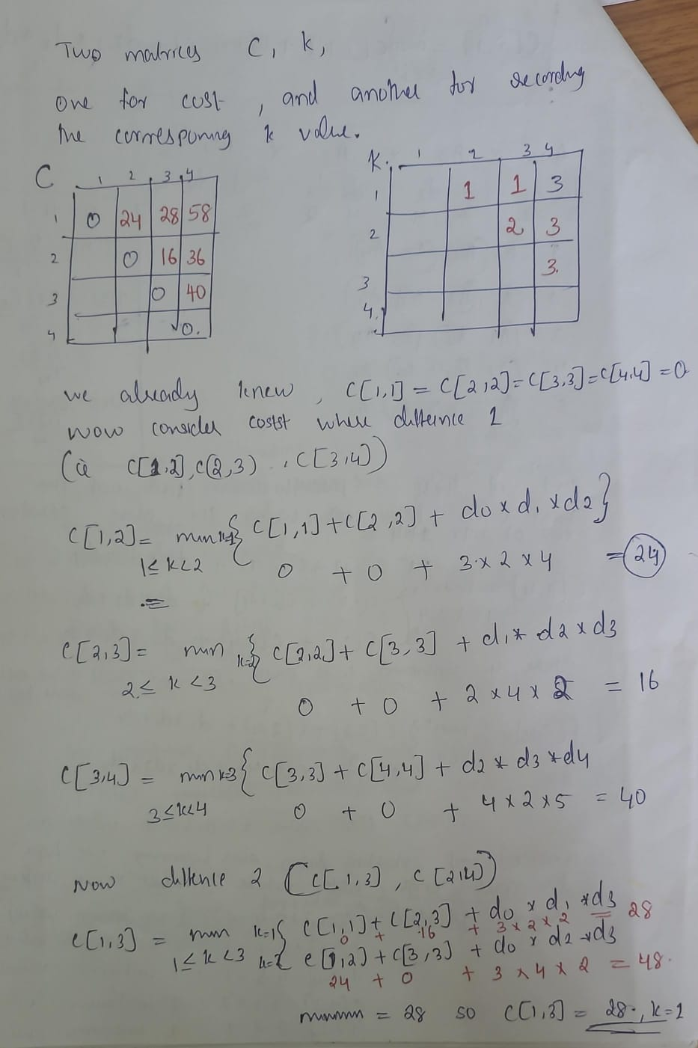

Slide 14
