Slide 1
Branch and Bound https://youtu.be/ylgHswyDIGY

Slide 2
Branch and Bound
▶ Branch and bound is a general algorithm for finding optimal solutions of various optimization problems.
▶ It consists of a systematic enumeration of all
candidate solutions, where large subsets of
fruitless candidates are discarded, by using
the
upper and lower estimated bounds of quantity being optimized

Slide 3
▶ The algorithm traverses a spanning tree of the solution space using the breadth first approach.
▶ It is a state space search method in which all children of E-node is generated before any other live node can become the E- node.

Slide 4
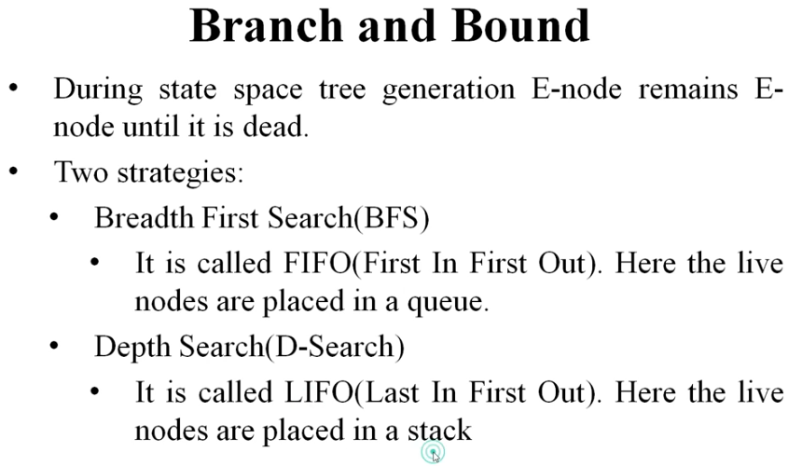

Slide 5
FIFO And LIFO
▶ Here, a BFS like state space search in which the live nodes are maintained using a queue is called FIFO and a D-Search like state space search in which the live nodes are maintained using a stack is called LIFO.
▶ As in the case of backtracking, bounding functions are used to avoid the generation of sub trees that do not contain an answer node.

Slide 6
LC(Least Cost Method)
▶ In both
selection rule
FIFO and
LIFO branch and bound,
for next E-node does not give
preference to a node that has a very good chance of getting the search to an answer node quickly.
▶ But in LC search
The search can be speeded up by adding a ranking function for live nodes.

Slide 7
▶ Next E-node is elected on the basis of ranking function.
▶ Rank is created on the basis of additional computational effort needed to reach an answer node from live node
▶ For any node x, cost could be → Number of nodes in the sub tree x that need to be generated before the answer node is generated

Slide 8
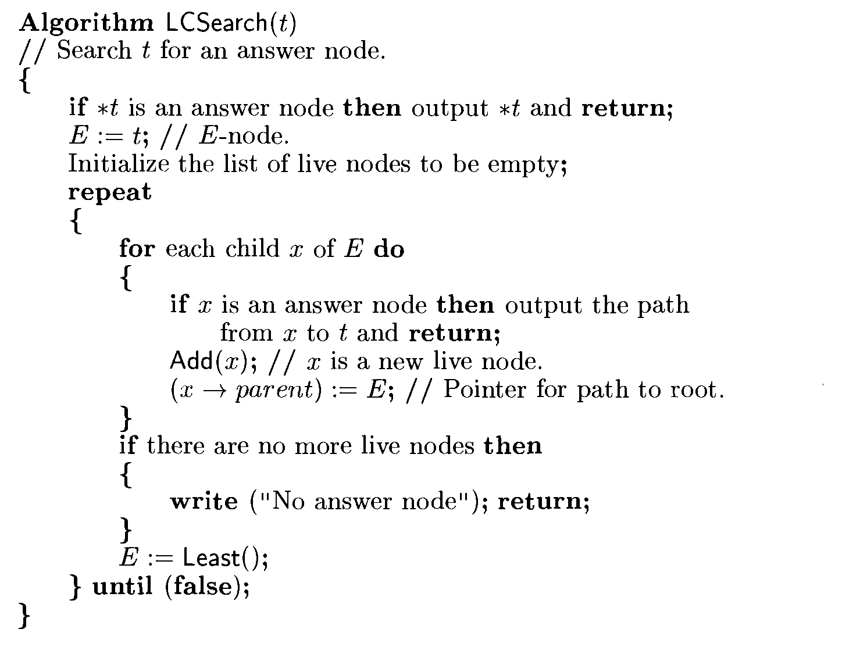

Slide 9
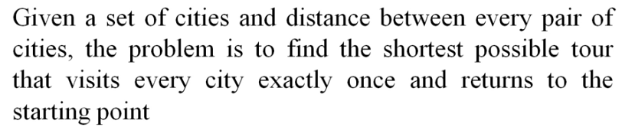
TRAVELLING SALESMAN PROBLEM

Slide 10
Let G=(V,E) be directed graph defining an instance of the travelling salesperson problem.
This graph is represented by a cost matrix where
Cij= the cost of edge, if there is a path between vertex i and vertex j
Cij = ∞, if there is no path
Convert the cost matrix into reduced matrix i.e. every row and column should contain at least one zero entry
Cost of reduced matrix is the sum of elements that are subtracted from rows and columns of cost matrix to make it reduced.

Slide 11
Make the state space tree for reduced matrix.
To find next node to be selected, find the least cost valued node by calculating the reduced cost matrix with every node.
If edges (i,j) is to be included, then there are three conditions to accomplish this task:
Change all entries in row i and column j to ∞
Set A[j,i] = ∞
reduce all rows and columns in resulting matrix except for rows and columns containing ∞

Slide 12
Calculate the cost of the matrix where cost = L + cost(i,j) + r
Where ‘L’ is the cost of original reduced cost matrix and ‘r’ is reduced cost matrix
Repeat the above steps for all nodes until all the nodes are generated and we get a path.

Slide 13
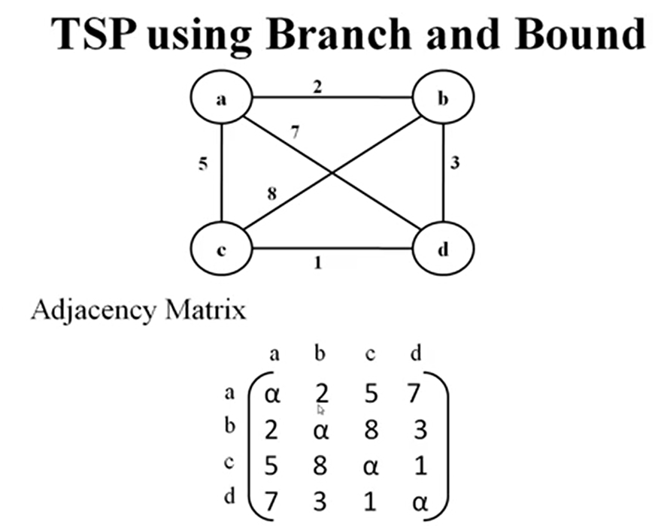

Slide 14
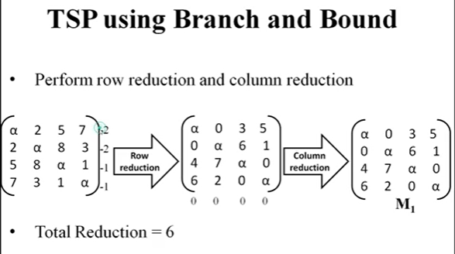
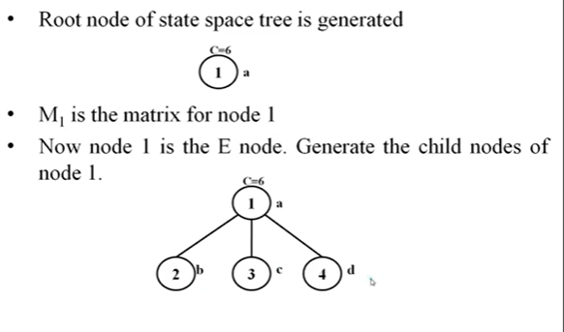

Slide 15
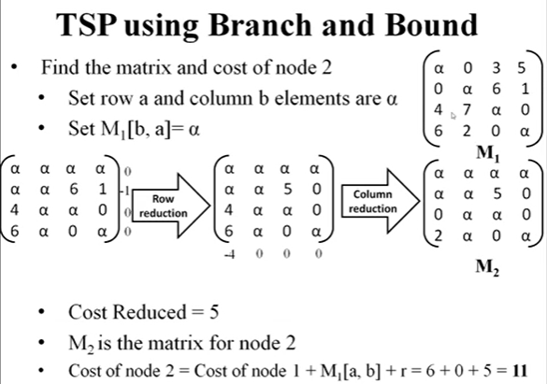

Slide 16
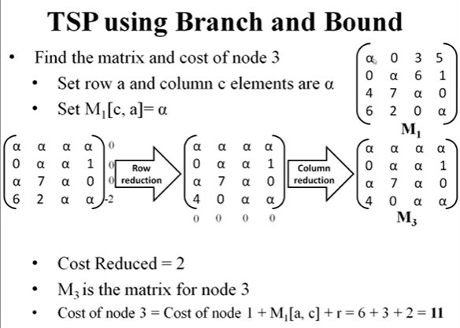

Slide 17
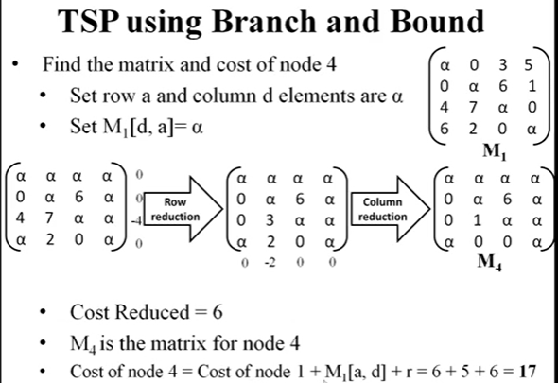

Slide 18
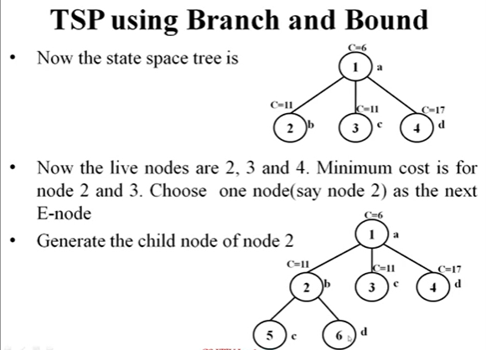

Slide 19
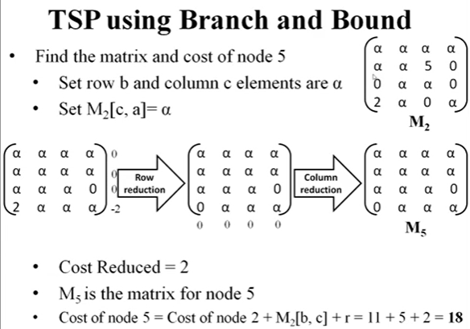

Slide 20
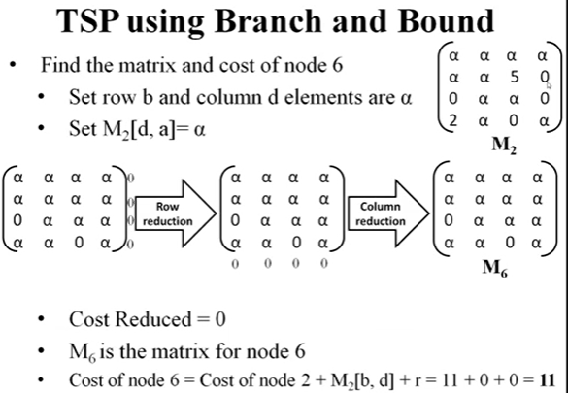

Slide 21
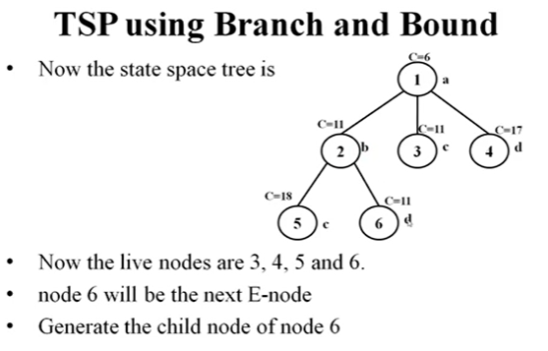
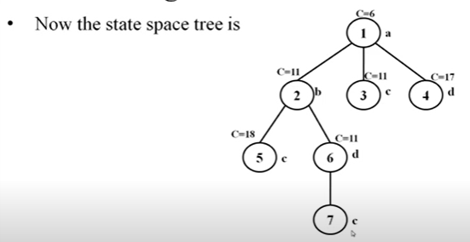

Slide 22


Slide 23
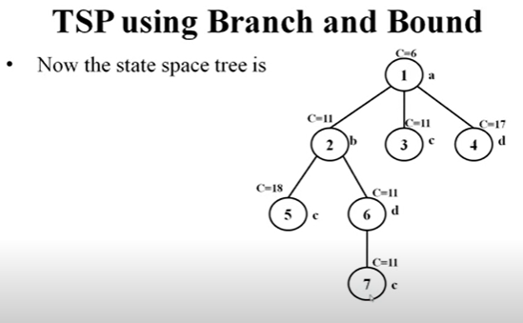
Next E node is 7.
But 7 has no child node as we reached a-b-d-c, then c to a.
The cost of this travel is 11

Slide 24
Example 2

Slide 25
∞ | 20 | 30 | 10 | 11
15 | ∞ | 16 | 4 | 2
3 | 5 | ∞ | 2 | 4
19 | 6 | 18 | ∞ | 3
16 | 4 | 7 | 16 | ∞
∞ | 10 | 17 | 0 | 1
12 | ∞ | 11 | 2 | 0
0 | 3 | ∞ | 0 | 2
15 | 3 | 12 | ∞ | 0
11 | 0 | 0 | 12 | ∞
Original matrix
Reduced matrix
L= 10 +2+2+3+4+1+3 = 25

Slide 26
25
1
i1=2
i1=5
i1=3
i1=4
2
3
4
5

Slide 27
∞ | ∞ | ∞ | ∞ | ∞
∞ | ∞ | 11 | 2 | 0
0 | ∞ | ∞ | 0 | 2
15 | ∞ | 12 | ∞ | 0
11 | ∞ | 0 | 12 | ∞
∞ | ∞ | ∞ | ∞ | ∞
1 | ∞ | ∞ | 2 | 0
∞ | 3 | ∞ | 0 | 2
4 | 3 | ∞ | ∞ | 0
0 | 0 | ∞ | 12 | ∞
Path 1,2, node 2
LC= 25+ 10 + 0 = 35
Path 1,3, node 3
LC= 25+ 17 + 11 = 53
∞ | ∞ | ∞ | ∞ | ∞
12 | ∞ | 11 | ∞ | 0
0 | 3 | ∞ | ∞ | 2
∞ | 3 | 12 | ∞ | 0
11 | 0 | 0 | ∞ | ∞
∞ | ∞ | ∞ | ∞ | ∞
10 | ∞ | 9 | 0 | ∞
0 | 3 | ∞ | 0 | ∞
12 | 0 | 9 | ∞ | ∞
∞ | 0 | 0 | 12 | ∞
Path 1,4, node 4
LC= 25+ 0 + 0 = 25
Path 1,5, node 5
LC= 25+ 1 + 5 = 31

Slide 28
25
1
i1=2
i1=5
i1=3
i1=4
2
35
31
3
53
25
4
5
The node with lowest cost is node 4 with cost 25. expand this node in the next iteration

Slide 29
∞ | ∞ | ∞ | ∞ | ∞
∞ | ∞ | 11 | ∞ | 0
0 | ∞ | ∞ | ∞ | 2
∞ | ∞ | ∞ | ∞ | ∞
11 | ∞ | 0 | ∞ | ∞
∞ | ∞ | ∞ | ∞ | ∞
1 | ∞ | ∞ | ∞ | 0
∞ | 1 | ∞ | ∞ | 0
∞ | ∞ | ∞ | ∞ | ∞
0 | 0 | ∞ | ∞ | ∞
Path 1,4,2, node 6
LC= 25+ 0 + 3 = 28
Path 1,4,3, node 6
LC= 25+ 12 + 13 = 50
∞ | ∞ | ∞ | ∞ | ∞
1 | ∞ | 0 | ∞ | ∞
0 | 3 | ∞ | ∞ | ∞
∞ | ∞ | ∞ | ∞ | ∞
∞ | 0 | 0 | ∞ | ∞
Path 1,4,5, node 6
LC= 25+ 0 + 11 = 36

Slide 30
25
i1=2
1
i1=5
i1=3
i1=4
35
2
25
31
53
3
4
5
i2=2
i2=5
i2=3
6
8
7
50
36
28
The node with lowest cost is node 6 with cost 28. expand this node in the next iteration

Slide 31
∞ | ∞ | ∞ | ∞ | ∞
∞ | ∞ | ∞ | ∞ | ∞
∞ | ∞ | ∞ | ∞ | 0
∞ | ∞ | ∞ | ∞ | ∞
0 | ∞ | ∞ | ∞ | ∞
∞ | ∞ | ∞ | ∞ | ∞
∞ | ∞ | ∞ | ∞ | ∞
0 | ∞ | ∞ | ∞ | ∞
∞ | ∞ | ∞ | ∞ | ∞
∞ | ∞ | 0 | ∞ | ∞
Path 1,4,2,5 node 10
LC= 28+ 0 + 0 = 28
Path 1,4,2,3, node 9
LC= 28+ 11 + 14 = 52

Slide 32
25
i1=2
1
i1=5
i1=3
i1=4
35
2
25
31
53
3
4
5
i2=2
i2=5
i2=3
6
8
7
i3=3
i3=5
50
36
28
10
9
52
28
The node with lowest cost is node 10 with cost 28. expand this node in the next iteration

Slide 33
Path 1,4,2,5,3 node 10
∞ | ∞ | ∞ | ∞ | ∞
∞ | ∞ | ∞ | ∞ | ∞
∞ | ∞ | ∞ | ∞ | ∞
∞ | ∞ | ∞ | ∞ | ∞
∞ | ∞ | ∞ | ∞ | ∞
LC= 28+ 0 + 0 = 28

Slide 34
25
i1=2
1
i1=5
i1=3
i1=4
35
2
25
31
53
3
4
5
i2=2
i2=5
i2=3
6
8
7
i3=3
i3=5
50
36
28
10
Path : 1,4,2,5,3
Cost: 28
9
52
28
i4=3
11
28

Slide 35
Example 3
∞ | 7 | 3 | 12 | 8
3 | ∞ | 6 | 14 | 9
5 | 8 | ∞ | 6 | 18
9 | 3 | 5 | ∞ | 11
18 | 14 | 9 | 8 | ∞

Slide 36
1
i1=2
i1=5
i1=4
17
i1=3
2
16
15
3
15
4
5
i2=4
i2=2
i2=3
15
15
7
8
6
i3=2
i3=3
15
9
10
15
i4=4
11
15

