Slide 1
Privacy Security Risk Analysis For Medical Big Data in Urban Computing
Alfin William
S5 MCA

Slide 2
Urban Computing
Use of urban resources and data mining to extract meaningful information from a large pool of urban data and using it to provide wisdom for people to make wise decisions in daily life.

Slide 3
Applications of Urban Computing
Transportation
Environment
Urban planning
Economics
Medical services

Slide 4
Medical Services in Urban Computing
Data involved is basically human – based.
Largely personal data containing health records.
Used for disease history , diagnosis of a patient.
Effectively useful in community planning , disease prevention and for medical research.

Slide 5
Data-flow of Medical Information in Urban Computing
Medical Resources
Subject Related data resources
Industry Related data resources
Internet data resources.

Slide 6
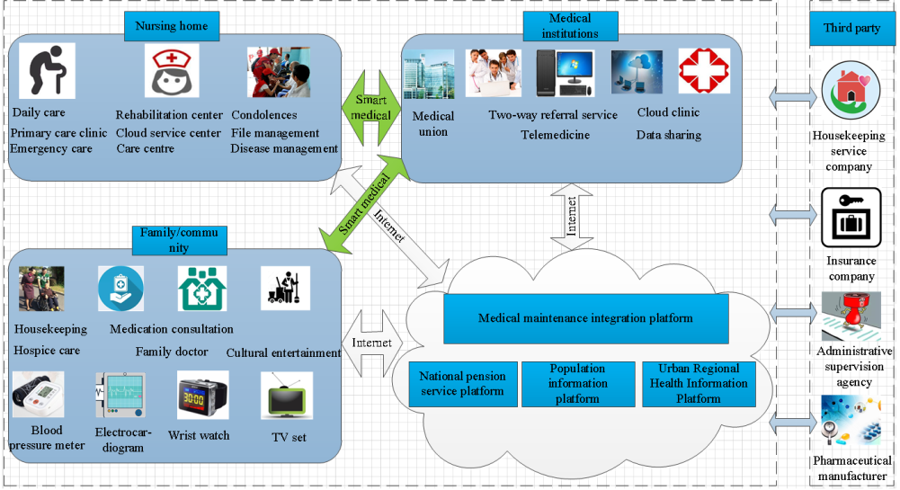

Slide 7
“Medical Big Data”. Is it Secure & private?
Booming technologies like Cloud Computing , IoT , mobile Internet posing high threat.
Urgent to solve information security issues throughout the lifecycle of medical big data.
These Lifecycle stages include : big data production > collection > storage > sharing > exchange and use.

Slide 8
In this study:
Initial analysis of risk indicators conducted using brainstorming, Delphi, questionnaire, Interview & field research.
Comprehensive weight of Secondary indicators calculated via GI method & Entropy weight method.

Slide 9
Fuzzy comprehensive evaluation model used to evaluate risk level of data.
Risk reduction Stratergies in the various individual life cycle of medical big data concluded and presented.

Slide 10
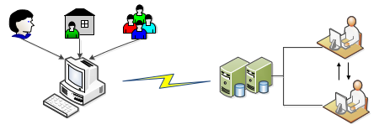
1. Design of Risk Evaluation Indicator System
Privacy & security issues most prominent in these four stages :
Data Collection
Data Transmission
Data Storage
Data usage & sharing

Slide 11
Due to Rapid development of Internet & medical, risk of
medical big data is now partly intersected with the risk of
network security and privacy leakage.
By consulting relevant medical experts and personnel of
medical institutions and also combining field research,
Brain storming, Delphi, Interview, questionnaire and other
research methods : An improved and established primary
risk index system was created.

Slide 12
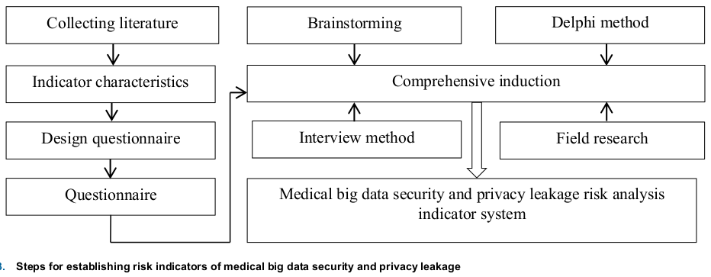
Resultant risk assessment indicator system included 4 First level
indicators and 35 Second level indicators.

Slide 13
Data Collection Phase (A1) :
Data collection without patient knowledge (B1)
Unethical medical staffs (B2)
Lack of patient privacy protection laws and regulations (B3)....(B9).
Data Transmission Phase (A2) :
Hardware security (B13)
Software security (B14)
Virus Intrusion (B15).. B(16)

Slide 14
Data Storage Phase (A3):
Internal Personnel stealing information (B17)
Virtual vulnerability (B19)
Data backup and recovery (B27)
Access control mechanism not perfect (B21)
Data Usage & Sharing Phase (A4):
Data ownership not clear (B3)
Encryption and key management weak (B11)
Hospital information pattern not standardised (B31)

Slide 15
2. Calculate Weight of Risk Analysis Indicators
a) Subjective Weight Calculation based on GI Method
Sorting the importance of Indicators
Determine the relative importance of each indicator
Determine weight of indicator
Cluster decision result

Slide 16
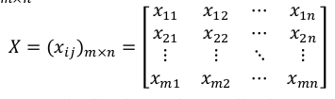
Objective Weight Calculation based on Entropy Method
Construct judgement matrix X according to expert score table

Slide 17
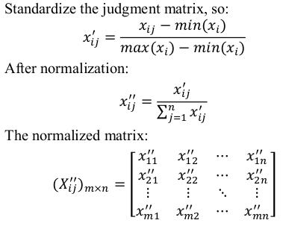
Data Standardization & normalization

Slide 18
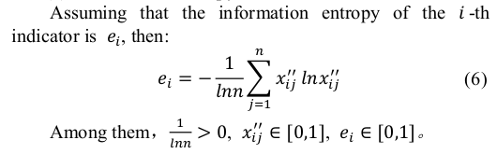
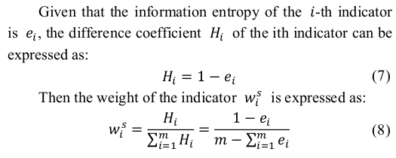
Calculate entropy of each indicator
Calculate weight of each indicator

Slide 19
3. Fuzzy Comprehensive Evaluation Method
Determine the indicator evaluation set of evaluated object
Determine weights and membership vectors of each indicator
to obtain fuzzy evaluation matrix.
Fuzzy evaluation matrix and indicator weight vector evaluated to obtain fuzzy comprehensive evaluation results.

Slide 20
Determining the indicator domain of the evaluation object
U = { u1 , u2 .. um }
m = no. Of evaluation indicators
Determine the weight vector of each vector:
Weights of indictors have been calculated by GI method & Entropy
method on step 2.
Determine the evaluation level domain :
Set of various evaluation results experts take on evaluation object,
represented by V: V = { v1 , v2 .... vn }
n = no. Of intervals for risk grades.

Slide 21
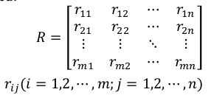
Single Factor Fuzzy evaluation
Fuzzy relation matrix R is determined :

Slide 22
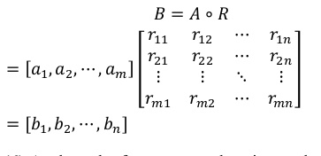
Multi-Factor Fuzzy evaluation
Fuzzy comprehensive evaluation result vector B can be obtained
by performing an intergrated operation on each of indicator weight
vector A and the fuzzy relation matrix R.

Slide 23
Analyze fuzzy comprehensive evaluation results
Result of current fuzzy comprehensive evaluation is a vector rather
Than a specific value , so further processing of result is needed.
According to specific scenarios , either one of two methods ,
Principle of maximum membership degree
Principle of weighted average
should be selected with respect to actual conditions.

Slide 24
4.1 Result Analysis
According to their conducted experimental analysis & sample study , they have come up with comprehensive results.
  In primary indicators , weights of data storage & data analysis was relatively higher with respect to data collection and transmission stages.

Slide 25
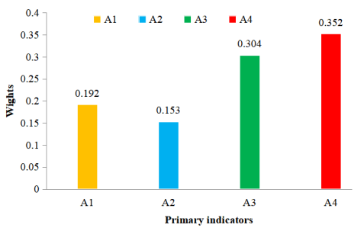
A1 : data collection , A2 : data transmisson , A3 : Data storage , A4: Data analysis

Slide 26
4.2 Future Risk Reduction Stratergies
Data Collection Phase :
          Privacy protection technologies like cryptography, local differential privacy, social graph privacy, location track privacy recommended.
Data Transmission Phase:
          Recommended use of VPN technology or SSL communication protocol
          to guarantee intrusion prevention from hackers & conduct timely scan for security vulnerabilities.

Slide 27
Data Storage Phase :
          Recommended to establish management system of “multi-level authorization and consistent responsibility” & strict medical data Confidentiality regulations.
          Severe punishment for medical data stealing & trafficking.
Data Use & Sharing Phase:
          Standardization of hospital platform interaction and electronic medical record interaction to prevent unauthorised access and tampering of medical data.

Slide 28
Conclusion
As an emerging cross – cutting area , urban computing is generating large amount of data in urban spaces using large scale sensor data’s and computer infrastructure.
Emergence of IoT and Big data accelerated the privacy & security risk related to urban computing.
This paper analyzed medical service industry in urban computing and it’s security & privacy concerns.
Cross – domain environment that includes education , health care , government and commerical sectors needs further research to ensure data safety.

Slide 29
Thank You

