Slide 1
Sports Match Analysis using Social Media Mining
Domain : Data Mining
Alfin William
LTVE17MCA058
Roll No : 55
MCA S6

Slide 2
Overview
Introduction
Literature Review
Problem Definition
Motivation
Objectives
Proposed System
Experimental Evaluation
Data Sets
Results & Discussion
Future Scope
Publications
Conclusion

Slide 3
Introduction
A live sports match conveys tremendous amount of information real-time in a fast pace.
This information about the gameplay , individual player performance & the one of many unique strategies that led to success should be analysed and recorded.
Conventional data analysing methods are costly and resource consuming , whereas combining the strength of Web data mining and Sports can yield better results and is economical in general.

Slide 4
Literature Review
AUTHOR | PAPER TITLE | YEAR OF PUBLISHING | METHODOLOGY
C. Xu, J. Wang, K. Wan, Y. Li, and L. Duan | Live sports event detection on broadcast video and web-casting text | 2006 | Using 4 modules: live text/video capturing, live text analysis, live video analysis, and live text/video alignment.
Young-seok kim and Mijung kim | ‘A Wisdom of Crowds’: Social Media Mining for Soccer Match Analysis | 2019 | Web scraping & API of collection, Clustering algorithms for organising and retrieval of data
Nichols, J. Mahmud, and C. Drews | Summarizing sporting events using twitter | 2012 | Unsupervised algorithm for generating a textual summary of events & comparison with human results.

Slide 5
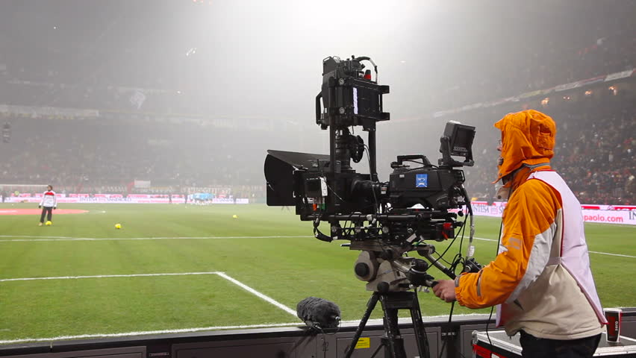
Problem Definition
Conventional Method
Current Sports team performance analysis include following methods:
Video data :

Slide 6
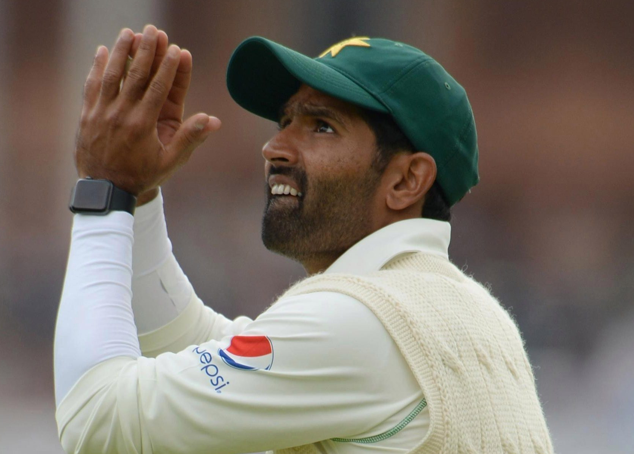
Video data from on-field cameras divided into thousand of individual events and analysing player speed , performance , posession time.
Wearable devices :
Wearable devices using technologies like GPS to capture performance based on running speed , cadence , distance , time etc

Slide 7
Drawbacks
Conventional methods drawbacks include:
Video data processing & analysis are complicated , computationally burdensome and not exactly cost efficient.
Wearable devices needs favourable conditions , needs constant monitoring , maintenance and risk of failure.

Slide 8
Motivation
Largely untouched area of Web Data Mining.
Scope of this project can be extended to other similar scenarios and applications that work with realtime human interaction data.
To analyse the effectiveness of Complex Data Mining Algorithms in computing & extracting useful information from largely unstructured human interaction data.

Slide 9
Objectives
Collect & analyse social media fan comments & extract logically top comments for performance improvement in future matches.
Divide fan comments into mutiple clusters of unique topics to analyse the specific area of gameplay they mostly focused & evaluated about.
Perform Sentiment analysis on fan comment data to evaluate fan satisfaction and overall emotional response to the match.

Slide 10
Proposed System
The Fan’s Perspective :
Fans comes in all shapes and sizes : from Daily workers to experienced Data scientists.
They closely follow their team and anticipate different use cases, deriving conclusions from it and sharing it real-time on social media.

Slide 11
This is a largely untouched pool of data that can effectively convey useful information to team’s management.
Using this derived data , Future matches and Stratergies of teams can be improved and managed to further make efficient use of team’s resources.
Morever , this data collection & manipulation involves less economical and computational overhead compared to conventional methods.

Slide 12



System Design
Data Collection Stage
Web Data Scraping : Collecting user comments from social
media sites using API’s like Twitter & Reddit API. This requires
Unique autentication keys and API Keys from client application.

Slide 13
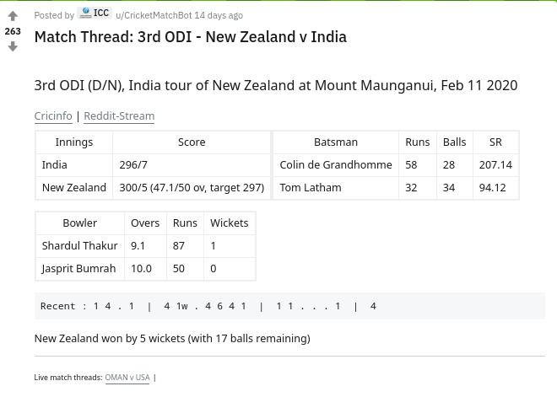
Sample Reddit Thread page for a Cricket match – This individual thread contained 4.6k
Unique user comments.

Slide 14
Preprocessing Data : After collecting data , the relevant keywords
are extracted using Data mining algorithm : -
TF – IDF Algorithm
[ Term frequency – Inverse Document frequency ]
Term frequency of individual relevant keywords in a document.
Compares the frequency with the frequency of that word in total
collection of documents.
Predicts the relevance of that specific word using both frequencies.

Slide 15
Data Processing Stage
K – Means Clustering
Derives homogeneous subgroups within the data corpus according to a similarity measure such as euclidean-based distance or correlation-based distance.
The results of clustering analysis help ODI experts identify similar fan requirements and in turn, specific fan requirements can be identified.

Slide 16
Data Processing Stage
Sentiment Analysis
Natural Language Toolkit ( NLTK ) of python was used for a Lexicon based method to sentiment analyse fan comments.
Comments are classified into positive , negative or neutral by comparing it with labelled dataset of words.

Slide 17
Result Representation Stage
Ipywidgets
This lightweight python GUI library can be used to
accommodate the entire results of most relevant fan comments
and their sentiment analysis and cluster classifications without
causing computational and resource overhead.

Slide 18
Experimental Evaluation
Data Collection Phase
Data set analysis revealed Reddit fan comments to be more critic and constructive than emotional reactions of twitter fans.
The 280 character limit of twitter proved to limit fans capability to express views.
Since reddit followed thread formatting with comments and subcomments style , it provided content rich debate data.

Slide 19
Data Processing Phase
TF – IDF values indicated fans mostly taking about a specific sports person or about a specific key event of the match.
Higher weight scores contained country , sports person names & historical score values.
K – Means Clustering proved strenuous since all data were from a similar domain.
Distinct Clusters contained similar comments since fans talked about multiple issues in a single comment.

Slide 20
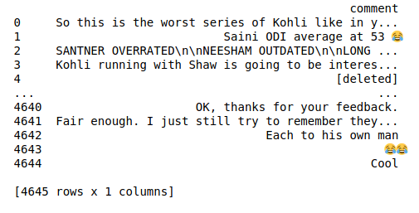
Screenshots
Reddit API results

Slide 21
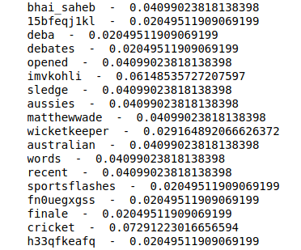
TF – IDF words with weight scores

Slide 22
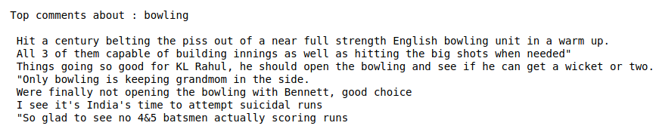
Top fan Comments

Slide 23
Cluster based top comments

Slide 24
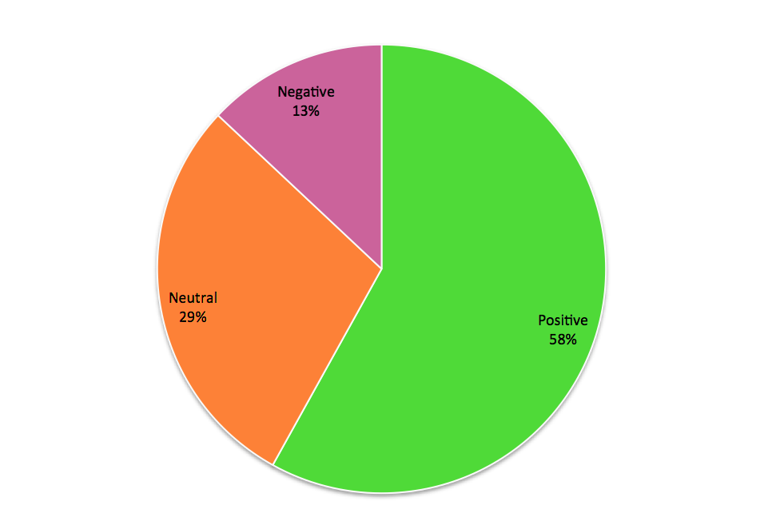
Sentiment Analysis
Total fan comments

Slide 25
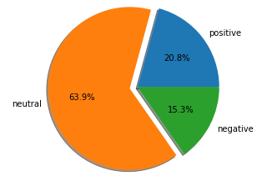
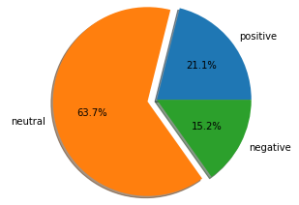
Cluster Based Sentiment Analysis
Batting Cluster
Bowling Cluster
Fielding Cluster

Slide 26
Results & Discussion
Data Scraping from social media sites were successful with use of REST API calls to clients.
Content ranging around 5000 comments retrieved from reddit possessed more quality factor than twitter data.
Preprocessing of text was imperative to weed out colloquial words , emojis and other noise from information.

Slide 27
TF – IDF algorithm resulted accurate weight predictions with weights within the range of 0.23 and 0.01.
K – Means Clustering with K value = 3 , seemed strenous due to similar domain of data.
Sentiment Analysis was successfully completed with fan emotions captured and recorded for future analysis.
The sentiments : Postive was above 50% in all cases followed by neutral emotion of around 15 – 30%.

Slide 28
Future Scope
Expanding to other social medias using their official API’s.
Automation and streamlining of the entire process.
Realtime collection & computation using Cloud computing.
Collection & storage of large data corpuses both historical data and present using Big Data methologies.

Slide 29
Conclusion
The project was successfully completed with results recorded.
Future enhancements were analysed and feasibility discussed.
Use of social media data for sports match analysis was realised and proven using valid results.
All processed data collected and stored in appropriate formats for future uses.

