Slide 1




K9 OPERATIONS AND CASE LAW FOR
OFFICERS & HANDLERS
Fourth Amendment Foundations for Detector Dog Operations
Law reviewed through September 9, 2026 • Training reference only — follow agency policy and legal guidance
For Patrol Officers Who Call for K9 • For K9 Handlers Who Deploy
Latimer School of Operational K9s • k9school.net

Slide 2
COURSE OVERVIEW
Class Agenda
01 Roles & Foundations
Patrol vs Handler responsibilities • Place • Caballes • Edmond
02 Probable Cause & Reliability
Harris deep dive • residual odor • documentation • testimony
03 Homes, Curtilage & Technology
Jardines • Dunn • Kyllo • Collins • Earl v. State
04 Alabama & 11th Circuit
Braddy • Ostertag • Bain marijuana odor • vehicle exceptions
05 Traffic Stop Duration
Rodriguez + Campbell • no added time without RS
06 Handler Cueing & Best Practices
Four Classes of Behavior • cueing • video defense
07 Occupant Removal
Mimms • Wilson • Creller as persuasive authority
08 Practical Exercises + Closing
Mock traffic stops • app-style decision questions
2

Slide 3
FOUNDATION
Two Separate Areas of Responsibility
PATROL OFFICER
K9 HANDLER
• Conduct a lawful stop
• Ensure scene safety (traffic, bystanders, loose dogs)
• Develop and articulate RS if an extension is needed
• Request K9 without slowing the traffic mission
• Search the vehicle only if PC or another exception exists
• Document times, observations, statements, and search results
• Do not interpret K9 behavior unless qualified; report only what you actually observed
• Respond expeditiously
• Confirm the scene is safe for deployment
• Understand whether the traffic mission is still active or what lawful basis supports continued detention
• Deploy the dog safely and neutrally
• Interpret and report the dog’s behavior
• Communicate clearly: Alert / No Alert / No deploy
• Do not create or adopt patrol RS facts; accurately report K9 activity, behavior, times, and results
3

Slide 4
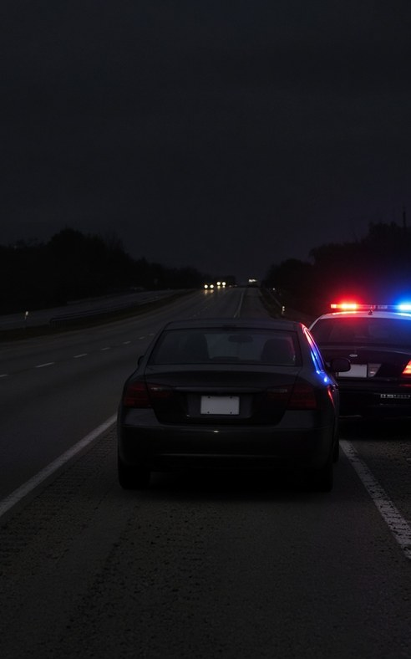
Pretextual Traffic Stops — legal if objectively justified
Whren v. United States, 517 U.S. 806 (1996)
An objectively lawful traffic stop is not invalid merely because the officer also has an investigative motive. The constitutional focus is the objective basis for the seizure.
Field rule: be able to identify the traffic violation or reasonable suspicion that justified the stop. Whren does not authorize discriminatory enforcement or biased statements.
4

Slide 5
FOUNDATION
The Fourth Amendment Lens
“The right of the people to be secure in their persons, houses, papers, and effects, against unreasonable searches and seizures…”
Search
Seizure
Physical intrusion on a protected person, house, paper, or effect to obtain information — or invasion of a reasonable expectation of privacy
Meaningful interference with a person’s liberty or possessory interests
Reasonableness
Probable Cause
The ultimate constitutional touchstone
Fair probability that contraband or evidence will be found
5

Slide 6
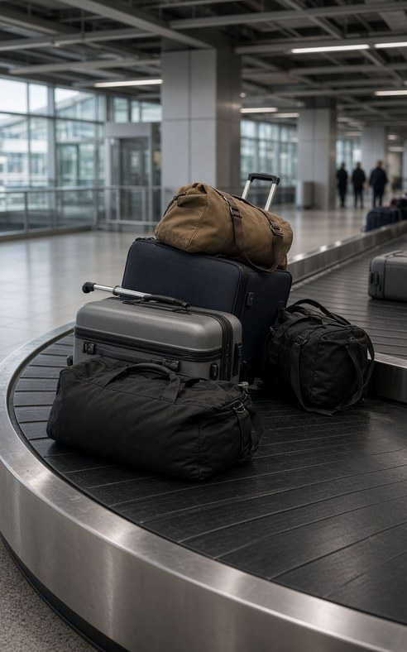
LANDMARK CASE
United States v. Place (1983)
462 U.S. 696 • 9–0 • Justice O’Connor
A canine sniff of luggage in a public place is not a “search” under the Fourth Amendment.
Not a Search
The sniff discloses only the presence or absence of narcotics — limited information that does not expose noncontraband items.
Public Place Context
Addressed luggage temporarily detained at an airport. Minimal intrusion relative to a full search of the contents.
Seizure Still Matters
While the sniff itself was not a search, the 90-minute detention of the luggage was an unreasonable seizure. Duration remains critical.
6

Slide 7
LANDMARK CASE
Illinois v. Caballes (2005)
543 U.S. 405 • 6–2 • Justice Stevens
A dog sniff conducted during a lawful traffic stop that does not prolong the stop is not a Fourth Amendment search.
Core Holding
Operational Impact
• Reveals only the location of a substance no one has a legal right to possess.
• Does not compromise any legitimate privacy interest.
• Relied on Place — canine sniff is sui generis.
• The stop itself must remain lawful in duration and scope.
• Free-air exterior sniff of a lawfully stopped vehicle is permitted without separate drug RS only if the sniff adds no time.
• A dog sniff is not part of the traffic mission.
• Caballes does not authorize extending the stop solely for the sniff.
• Rodriguez — and in the 11th Circuit, Campbell — control the timing question.
7

Slide 8
RELATED CASE
City of Indianapolis v. Edmond (2000)
531 U.S. 32 • 6–3 • Justice O’Connor
A highway checkpoint whose primary purpose is to detect evidence of ordinary criminal wrongdoing (drug interdiction) violates the Fourth Amendment.
Why It Matters for Patrol & K9
Edmond reinforces that suspicionless seizures whose primary purpose is ordinary crime control are unconstitutional. Drug-dog checkpoints that stop every vehicle or random vehicles primarily to discover narcotics fall under this rule.
Contrast: properly structured checkpoints serving recognized non-crime-control purposes, such as sobriety or border-related purposes, are analyzed differently.
Practical takeaway: Do not use a K9 unit as the justification for a general crime-control roadblock. A stop still needs individualized suspicion or a recognized checkpoint/constitutional exception.
8

Slide 9
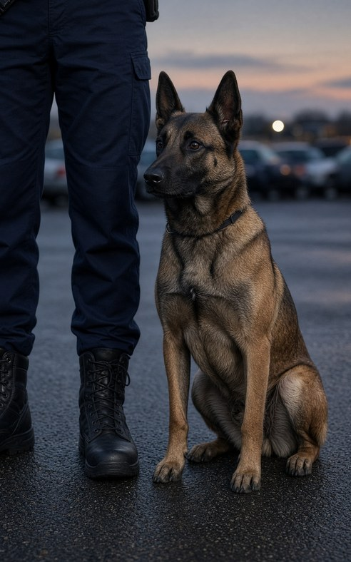
LANDMARK CASE
Florida v. Harris (2013)
568 U.S. 237 • Unanimous • Justice Kagan
“The question — similar to every inquiry into probable cause — is whether all the facts surrounding a dog’s alert, viewed through the lens of common sense, would make a reasonably prudent person think that a search would reveal contraband or evidence of a crime. A sniff is up to snuff when it meets that test.”
Training & Certification
Evidence that a bona fide organization certified the dog can itself provide sufficient reason to trust the alert.
Totality of Circumstances
Courts consider training records, handler experience, the particular alert, and any conflicting evidence.
Defense Opportunity
Defendant may still challenge reliability, handler conduct (including cueing), and the specific alert circumstances.
9

Slide 10
RELIABILITY & DEFENSIBILITY
Best Practices After Florida v. Harris
1
Current certification from a recognized organization
2
Recent controlled-testing records (including residual-odor scenarios)
3
Training logs showing consistent performance
4
Handler training and experience documentation
5
Clear articulation of the dog’s trained final response versus mere interest
6
Complete body-worn video that captures the deployment and handler movement without directing body language
10

Slide 11

PRACTICAL ISSUE
Residual Odor & Unverified Alerts
A dog may alert to residual odor from drugs that are no longer present. Under Harris, a negative search does not automatically defeat probable cause. The question remains whether all facts surrounding the alert would make a reasonably prudent person believe a search would reveal contraband or evidence.
Handlers must be prepared to:
• Explain odor dynamics and residual scent in plain language
• Distinguish a trained final response from mere interest
• Document controlled-testing performance that includes residual-odor scenarios
• Avoid over-claiming: an alert does not always mean current presence of a usable quantity
11

Slide 12
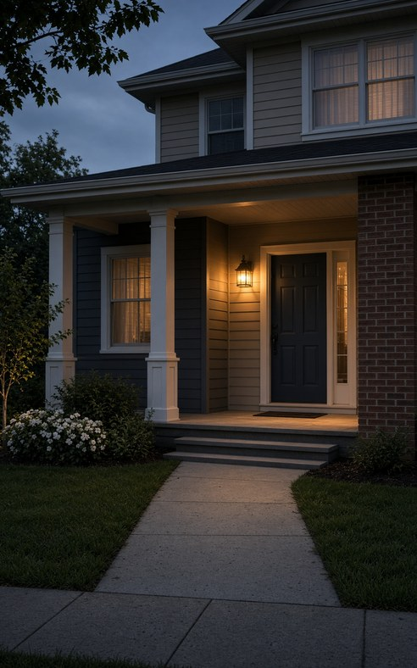
LANDMARK CASE
Florida v. Jardines (2013)
569 U.S. 1 • 5–4 • Justice Scalia
Using a trained dog to investigate the area immediately surrounding a home (the curtilage) is a Fourth Amendment search.
Property-Based Holding
The home is “first among equals.” An officer may approach a home and knock (knock-and-talk), but introducing a trained police dog to explore the area around the home in hopes of discovering evidence is something else. There is no customary invitation to do that.
Practical Consequences
• Front porch / doorway sniffs of residences generally require a warrant or recognized exception to the warrant requirement.
• Decision rests primarily on trespass / property rights.
• Caballes remains good law for vehicles and public places.
• Apartment hallways and door seams raise fact-specific questions (see Earl).
12

Slide 13
CURTILAGE RULES
What Counts as Curtilage? The Dunn Factors
United States v. Dunn (1987) supplies the four factors courts use. They are analytical tools — not a mechanical formula.
1
Proximity
2
Enclosure
How close is the area to the residence? Front porches and areas immediately adjacent to doors are almost always curtilage.
Is the area enclosed by a fence, wall, or other barrier that marks it as part of the home’s private space?
3
Nature of Uses
4
Steps to Protect Privacy
Is the area used for intimate activities of the home rather than open fields or public access?
Has the resident taken steps to shield the area from observation by people passing by?
13

Slide 14

LANDMARK CASE
Kyllo v. United States (2001)
533 U.S. 27 • 5–4 • Justice Scalia
Thermal imaging of a home to detect interior heat signatures is a search when the technology is not in general public use.
Justice Kagan’s Jardines Concurrence
Justice Kagan’s concurrence in Jardines treated a trained drug dog as similar to a “device not in general public use.” Walking that dog to a home’s front door to explore by smell was compared to the thermal scan prohibited in Kyllo.
Important: the Jardines majority rested on property/trespass. Kyllo is an alternative privacy-based explanation from the concurrence.
14

Slide 15

ALABAMA AUTHORITY
Earl v. State, 309 So. 3d 641 (Ala. Crim. App. 2020)
Alabama Court of Criminal Appeals • May 29, 2020
A drug-dog sniff of the door seams of the apartment in Earl was an illegal search under Jardines.
Key Facts & Holding
Holding: The sniff at the apartment door seams was an illegal search under Jardines. The alert could not supply probable cause for the warrant.
Field rule: treat residential apartment door/door-seam sniffs conservatively. Do not deploy a dog at a residential door without a warrant, consent, exigency, or other lawful authority.
15

Slide 16
ALABAMA CASE LAW SUMMARY
Operational Takeaways for Alabama Deployments
1
Residential door/door-seam sniffs
Treat the immediate area at residential doors as protected absent lawful authority. Earl controls its facts; use a conservative field rule.
2
Traffic stop timing
Complete the mission diligently. Under Rodriguez/Campbell, unrelated K9 activity cannot add time without independent RS.
3
Certification & records
Maintain current certification and controlled-testing records. Under Harris these form strong reliability evidence, not a checklist.
4
Marijuana odor in Alabama
Under Bain v. State, legal hemp does not presently eliminate PC based on marijuana odor. Document exactly what you smelled.
5
Vehicles in curtilage
Driveways/carports adjacent to a residence may be inside curtilage. Collins limits access even when vehicle PC exists.
16

Slide 17
ALABAMA VEHICLE SEARCH EXCEPTIONS
Warrantless Vehicle Searches Under Alabama Law
Automobile Exception
Probable cause plus a readily mobile vehicle permits a warrantless vehicle search; no separate exigency is required. A reliable dog alert strongly supports PC under Harris’s totality test. Do not enter curtilage to reach the vehicle without lawful authority. Harris v. State; State v. Montgomery; Collins v. Virginia.
Plain Smell / Odor of Marijuana
Odor of burned or raw marijuana from a vehicle currently provides probable cause under Alabama law. Bain v. State, 414 So. 3d 168 (Ala. Crim. App. 2024), rejected the argument that legal hemp eliminates PC based on marijuana odor. Also see Blake v. State; Adams v. State.
Consent
Voluntary consent is valid. Scope is judged by what a reasonable person would understand. Consent can be limited or withdrawn.
Search Incident to Arrest
Passenger compartment when arrestee is unsecured and within reaching distance, or when it is reasonable to believe the vehicle contains evidence of the offense of arrest. Arizona v. Gant applies.
Inventory Search
Lawful impound + standardized inventory policy. Must not be a pretext for an investigative search.
17

Slide 18
LANDMARK CASE
Wyoming v. Houghton (1999)
526 U.S. 295 • 6–3 • Justice Scalia
Police with probable cause to search a car may inspect passenger belongings in the vehicle capable of concealing the object of the search.
After a K9 Alert — Scope of the Vehicle Search
A reliable dog alert supplies probable cause to search the vehicle under the automobile exception. Houghton holds that this PC is not limited to the driver’s property. Purses, bags, backpacks, and other containers found in the car may be searched if they could hold the contraband the dog is trained to detect. Ownership by an unsuspected passenger does not create a separate warrant requirement.
Limits still apply: Houghton covers effects associated with the vehicle, not a search of the passenger’s person. Combined with Caballes, Harris, and Alabama vehicle-exception cases: alert → PC for the car and containers in it capable of concealing the target odor.
18

Slide 19
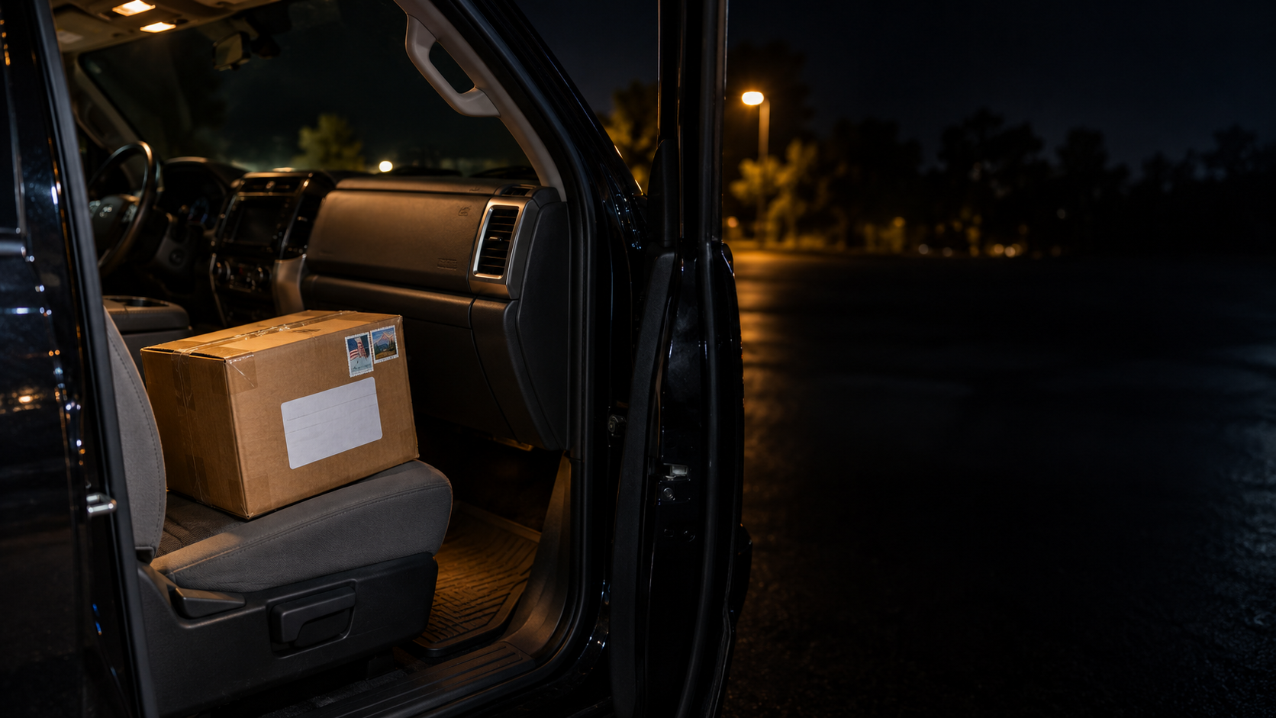
VEHICLE CONTAINERS + MAIL CLAIMS
Stamped Box in a Car
Can we search it? Yes — if PC reaches it.
• Stamps, tape, and an address do not create a roadside “mail shield.”
• Not yet in USPS custody? Treat it as a container inside the vehicle.
• Carroll / Ross / Acevedo: PC allows search of any area or container that could hold the object of the search.
• K9 alert: PC under Harris when reliability and totality support it.
Caveat: Actual USPS mail stream = warrant / postal inspector route unless a separate exception applies, such as Ramsey border-search authority.

Slide 20
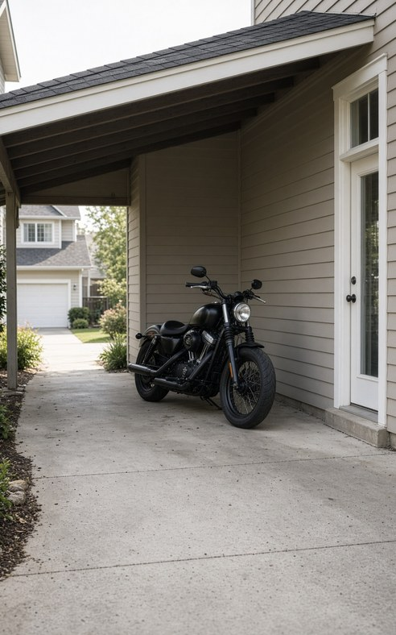
LANDMARK CASE
Collins v. Virginia (2018)
584 U.S. ___ • 8–1 • Justice Sotomayor
The automobile exception does not permit a warrantless entry onto the curtilage of a home to search a vehicle parked there.
Why It Matters for K9 Deployments
Even if you have probable cause to search a vehicle under the automobile exception, you still need a lawful right of access to that vehicle. Walking onto the curtilage (for example, a partially enclosed driveway or carport immediately adjacent to the house) to reach the vehicle is itself a search of the curtilage and requires a warrant or exception.
Combined with Jardines and Earl: do not treat a vehicle parked in the curtilage of a residence the same way you treat a vehicle on a public roadway. Location still controls the analysis.
19

Slide 21
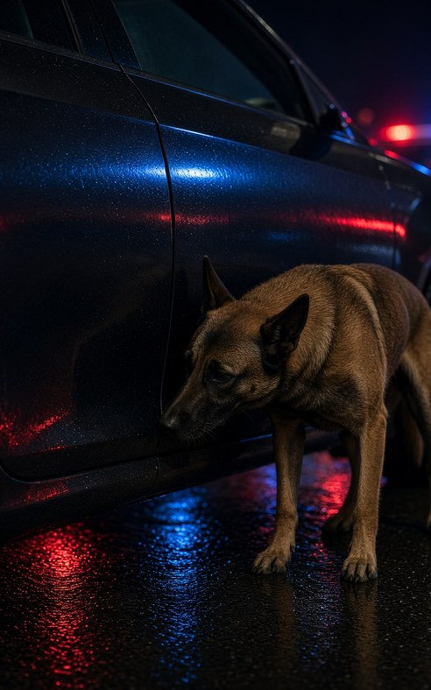
LANDMARK + 11TH CIRCUIT
Rodriguez v. United States + United States v. Campbell
Rodriguez, 575 U.S. 348 (2015) • Campbell, 26 F.4th 860 (11th Cir. 2022) (en banc)
Without independent reasonable suspicion, officers may not add time to a traffic stop to conduct unrelated K9/drug investigation.
Mission of the Stop
The stop lasts only as long as reasonably required to complete traffic and safety tasks: license, registration, insurance, warrants, roadway safety, and citation/warning tasks.
No Added Time
Campbell asks whether the officer conducted an unrelated criminal inquiry that added time to the stop without RS. There is no “bonus time” because traffic work could have been finished faster.
RS Exception
If independent reasonable suspicion develops during the lawful stop, the officer may reasonably extend the detention, including waiting for or deploying a K9.
20

Slide 22
RODRIGUEZ / CAMPBELL TIME LIMITS
No Fixed Minute Limit — Ask Whether K9 Activity Added Time
Dog already on scene
Sniff is generally lawful when it occurs while traffic/safety tasks are being diligently performed and the sniff adds no time.
Dog arrives during mission
Sniff can proceed if the traffic mission is still being diligently pursued. Do not slow, suspend, or pad the mission to create dog time.
Mission objectively complete — no RS
Further detention solely for a dog sniff is unconstitutional. Do not rely only on whether the ticket has been physically handed over.
Mission complete — with RS
Independent RS can justify a reasonable extension. Document the facts known before the extension.
21

Slide 23
OPERATIONAL FRAMEWORK
Where the Sniff Occurs Changes the Legal Analysis
Public Place /
Luggage
Vehicle Exterior
(Traffic Stop)
Vehicle
Interior
Home / Apartment
Curtilage
Vehicle in
Curtilage
Generally not a search (Place)
Limited by seizure duration
Not a search if sniff adds no time
Caballes + Rodriguez/Campbell
Conservative field rule:
Do not facilitate, command, encourage, or create an interior entry unless you already have lawful authority to search.
Is a search (Jardines + Earl)
Warrant or recognized exception
Access itself may be a search
Collins v. Virginia
22

Slide 24
BEHAVIOR SCIENCE FOUNDATION
The Four Classes of Detector Dog Behavior
Behavior is evidence — but its origin decides what it means. Latimer, Behavior Is Evidence (rev. 2026), Ch. 2.
1
Intrinsic Behavior
2
Trained Behavior
Naturally expressed changes the dog didn't have to be taught — respiration, head position, body tension, pace — produced by what the dog is experiencing.
The trained final response (sit, freeze, bark, scratch) — a deliberately taught way to communicate that the dog resolved an odor problem. Communication, not discovery.
3
Independently Learned Behavior
4
Handler-Influenced Behavior
Problem-solving strategies the dog developed through experience — bracketing, overshooting and reacquiring odor — never directly commanded by the handler.
Leash tension, body position, pace, or repeated commands that shape the dog's response, consciously or not — the class courts scrutinize as cueing.
23

Slide 25
HANDLER-INFLUENCED BEHAVIOR — COURTROOM RISK
Conscious and Unconscious Influence
“Circumstances surrounding a particular alert may undermine the case for probable cause… if the officer, consciously or not, cued the dog…”
— Florida v. Harris, 568 U.S. 237 (2013)
Conscious / Intentional
Unconscious / Inadvertent
Handler deliberately signals, shapes, or pressures the dog toward a response. Do not frame this around what is later found; the issue is handler conduct at the time of deployment.
Handler’s natural body language, expectation, leash tension, timing, or movement may influence the dog without deliberate intent. Still undercuts reliability under the Harris totality test.
24

Slide 26
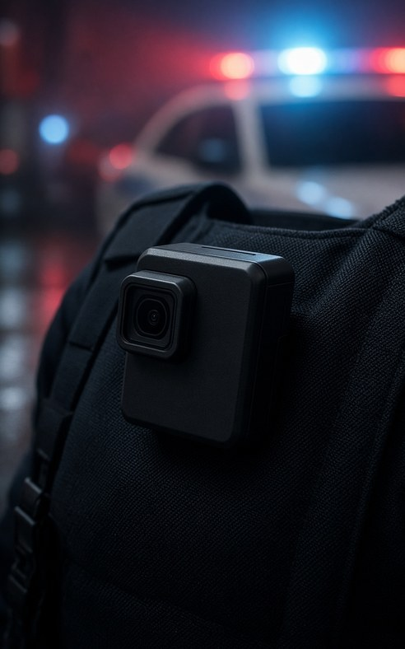
HANDLER-INFLUENCED BEHAVIOR
Potential Cueing Indicators on Body-Cam
• Leash pressure / tension
Slight upward or lateral pressure at the moment the handler wants a response
• Body orientation
Handler stops and “squares up” to a specific panel, handle, or seam just before the dog responds
• Hand or arm movement
Pointing, tapping the side, or reaching toward a pocket/treat at a critical moment
• Verbal or tone change
Subtle shift in voice, breathing, or a quiet command that coincides with the response
• Pace / pattern change
Slowing, stopping, or repeating a pass only at the location of interest
• Eye focus
Handler staring at a particular area while the dog is working instead of watching the dog’s overall behavior
25

Slide 27
HANDLER-INFLUENCED BEHAVIOR
Avoidance & Courtroom Defense Best Practices
1. Independent Source Commitment
The dog works odor to source without the handler directing or “helping” the final response.
2. Neutral body position
Handler remains upright, eyes on the dog’s overall movement — not locked on a specific panel or handle.
3. Minimal leash tension
Especially during the final approach to a potential source. Loose leash is cleaner on video.
4. Consistent search pattern
Same pace and pattern regardless of suspicion level. Avoid repeated passes only at the area of interest.
5. Video everything
Complete video can strongly corroborate — or contradict — the handler’s testimony.
6. Observation before interpretation
Document posture, head turn, breathing, sniff intensity, bracket/reacquisition behavior, and final response before stating the handler’s conclusion.
26

Slide 28
CASE SUMMARY
United States v. Braddy, 11 F.4th 1298 (11th Cir. 2021)
11th Circuit • August 31, 2021 • Saraland, Alabama stop
Facts
Officer Sullivan stopped Braddy for bicycles obstructing the license tag. Two certified dogs were deployed. Neither completed its trained final response. Officers described behavioral changes (posture, tail, breathing, partial paw lift). Search recovered ~62 kg cocaine and ~$40,000 cash.
Holdings
1. The traffic stop was lawful; any mistake of law was objectively reasonable.
2. The stop was not unlawfully prolonged under Rodriguez.
3. The dogs’ handler-recognized alerts were sufficiently reliable under Harris to establish probable cause.
Note: Campbell is the later en banc 11th Circuit timing authority.
27

Slide 29
BRADDY RULING DETAILS
Why the 11th Circuit Upheld Handler-Recognized Alerts
Majority Reasoning
Dissent & Takeaway
• Harris rejects any strict evidentiary checklist.
• A full trained final response is not constitutionally required.
• The test is whether all facts surrounding the dog’s behavior, viewed through common sense, support PC.
• Training, certification, and the handlers’ familiarity with the specific dogs supported reliability.
Judge Rosenbaum dissented in part, viewing the descriptions as too general and subjective.
Classroom takeaway: Specific observable behavior, handler familiarity, training/certification and the surrounding circumstances determine whether a handler-recognized alert establishes PC. A clear trained final response remains stronger evidence, and complete video matters.
Behavior science note: the behavioral changes Braddy credits are Intrinsic Behavior under the Four Classes model. The trained final response communicates a conclusion the dog's behavior already reached — it is not the moment of discovery.
28

Slide 30
United States v. Ostertag, No. 25-8055 (10th Cir. 2026)
Sept. 8, 2026 • Persuasive only in Alabama
Key Facts
During a lawful traffic stop, a certified narcotics dog conducted an exterior sniff. Before touching the vehicle, the dog displayed alert-related behavior the handler associated with target odor. The dog later placed her front paws on the vehicle.
Holding
1. Caballes still governed the exterior public-roadway sniff.
2. The court assumed without deciding that physical contact while sniffing might be a search.
3. Probable cause already existed based on pre-contact alert behavior.
4. Teaching point: do not rely on the dog touching the vehicle; articulate what the dog did before contact.
29

Slide 31
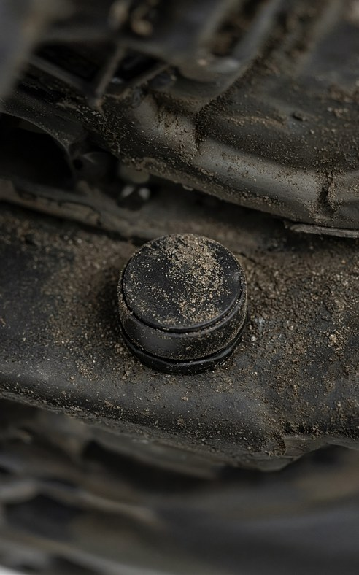
LANDMARK CASE
United States v. Jones (2012)
565 U.S. 400 • 9–0 • Justice Scalia (majority)
Attaching a GPS tracking device to a vehicle and using it to monitor movements is a Fourth Amendment search.
Property / Trespass Theory
The majority held that when the Government physically occupies private property (the vehicle — an “effect”) for the purpose of obtaining information, a search has occurred. This restored the common-law trespass understanding of the Fourth Amendment.
One year later, Jardines applied the same property theory to a drug dog on a front porch. Both cases involve physical intrusion onto protected property for investigative purposes.
30

Slide 32

FOUNDATIONAL CASE
Katz v. United States (1967)
389 U.S. 347 • The Fourth Amendment protects people, not places
Harlan Two-Part Test (still used today)
1. Did the person exhibit an actual (subjective) expectation of privacy?
2. Is that expectation one that society is prepared to recognize as reasonable?
Why Katz Still Matters for K9 Work
Caballes and Place rely on the idea that there is no legitimate expectation of privacy in contraband. Jardines and Jones confirm that property/trespass analysis also remains available.
Field rule: Katz privacy analysis and property/trespass analysis coexist. Depending on the facts, either can establish that a search occurred. For homes, apartment doors, and curtilage, analyze lawful access carefully under Jardines, Earl, Collins, and Katz as applicable.
31

Slide 33
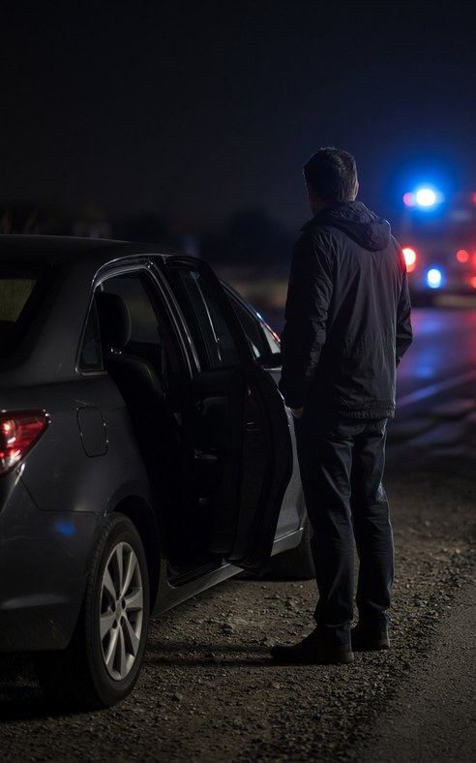
LANDMARK CASE
Mimms + Wilson + Johnson
Mimms: driver • Wilson: passengers • Johnson: frisk requires separate armed/dangerous RS
During a lawful traffic stop, an officer may order the driver and passengers out of the vehicle for officer safety.
ORDER OUT ≠ FRISK.
Core Reasoning
• Officer safety is a weighty interest during traffic stops.
• Mimms applies to drivers; Wilson extends the rule to passengers.
• Ordering someone out is a minimal additional intrusion during a lawful stop.
• A patdown/frisk is different: Arizona v. Johnson requires reasonable suspicion that the person is armed and dangerous.
Practical point: You may order occupants out during a lawful stop, but articulate separate facts before frisking.
32

Slide 34
PERSUASIVE AUTHORITY — NOT ALABAMA CONTROL
State v. Creller, 386 So. 3d 487 (Fla. 2024)
No. SC2022-0524 • May 23, 2024 • Justice Francis
A Florida Supreme Court decision held that a K9 officer arriving midway through a lawful traffic stop may command the driver to exit for officer safety before a lawful exterior dog sniff.
Key Facts
Traffic stop for cutting through a parking lot. Consent refused; K9 called. When the handler arrived, the citation was still being written. Handler ordered Creller out for safety because the driver remained in control of the vehicle while handler and dog would work around it. Creller refused and was removed; methamphetamine was found after arrest.
Holding
Florida Supreme Court quashed the 2d DCA and approved State v. Benjamin. Mimms applied to the K9 officer. Teach Creller as persuasive authority only; Alabama officers still analyze timing under Rodriguez/Campbell.
33

Slide 35
HANDLER ANALYSIS
Two Separate Questions — Do Not Confuse Them
1. Can I order them out?
2. Can I extend the detention?
Mimms (driver) and Wilson (passengers) give substantial authority during a lawful traffic detention to order occupants out for officer safety.
Creller illustrates how that authority may apply to a K9 officer who arrives mid-stop and needs the driver out before deploying the dog.
Articulate the safety reason: your attention is on the dog, environment, traffic, and movement around the vehicle.
This is the Rodriguez/Campbell question.
Exit-order authority does not create authority to add time for a dog sniff without independent RS. You cannot manufacture additional time by labeling the action “officer safety.”
Ask: Was the traffic mission being diligently pursued, and did K9 activity add time?
34

Slide 36
HANDLER BEST PRACTICE — NOT A MANDATE
Occupants Out During a K9 Sniff — When & Why
Preferred practice when circumstances reasonably allow it
From a handler standpoint there are legitimate safety reasons for removing occupants when circumstances reasonably allow it. Your attention needs to be on the dog, his behavior, the environment, traffic, and movement around the vehicle. You do not want to simultaneously monitor someone sitting behind the wheel of the vehicle you are working around.
Not a rigid “always” rule
Depending on the circumstances, leaving an occupant in the vehicle may be perfectly workable. Do not turn this into “We always take everybody out because that’s how we do K9 sniffs.”
Safety trumps “winning” the case
If the circumstances make a sniff unsafe, do not do something unsafe just because you are worried the legal clock is running. Officer and K9 safety come first.
35

Slide 37
CLASSROOM TEACHING POINTS
What Handlers & Patrol Officers Must Understand
• Articulate the safety concern
If you remove someone because having that person behind the wheel presents a legitimate safety concern while you work the dog, be able to say so clearly — on the stand and in your report.
• Mimms/Wilson ≠ Rodriguez authority
Your authority under Mimms or Wilson to order occupants out does not give you authority to unlawfully extend the stop under Rodriguez.
• Creller is nuanced
Creller is useful persuasive authority, but it is not controlling Alabama law. It illustrates why facts matter: lawful exit order, active traffic mission, officer safety, and no unlawful extension.
• Free-air sniff vs. RS
No independent drug RS is required for an exterior sniff only when the sniff adds no time to an otherwise lawful stop. If the sniff adds time, independent RS is required.
• Make the best decision with the facts available
Sometimes you may not have the choice to leave someone in. Understand why the situations are different and decide according to all the facts.
36

Slide 38
PRACTICAL EXERCISES
Mock Traffic Stops — How to Run These
These exercises are designed for active learning in an 8-hour class.
Format options:
• Table-top discussion
• Role-play
• Small-group scenario analysis
For each scenario answer:
1. Was the initial stop lawful?
2. What traffic/safety task remained?
3. What was the officer actually doing during each interval?
4. Did K9-related activity add time under Rodriguez/Campbell?
5. Was the deployment/sniff constitutional?
6. Did the alert establish PC under Harris/Braddy?
7. What should be documented differently?
Answer keys follow for instructor use. Do not distribute before students work the problems.
37

Slide 39
PRACTICAL EXERCISE 1
Patrol calls for K9 — mission still open
Scenario Script
Officer Davis stops a vehicle at 22:10 for speeding (68 in a 45). He immediately begins running the license, registration, insurance, and warrants, and starts preparing a citation. At 22:14 he radios for a K9 while continuing those tasks. Handler Torres arrives at 22:19. Davis is still diligently completing the citation and records work. Torres independently deploys his certified dog without interrupting Davis. The dog gives a trained final response at the driver’s door. Cocaine is recovered from the center console.
Class Discussion Questions
Evaluate: stop legality, whether the sniff added time under Rodriguez/Campbell, sniff constitutionality, and Harris reliability.
38

Slide 40
PRACTICAL EXERCISE 2
Patrol calls for K9 — mission already complete
Scenario Script
Officer Lee stops a vehicle at 01:20 for an expired tag. She completes the records check and issues a written warning at 01:32. The traffic mission is objectively complete. She tells the driver he is free to leave, then asks if he will voluntarily wait for a K9 that is 8 minutes away. The driver refuses. Lee instructs him to remain. Handler arrives at 01:41. Dog alerts. Methamphetamine is found in the trunk.
Class Discussion Questions
Evaluate under Rodriguez/Campbell. Was the continued detention lawful? Does refusal to wait voluntarily create RS? What would change the analysis?
39

Slide 41
PRACTICAL EXERCISE 3
Dual-role handler — did the dog add time?
Scenario Script
Handler Martinez, in a marked K9 unit, observes a vehicle cross the fog line twice and fail to maintain its lane as nearly as practicable under Ala. Code § 32-5A-88. He stops the vehicle at 23:05. The driver provides a valid license and registration. Martinez runs records and prepares a warning. At 23:11, before handing over the warning, Martinez stops traffic-related work and deploys his own certified dog. No independent criminal RS has developed beyond ordinary nervousness and an air freshener. The dog gives a trained final response at the rear passenger door. Marijuana is found.
Class Discussion Questions
Was the stop justified? Did the handler’s dual role add time under Campbell? Would the result change if independent RS or marijuana odor developed during the stop?
40

Slide 42
PRACTICAL EXERCISE 4
Handler-recognized alert + cueing risk on video
Scenario Script
Officer Chen stops a vehicle at night because the rear plate lamp is not illuminating the plate as required by Ala. Code § 32-5-240(c). He calls for a K9. Handler arrives while Chen is diligently writing the citation. The dog’s trained final response is a sit. On the second pass near the trunk, the dog snaps its head, closes its mouth, changes breathing, stiffens, and lifts a paw but does not sit. At that moment the handler tightens the leash, squares up to the trunk seam, and says, “That’s my alert.” Body-cam captures the handler movement. Certification is current; controlled testing includes both successful finds and one recent unverified alert in a blank vehicle.
Class Discussion Questions
Apply Harris and Braddy. Can a handler-recognized alert establish PC without a final response? What does the video do to the totality analysis?
41

Slide 43
ANSWER KEY — EXERCISE 1
Patrol calls for K9 — mission still open
1. Stop: Lawful (speeding).
2. Rodriguez/Campbell: Traffic tasks were being diligently pursued, and the separate handler’s sniff added no time. Constitutional under Caballes + Rodriguez/Campbell.
3. Sniff: Free-air exterior sniff during a lawful, non-prolonged stop is not a search.
4. Alert: Full final response by a certified dog strongly supports PC under Harris’s totality test.
5. Best practice: Document exact times: stop start, K9 request, arrival, traffic tasks being performed, deployment, alert, and search.
42

Slide 44
ANSWER KEY — EXERCISE 2
Patrol calls for K9 — mission already complete
1. Stop: Lawful (expired tag).
2. Rodriguez/Campbell: The traffic mission was objectively complete. Further detention solely to await a dog required independent RS. None is stated.
3. Sniff/search: Fruit of the unlawful seizure; suppression likely.
4. What would change it: Independent RS developed during the lawful stop, or voluntary consent to wait.
5. Teaching point: The “free to leave” statement helps show the mission was over, but the constitutional test is objective: were traffic tasks completed or reasonably should they have been completed, and did unrelated K9 activity add time?
43

Slide 45
ANSWER KEY — EXERCISE 3
K9 handler makes the stop and deploys
1. Stop: Crossing the fog line twice and failing to maintain lane as nearly as practicable can support a lawful stop if the facts show a traffic violation or RS.
2. Rodriguez/Campbell: Holding paperwork does not keep the mission alive. If Martinez stops traffic work and deploys his own dog without independent RS, the deployment likely adds time and creates a problem.
3. Dual role: Not automatically unconstitutional, but it creates a timing/documentation risk. The handler must not manufacture K9 time.
4. Alert: A trained final response supports PC only if the sniff itself was lawfully conducted.
5. Variation: If marijuana odor or other independent RS developed during the lawful stop, the extension/deployment analysis changes.
44

Slide 46
ANSWER KEY — EXERCISE 4
Partial alert + handler focus on video
1. Stop & timing: Plate-lamp stop is lawful; sniff occurred while Chen was diligently writing the citation, so no Rodriguez/Campbell problem if K9 activity added no time.
2. Alert reliability: Braddy helps the government because a trained final response is not constitutionally required. But Harris requires totality analysis of this specific deployment.
3. Video: Leash tension, squaring up, and handler focus at the critical moment can materially undermine the handler’s characterization. Certification does not immunize a particular sniff.
4. Likely issue: A suppression court must decide whether the observed behavior, training history, and video support PC. The drugs found afterward cannot retroactively create PC.
5. Teaching point: Describe the dog’s behavior objectively first; avoid conclusory “he alerted” testimony unsupported by video or training.
45

Slide 47
CLOSING
Key Takeaways for the Street & the Courtroom
1. Location matters: public roadway ≠ vehicle interior ≠ residential curtilage.
2. The K9 sniff is not part of the traffic mission. Without independent RS, it cannot add time. Rodriguez • Campbell
3. Mission completion is objective. Ask what traffic/safety tasks were actually being performed and whether they reasonably should have been completed.
4. A trained final response is not constitutionally required. PC depends on the totality surrounding the dog’s behavior and reliability. Harris • Braddy
5. Handler influence and pre-contact behavior matter. Know the Four Classes of Detector Dog Behavior — independent searching, objective behavior descriptions, and complete video improve defensibility. Braddy • Ostertag
6. Alabama marijuana odor remains legally significant. Legal hemp does not presently eliminate PC based on marijuana odor. Bain v. State
7. Authority hierarchy: U.S. Supreme Court → Alabama appellate courts → published 11th Circuit for federal court → unpublished/other states as persuasive only.
46

Slide 48

Latimer School of Operational K9s
k9school.net
Questions • Discussion • Application
App field guide: K9 Operations & Traffic Stop Edition
8-Hour Professional Development Class
For Patrol Officers & K9 Handlers
Companion text: Behavior Is Evidence, by David Latimer
Law reviewed through September 9, 2026
Training reference only — follow agency policy, prosecutor guidance, and current law.

