Slide 1
MCEVS
Multi-Configurational EVtol Sizing
by Alfiyandy Hariansyah
at OCTAD LAB, HKUST

Slide 2
MCEVS: Multi-Configurational EVtol Sizing
Sizing means estimating the weight of the vehicle, typically done at the conceptual phase
MCEVS is currently capable of sizing multirotor and lift+cruise eVTOL configurations
Given a mission requirement (payload, range, cruise speed, and flight profiles) and the vehicle's geometric and operation variables, MCEVS will estimate the feasible total and component weights.
MCEVS is also capable of orchestrating configuration optimization, i.e., finding the geometric and operation variables that result in the optimal overall weight of the vehicle.

Slide 3
XDSM: General optimization

Slide 4
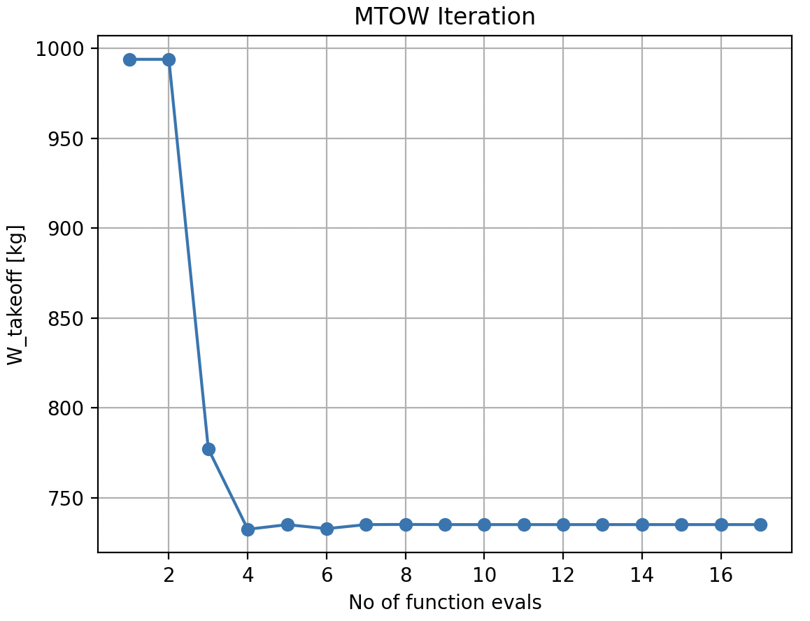
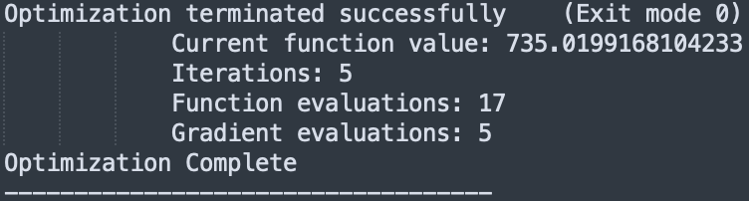
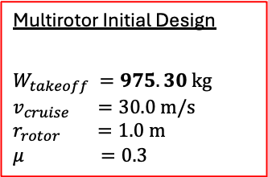
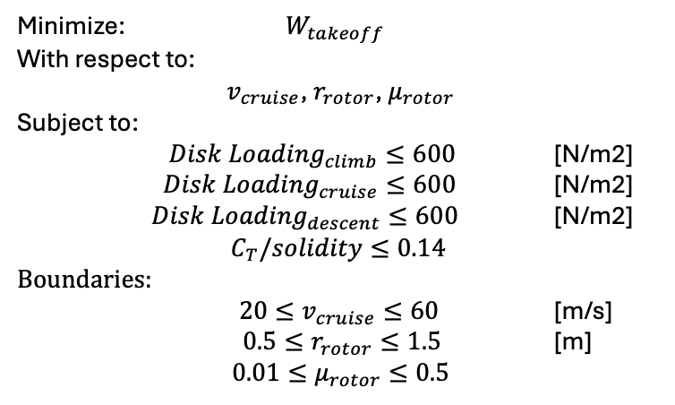
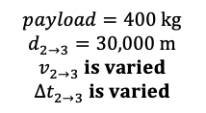
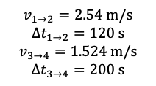
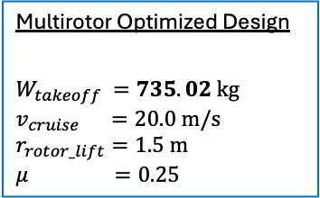
Optimizing a multirotor configuration (1/2)
With the parameters given, the following optimization is performed.
Mission
2
3
Minimize: $W_{takeoff}$
With respect to:
$v_{cruise}$, $r_{rotor}$, $μ_{rotor}$
Subject to:
${Disk Loading}_{climb}≤600$ [N/m2]
${Disk Loading}_{cruise}≤600$ [N/m2]
${Disk Loading}_{descent}≤600$ [N/m2]
$$C_{T}/solidity≤0.14$$
Boundaries:
$20≤v_{cruise}≤60$ [m/s]
$0.5≤r_{rotor}≤1.5$ [m]
$0.01≤μ_{rotor}≤0.5$
Multirotor Initial Design
$$W_{takeoff} =975.30 kg$$
$$v_{cruise} =30.0 m/s$$
$$r_{rotor} =1.0 m$$
$$μ =0.3$$
1-2: hover climb
2-3: cruise
3-4: hover descent
1
4
$$v_{1→2}=2.54 m/s$$
$$∆t_{1→2}=120 s$$
$$v_{3→4}=1.524 m/s$$
$$∆t_{3→4}=200 s$$
$$payload=400 kg$$
$$d_{2→3}=30,000 m$$
$$v_{2→3} is varied$$
$$∆t_{2→3} is varied$$
-24.63%
weight reduction
With an optimizer called SLSQP, aided by the analytical derivatives of the model, a gradient-based optimization is performed.
Multirotor Optimized Design
$$W_{takeoff} =735.02 kg$$
$$v_{cruise} =20.0 m/s$$
$$r_{rotor_lift}=1.5 m$$
$$μ =0.25$$

Slide 5
Optimizing a multirotor configuration: XDSM (2/2)

Slide 6
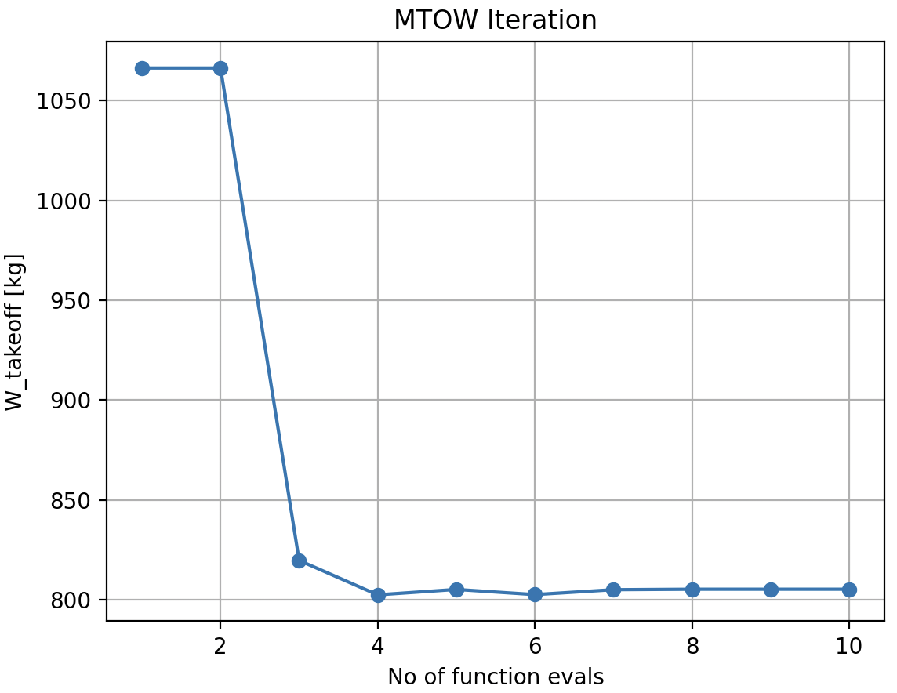
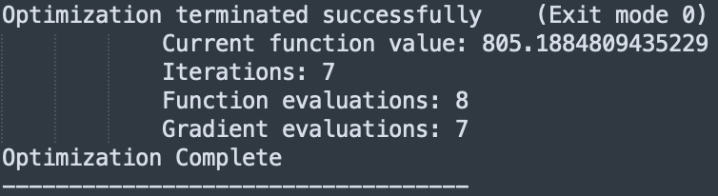
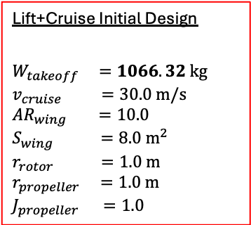
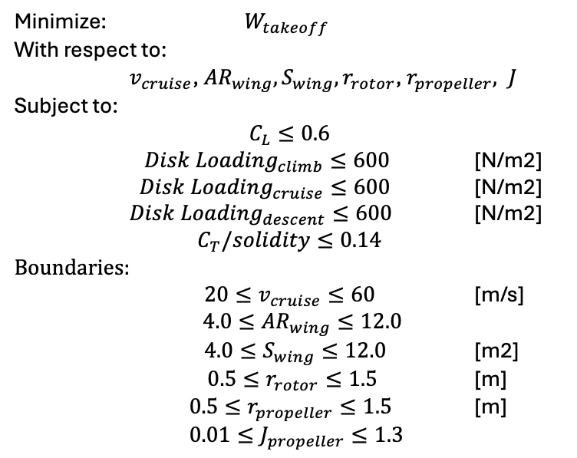
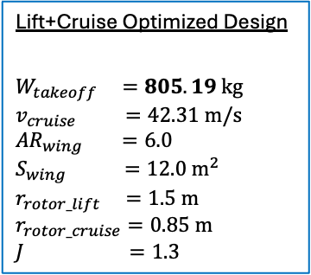
Optimizing a lift+cruise configuration (1/2)
With the parameters given, the following optimization is performed.
Mission
Minimize: $W_{takeoff}$
With respect to:
$v_{cruise}$, ${AR}_{wing}, S_{wing}, r_{rotor}$, $r_{propeller}, J$
Subject to:
$C_{L}≤0.6$
${Disk Loading}_{climb}≤600$ [N/m2]
${Disk Loading}_{cruise}≤600$ [N/m2]
${Disk Loading}_{descent}≤600$ [N/m2]
$$C_{T}/solidity≤0.14$$
Boundaries:
$20≤v_{cruise}≤60$ [m/s]
$4.0≤{AR}_{wing}≤12.0$
$4.0≤S_{wing}≤12.0$ [m2]
$0.5≤r_{rotor}≤1.5$ [m]
$0.5≤r_{propeller}≤1.5$ [m]
$0.01≤J_{propeller}≤1.3$
Lift+Cruise Initial Design
$$W_{takeoff} =1066.32 kg$$
$$v_{cruise} =30.0 m/s$$
$${AR}_{wing} =10.0$$
$$S_{wing} =8.0 m^{2}$$
$$r_{rotor} =1.0 m$$
$$r_{propeller} =1.0 m$$
$$J_{propeller} =1.0$$
2
3
1-2: hover climb
2-3: cruise
3-4: hover descent
1
4
$$v_{1→2}=2.54 m/s$$
$$∆t_{1→2}=120 s$$
$$v_{3→4}=1.524 m/s$$
$$∆t_{3→4}=200 s$$
$$payload=400 kg$$
$$d_{2→3}=30,000 m$$
$$v_{2→3} is varied$$
$$∆t_{2→3} is varied$$
-24.49%
weight reduction
Lift+Cruise Optimized Design
$$W_{takeoff} =805.19 kg$$
$$v_{cruise} =42.31 m/s$$
$${AR}_{wing} =6.0$$
$$S_{wing} =12.0 m^{2}$$
$$r_{rotor_lift} =1.5 m$$
$$r_{rotor_cruise}=0.85 m$$
$$J =1.3$$

Slide 7
Optimizing a lift+cruise configuration: XDSM (2/2)

