Slide 1

Course Project Briefing
Mech 3620 – aircraft design
HKUST, Spring 2026

Slide 2

About me – Alfi
(3rd year PhD student)
Education
2024 – now: Ph.D. in Mechanical Engineering, HKUST, Hong Kong SAR
2021 – 2023: M.Eng. in Aerospace Engineering, Tohoku University, Japan
2017 – 2021: B.Eng. in Mechanical and Aerospace Engineering, Tohoku University, Japan.
Experience
2023 – 2024: Structural Analysis Engineer (full-time), PT. Turkish Aerospace Indonesia, Bandung, Indonesia
2022 – 2023: Aerodynamics Engineer (part-time), teTra aviation corp., Tokyo, Japan
Research
Bachelor and master: Deep learning techniques for aerodynamic wing shape optimization
PhD: electric vertical takeoff and landing (eVTOL) conceptual design and optimization
https://alfiyandyhr.github.io/

Slide 3

A Request for Regional Jet Conceptual Design
Ms. Y from Horizon Group, a consortium of regional airlines in the Greater Bay Area and Southeast Asia, requested a regional jet conceptual design.
Aircraft tailored for high-frequency, short-to-medium haul operations.
Design philosophies:
  Operational flexibility
  Rapid turnaround times
  Superior economic efficiency
  Competitive passenger experience

Slide 4
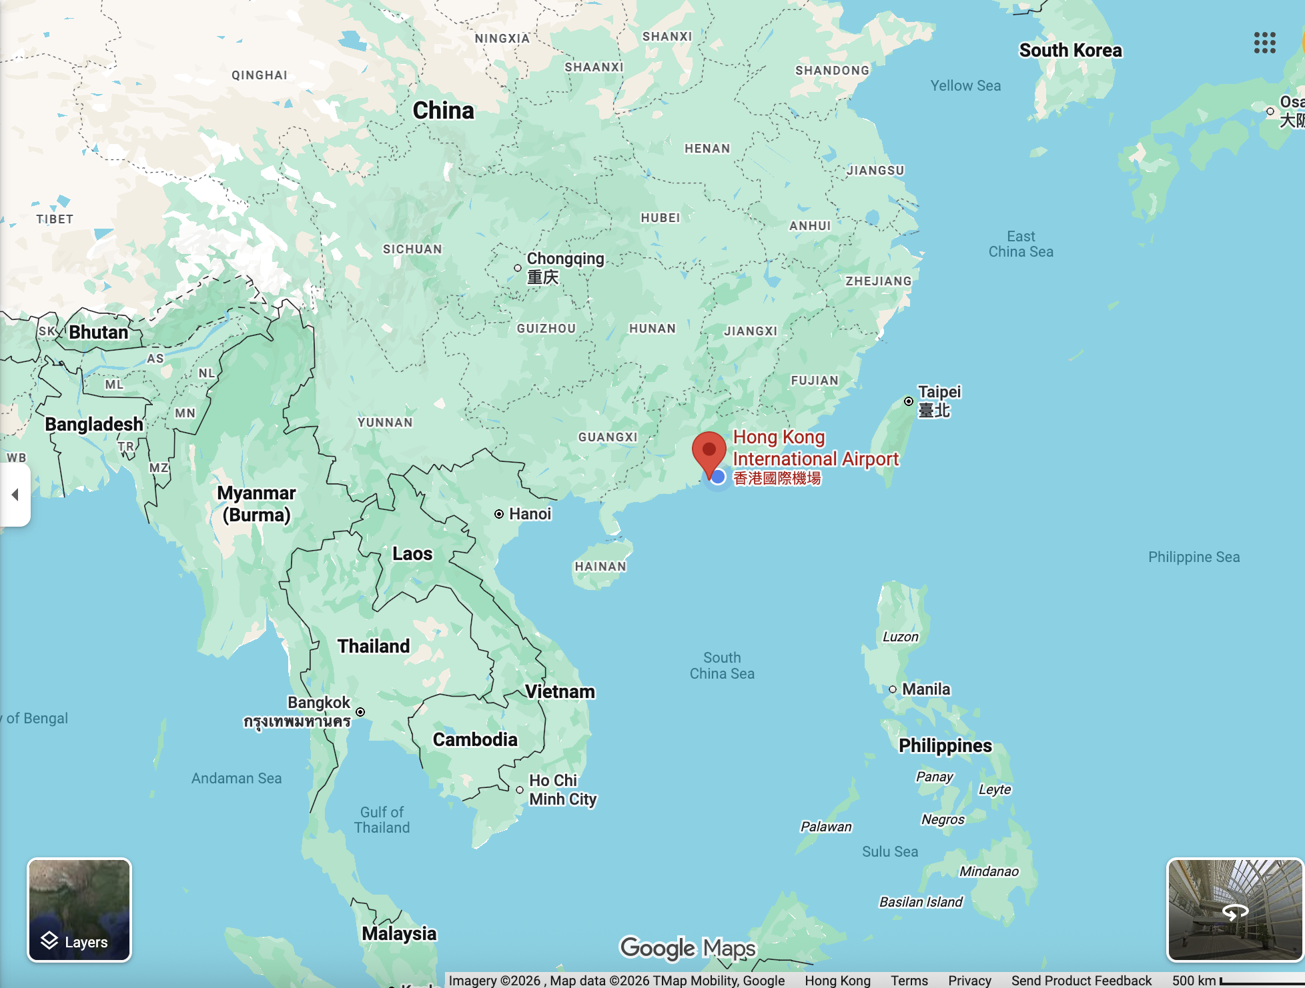
Concept of Operations
Operating primarily Hong Kong International Airport (HKG), the aircraft is expected to serve the following sectors:
  Da Nang International Airport (DAD)
  Wuhan Tianhe International Airport (WUH)
  Clark International Airport (CRK)
  HKG – DAD: 930 km
  HKG – WUH: 940 km
  HKG – CRK: 1050 km

Slide 5
Design Requirements & Objectives (DRO)
General Requirements
  Passenger and cargo capacity, maximum takeoff weight, and aircraft dimensions.
Performance Requirements
  Range, service ceiling, takeoff, landing, climb, and cruise.
Certification Requirement
  Airworthiness standards: FAR-25 (Transport Category Airplane)
  https://www.ecfr.gov/current/title-14/chapter-I/subchapter-C/part-25
Environmental and Operational Requirement
  CO₂ emission, noise levels, fuel consumption per passenger km, rapid turnaround times (e.g., simultaneous passenger and cargo loadings by means of separation of service doors, etc).

Slide 6
Additional Measures of Merit (MoM)
The previous requirements are must-haves. They are not nice-to-have.
But you need to be aware that there are several competitors in this market. The more your design exceeds their performance, the higher your chances will be to win this tender (i.e., to outperform competitors in the business world and achieve a higher grade in the academic setting).
So, you should demonstrate higher performance than the requirements plus additional measures of merit (MoM): e.g., advanced avionics, unique features, innovative materials, future-proofing for future variants using hybrid-electric, design flexibility, etc.

Slide 7
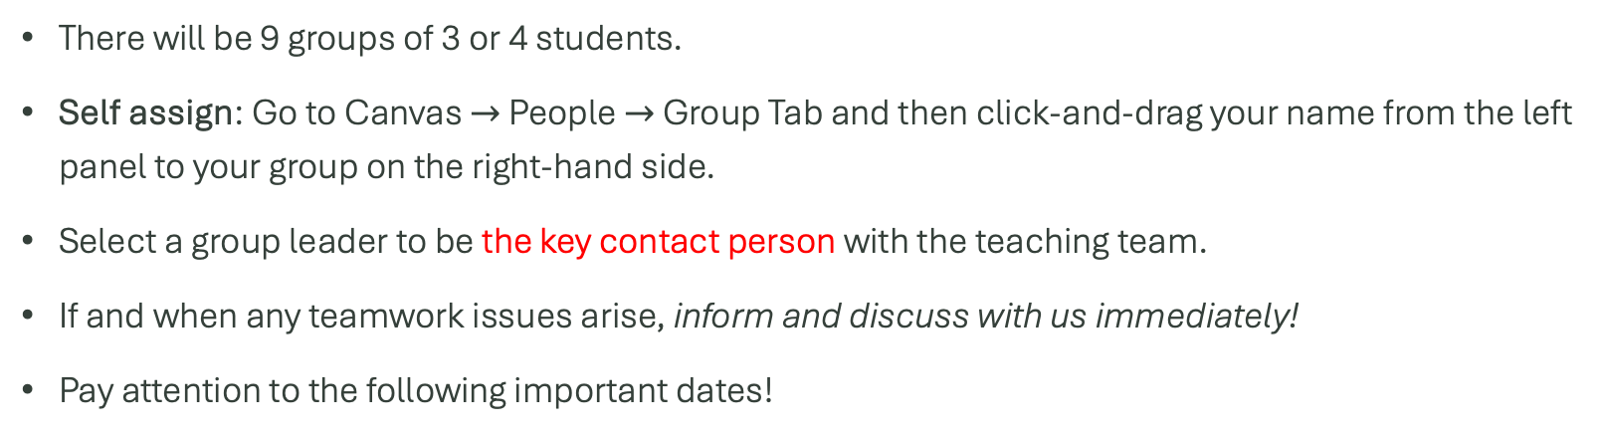
Design Project Group Formation
There will be 9 groups of 3 or 4 students.
Self assign: Go to Canvas $→$ People $→$ Group Tab and then click-and-drag your name from the left panel to your group on the right-hand side.
Select a group leader to be the key contact person with the teaching team.
If and when any teamwork issues arise, inform and discuss with us immediately!
Pay attention to the following important dates!
Date | Task
February 13, 2026 | Finalize group formations
March 18, 20, & 25, 2026 | Midterm project review
May 6 & 8, 2026 | Final project presentations
May 15, 2026 | Project final report deadline
Preliminary Design Review (PDR)
Critical Design Review (CDR)

Slide 8
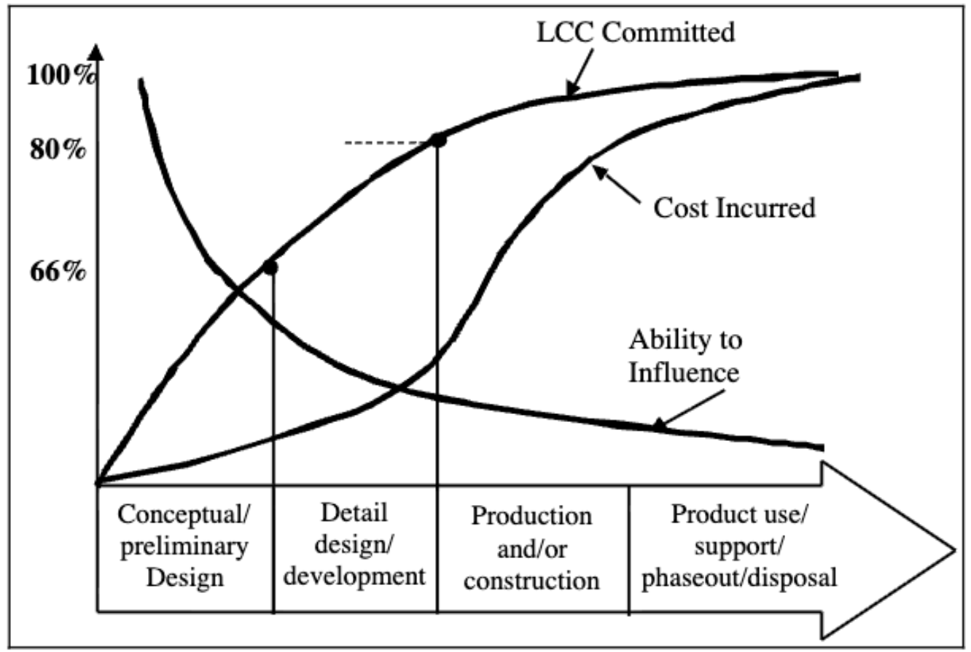
Ref: Murman 2002, Challenges in the Better, Faster, Cheaper Era, of Aeronautical Design, Engineering, and Manufacturing https://doi.org/10.1017/S0001924000091983

