Slide 1


Introduction to Git and GitHub
A Version Control System Platform
BY Alfi, HKUST, 2026

Slide 2
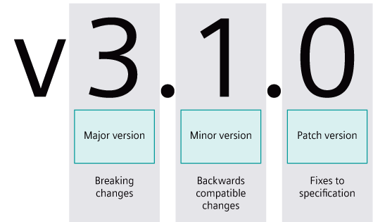
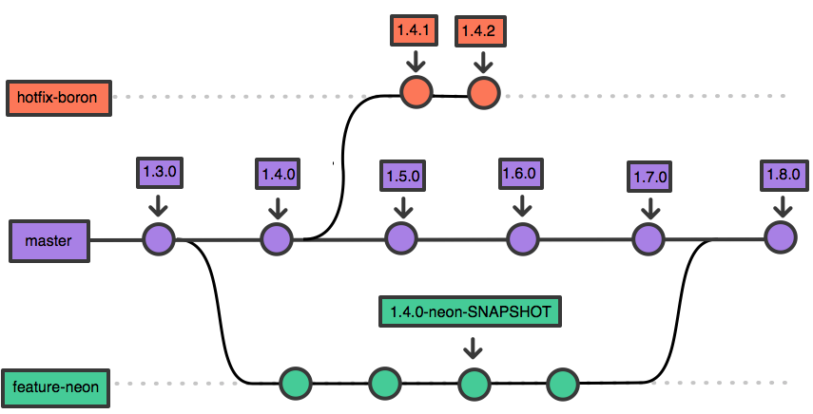
What is versioning?
A fancy word for tracking changes to files.
Key Points
Take snapshots of changes
View the history of changes
Roll back changes

Slide 3
What is Git and Github?
Git is an open-source and free version control system (VCS),
while GitHub is a service platform built on top of Git.
Key Points
Git is the protocol language
GitHub is just like Google Drive, Dropbox, or One Drive but tailored to programmers.
Installation and sign up
To install Git, go to: https://git-scm.com/downloads (if you prefer a command line workflow)
To install GitHub desktop, go to: https://desktop.github.com/download/ (if you prefer a GUI-base workflow)
To sign up on GitHub, go to: https://github.com/signup
choose either one

Slide 4








How Git and Github work?
A repository of files is stored on GitHub
Developer clones/pulls request from the GitHub repository.
Developer makes changes
to the local repository.
Developer commits changes and pushes to the GitHub repository.
Edit files
Add files
Delete files

Slide 5
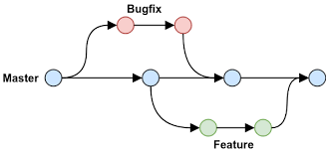
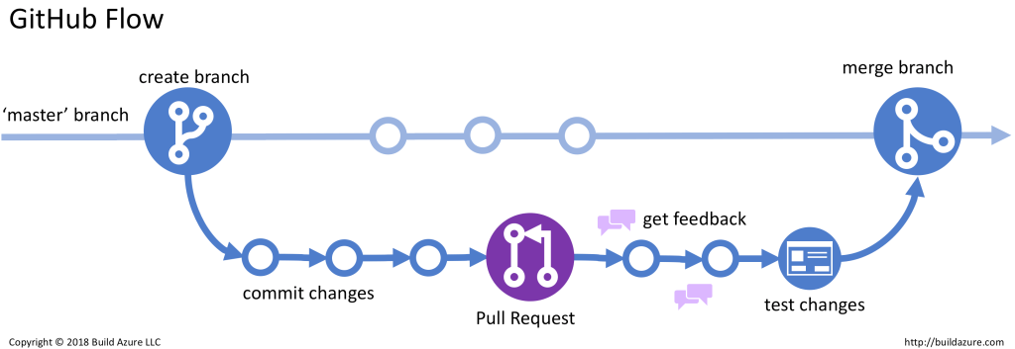
Typical workflow

Slide 6
Workflows on GitHub desktop (1/2)
Create a remote repository on GitHub (AircraftDesignProject) and add collaborators
Create issues for new features: “Feature: wing geom” and ”Feature: fuselage geom”
Open GitHub desktop, sign in to your account, and click “Authorize desktop”
Clone a GitHub repository to your local directory
  https://github.com/alfiyandyhr/AircraftDesignProject.git
Check available branches in “Current Branch” tab
Alfi creates a new branch called “wing-geom” and publishes it to the remote repository.
Alfi opens the branch on an external text editor (e.g., Sublime Text)
Alfi starts working on that new branch: create, edit, or delete files → commit → push
Alfi makes a pull request by clicking “Preview Pull Request” and “Create Pull Request”
Alfi assignes a reviewer (Reyner)
Reviewer (Reyner) agrees → add which development to close → merge with the main branch

Slide 7
Workflows on GitHub desktop (2/2)
Reyner creates a new branch called “fuselage-geom” and publishes it to the remote repository.
Reyner opens the branch on an external text editor (e.g., Visual Studio)
Reyner starts working on that new branch: create, edit, or delete files → commit → push
Reyner makes a pull request by clicking “Preview Pull Request” and “Create Pull Request”
Reyner assignes a reviewer (Alfi)
Reviewer (Alfi) agrees → add which development to close → merge with the main branch
Alfi and Reyner fetch the updated main branch by clicking “Fetch origin”
Alfi and Reyner delete their old branch on their local branch

Slide 8
Resolving a conflict
Reyner modifies “README.md” to include the following text:
  “- designing an aircraft given a set of requirements from Mr. Seth”
Reyner commits and pushes to the remote repository (main branch)
Alfi also modifies “README.md” to include the following text (without pulling the latest repo):
  “Analyses include aerodynamics, stability, structures, and initial sizing.”
Alfi has to resolve the conflicts by manual editing (on text editor):
  Accepts Reyner’s change, discard his change
  Accepts his change, discard Reyner’s change
  Modifies the change to accommodate his change and Reyner’s change

Slide 9
Workflows on command line (1/2)
Create a remote repository on GitHub (AircraftDesignProject), add collaborators, and generate token for remote access
Create issues for new features: “Feature: wing geom” and ”Feature: fuselage geom”
Open terminal and configure your identity:
  git config --global user.name “Albert HKUST”
  git config --global user.email “alberthkust@gmail.com”
Clone a GitHub repository
  git clone https://github.com/alfiyandyhr/AircraftDesignProject.git
Check available branches
  git branch -a
Alfi starts a specific mini-project: wing-geom
  git checkout –b wing-geom
Alfi starts working on that mini project: create, edit, or delete files → commit → push
  git status
  git add create_wing.py
  git commit –m “added wing code”
  git push origin wing-geom

Slide 10
Workflows on command line (2/2)
Create a pull request → assign a reviewer (Reyner)
Reviewer (Reyner) agrees → add which development to close → merge with the main branch
Reyner starts a specific mini-project: fuselage-geom
  git checkout –b fuselage-geom
Reyner starts working on that mini project: create, edit, or delete files → commit → push
  git status
  git add create_fuselage.py
  git commit –m “added fuselage code”
  git push origin fuselage-geom
Create a pull request → assign a reviewer (Alfi)
Reviewer (Alfi) agrees → add which development to close → merge with the main branch
Alfi and Reyner pull the updated main branch and delete their old branches
  git checkout main
  git pull
  git branch –d fuselage-geom

Slide 11
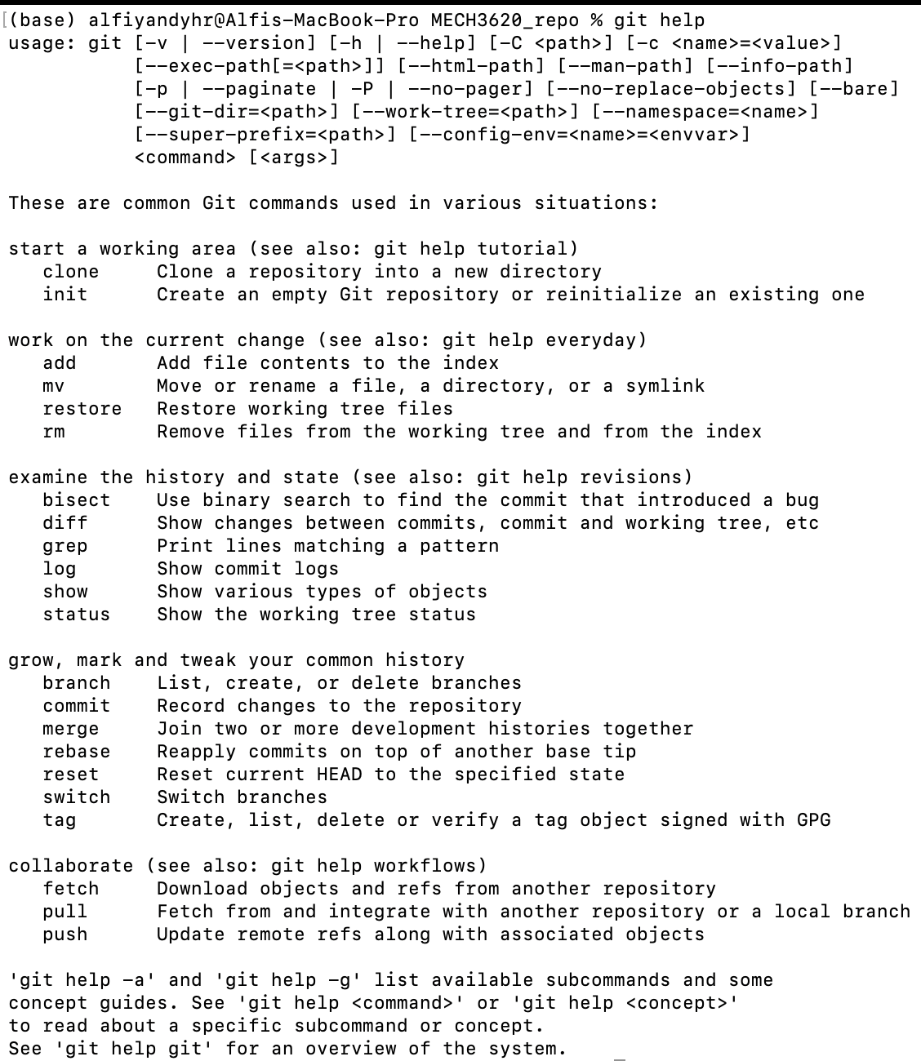
Git commands

