Slide 1

Introduction to Julia
A Programming Language for Scientific Computing
BY Alfi, HKUST, 2025

Slide 2
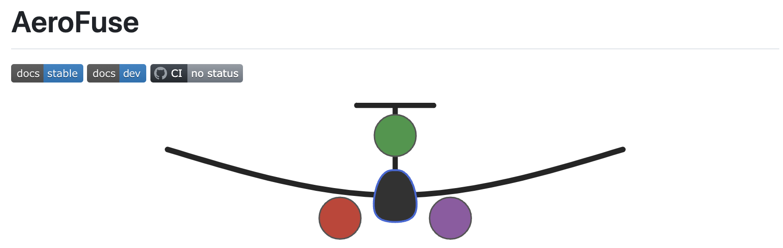
Why Julia?
It’s fast, dynamic, reproducible, general, open-source → good for scientific computing.
Key Points
Most aerospace engineering students and instructors are familiar with MATLAB.
Its syntax is very similar to MATLAB, but faster and open-source.
It supports linear algebra, differential equations, and other science and engineering interests.
It has Pluto.jl, a nice notebook format for running experiments and giving instructive presentations.
Our in-house aircraft design and analysis framework (legacy) was written in Julia: AeroFuse.jl

Slide 3
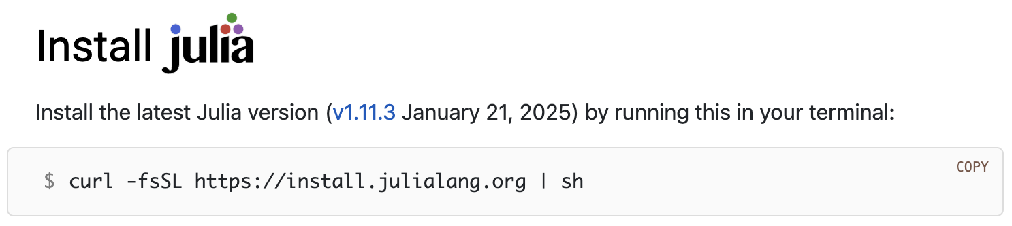
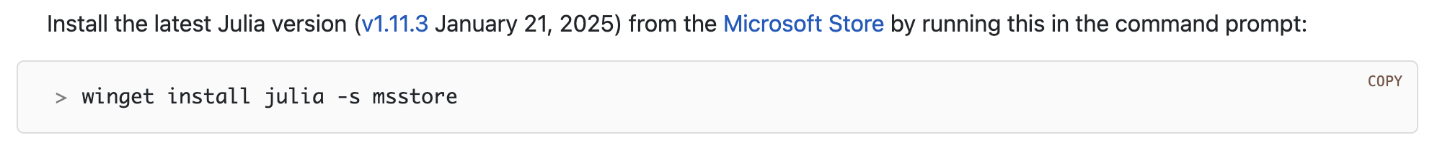
Julia installation (recommended)
For Linux and MacOS
For Windows
For manual installation, please go to https://julialang.org/downloads/platform/

Slide 4
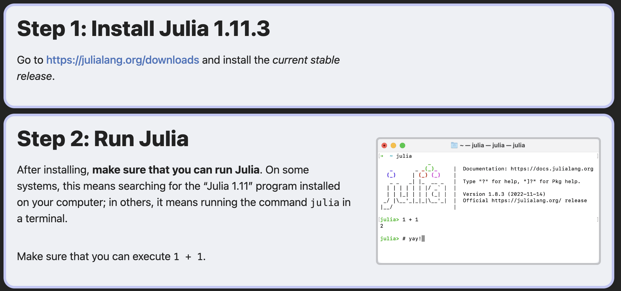
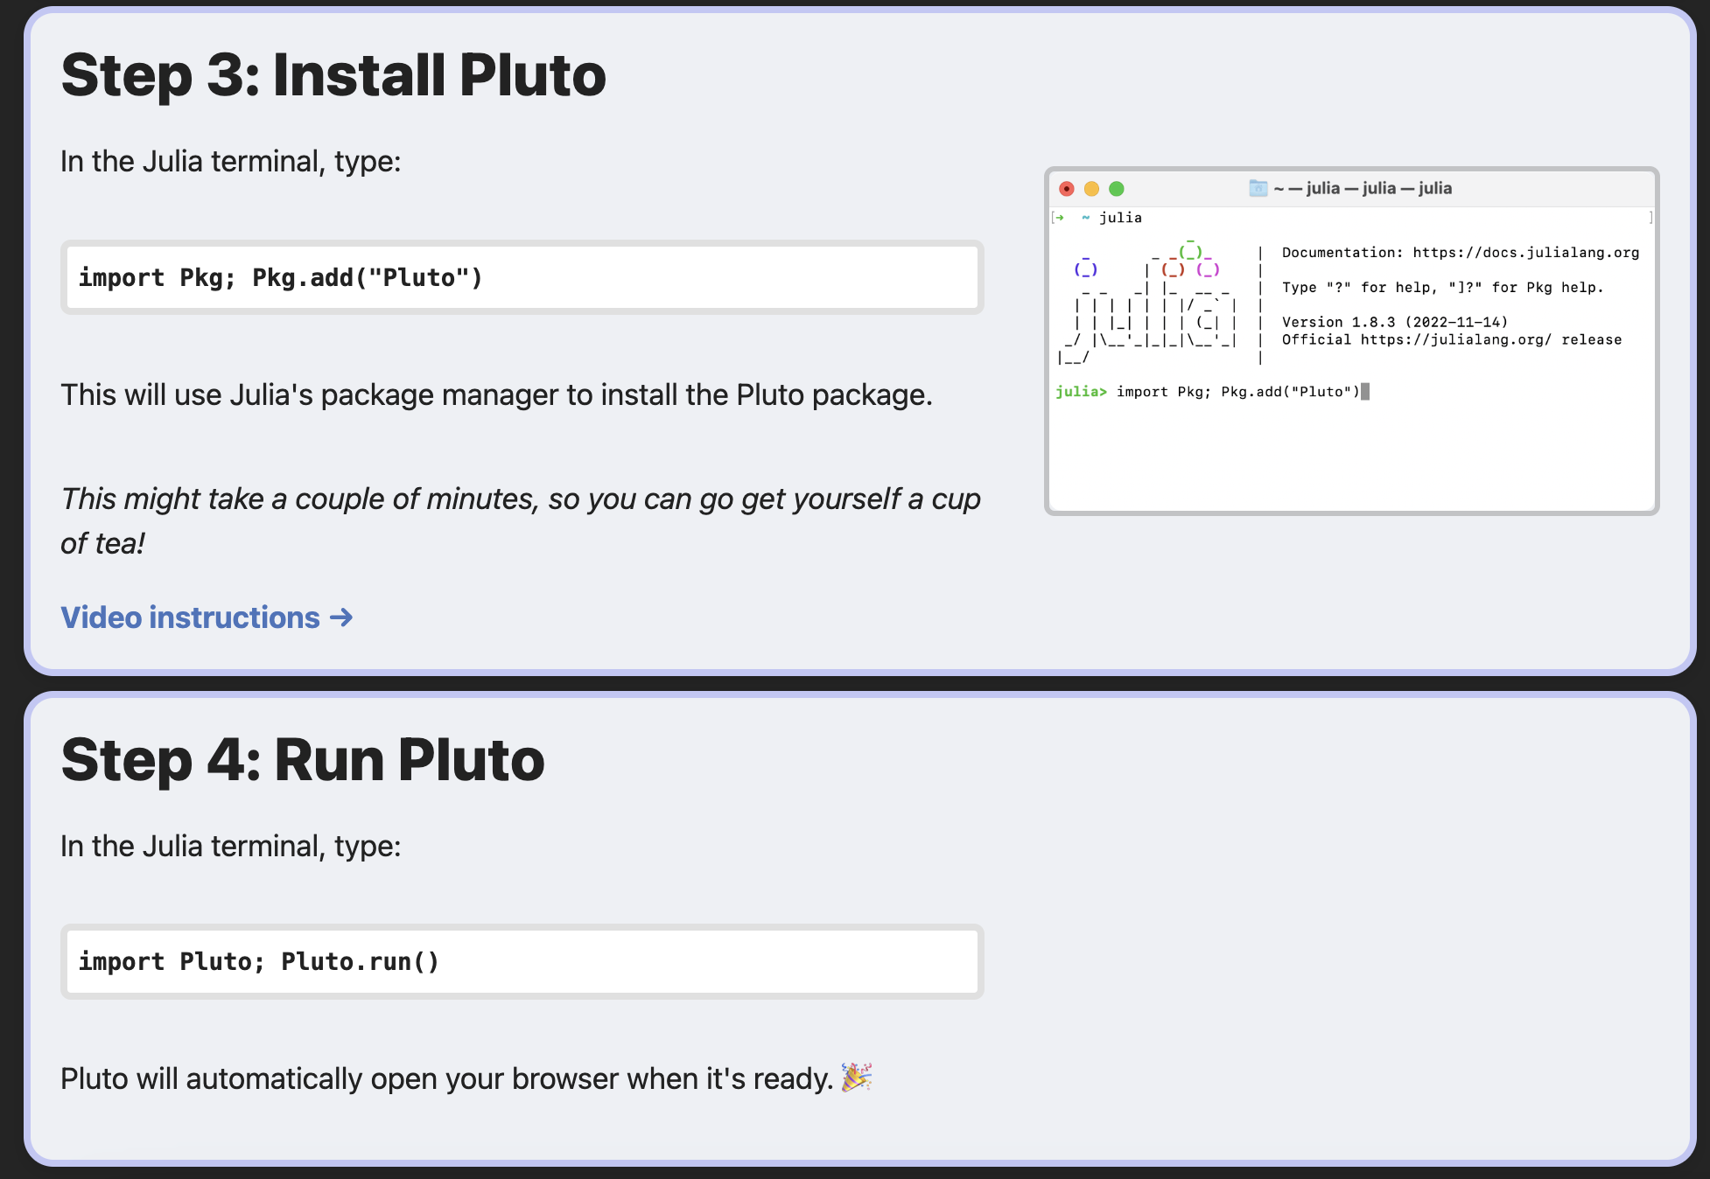
Pluto.jl installation (recommended)
A web-based interactive computing platform similar to Jupyter Notebook with Python (although Julia can also run on Jupyter Notebook)
Notes:
It’s convenient to run Julia and Pluto in your desired working directory.

Slide 5
Today’s key things to learn
How to navigate stuff in Pluto.jl?
Variables and Printing
  Integer, real, complex, strings, char
  println() vs @show
Data structures
  Arrays, tuples, dictionaries
Control flow
  Loops, conditionals, functions, broadcasting, and additional tips
Linear algebra (optional)
  LinearAlgebra.jl package, operations, eigen decompositions

