Slide 1
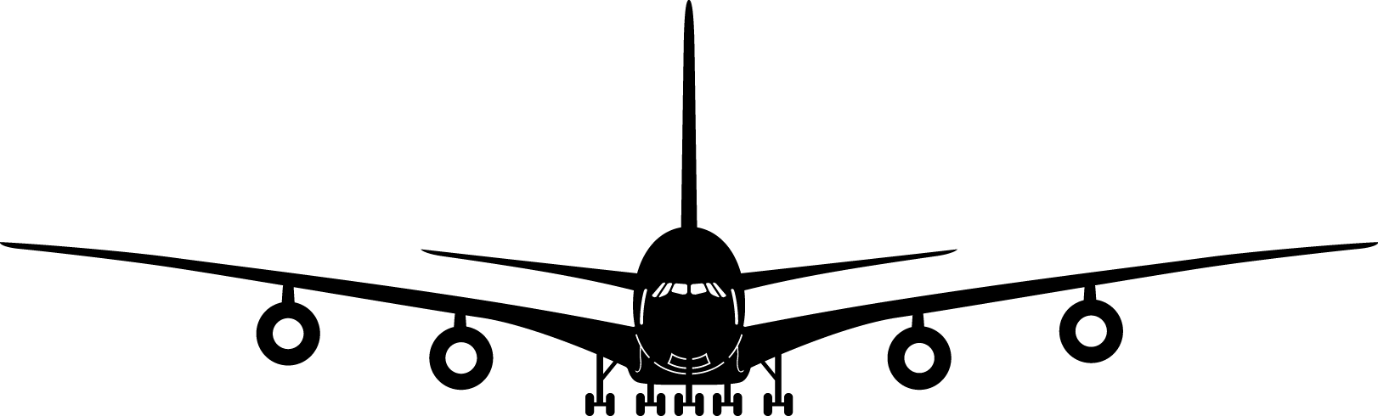
Preliminary Weight Estimation
BY Alfi, HKUST, 2026

Slide 2
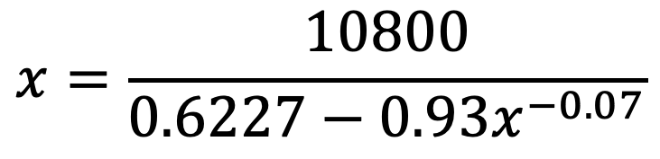
How do you solve the following equation?
$$x=\frac{10800}{0.6227−0.93x^{−0.07}}$$
Key Points
The solution cannot be obtained analytically → needs an iterative solver
Two approaches:
  Fixed-point iteration method
  Bisection method

Slide 3
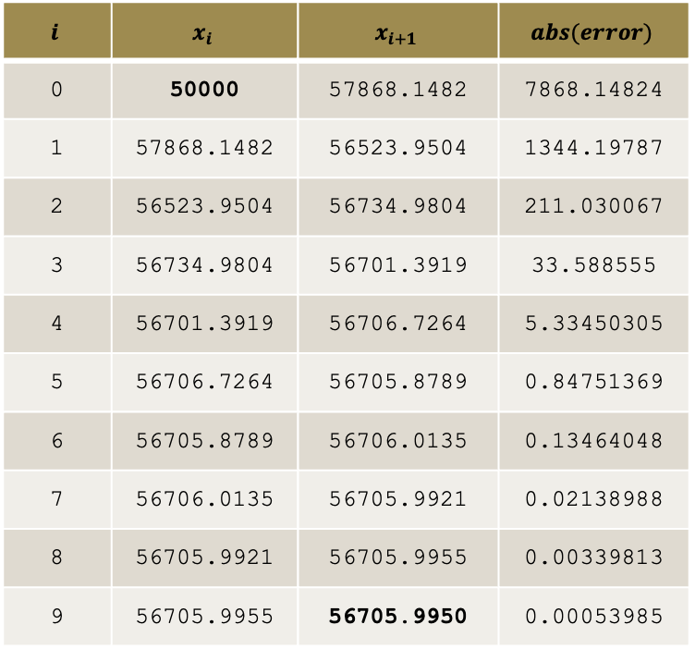
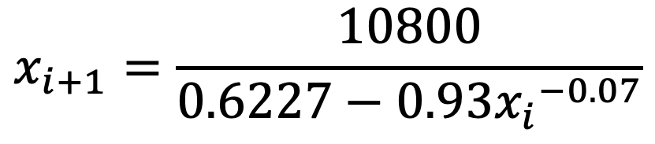
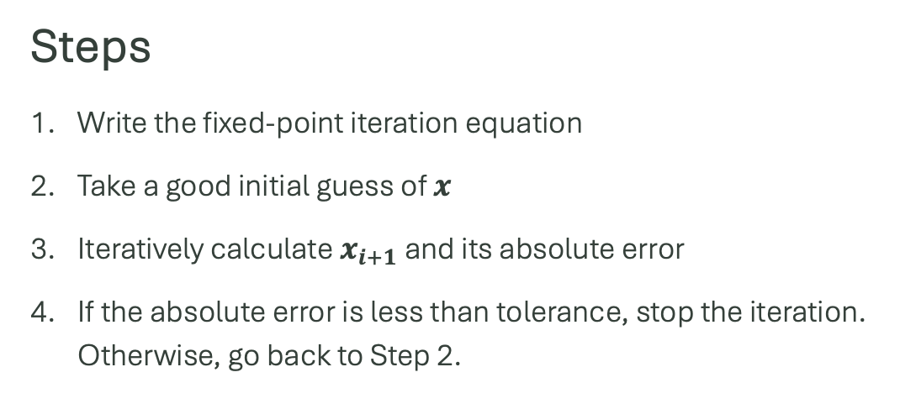
1. Fixed-point iteration method (recommended)
$$x_{i+1}=\frac{10800}{0.6227−0.93{x_{i}}^{−0.07}}$$
$$i$$ | $$x_{i}$$ | $$x_{i+1}$$ | $$abs(error)$$
0 | 50000 | 57868.1482 | 7868.14824
1 | 57868.1482 | 56523.9504 | 1344.19787
2 | 56523.9504 | 56734.9804 | 211.030067
3 | 56734.9804 | 56701.3919 | 33.588555
4 | 56701.3919 | 56706.7264 | 5.33450305
5 | 56706.7264 | 56705.8789 | 0.84751369
6 | 56705.8789 | 56706.0135 | 0.13464048
7 | 56706.0135 | 56705.9921 | 0.02138988
8 | 56705.9921 | 56705.9955 | 0.00339813
9 | 56705.9955 | 56705.9950 | 0.00053985
Steps
Write the fixed-point iteration equation
Take a good initial guess of $x$
Iteratively calculate $x_{i+1}$ and its absolute error
If the absolute error is less than tolerance, stop the iteration. Otherwise, go back to Step 2.

Slide 4
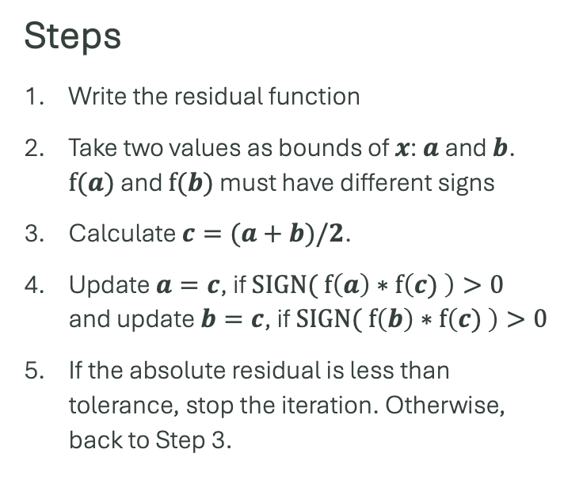
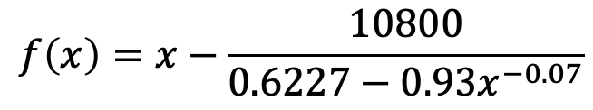
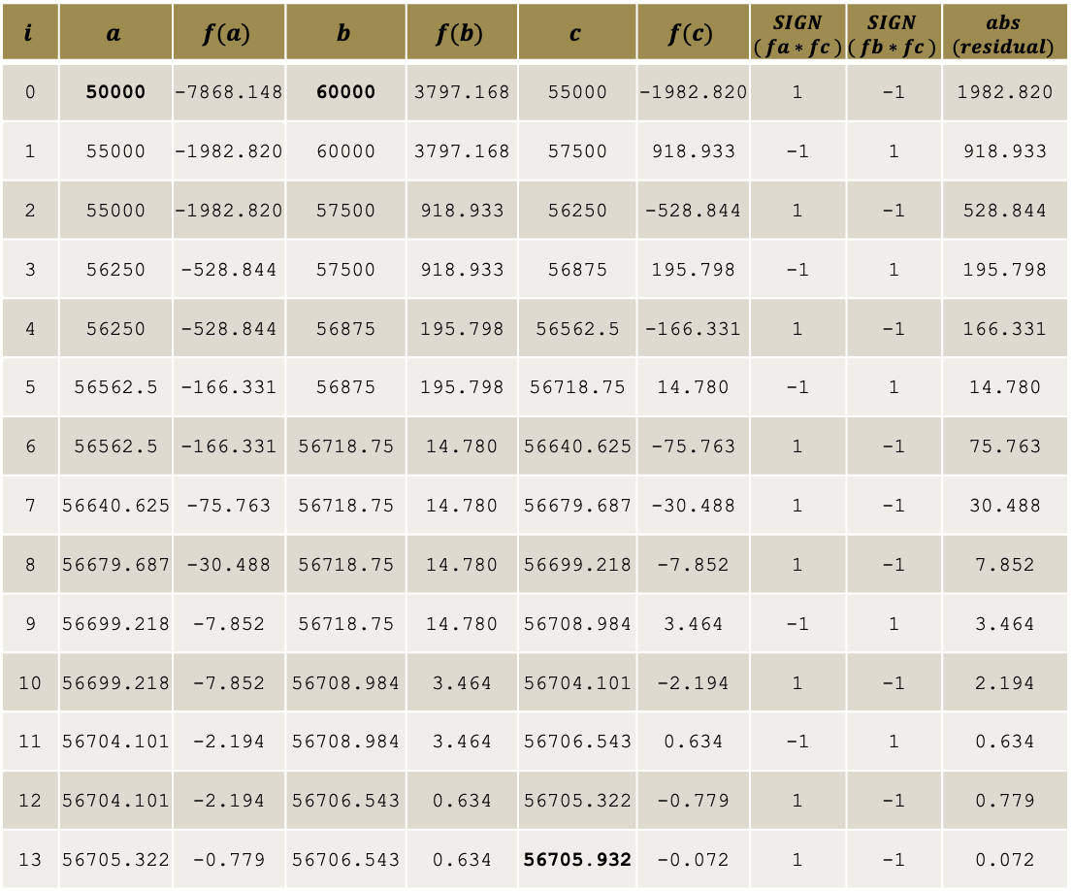
2. Bisection method
$$i$$ | $$a$$ | $$f(a)$$ | $$b$$ | $$f(b)$$ | $$c$$ | $$f(c)$$ | $$SIGN$$ $$( fa∗fc )$$ | $$SIGN$$ $$( fb∗fc )$$ | $$abs$$ $$(residual)$$
0 | 50000 | -7868.148 | 60000 | 3797.168 | 55000 | -1982.820 | 1 | -1 | 1982.820
1 | 55000 | -1982.820 | 60000 | 3797.168 | 57500 | 918.933 | -1 | 1 | 918.933
2 | 55000 | -1982.820 | 57500 | 918.933 | 56250 | -528.844 | 1 | -1 | 528.844
3 | 56250 | -528.844 | 57500 | 918.933 | 56875 | 195.798 | -1 | 1 | 195.798
4 | 56250 | -528.844 | 56875 | 195.798 | 56562.5 | -166.331 | 1 | -1 | 166.331
5 | 56562.5 | -166.331 | 56875 | 195.798 | 56718.75 | 14.780 | -1 | 1 | 14.780
6 | 56562.5 | -166.331 | 56718.75 | 14.780 | 56640.625 | -75.763 | 1 | -1 | 75.763
7 | 56640.625 | -75.763 | 56718.75 | 14.780 | 56679.687 | -30.488 | 1 | -1 | 30.488
8 | 56679.687 | -30.488 | 56718.75 | 14.780 | 56699.218 | -7.852 | 1 | -1 | 7.852
9 | 56699.218 | -7.852 | 56718.75 | 14.780 | 56708.984 | 3.464 | -1 | 1 | 3.464
10 | 56699.218 | -7.852 | 56708.984 | 3.464 | 56704.101 | -2.194 | 1 | -1 | 2.194
11 | 56704.101 | -2.194 | 56708.984 | 3.464 | 56706.543 | 0.634 | -1 | 1 | 0.634
12 | 56704.101 | -2.194 | 56706.543 | 0.634 | 56705.322 | -0.779 | 1 | -1 | 0.779
13 | 56705.322 | -0.779 | 56706.543 | 0.634 | 56705.932 | -0.072 | 1 | -1 | 0.072
Steps
Write the residual function
Take two values as bounds of $x$: $a$ and $b$. $f(a)$ and $f(b)$ must have different signs
Calculate $c=(a+b)/2$.
Update $a=c$, if $SIGN( f\left(a\right)∗f\left(c) \right)>0$ and update $b=c$, if $SIGN( f\left(b\right)∗f\left(c) \right)>0$
If the absolute residual is less than tolerance, stop the iteration. Otherwise, back to Step 3.
$$f\left(x\right)=x−\frac{10800}{0.6227−0.93x^{−0.07}}$$

Slide 5
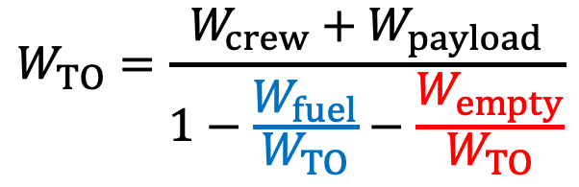


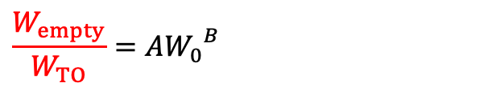

Take-off weight ($W_{TO}$) sizing
$$W_{TO}=W_{crew}+W_{payload}+W_{fuel}+W_{empty}$$
$W_{crew}$, $W_{payload}$ are constants
→ obtained from requirements
$$W_{TO}=\frac{W_{crew}+W_{payload}}{1−\frac{W_{fuel}}{W_{TO}}−\frac{W_{empty}}{W_{TO}}}$$
$\frac{W_{fuel}}{W_{TO}}→$ typically constant
→ from mission analyses
$$\frac{W_{empty}}{W_{TO}}=A{W_{0}}^{B}$$
→ from Raymer, Aircraft Design
Key Points
The take-off weight equation is similar to the previous equation we solved!
It can be solved iteratively!

Slide 6
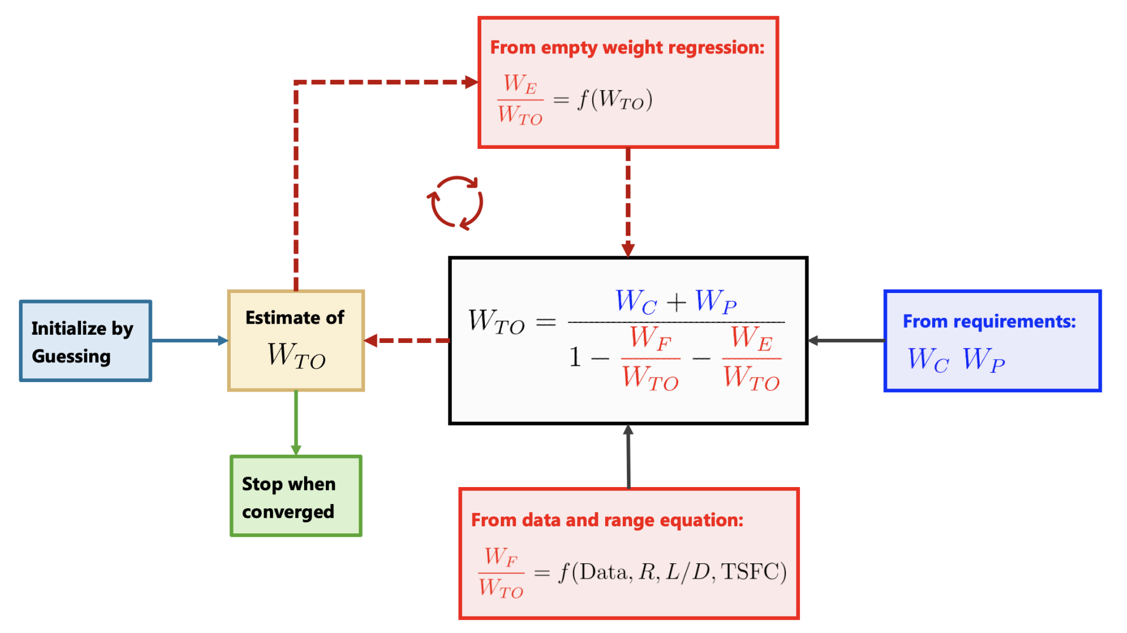
Source: Prof. Zhenyu Gao’s lecture notes

