Slide 1

MECH 3620
Structural Analysis
Wu Fangyi
2026.4.8

Slide 2



Initialize by Experience
$$C_{L,max}$$
AR
L/D
Constraint Analysis
Initial Weight Estimation
T/W
W/S
W
W, T, $S_{ref}$
Wing & Fuselage Design
verify
Sanity Check
Geometry + Aero Curves
Detailed Weight Estimation
Stabilizer
CG, $W_{i}$, $x_{i}$
(Table 8)
(Table 7)
SM < desired?
Stability Analysis
SM < desired?
Static margin
Stop
Notes:
1. VLM method for stability analysis (unfinished part in last tutorial)

Slide 3
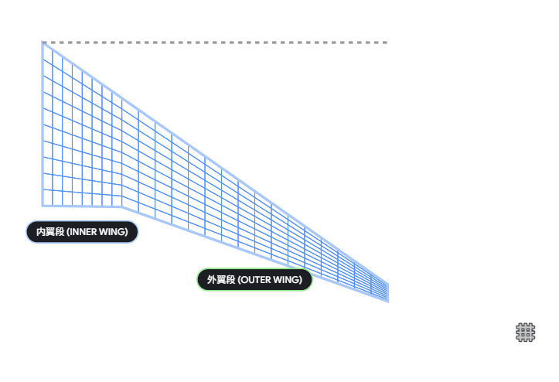
wing_mesh = WingMesh(wing, [8,16], 10,
span_spacing = fill(Uniform(), 4))
8
16
spanwise
10
chordwise
Notes:
(Open 6_Preliminary_Weight_and_Balance_with_Stability_Analysis.jl and explain it)
Once your approximated static margin is good enough, try to use VLM to analyze the aerodynamic coefficients of forces and moments.
As a setup, we need to mesh the lifting surfaces. Meshing is relatively slow, so we can disable this part when we use this notebook for theoretical calculations.
Here, three lifting surfaces require meshing (this page). In this example, the main wing has two spanwise sections. [8, 16] means the inner section is divided into 8 meshes, while the outer section is divided into 16.
The function ComponentVector and make_horseshoes establish the entity of VLM. And we need to set the freestream and reference values. When you are setting the alpha of freestream, remember to check your cruise AOA.
Then we use the solve_case() function to run the VLM analysis. The element number, freestream, and reference value are returned for checking.
As we did in previous aerodynamic analysis, an alpha-sweeping function is developed to check the static margin under different AOA. Here we use alphas from -10 to 10.
We already discussed about the Prandtl-Glauert Singularity problem. So in this code, there are two examples of Mach number. M1 is 0.84, and M2 is 0.2, we can check the effectiveness of the correction.
After mapping and solving under different AOA, we derive two dataframes, including 3D coefficients of forces and moments.
You can choose to plot any curves you need. And the plot in the example is to prove that VLM is not sensitive to Mach number. For an accurate result, you can turn to other CFD methods. But using a lower Mach number in this notebook is also acceptable.
Now we have all the aero-coefficients from the simulation. In the neutral point equation, what we need is the coefficient derivative. freestream_derivatives() is the function for all the derivatives. In the printed values, the second column is the partial derivative of alpha.
And we use dot to access the values and derivatives of each component. We derive the specific values: XXXX. The lift curve slope can be compared with the DATCOM results.

Slide 4
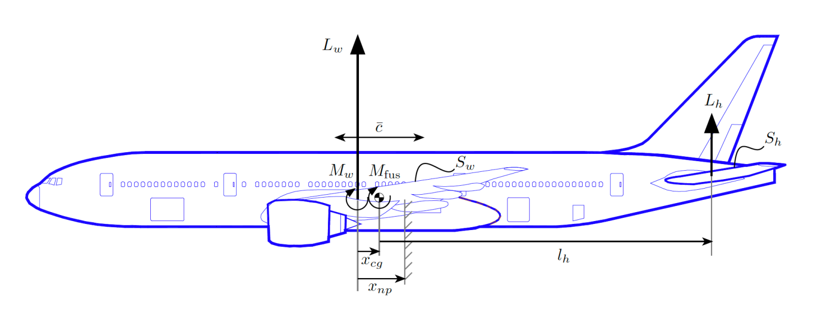
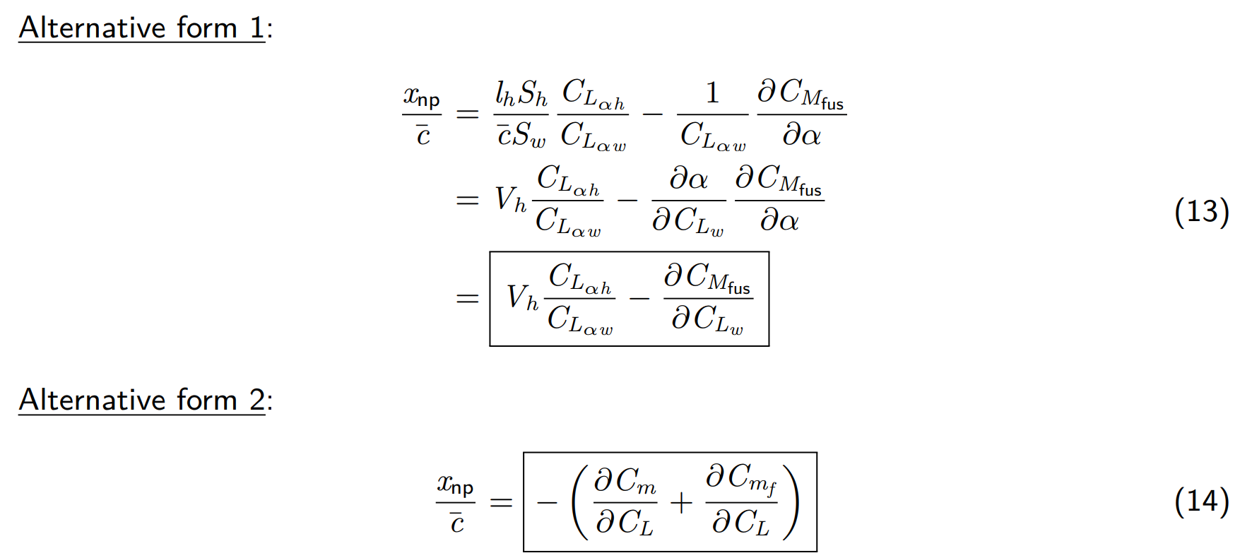


$$x_{w}$$
$$x_{h}$$
Theoretical
Method
$$i_{w,h}$$
VLM
Method
Source: Prof. Gao, "Weight and Balance, Stability Analysis", MECH 3620
Notes:
And this time we use equation 14, because all the coefficients from VLM are derived with respect to the nose point, and the total value can be used.
(Write the derivation of alternative form 2, manuscript 1-2)
In the aircraft entity for VLM, there’s no fuselage. Because VLM is based on the simplification that turns all the components into a 2D flat plate, it does not apply to thick and blunt structures. It so happens that this item in equation 14 can be calculated independently.
So we need to use slender-body theory again. But this time, we have a more accurate CL_alpha of the wing. We need to use wing.CZ_alpha as the input of CM/CL ratio of the fuselage.
After putting the coefficient term from both VLM and fuselage into the formula from equation 14, we can calculate the position of NP. This time, x_np_vlm is relative to the nose point, so we add the reference location.
Now we derive the final static margin. This result can be reserved if the SM is within the range of experience data.

Slide 5



Initialize by Experience
$$C_{L,max}$$
AR
L/D
Constraint Analysis
Initial Weight Estimation
T/W
W/S
W
W, T, $S_{ref}$
Wing & Fuselage Design
Engine Selection
Sanity Check
Verify
${Geo}_{i}$ + Aero Curves
Detailed Weight Estimation
Stability Analysis
${Geo}_{total}\text{,}$CG, $W_{i}$
Static Margin
Structural Analysis
V-n Diagram
(Structure Design)
Cost Analysis
Notes:
2. Flow Chart – the position of structural analysis
So far, we’ve covered several critical steps. We initially derived WTS from CA and WE. And then designed the main components, the wing and the fuselage.
I noticed some groups also completed their engine selection in the midterm report. You can make some adjustments after the lecture about the propulsion system.
After that, the geometry of the three main components is decided with iterative updates. And the aerodynamic characteristics are derived by Aerofuse.
Last week, we covered the detailed weight estimation. By calculating weight and adjusting the locations of components, we design the stabilizer geometry, confirming the CG and NP, and use static margin as the index for stability optimization.
There’s still one important trade-off factor. It is the structure.

Slide 6
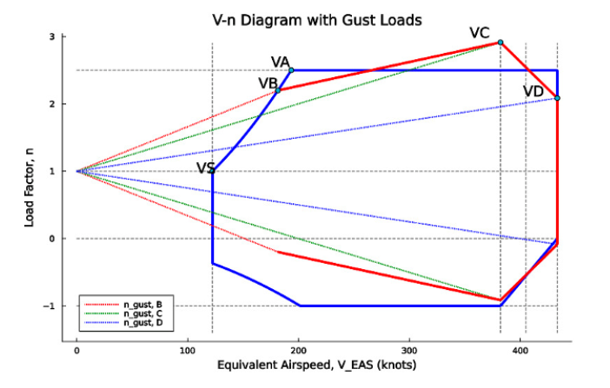
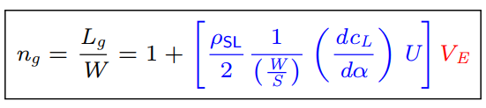
Source: Prof. Gao, "Weight and Balance, Stability Analysis", MECH 3620
Notes:
3. V-n Diagram
(I planned to draw each curve and show them the forming process of the envelope as manuscript 3-5. But this week they already took the lecture ‘aircraft structures’. So, covering this part with code is also understandable.)
In the conceptual design stage, we don’t need to conduct a detailed structural design or airload distribution analysis, as this is the domain of design and stress engineers.
However, providing a flight envelope is necessary. After deciding on a version of geometry and weight, we need to provide the estimated load cases for further structural analysis.
In the last lecture, Prof. taught us about the structure and flight envelopes. And before that, we should know how to draw V-N diagram using notebook 7. Because this is the one you will use in Milestone 4.
3-1. basic flight envelope
V-n diagram is also called maneuver diagram, as it defines the regime of speed V and load factor n. Each boundary in the diagram corresponds to a maneuvering limit.
n = L/W v= EAS
There are three types of boundaries: structure, speed, and aerodynamics.
Structure boundaries are determined by regulations, FAR-25. It gives all civil aircraft the same safety load restriction.
n_max: max limit load.
n_min: min limit load = -1. It means the aircraft must be capable of withstanding at least one upside-down level flight.
Speed boundaries are derived from requirements.
V_c: The design EAS. From the cruise Mach number 0.74 (or your design speed), we can calculate Vc.
V_mo: The maximum operating EAS. It gives the pilot an operating margin. V_mo=1.06V_c
V_d: The design diving speed. In extreme diving conditions, pilots need several seconds to react. So we set this extreme velocity large enough to prevent structural damage. V_d=1.07V_mo
However, both the two extreme conditions, upside-down and diving, are small probability events. They occurring simultaneously is almost impossible. So we choose the point of (vc,nmin) and (vd, 0), and plot a linear increasing line between them.
Aerodynamic boundaries are decided by the stall. For a certain speed, the reachable load factor is limited by CLMAX.
From the definition of n, we find that n(V) is a quadratic function passing through the origin. Cl decides the slope, so the boundary occurs at CLMAX.
You can imagine a pilot trying to reach the load factor limit. As the aircraft speeds up from 0, he will pull up to increase the AOA to reach CLMAX. But when the speed is increased to a certain level, the n touches the structural limit. At that point, the velocity is called VA.
V_A: the design maneuvering speed.
V_S: the stalling speed at normal level flight. The bottom line for safe flight is a sufficient speed to fly level, which means L=W when AOA reaches CLMAX.
3-2. Gust envelope
Except for the basic regime, the load designer also takes the impact of gusts into account. We can use a gust velocity that occurred on cruise conditions to derive the impact on the load.
The gust load is linear to the velocity of the aircraft. The intercept is n=1, and the slope is determined by the gust velocity U. (this page)
In the airworthiness regulations, aircraft must be able to withstand vertical gusts of different intensities at different flight speeds.
U_e,c: The regulated gust velocity at cruise speed.
U_e,d: The regulated gust velocity at diving speed.
U_e,b: The rough gust velocity. We can find an intersection point of this line with the stall curve. At that point, the load generated by the gust is equal to its maximum aerodynamic capability.
Under the extreme gust, the aircraft will fly at VB, so that the gust can lead to a stall rather than a greater load to damage the structure.
The final V-n plot is the union of the basic flight and gust envelope. According to this envelope, further structural design will be carried out.
3-3. Difference between Code and Lecture
(Open 7_FlightEnvelope.jl, explain the input parameters and functions)
n_min is defined by -0.4 * n_max. You can keep this or use -1.
Gust alleviation factor Kg is used to reflect the relative inertia of the aircraft.
In the basic envelope-plotting function, the aircraft is not permitted to have a negative load between vs and 50 m/s at slow speeds. So the vertical boundary is moved to 50 m/s as n =0-1.

