Slide 1

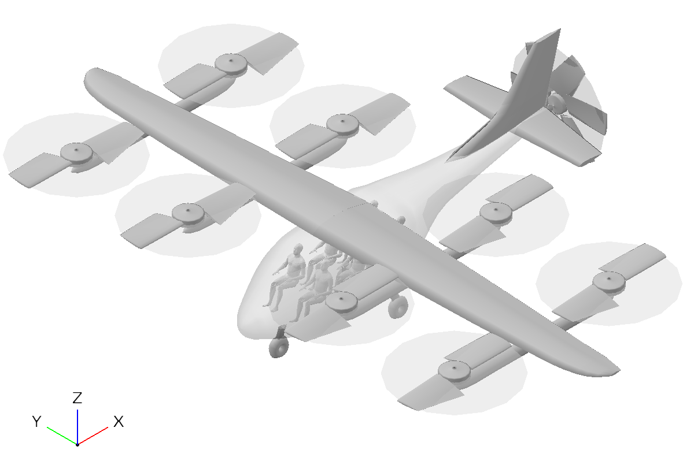
Optimal Conceptual Design and Upgrade Strategies for eVTOL Aircraft Under Evolving Technologies
ICAS PAPER 2026_0631
M. A. Hariansyah¹, C. Reyner¹, R. P. Liem², P. S. Palar³
The Hong Kong University of Science and Technology, HKSAR
Imperial College London, United Kingdom
Institut Teknologi Bandung, Indonesia
Presenter: M. A. Hariansyah (Alfi)
Notes:
Good morning, everyone. Thanks for attending this session.
My name is Alfiyandy Hariansyah. I am a PhD student at HKUST.
My focus today is also on eVTOLs but from a different perspective, which is,
Optimal conceptual design and upgrade strategies, specifically under evolving technologies.

Slide 2
Part I
Introduction
Notes:
Today, there is massive global hype around eVTOL development.
Rotorcraft have been around for decades,
so why is everybody suddenly talking about it now?

Slide 3
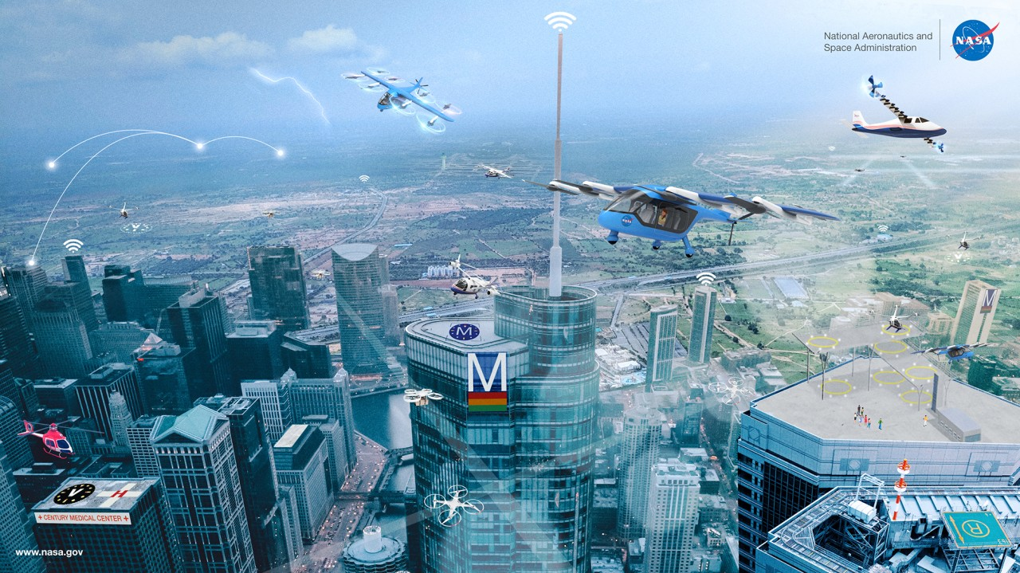
Distributed Electric Propulsion (DEP) as an enabler for eVTOL aircraft
NASA’s vision of a mature UAM city ecosystem [1].
DEP distributes multiple smaller electric motors across the airframe [2]. Figure: all-electric propulsion.
Irene MG, IEEE CSS Forum On Robotic and Control Engineering Seminar, 2021.
Kim HD et al., AIAA/IEEE Electric Aircraft Technologies Symposium, 2018.
Notes:
The recent push toward Urban Air Mobility is largely enabled by Distributed Electric Propulsion, or DEP.
As you can see in the diagram on the right, DEP distributes multiple smaller electric motors.
Because electric motors maintain consistent power density and efficiency regardless of their size,
we can place them flexibly across the airframe,
which is why people have come up with hundreds, if not thousands, of configurations imaginable.
So, it is the fundamental building block that makes modern all-electric eVTOL aircraft possible.

Slide 4
Technologies are evolving (1/2)
plateauing as it reaches limits
rapid improvement
initial progress
Example: battery specific energy (Wh/kg) projection model [3].
Tiede B et al., IEEE Transportation Electrification Conference & Expo (ITEC), 2022.
Notes:
However, the technologies that make up DEP are evolving rapidly.
Let us look at battery specific energy as an example.
It tells you how much energy a battery pack can carry in Wh, per kg of its mass.
As you can see, it is expected to follow an S-curve.
Initially, the progress is slow, but suddenly it undergoes rapid improvement; this is where we are now in 2026.
Later, it will saturate because it’s not going to go up forever, as there are limits in cell chemistry.

Slide 5
Technologies are evolving (2/2)
Electric motor:
specific power (kW/kg) and efficiency [4].
Power converter:
specific power (kW/kg) and efficiency [5].
Other technology building blocks of DEP are also improving and can be projected.
These types of parameters are known unknown: uncertain, yet bounded, and expected to improve [6].
Pastra CL et al., IEEE Transportation Electrification Conference & Expo (ITEC), 2022.
Hall C et al., IEEE Transportation Electrification Conference & Expo (ITEC), 2022.
Mc Manus H and Hastings D, INCOSE International Symposium, Vol. 15, No. 1, 2005.
Notes:
The same trend is true for other powertrain components.
For electric motors and power converters, we expect their specific power to increase significantly between now and 2050.
Meanwhile, their efficiencies are already quite high and are physically bounded near unity, so they will see only marginal improvements.
We treat these future technology parameters as “known unknowns”.
We know they are uncertain, but they are bounded within projection envelopes, and they are expected to improve over time.

Slide 6
An aircraft optimal at EIS will not remain optimal
technological obsolescence
Weight, energy consumption, etc.
fixed design, fixed technology
Objective
function
retrofit: fixed design, new technology
redesign: new design, new technology
2030
Year
2070
2030
20XX
2070
EIS: entry-into-service
Technologies continuously evolve, while product upgrades occur at discrete intervals.
EOP: end-of-production
When should the upgrades occur?
Notes:
If we optimize an aircraft for its entry into service year, say 2030, with an objective function to be minimized.
If we fix the design and technology, nothing changes, right? To remain competitive, the aircraft must evolve.
We can either perform a retrofit, where we keep the fixed airframe but swap in new technology, or we can perform a redesign, creating an entirely new aircraft every year.
The “fixed design fixed technology“ will quickly become suboptimal as better technologies become available.
These gaps are what we call technological obsolescence.
Technologies evolve, while upgrades occur at discrete intervals. The critical question is: when should these upgrades occur?
It’s just like smartphones. You don't buy a new model every year unless the upgrade offers a meaningful change in performance.

Slide 7
Research questions
How do we size and optimize an eVTOL aircraft at the conceptual level?
  Multidisciplinary Design Optimization (MDO) architecture benchmark
  Design objective trade-off study
  Sensitivity to mission requirements and battery technology
Which future technologies will drive the optimal design?
  Sensitivity to projected technology levels (battery, motor, converter)
When should the aircraft evolve?
  Future-aware optimal upgrade strategy (retrofit and redesign)
Notes:
To address this, our research has three main questions.
First, how do we size and optimize an eVTOL aircraft at the conceptual level?
Second, among all the evolving technologies, which ones actually drive the changes in the optimal design?
And third, based on those technology trends, when should the aircraft evolve through retrofit and redesign?

Slide 8
Reference vehicle and mission
NASA Lift-Plus-Cruise OpenVSP model [7].
Adapted Uber Air mission requirement [8]
Johnson W and Silva C, The Aeronautical Journal, Vol. 126, No. 1295, 2022.
Holden J and Goel N, Uber Elevate, 2016.
Notes:
For our baseline, we use the NASA Lift Plus Cruise concept vehicle,
with eight distributed lift rotors and single pusher propeller.
The design mission follows a simplified Uber Air profile,
which includes vertical takeoff, cruise and landing.

Slide 9
Part II
How do we size and optimize an eVTOL aircraft at conceptual design level?
Notes:
Let’s answer the first question.

Slide 10
Conceptual sizing process
This is called an eXtended Design Structure Matrix (XDSM)
Multi-Disciplinary Analysis solver: Newton, Jacobi, Bisection, etc.
Performance
Weight estimation
Sizing: How do we converge on takeoff weight?
more weight $→$ more lift $→$ more power $→$ more energy $→$ heavier battery $→$ heavier system $→$ more weight
Notes:
Let’s review a conceptual sizing process.
It is the process that requires solving a coupled weight-and-energy loop.
If you add more weight, you need more lift.
More lift means more drag, which needs more power, more energy, which means a heavier battery and system, and the loop starts again.
To solve this, we use an MDA solver, which iterates through performance and weight estimation modules
until the takeoff weight converges.

Slide 11
Multidisciplinary Design Optimization (MDO) architectures [9]
Multidisciplinary Feasible (MDF)
Individual Discipline Feasible (IDF)
Hybrid MDF–IDF
Need an MDA solver
Optimizer controls only the design variables
Takeoff weight is converged at each optimizer iteration
No need for an MDA solver
Optimizer controls design and all coupling variables
Parallel execution for discipline solvers
No need for an MDA solver
Optimizer controls design and takeoff weight variables
Sequential execution for discipline solvers
Different MDO architectures might differ in terms of computational cost, robustness, or optimal solutions.
Martins JRRA and Lambe AB, AIAA Journal, Vol. 51, No. 9, 2013.
Notes:
To optimize the design, we need to wrap an optimizer around that sizing process.
We evaluated three different MDO architectures.
The first is Multidisciplinary Feasible, or MDF, which uses a full MDA solver at every optimizer step.
The second is Individual Discipline Feasible, or IDF, which removes the inner solver and lets the optimizer handle all the coupling variables simultaneously.
The third is a Hybrid MDF--IDF approach, which removes the inner solver but keeps the sequential execution of the disciplines.

Slide 12
Considerations for MDO in conceptual design
Choose our MDO architecture framework wisely
  Perform MDO architecture benchmark if needed or if we can afford it
Which design objective matters?
  Takeoff weight, energy consumption, mission time, cost, carbon footprint, range
Aircraft design always starts with a mission
  Configuration selection depends on a mission, not the other way around
  Be clear with what is fixed as requirement, what can be changed
Make several assumptions on the underlying technologies
  Traditional engineering design freezes requirements early
  e.g., battery specific energy, motor specific power, etc.
Notes:
When setting up MDO for conceptual design, there are several considerations.
First, we must choose our MDO architecture wisely.
Different architectures perform differently depending on the problem.

Slide 13
MDO architecture benchmark results
MDO architectures were benchmarked over 550 eVTOL design test problems with different design objectives, mission range, cruise speed, and initial solutions.
Metric | MDF | IDF | Hybrid MDF–IDF
Mean MDA calls | 282 | 21 | 15
Success rate | 100% | 100% | 100%
Number of cases where objective value is lower (better) | 98 | 38 | 392
Hybrid MDF–IDF is selected as the computational architecture,
since it provides the balance of computational cost, robustness, and optimality.
Notes:
We benchmarked the three MDO architectures across different eVTOL design test cases.
The results indicate that the Hybrid MDF--IDF is the most efficient for our case.
It required a mean of only 15 solver calls, compared to 282 for the MDF.
Also, it successfully found the best objective value in 392 of the test cases.
Therefore, we selected the Hybrid architecture for all subsequent studies in this research.

Slide 14
Considerations for MDO in conceptual design
Choose your MDO architecture framework wisely
  Perform MDO architecture benchmark if needed or if you can afford it
Which design objective matters?
  Takeoff weight, energy consumption, mission time, cost, carbon footprint, range
Aircraft design always starts with a mission
  Configuration selection depends on a mission, not the other way around
  Be clear with what is fixed as requirement, what can be changed
Make several assumptions on the underlying technologies
  Traditional engineering design freezes requirements early
  e.g., battery specific energy, motor specific power, etc.
Notes:
The second major consideration is deciding which design objective actually matters.
Depending on our goal, it could be minimizing takeoff weight, energy consumption, mission time, cost, etc.
The choice of objective will fundamentally alter the final aircraft design.

Slide 15
Design objective trade-off study
We investigated weight-minimal (WM), energy-minimal (EM), and time-minimal (TM) designs
Mission ranges were swept from 10 km to 220 km
Three battery SE values: 250, 400, and 550 Wh/kg
WM and EM have similar trends due its coupling, though each still has absolute advantage
TM prioritizes speed, leading to high penalties
Notes:
To understand this impact, we conducted a trade-off study across three different design objectives
minimizing weight, energy, and time.
We swept the mission range from 10 to 220 kilometers across three different battery SE levels.
We observe that minimizing time always prioritizes speed, which leads to severe weight and energy penalties.
On the other hand, the trends for minimizing weight and energy are closely coupled.

Slide 16
Weight and energy are coupled, but not identical objectives
WM: weight-minimal
EM: energy-minimal
TM: time-minimal
WM lowers structure weight, EM lowers energy, and thus battery weight.
Each objective leads to different geometries and component-weight breakdowns.
Notes:
Weight and energy are coupled, but they are not identical.
Here, we look at the resulting geometries.
WM design tries to lower the structural weight.
It does this by selecting smaller wings and smaller rotors.
Conversely, EM design tries to reduce aerodynamic drag and hover power.
It has a higher-aspect-ratio wing and larger lift rotors.
This reduces the energy required, which in turn shrinks the battery weight, even though the structural weight increases.
So, each objective leads to different geometries and component weight breakdowns.

Slide 17
Considerations for MDO in conceptual design
Choose your MDO architecture framework wisely
  Perform MDO architecture benchmark if needed or if you can afford it
Which design objective matters?
  Takeoff weight, energy consumption, mission time, cost, carbon footprint, range
Aircraft design always starts with a mission
  Configuration selection depends on a mission, not the other way around
  Be clear with what is fixed as requirement, what can be changed
Make several assumptions on the underlying technologies
  Traditional engineering design freezes requirements early
  e.g., battery specific energy, motor specific power, etc.
Notes:
The third consideration is that aircraft design always starts with a mission.
So don’t ask which mission is suitable for which configuration, but ask which configuration is suitable for which mission.
and also, we need to be clear about what is fixed and what can be changed.
Whether to fix the range as requirement, or maximize it as design variable, for example.
The fourth consideration is that we need to make assumptions about the underlying technologies.
Traditional engineering design often freezes these requirements early,
which can be bad because if the assumptions do not reflect reality, we have to revisit our design, it takes a lot of work.

Slide 18
Sensitivity to mission requirements and battery technology
Higher battery specific energies expand the possible mission domain.
Remember the weight-energy coupled loop!
Notes:
We mapped the feasible design space across mission requirements to see how these technology assumptions play out.
So here, for each mission range and cruise speed requirement, we performed design optimization and obtained an optimal aircraft.
The hatched areas represent missions that are infeasible to fly.
As you can see, moving from left to right, higher battery SEs significantly expand the possible mission domain.
This reinforces the fact that battery technology is the primary bottleneck for eVTOL feasibility.

Slide 19
Part III
Which future technologies move the optimal design?
Notes:
Part 3, which technologies actually drive the optimal design?

Slide 20
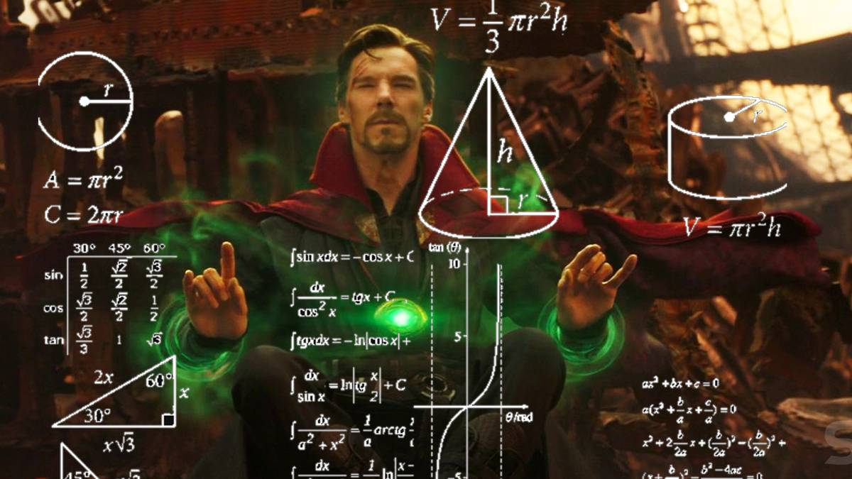



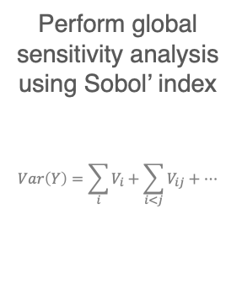

Measuring sensitivity of optimal design to projected technologies
Step 1
Step 2
Step 3
Step 4
Define technology vector $Θ(t)$ and its projection envelope
$$Θ\left(t\right)=[ρ_{b},ρ_{m},ρ_{c},η_{m},η_{c}]$$
Sample technology states at multiple future years
$Θ\left(t\right)$ at
$$t=[2030,…, 2070]$$
Optimize the aircraft with the sampled technology states
$$x^{∗}(t)={argmin}_{x} f(x,Θ\left(t\right))$$
Perform global sensitivity analysis using Sobol’ index
$$Var\left(Y\right)=\sum_{i}{V_{i}+\sum_{i<j}{V_{ij}+…}}$$
Projection models for battery, motor, converter
Dr. Strange looking into the future [10]
Multidisciplinary Design Optimization process
Sensitivity Analysis Library in Python [11]
https://screenrant.com/infinity-war-doctor-strange-futures-how-many-why/
Iwanaga T et. al., Socio-Environmental Systems Modelling, Vol. 4, 18155, 2022.
Notes:
To do this, we performed a global sensitivity analysis.
First, we defined our technology vector and its projection envelope. We considered the battery, motor, and converter parameters.
Second, we sampled thousands of possible technology states within those envelopes for each future year.
You know, it’s like one of the Avengers movie scenes, where Dr. Strange trying to look into the future.
Third, we optimized the aircraft for every single sampled state.
Finally, we used Sobol indices to measure how much of the variance in the optimal design was caused by each technology variable.

Slide 21
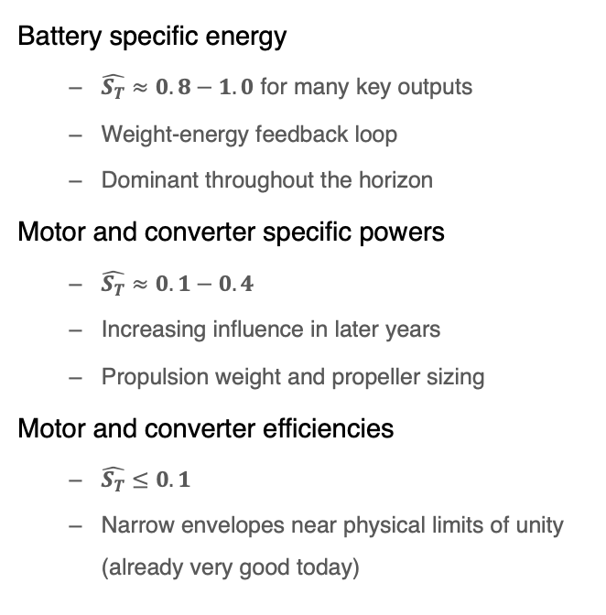
Battery SE dominates, powertrain SPs grow influence later
Battery specific energy
  $\hat{S_{T}}≈0.8−1.0$ for many key outputs
  Weight-energy feedback loop
  Dominant throughout the horizon
Motor and converter specific powers
  $\hat{S_{T}}≈0.1−0.4$
  Increasing influence in later years
  Propulsion weight and propeller sizing
Motor and converter efficiencies
  $\hat{S_{T}}≤0.1$
  Narrow envelopes near physical limits of unity (already very good today)
Notes:
The Sobol indices reveal that Battery SE is the dominant driver.
It controls the weight and energy feedback loop
However, we also observe that motor and converter specific powers become increasingly influential in the later years,
particularly regarding propulsion weight and propeller sizing.
In contrast, motor and converter efficiencies have almost zero influence on the design variance,
because their projection envelopes are very narrow and already near their physical limits.

Slide 22
Part IV
When should the aircraft evolve?
Notes:
Next, we address our final question:
When should the aircraft be upgraded to keep pace with technologies?

Slide 23
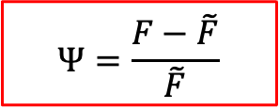
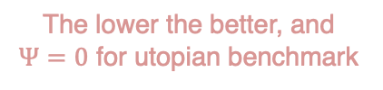
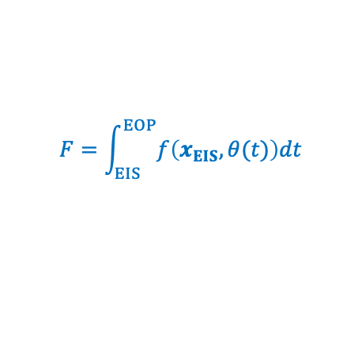
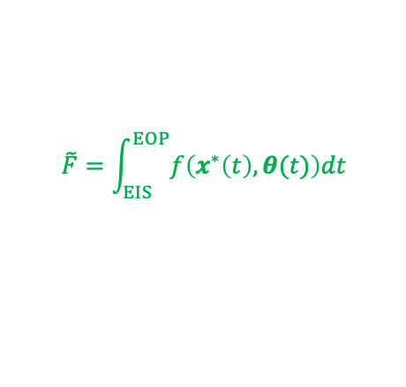
Utopian benchmark and future-aware penalty metric
EIS: entry-into-service
EOP: end-of-production
technological obsolescence
Objective
function
Objective
function
EIS
EOP
EIS
EOP
utopian benchmark:
new design, new technology every year
continuous retrofit:
fixed design, new technology every year
$$\tilde{F}=\int_{EIS}^{EOP}{f\left(x^{∗}\left(t\right), θ(t)\right)dt}$$
$$F=\int_{EIS}^{EOP}{f\left(x_{EIS}, θ(t)\right)dt}$$
$$Ψ=\frac{F−\tilde{F}}{\tilde{F}}$$
future-aware penalty metric equation
The lower the better, and
$Ψ=0$ for utopian benchmark
Notes:
First, we established a utopian benchmark, which represents a scenario
where an aircraft is continuously redesigned every single year to perfectly match the latest technology.
Continuous retrofit represents a fixed design, but with new technology every year.
If we integrate objective f over time for utopian, we will get this area under the curve, right?
Same is true for retrofit. When we compare them, and subtract the former, the area difference represents technological obsolescence.
The future-aware penalty metric is defined as the normalization of the area difference between an upgrade strategy with utopian benchmark.
The lower the value, the better. If it is utopian, then this metric equals zero.

Slide 24
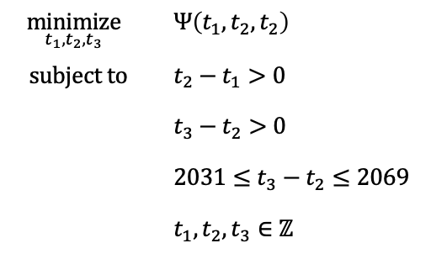



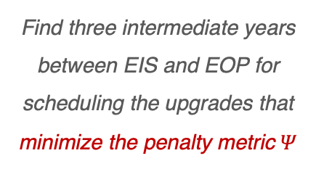
Formulation: optimal upgrade strategy
EIS: entry-into-service
EOP: end-of-production
Optimization problem
Objective
function
$$\underset{t_{1},t_{2},t_{3}}{minimize}{ }$$ | $$Ψ\left(t_{1},t_{2},t_{2}\right)$$
$$subject to$$ | $$t_{2}−t_{1}>0$$
 | $$t_{3}−t_{2}>0$$
 | $$2031≤t_{3}−t_{2}≤2069$$
 | $$t_{1},t_{2},t_{3}∈ℤ$$
EIS
EOP
2030
2070
$$t_{1}$$
$$t_{2}$$
$$t_{3}$$
Find three intermediate years between EIS and EOP for scheduling the upgrades that minimize the penalty metric $Ψ$
Solved using a genetic algorithm (NSGA-II)
Integer design variables
Solved under redesign and retrofit framework
Notes:
Next, we formulated an integer optimization problem to minimize this penalty metric.
We assume the aircraft enters service in 2030 and ends production in 2070.
We want to find the exact three intermediate years to perform major upgrades,
Minimizing the penalty metric Psi.
We solved this using a genetic algorithm,
under a clean-sheet redesign and component-swap retrofit framework.

Slide 25
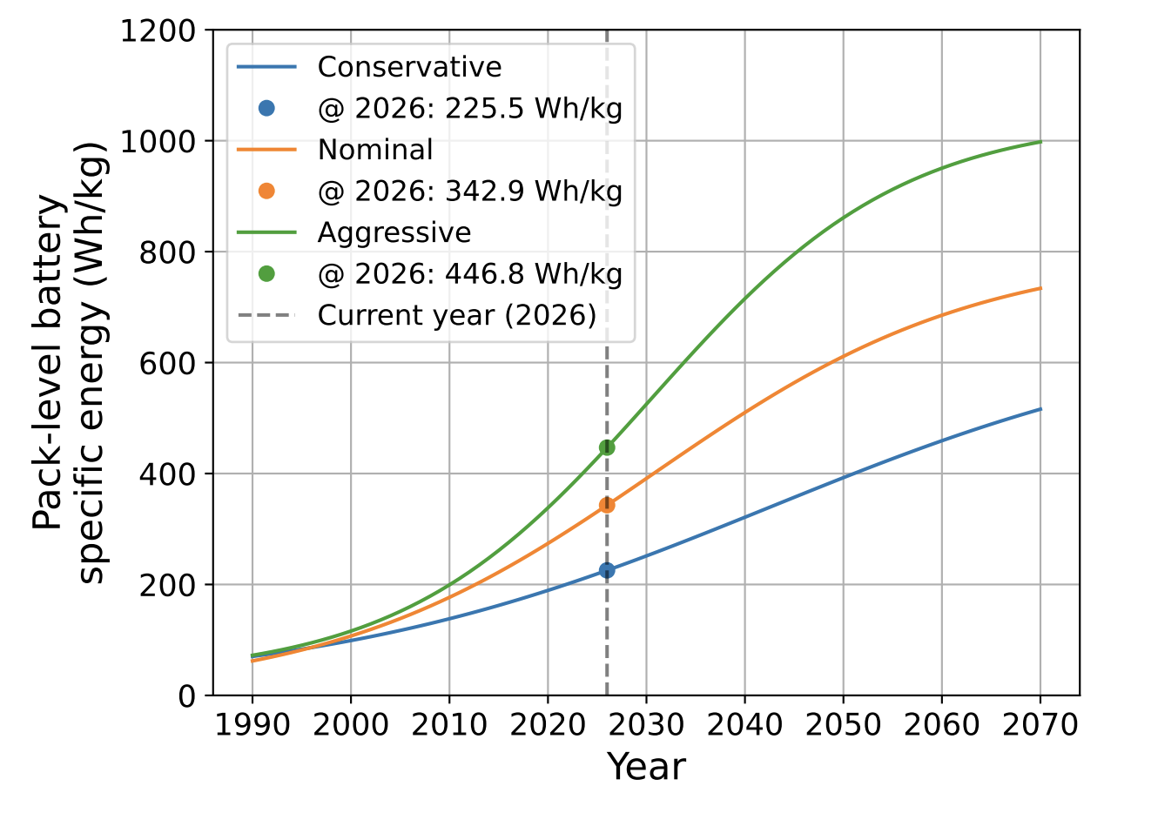


Results: optimal discrete upgrade schedules
Conservative example
Discrete upgrades are non-uniform.
Optimizer clusters upgrades closer together during earlier years and spaces them further apart during later years.
Optimal discrete upgrades are 21.9% better than uniform upgrades in redesign case, and 1.2% better in retrofit case.
Clean-sheet redesign
Component-swap retrofit
Rapid improvement
$$Δ_{Ψ}=21.9\%$$
$$Δ_{Ψ}=1.2\%$$
Notes:
The red curve here represents a uniform 10-year upgrade plan,
While the blue curve represents the resulting optimal upgrade schedules.
The results show that the optimal upgrade schedules are non-uniform.
Instead of upgrading every 10 years, the optimizer clusters the upgrades closer together during the early years, with intervals of 5 to 8 years.
It then spaces them further apart in the later years, with intervals of 11 to 16 years.
This makes sense because the strategy aligns with the technology S-curve. It capitalizes on the rapid technological improvements early on,
and waits longer when the technology begins to saturate.
By using this non-uniform schedule, we reduce the penalty metric by roughly 22 percent for redesigns, and 1.2 percent for retrofits.

Slide 26
Part V
Conclusion and future work
Notes:
I will now conclude the presentation.

Slide 27
Concluding remarks
Hybrid MDF–IDF was selected for the MDO architecture since it provides a balance of computational efficiency, robustness, and optimality.
The optimal eVTOL conceptual design is affected by the design objective selection, mission requirements, and technology levels.
Battery specific energy is the dominant technology driver, with powertrain specific power becoming more influential in later years.
Optimal discrete upgrade schedules are non-uniform and should be concentrated during rapid technology advancement.
Notes:
First, the Hybrid MDF--IDF was selected because it provides the best balance of computational efficiency, robustness, and optimality for eVTOL sizing.
Second, the optimal conceptual design is highly sensitive to the chosen design objective, the mission requirements, and the assumed technology levels.
Third, battery SE is the dominant technology driver governing the optimal design, though powertrain SPs become increasingly influential in later decades.
Finally, optimal upgrade schedules are non-uniform and should be concentrated during periods of rapid technology advancement.

Slide 28
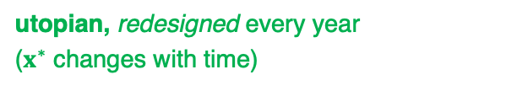
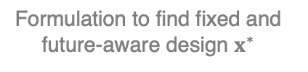

Future work: future-aware design optimization
poor performance
Formulation to find fixed and future-aware design $x^{∗}$
$$x^{∗}=\min_{x}{Ψ\left(x;θ(t)\right)}$$
Objective
function
better performance
design optimized at EIS, retrofitted
future-aware design, retrofitted
utopian, redesigned every year
($x^{∗}$ changes with time)
Year
2030
2070
What if we have a design that may perform slightly poor at first due to being undersized, but becomes better as technology improves?
Notes:
For our future work, we plan to shift our focus to future-aware design optimization.
Currently, we optimize the aircraft for its EIS year.
However, what if we intentionally design an aircraft that may perform poor initially
we want to explore formulations where we intentionally design an aircraft that might perform slightly poorly at first (perhaps being undersized),
but becomes better as technology improves.
This can be achieved by directly minimizing the metric Psi to get the fixed design x.
Theoretically, this approach could yield a lower total penalty metric Psi.
We are preparing a journal paper on this. So, please stay tuned.

Slide 29
Thank you!
Contact: mahariansyah@connect.ust.hk
Notes:
Thank you very much for your attention,
I’m happy to take questions.

Slide 30
Supplementary slides

Slide 31
Multidisciplinary Feasible (MDF)
Go back to main slides.

Slide 32
Individual Discipline Feasible (IDF)
Go back to main slides.

Slide 33
Hybrid MDF–IDF
Go back to main slides.

Slide 34
Optimal parameters vs mission range for different design objectives

Slide 35
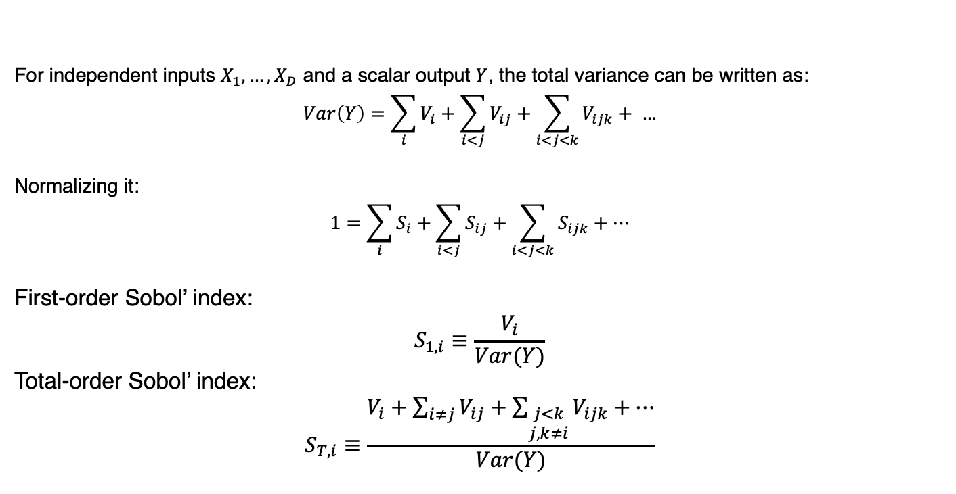
Introduction to Sobol’ index
For independent inputs $X_{1},…, X_{D}$ and a scalar output $Y$, the total variance can be written as:
$$Var\left(Y\right)=\sum_{i}{V_{i}+\sum_{i<j}{V_{ij}}+\sum_{i<j<k}{V_{ijk}}+ …}$$
Normalizing it:
$$1=\sum_{i}{S_{i}+\sum_{i<j}{S_{ij}}}+\sum_{i<j<k}{S_{ijk}}+…$$
First-order Sobol’ index:
$$S_{1,i}≡\frac{V_{i}}{Var(Y)}$$
Total-order Sobol’ index:
$$S_{T,i}≡\frac{V_{i}+\sum_{i≠j}{V_{ij}}+\sum_{\begin{matrix}j<k \\ j,k≠i\end{matrix}}{V_{ijk}}+…}{Var(Y)}$$

Slide 36
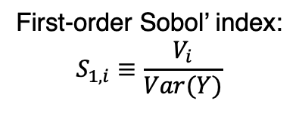
First-order Sobol’ indices for various optimal outputs
First-order Sobol’ index:
$$S_{1,i}≡\frac{V_{i}}{Var(Y)}$$

Slide 37
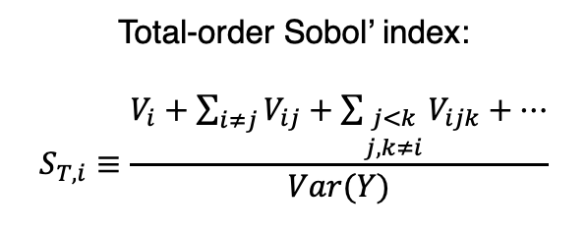
Total-order Sobol’ indices for various optimal outputs
Total-order Sobol’ index:
$$S_{T,i}≡\frac{V_{i}+\sum_{i≠j}{V_{ij}}+\sum_{\begin{matrix}j<k \\ j,k≠i\end{matrix}}{V_{ijk}}+…}{Var(Y)}$$

Slide 38
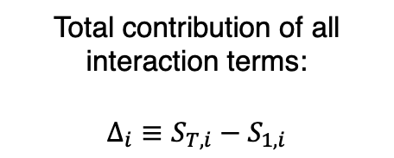
Total contribution of all interaction terms of Sobol’ indices
Total contribution of all interaction terms:
$$Δ_{i}≡S_{T,i}−S_{1,i}$$

Slide 39
Optimal upgrade strategy under redesign for all projection scenarios

Slide 40
Optimal upgrade strategy under retrofit for all projection scenarios

Slide 41
Optimal geometries under different projection scenarios
Conservative
Nominal
Aggressive

