Slide 1
Structural Sizing of an Aircraft Wing Structure
MECH5930 Term-Project Presentation
Alfiyandy Hariansyah (21023691); Xi Chen (21147100)
mahariansyah@connect.ust.hk; xchenim@connect.ust.hk
10-Dec-2025
THE HONG KONG UNIVERSITY OF SCIENCE AND TECHNOLOGY
DEPARTMENT OF MECHANICAL AND AEROSPACE ENGINEERING

Slide 2
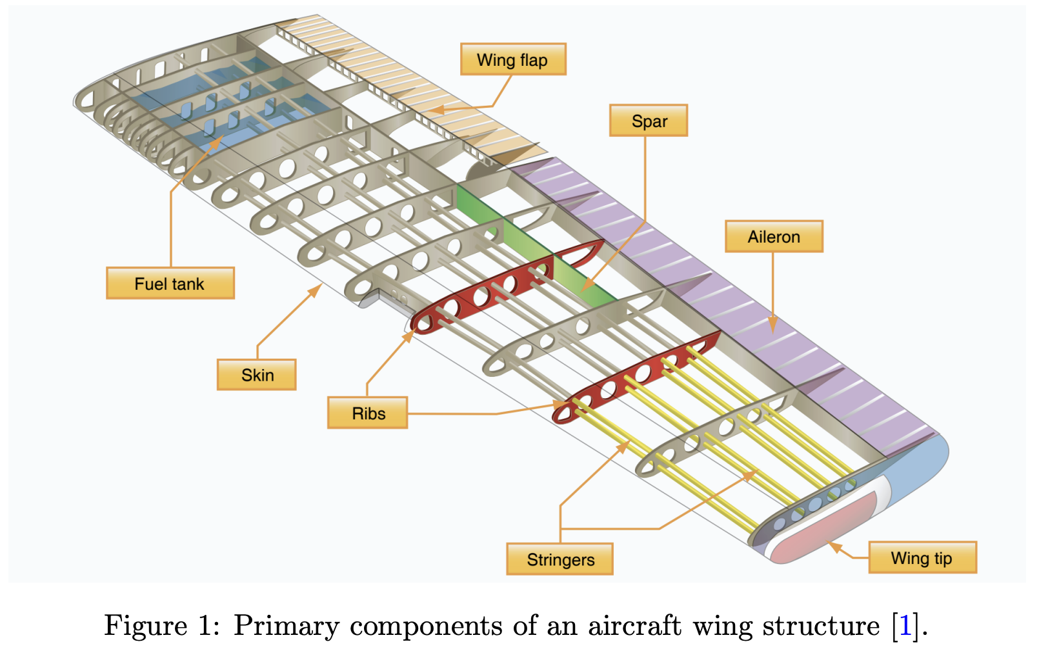
Introduction: aircraft wing structure
An aircraft wing structure must withstand various loads:
Aerodynamics
Inertial load (self-weight)
Operational loads (gust, maneuver, etc.)
Main components:
Outer skin: transfer aero load
Spars: resist bending and shear
Ribs: maintain airfoil shapes
Stringers: handle torsions

Slide 3
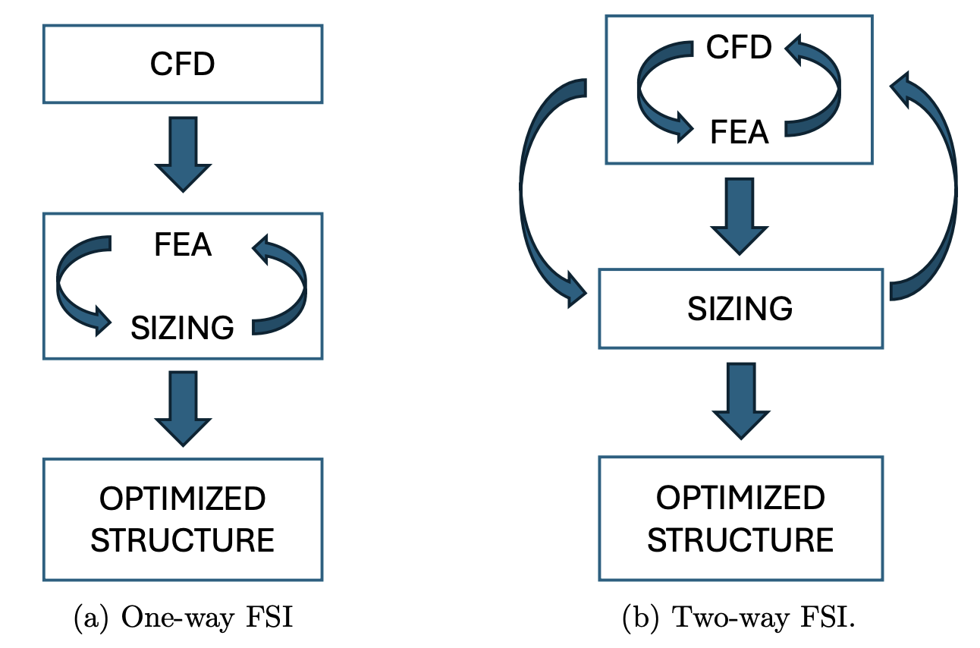
Introduction: structural sizing
Structural sizing: an optimization process determining the optimal dimensions for the structures (e.g., skin thickness, spar cross-sections, rib placement)
FSI: fluid structure interaction
One-way FSI: FEA and CFD are not coupled, sizing iteration is only with FEA
Two-way FSI: FEA and CFD are coupled, sizing iteration is with both CFD and FEA

Slide 4
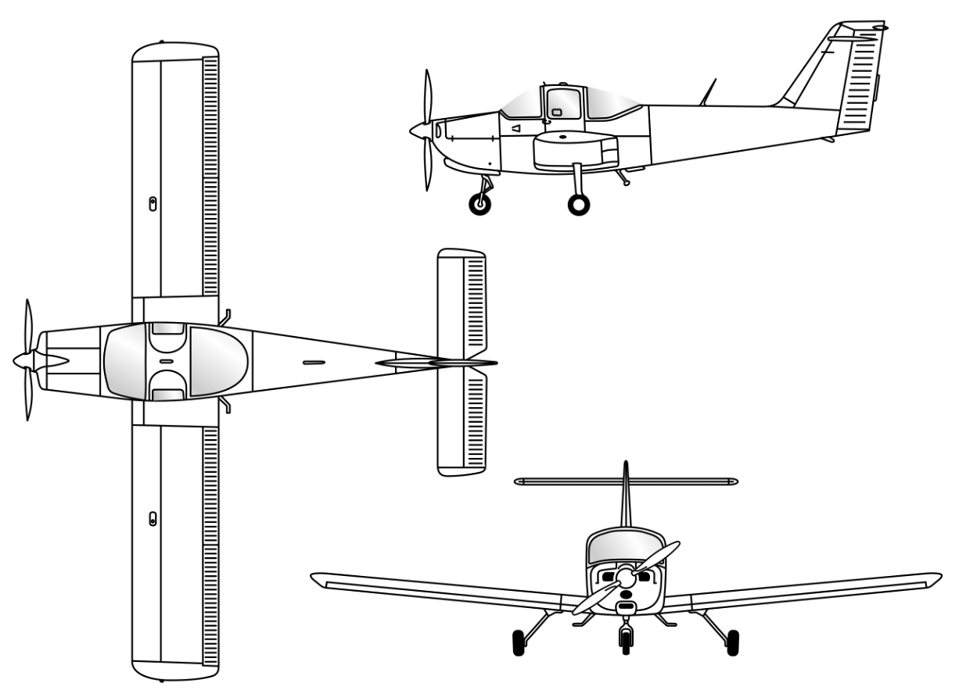
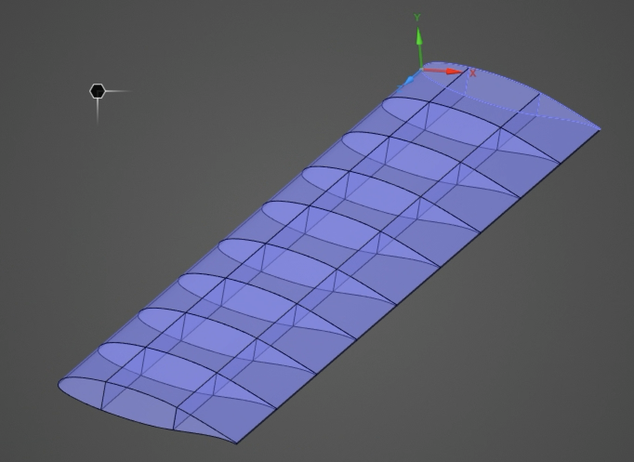
Introduction: problem description
The wing geometry is adopted from the Piper PA-38 Tomahawk. The structural model is a cantilevered half-wing with a closed wing box formed by upper and lower skins, two spanwise spars, and ten chordwise ribs (shared topology, no need contact elements).
Stringers are not modeled !!!
Material:
aerospace-grade isotropic Al 2024-T3
General Aviation airplane: PA-38 3-view drawing

Slide 5
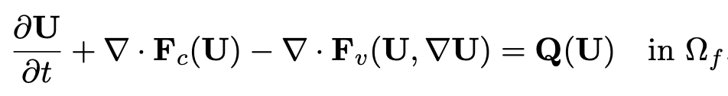
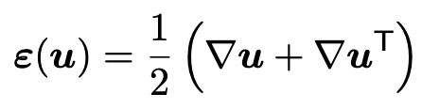


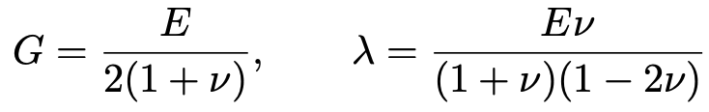


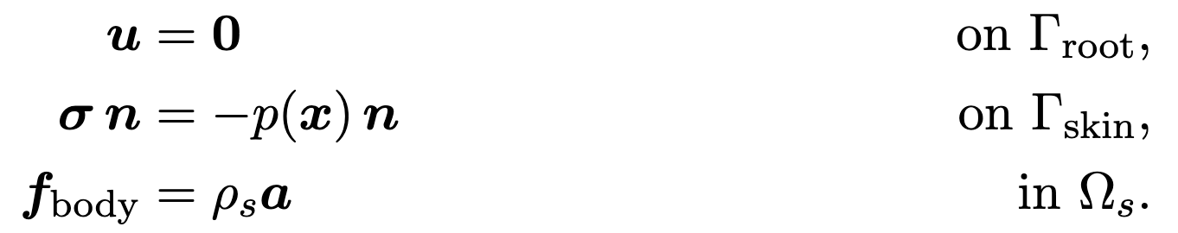
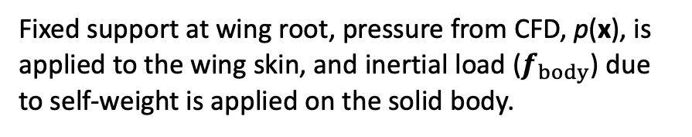
Governing Equations and Boundary Conditions
FEA: Linear Elasticity
CFD: Compressible Navier-Stokes
Reynolds-Averaged Navier Stokes
with SST k-omega turbulence model
Boundary Conditions
Fixed support at wing root, pressure from CFD, p(x), is applied to the wing skin, and inertial load ($f_{body}$) due to self-weight is applied on the solid body.

Slide 6
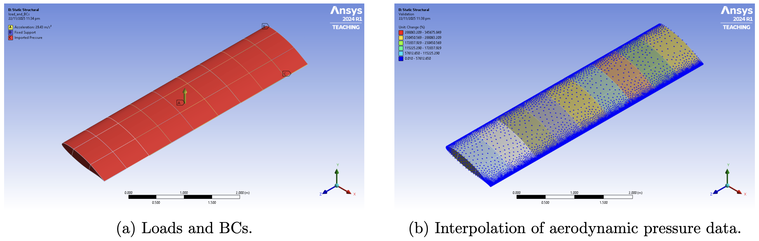
Loads and Boundary Conditions
Fixed support
Upward inertial
acceleration (n * g) creates downward inertial load (self-weight)
Structural boundary conditions and pressure mapping strategy.

Slide 7
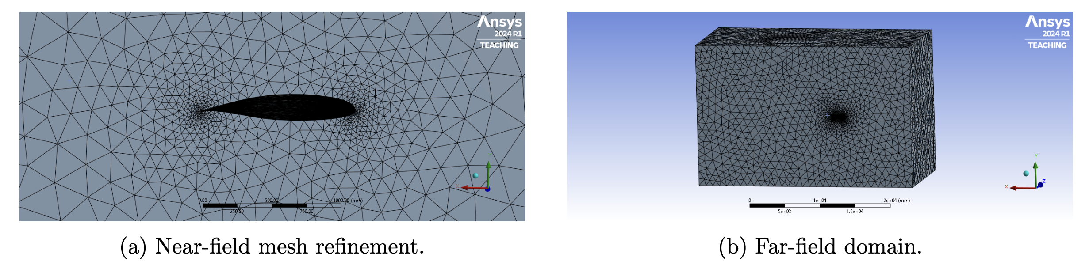
Aerodynamic Analysis in ANSYS Fluent
Unstructured mesh for CFD analysis contains ~760,000 cells → 10 minutes on Virtual Barn.

Slide 8
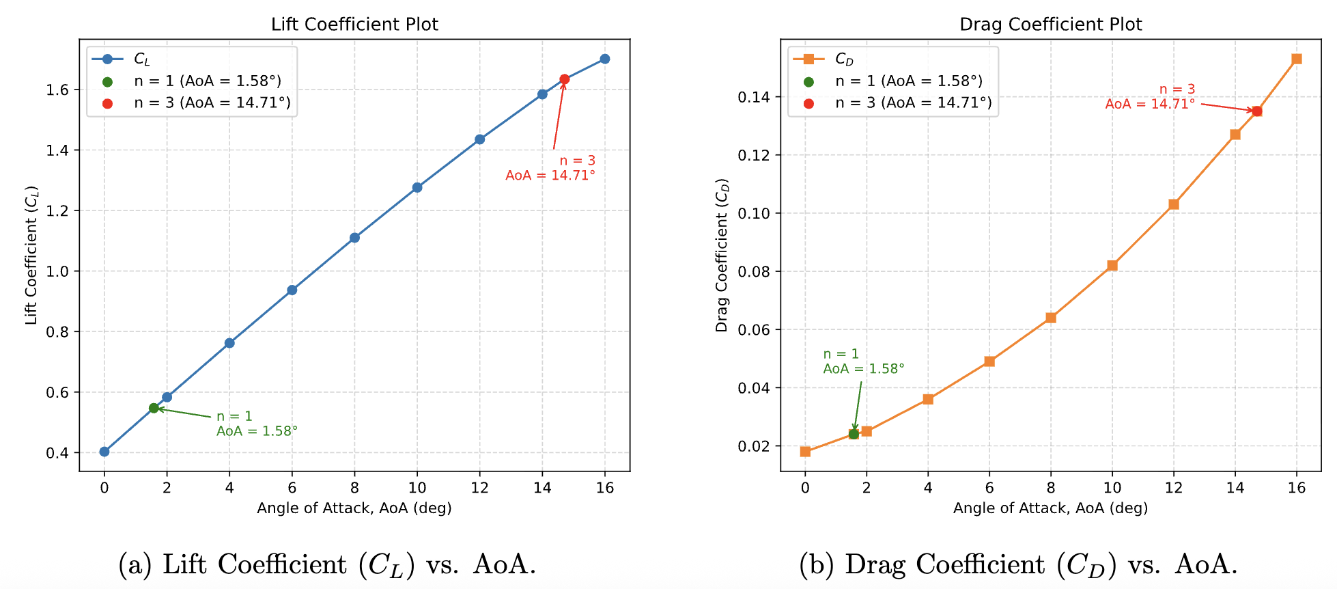
Aerodynamic Analyses: AoA Sweep
CFD conditions: cruise altitude (10,500 ft); cruise speed (51.39 m/s, subsonic)
Aerodynamic Polar Curves obtained from CFD analyses

Slide 9
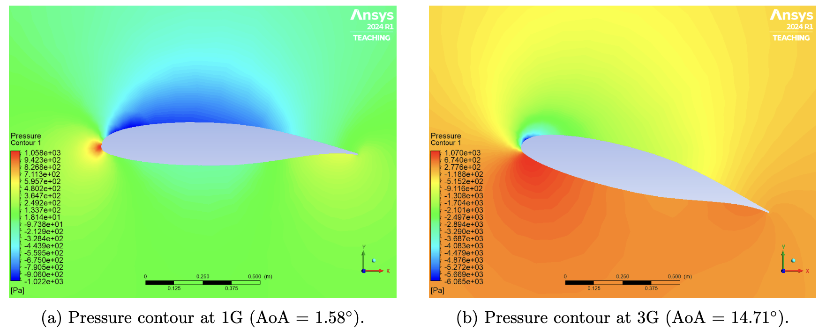
Load Case Selection
Two flight conditions: 1G steady level flight & 3G pull-up maneuver
We pick the 3G load for performing the subsequent design and analyses.

Slide 10
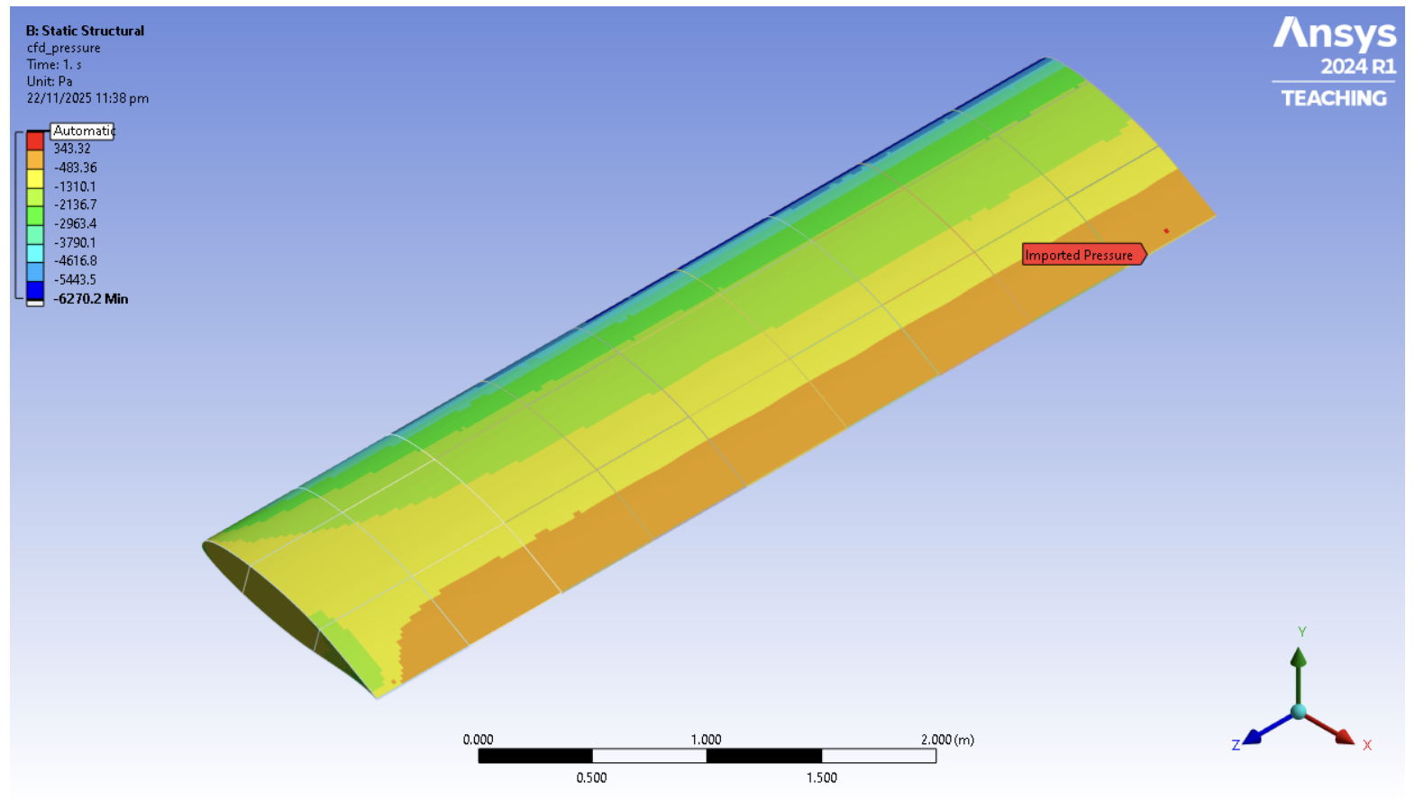
Imported 3G Load Case
The 3G load case was then mapped into the FEA model (one-way FSI).

Slide 11
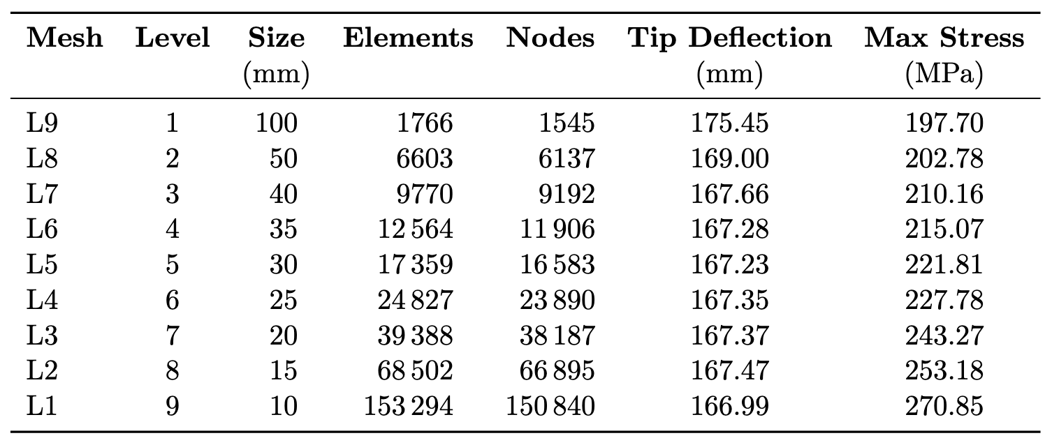
Finite Element Mesh: Grid Convergence Study (1/2)
A mesh refinement study was performed on the structural finite element model. The global shell element size was varied from 100 mm to 10 mm, and the corresponding number of elements, wing tip deflection, and maximum von Mises stress were recorded.
Mesh refinement has a strong influence at coarse levels, but both tip deflection and stress plateau once the global element size falls below ~35 mm, with tip deflection varying by less than 0.15% between the 30–15 mm meshes. Maximum von Mises stress increases monotonically with refinement (197.7 MPa → 243.27 MPa), though further gains beyond the 15–10 mm meshes diminish relative to the added computational cost.

Slide 12
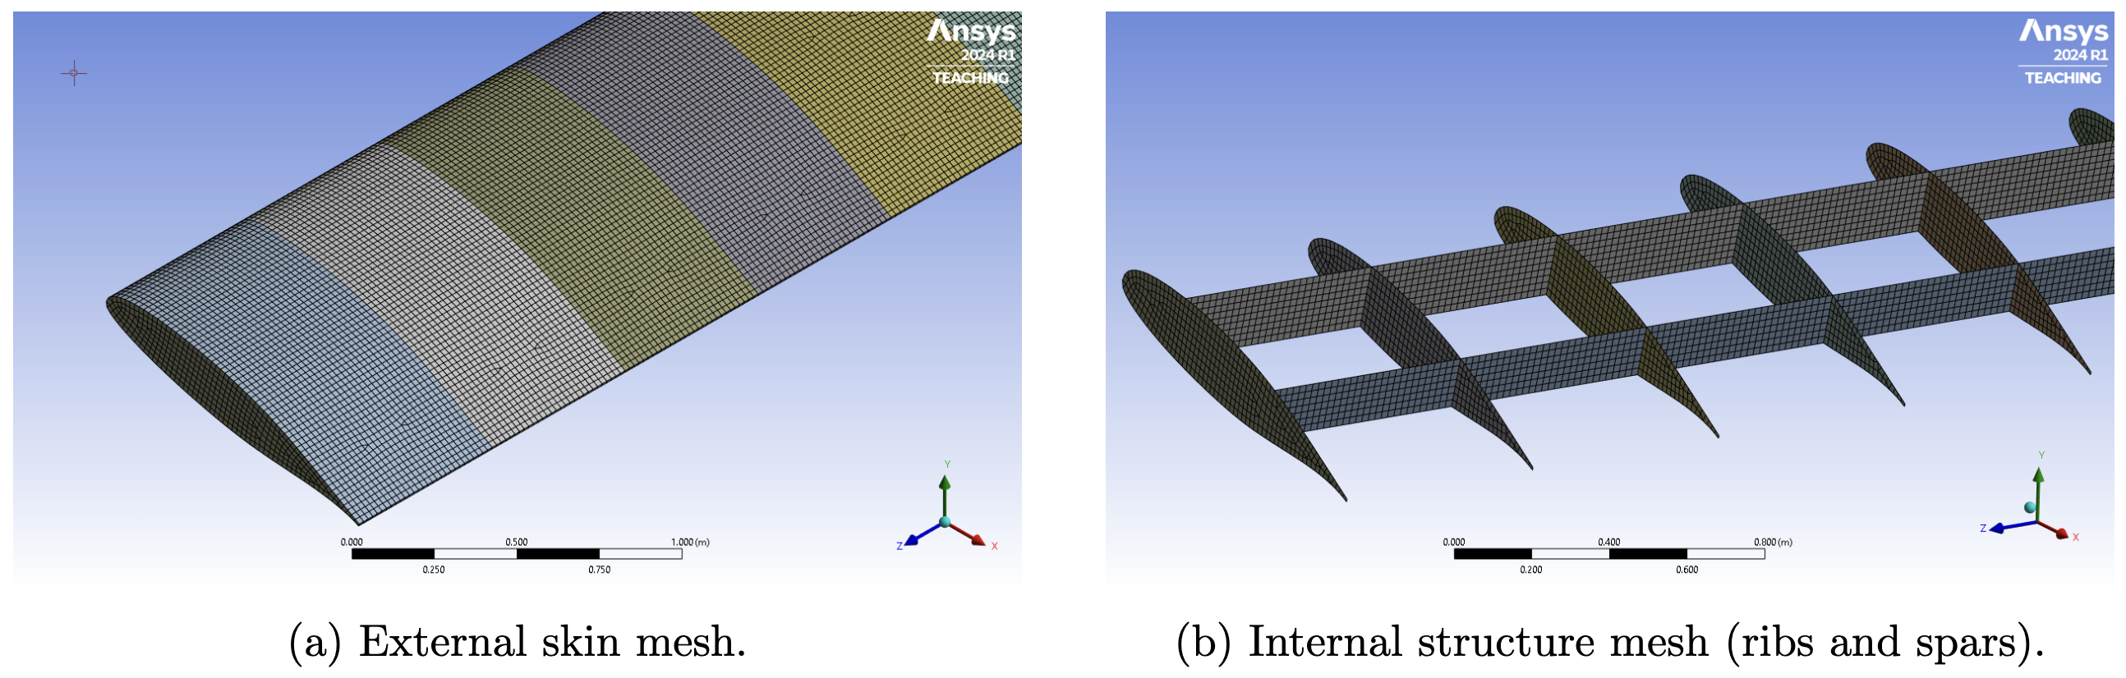
Finite Element Mesh: Grid Convergence Study (2/2)
SHELL181 (4-node, linear) elements with a global size of 20 mm (L3 Mesh) was selected.

Slide 13
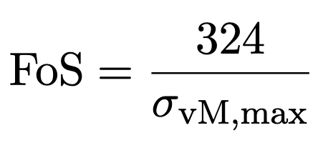
Phase 1: Rib Layout Selection (1/2)
Phase 1 aims to identify the optimal arrangement of the eight intermediate ribs to improve structural performance under the 3G load case, evaluating six rib-layout strategies. For each layout, mass, maximum von Mises stress, tip deflection, and Factor of Safety were computed, and the best configuration is selected based on achieving high FoS and low deflection while keeping rib thicknesses equal.
The Factor of Safety is based on the material yield stress of Aluminum 2024-T3 (324 MPa), using:

Slide 14
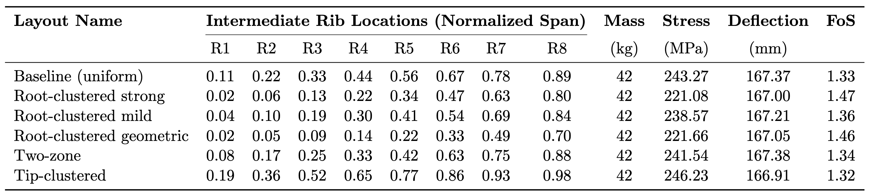
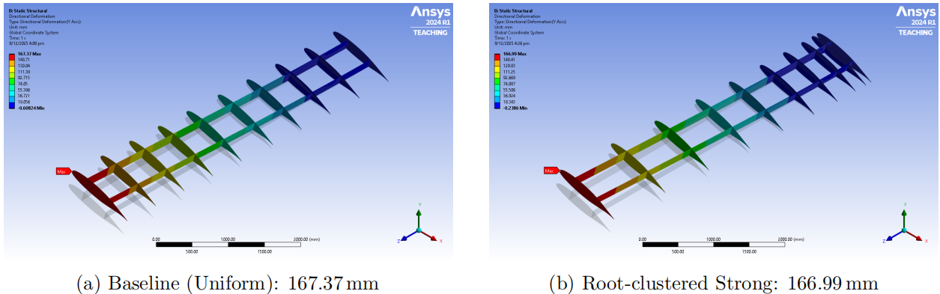
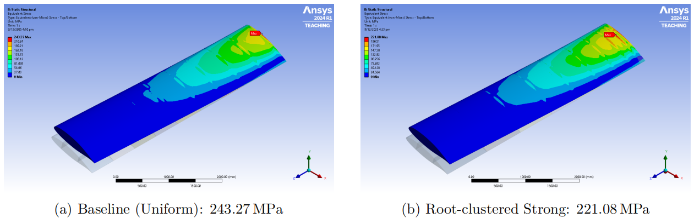
Phase 1: Rib Layout Selection (2/2)
Results: Performance comparison of different rib layout strategies
Comparison of wing tip deflection and internal rib arrangement (skin hidden for clarity)
Comparison of maximum von Mises stress distributions

Slide 15
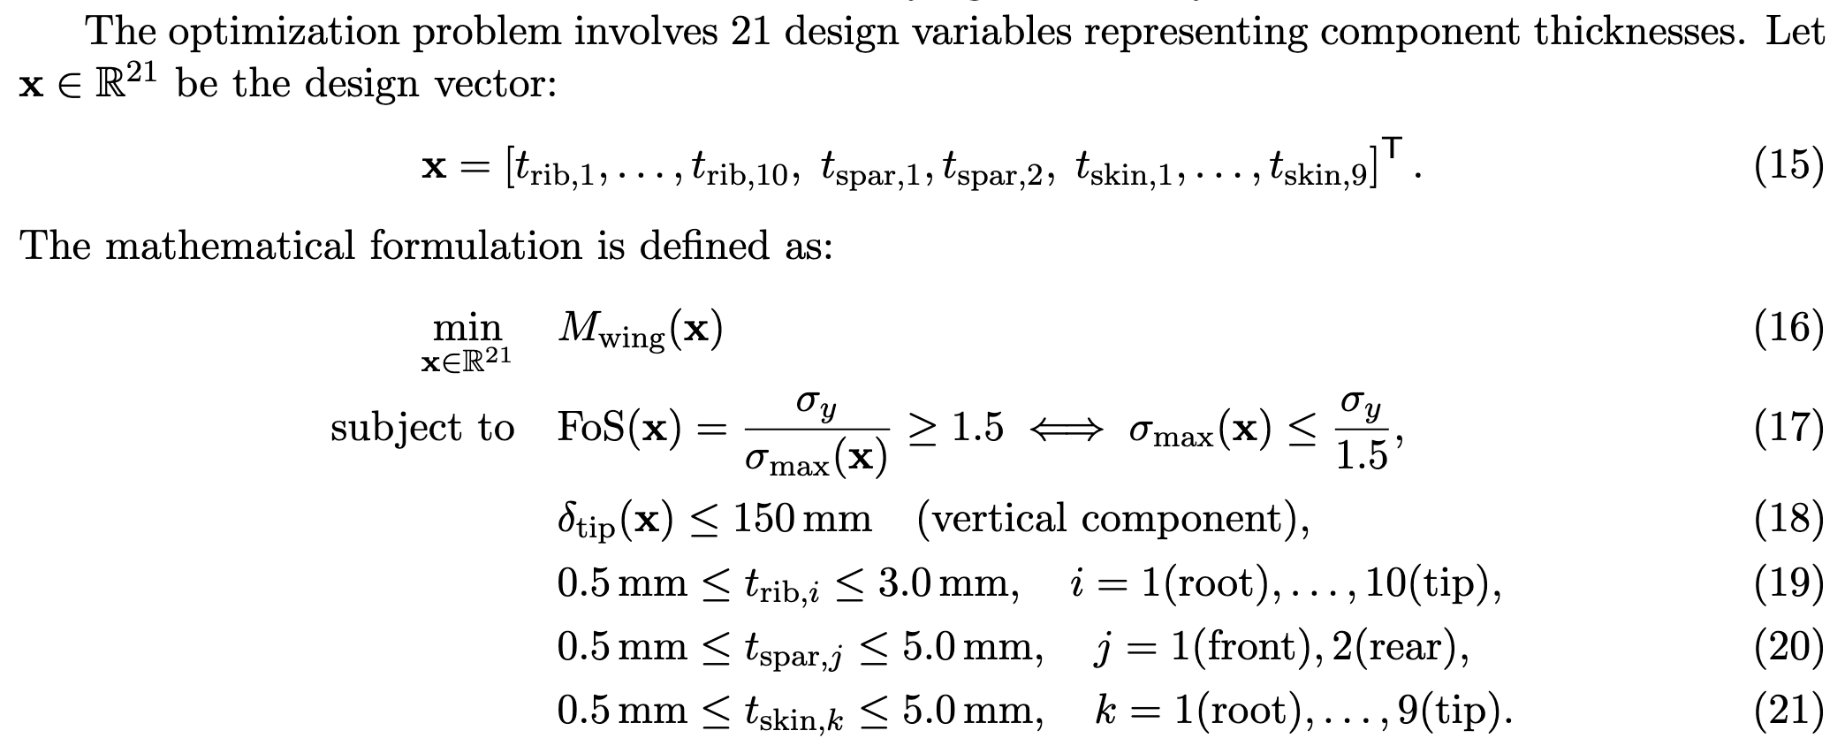
Phase 2: Structural Sizing Optimization (1/4)
1
2
3
4
5
6
7

Slide 16
Phase 2: Structural Sizing Optimization (2/4)
Best Feasible Design: Design Point (DP) 482
Adaptive Single-Objective (Kriging Surrogate + MISQP optimizer):
150 DoE samples + 350 infill samples = 500 total samples

Slide 17
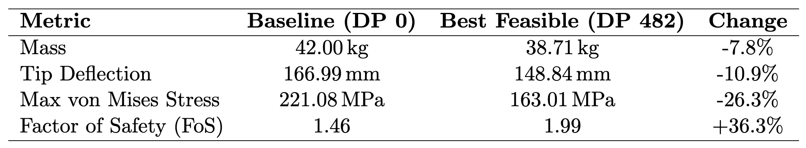
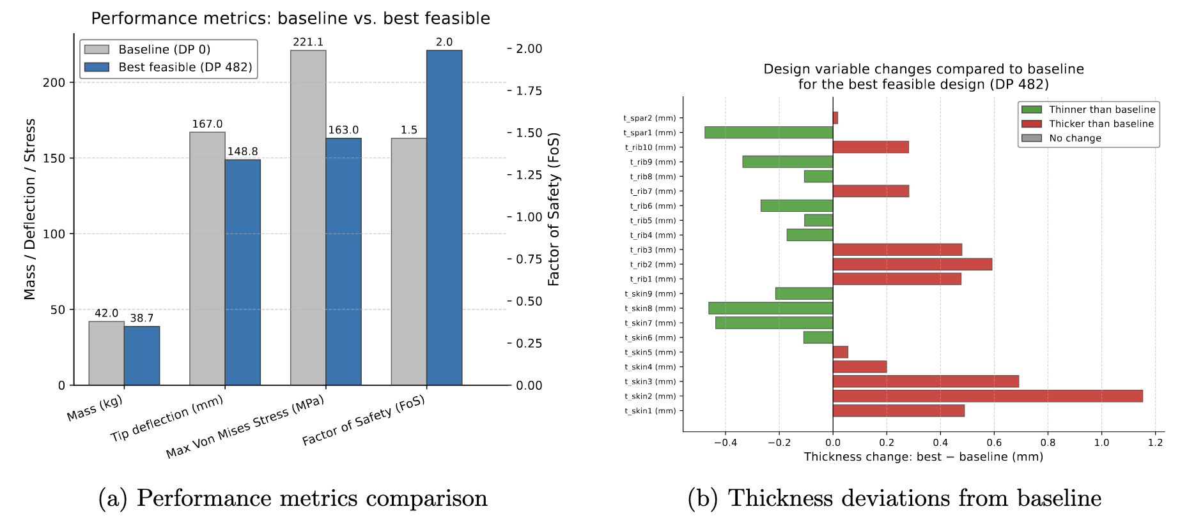
Phase 2: Structural Sizing Optimization (3/4)
DP 482 (best feasible design) reduces the mass by 7.8% from the baseline, but has a higher factor of safety and lower tip deflection.
DP 482 thickens the root skin and rib thicknesses, while outboard components thicknesses are reduced (generally follow beam theory principles).

Slide 18
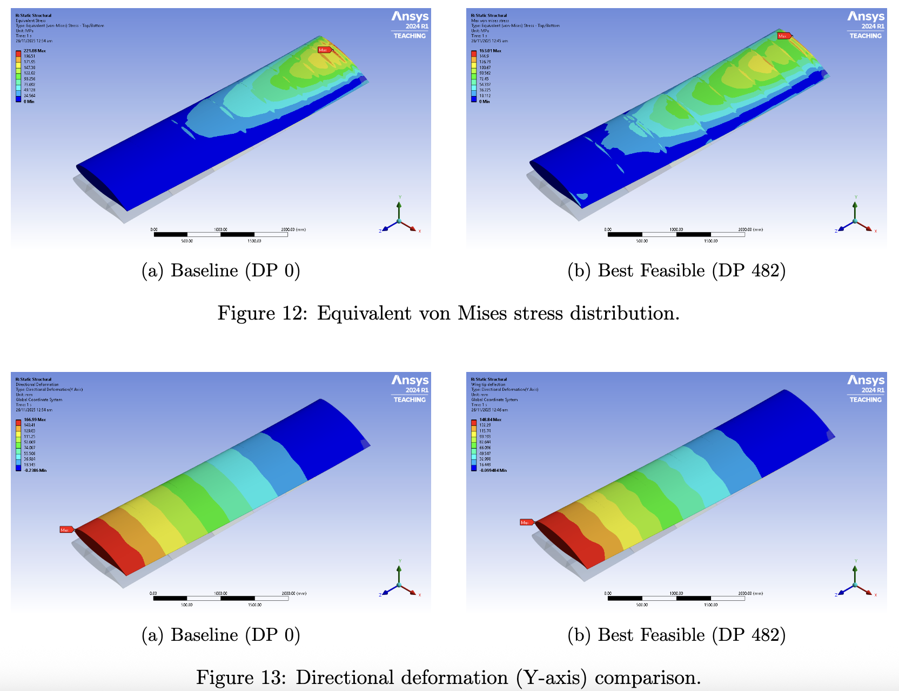
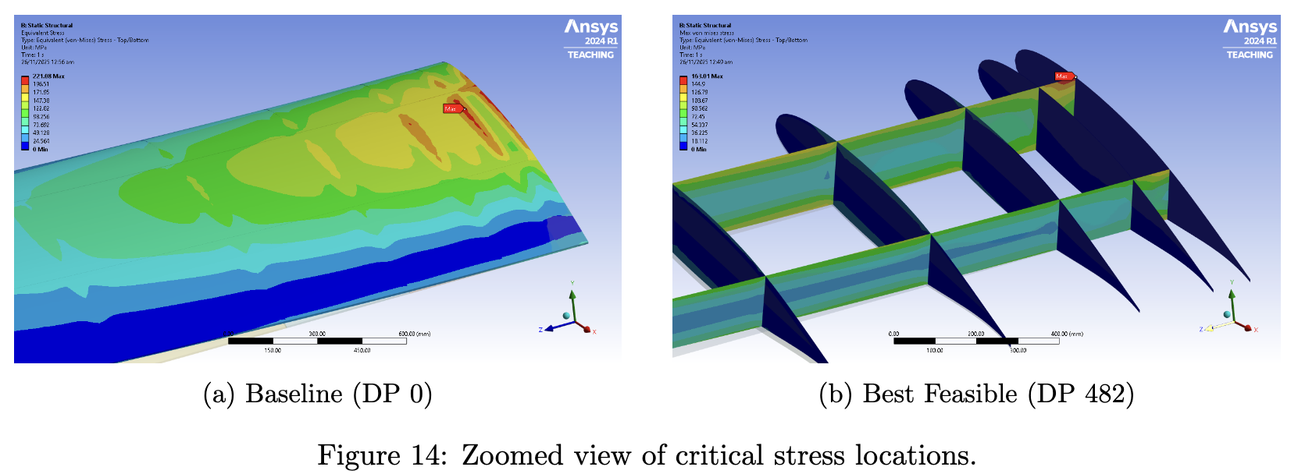
Phase 2: Structural Sizing Optimization (4/4)

Slide 19
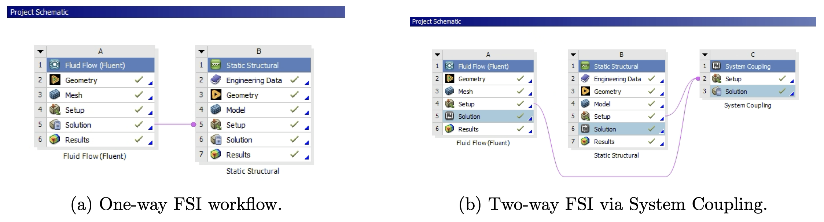
Phase 3: Aero-structural Coupling (Two-Way FSI) (1/3)
We quantify the effect of the coupling between aerodynamics and structures by performing two-way FSI analysis on the best feasible design (DP 482).

Slide 20
Phase 3: Aero-structural Coupling (Two-Way FSI) (2/3)
The coupling system converges in less than 6 iterations (RMS < 0.0001).

Slide 21
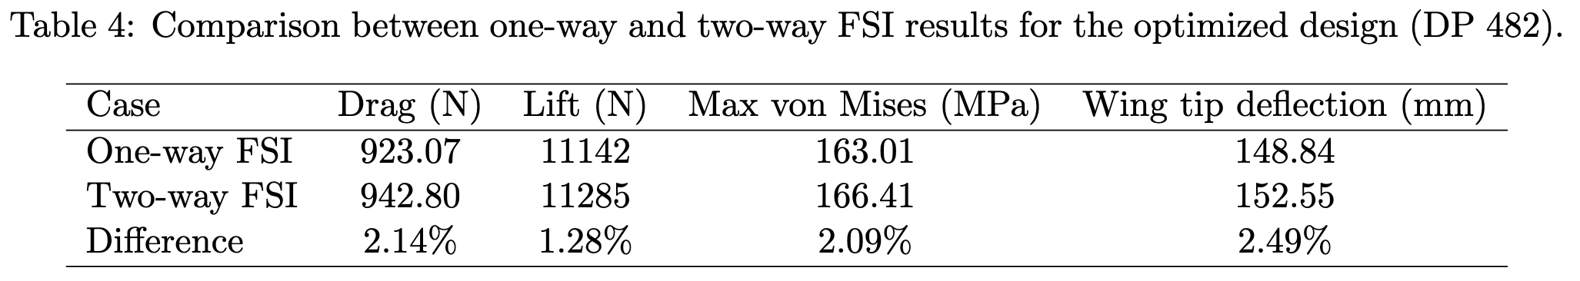
Phase 3: Aero-structural Coupling (Two-Way FSI) (3/3)
violation
The coupled aero-structural deformation slightly increases the wing AoA, increasing the total aero lift and drag.
The increased aero load in turn increases the max von mises stress and wing tip deflection.
Note that under coupled aero-structural load, the best feasible design (DP 482) violates the wing tip deflection constraint (152.55 > 150 mm).
In other words, uncoupled aero-structural load (one-way FSI) is in fact non-conservative.

Slide 22
Conclusion
Optimization success
Achieved 7.8 % mass reduction (42.0 kg → 38.7 kg) using the Root-clustered layout with optimized panel thicknesses (DP 482)
Satisfied all constraints under one-way FSI, with a tight stiffness margin (148.8 mm<= 150.0 mm)
Aero-structural insight:
Two-way FSI revealed that the rigid-wing assumption is non-conservative
Aero-structural feedback increased wing tip deflection by 2.5 %
Key takeaway:
The optimized design (DP 482) violated the stiffness limit under a coupled load (152.6 mm > 150.0 mm)
Future sizing requires added safety margins or fully coupled optimization

Slide 23
Thank you.

