Slide 1
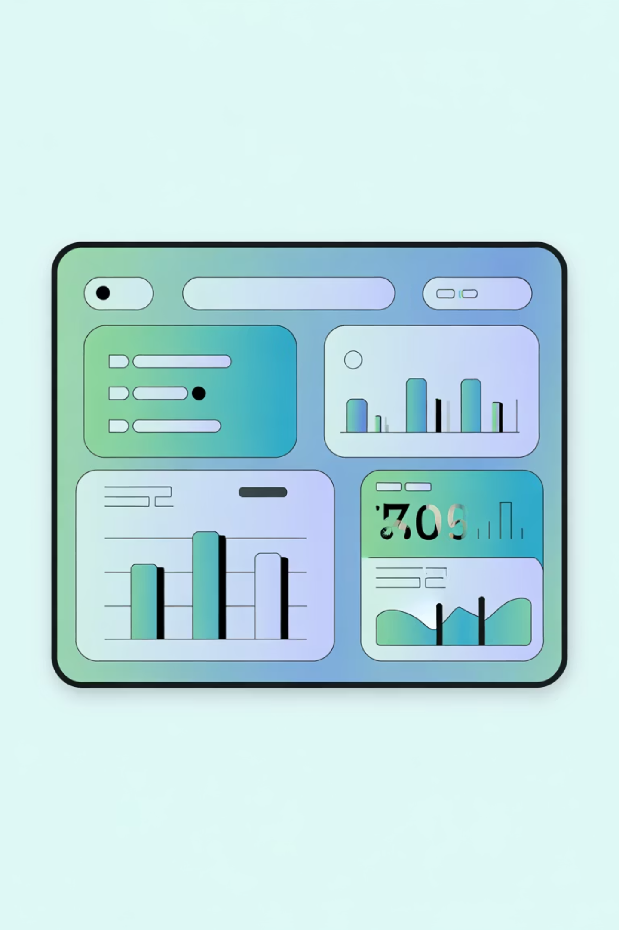
Customer Shopping Behavior Analysis
Uncovering insights from 3,900 purchases to drive strategic business decisions

Slide 2
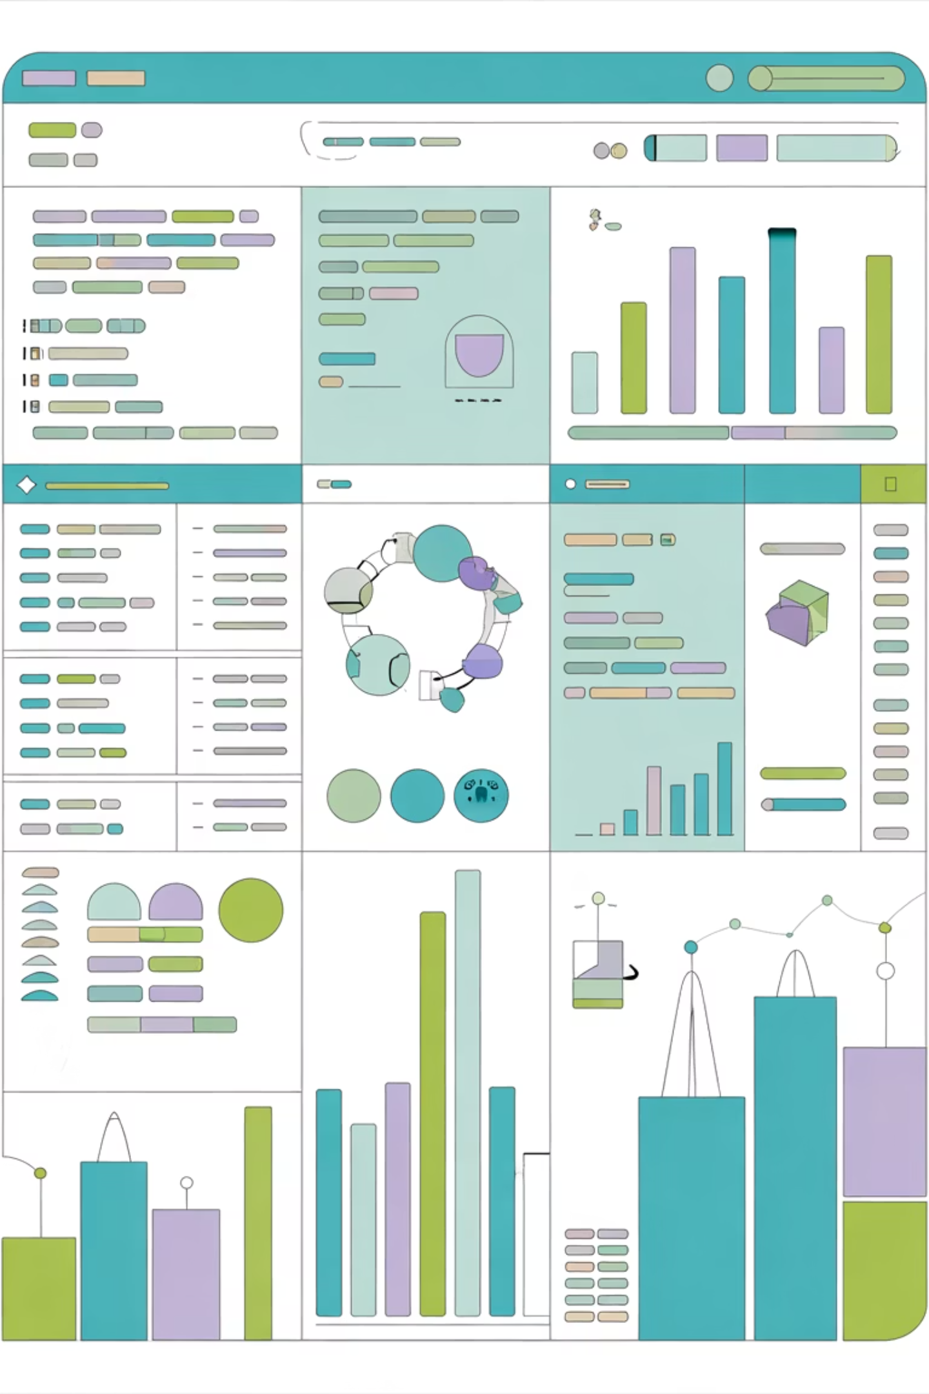
Dataset Overview
3,900
18
50
Total Purchases
Data Points
Locations
Features per customer transaction
Geographic coverage nationwide
Transactions analyzed across all categories
25
Products
Unique items tracked

Slide 3
Data Preparation Journey
01
02
Data Loading & Exploration
Cleaning & Standardization
Imported dataset using pandas, analyzed structure with df.info() and summary statistics
Handled 37 missing review ratings, standardized columns to snake_case format
03
04
Feature Engineering
Database Integration
Created age_group bins and purchase_frequency_days columns for deeper analysis
Connected to PostgreSQL, loaded cleaned data for SQL business analysis

Slide 4
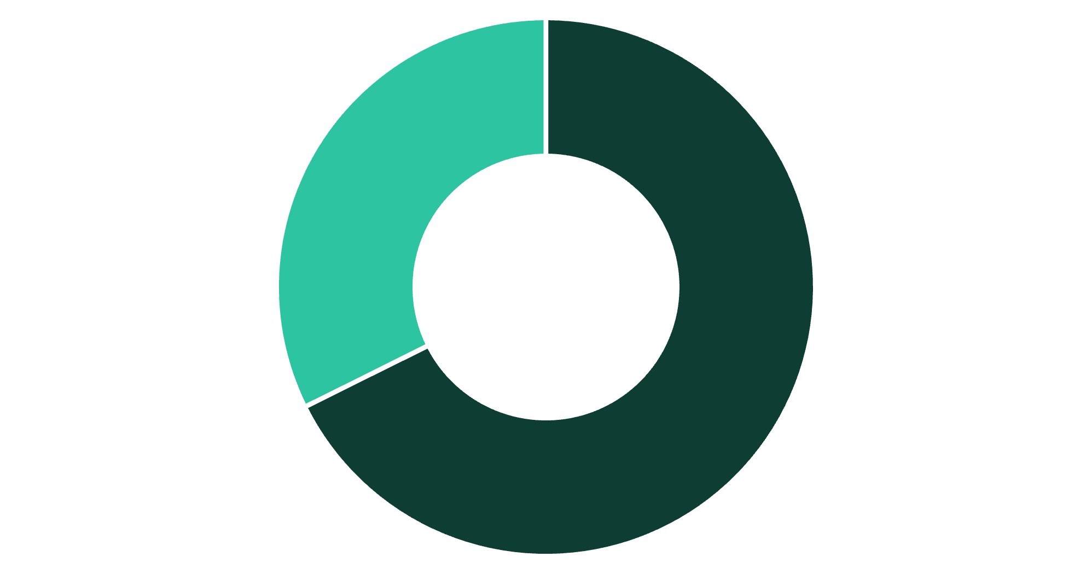

Revenue Insights by Gender
Key Finding
Male customers generate 68% of total revenue, representing significant market dominance
Consider targeted campaigns to increase female customer engagement and spending
Male
Female

Slide 5

Top-Performing Products
Gloves
Sandals
Boots
Highest rated: 3.86 stars
Second place: 3.84 stars
Strong performer: 3.82 stars
Hat
Skirt
Popular choice: 3.80 stars
Top five: 3.78 stars

Slide 6



Customer Segmentation Analysis
New
1
83 customers
Returning
2
701 customers
Loyal
3
3,116 customers
80% of customers classified as Loyal, demonstrating strong retention and repeat purchase behavior

Slide 7
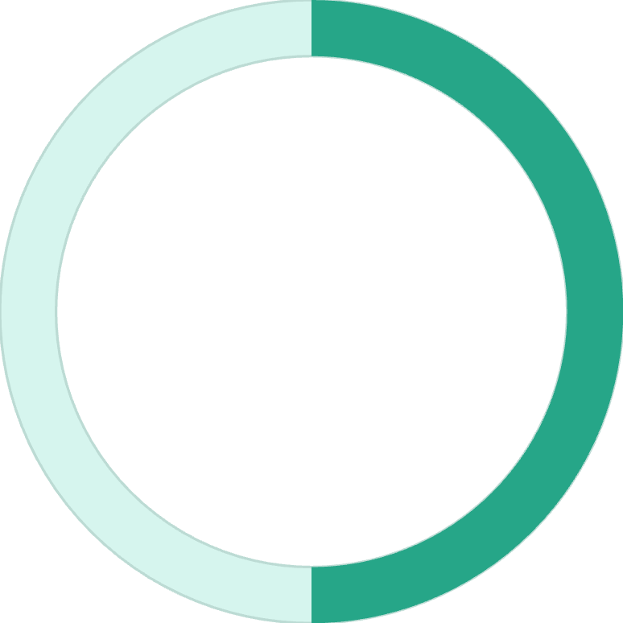
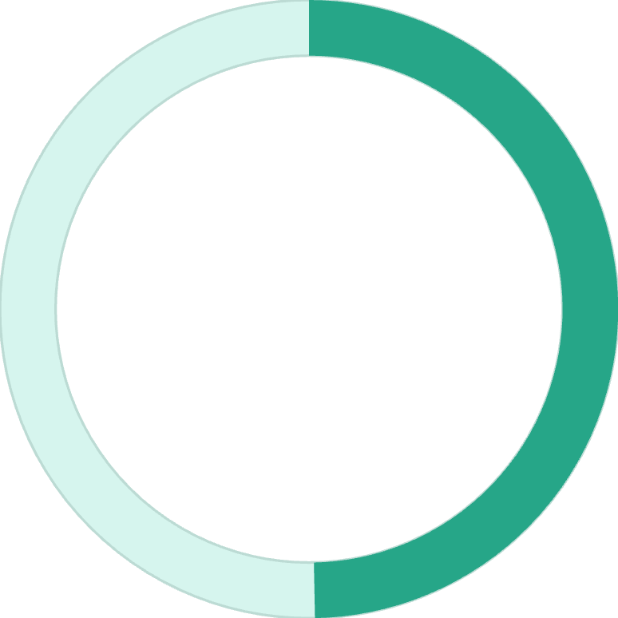
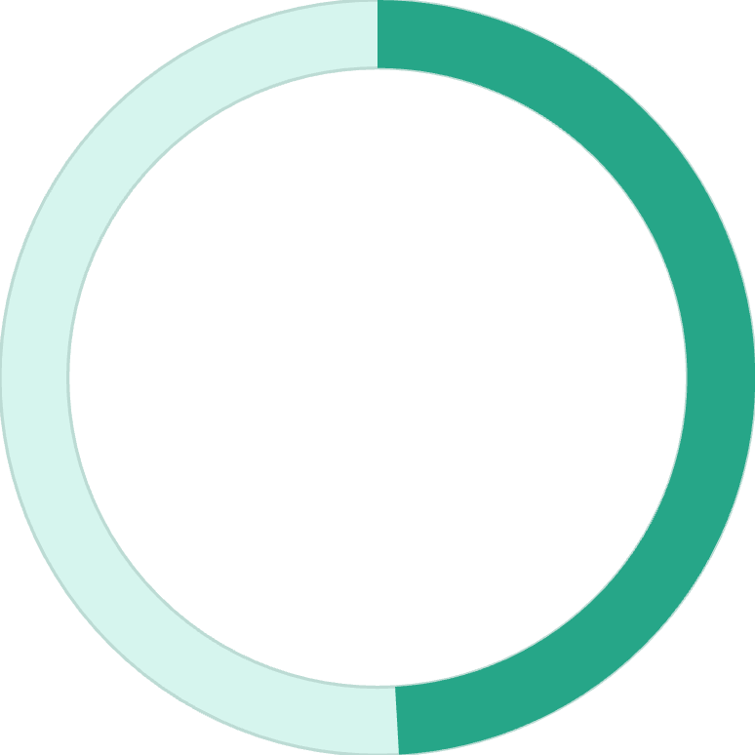
Shipping & Spending Patterns
Express Shipping
Standard Shipping
Average spend: $60.48
Average spend: $58.46
Premium service attracts higher-value purchases
Cost-conscious customers with solid baseline spending
50%
49.7%
49.1%
Hat Discount Rate
Sneakers
Coat
Highest discount dependency
Second most discounted
Heavy promotion reliance

Slide 8
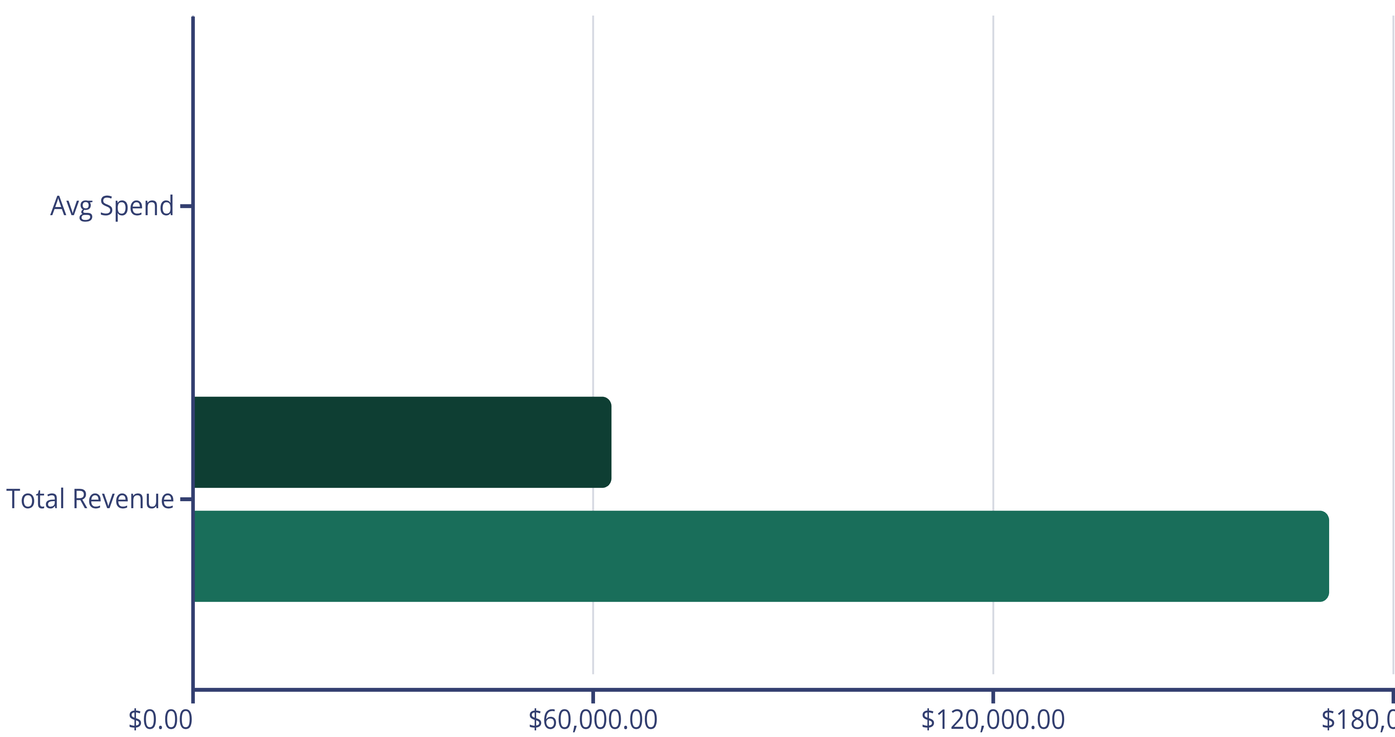
Subscription Status Comparison
Subscribers
Non-Subscribers
Subscribers: 1,053
Non-Subscribers: 2,847
Similar spending per transaction but lower total volume
73% of customer base drives majority of revenue

Slide 9
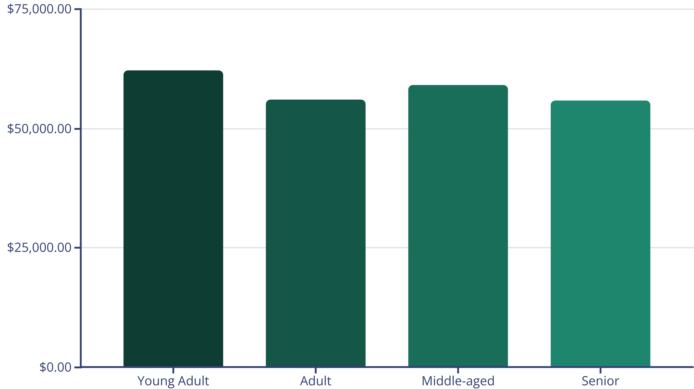
Revenue by Age Demographics
Young Adults lead revenue generation, followed closely by Middle-aged customers. Balanced distribution across all age segments.

Slide 10
Strategic Recommendations
Boost Subscriptions
Loyalty Programs
Review Discount Policy
Reward repeat buyers to strengthen the 80% loyal customer base
Promote exclusive benefits to convert non-subscribers and increase recurring revenue
Balance 50% discount rates on key products with margin control strategies
Product Positioning
Targeted Marketing
Highlight top-rated items (Gloves, Sandals, Boots) in marketing campaigns
Focus on Young Adults and express-shipping users for maximum ROI

