Slide 1
Evlab17 preprocessing

Slide 2
Data preprocessing: Syntax and setting files
evlab17_run_preproc pipeline_preproc_DefaultMNI.cfg /SUBJECTS/mysubject/datafiles.cfg
pipeline.cfg
datafiles.cfg
Preprocessing steps
Functional/structural data
Note: example ready-to-use pipelines
preproc_pipeline_DefaultMNI.cfg
preproc_pipeline_DefaultMNI_IndirectNormalization.cfg
preproc_pipeline_DefaultMNI_LiberalOutliers.cfg
preproc_pipeline_DefaultMNI_SliceTiming.cfg
preproc_pipeline_DefaultFS.cfg
preproc_pipeline_DefaultFS_Segment.cfg
Note: example datafiles
example_datafiles_DicomFunctionals.cfg
example_datafiles_DicomFunctionalsStructurals.cfg
example_datafiles_NiftiFunctionals.cfg
See “help evlab17_run_preproc” for format details

Slide 3
Data preprocessing: Syntax and setting files
datafiles.cfg
#dicoms
/SUBJECTS/mysubject_dicoms/*-1.dcm
#functionals
7 9 11 13
#RT
2
Location of dicom files
Functional runs
Data acquisition time (s)
See “help evlab17_run_preproc” for format details

Slide 4
Data preprocessing: Syntax and setting files
pipeline.cfg
structural_manualorient
structural_cente
structural_segment
structural_normalize
structural_segment&normalize
functional_removescans
functional_manualorient
functional_center
functional_slicetime
functional_realign
functional_realign_noreslice
functional_realign&unwarp
functional_realign&unwarp&phasemap
functional_art
functional_coregister_affine
functional_coregister_nonlinear
functional_segment
functional_normalize_indirect
functional_normalize_direct
functional_segment&normalize_indirect
functional_segment&normalize_direct
functional_smooth
functional_motionmask
#steps
functional_realign
functional_center
functional_art
functional_segment&normalize_direct
functional_smooth
functional_smooth
#fwhm
4
6.9282
#art_thresholds
5 0.9
Preprocessing steps selection and order
Addiitional info (depending on selected steps)
See “help evlab17_run_preproc” for format details

Slide 5
Evlab17
first-level models

Slide 6
First-level model estimation: Syntax and subject-model files
evlab17_run_model pipeline_model_Default.cfg /SUBJECTS/mysubject/modelSWJN.cfg;
pipeline.cfg
modelSWJN.cfg
General model estimation parameters
Subject data and model
mysubject_SWJN.cat
(List of .para files)
designS1.para
What is my design?
designS2.para
Note: example configuration parameters
pipeline_model_Default.cfg
Note: example model file
example_modelfiles_langlogSN.cfg
See “help evlab17_run_model” for format details

Slide 7
First-level model estimation: Syntax and subject-model files
modelSWJN.cfg
#dataset
/SUBJECTS/mysubject/nii/evlab17_2017_03_15_175525522.mat
#design
/SUBJECTS/mysubject/mysubject_langlocSN.cat
#model_name langlocSN
#contrasts
Act_Diff SEM_Act_Diff 1
Pas_Diff SEM_Pas_Diff 1
ActDiff-PasDiff SEM_Act_Same 1 SEM_Pas_Diff -1
TestModulation1 SEM_Act_SamexResponseTime 1
TestModulation2 SEM_Act_DiffxReactionTime 1
TestModulation3 SEM_Pas_Samextime 1
TestModulation4 SEM_Pas_Diff_EVENT01 1
File created during preprocessing
.cat file (model design)
For each contrast (row):
Name
Condition1
Weight1
Condition2
Weight2
…
Note: condition names from .cat file
See “help evlab17_run_model” for format details

Slide 8
First-level model estimation: Syntax and subject-model files
mysubject_langloc.cat
superloc2conds_Parvizi_c1.para
For each block/event: onset and condition number
(note: default #units scans)
#runs 1 2
#path /mindhive/..../PARAS
#files
superloc2conds_Parvizi_c1.para
superloc2conds_Parvizi_c2.para
#onsets
0.00 1
3.00 2
7.00 4
#names
SEM_Act_Same
SEM_Act_Diff
SEM_Pas_Same
SEM_Pas_Diff
#durations
3 3 3 3
names
durations (rows: one value per condition; columns: one value per block/event)
.cat file = list of .para files
Temporal –modulation Breaks specified conditions into main and temporal effects
#pmod
1 1 0 0
#pmod_names
ReactionTime
#pmod_values
0. 11
0. 43
0.16
#tmod
0 0 2 0
Parametric–modulation
Breaks specified conditions into main and other user-defined effects
Non-parametric- modulation
Breaks specified condition into block/event-specific effects
#npmod
0 0 0 1

Slide 9
First-level model estimation: additional-settings file
Pipeline_model_Default.cfg
#smoothinglevel 1
#model_basis
hrf+deriv
#model_covariates
motion
art
#model_serial
AR(1)
#hpf 128
#model_session 1
#contrast_addsession 1
#contrast_addcv 1
#contrast_addoddeven 1
Basis function (hrf / hrf+deriv / hrf+derivs)
Covariates (motion / art / session-specific files)
Serial correlations (none / AR(1))
High-pass filter (seconds)
Automatically add CV / even-odd contrasts
Other settings: (#RT) #units #mthresh #explicitmask #model_folder #contrast_addsession

Slide 10
Evlab17
Quality Assurance plots

Slide 11
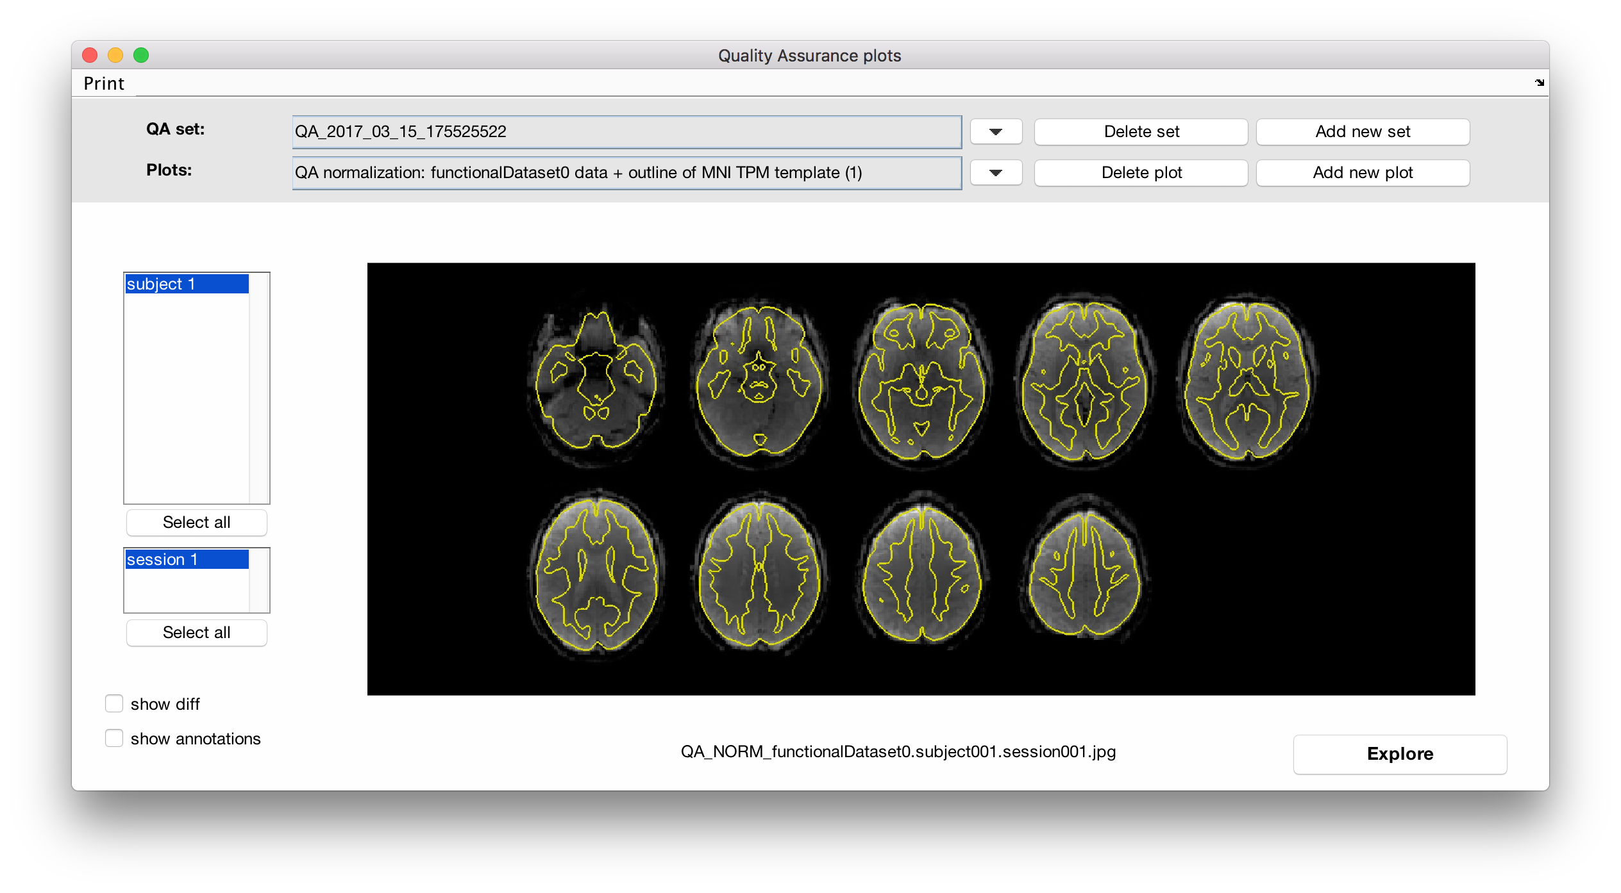
Data preprocessing: Syntax and setting files
evlab17_qaplots /SUBJECTS/mysubject/nii;
Is your data properly realigned? Is your data coregistered to MNI space? Does your data show residual subject-motion, physiological or artifactual effects?

