Slide 1

Applying Data Science to Real Estate: A Case Study on Building Permits
Capstone Project Submission for Evaluation by the PropertyQuants Team
Presented by: Alfonso Hernandez
19 April 2024

Slide 2

Project overview
Exploring trends in building permits to uncover real estate insights, this project is split into two distinct parts:
Extract Transform Load (ETL) – the US Census Bureau reports the amount of residential building permits issued per Core Based Statistical Area (CBSA). The first subproject is a code-based solution to collect the reports (extract), standardize and clean the data (extract), and store them in a database (load).
Time Series Analysis – the analysis is based on ARIMA modeling, a popular method for forecasting time series data that can account for trends, cycles, and seasonality.

Slide 3


Technological Stack
Powered by: Python, Anaconda, SQLAlchemy, Marshmallow, SQLite, pandas, statsmodels, iPython

Slide 4
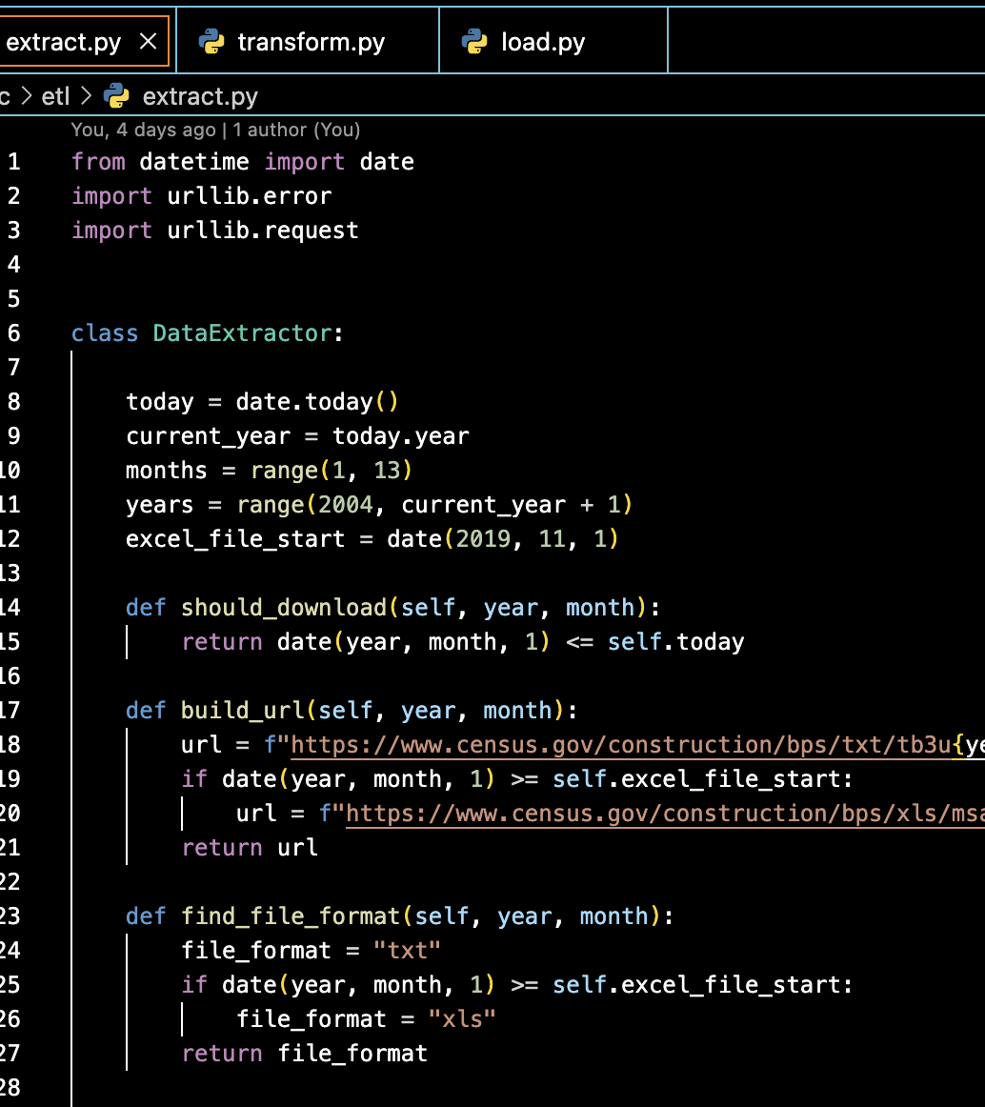
ETL
Extract: Historical data (2004-present) from text and Excel files.
Transform: Standardization challenges due to varying data points over years; text file parsing.
Load: Smooth transition with standardized CSVs for database integration.

Slide 5
ARIMA Modeling: Advanced Forecasting
Autoregressive Integrated Moving Average (ARIMA) for time series prediction.
Analyzes trends, cycles, and seasonal variations in building permits data.
Data-Driven Insights
Transforms historical data into actionable forecasts.
Supports strategic planning and investment decisions in real estate.
Enables anticipation of market dynamics.
Informs data-savvy real estate development and investment strategies.

Slide 6
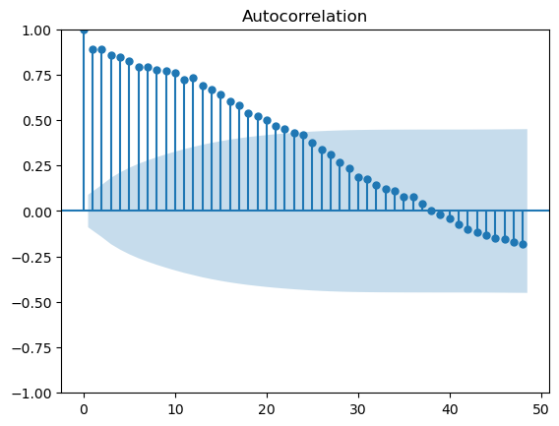
Forecasting & Visual Insights
Historical Impact Analysis
Examination of building permits data reveals clear impacts from the 2008 US Housing Crisis and the 2020 COVID Pandemic.
Notable difficulty in many CBSAs to rebound to pre-2008 levels.
Predictive Autocorrelation
Autocorrelation analysis shows permits issuance follows predictable trends, enabling forecasts up to 24 months in some metros.
Enhanced by visual autocorrelation graphs for intuitive understanding.

Slide 7
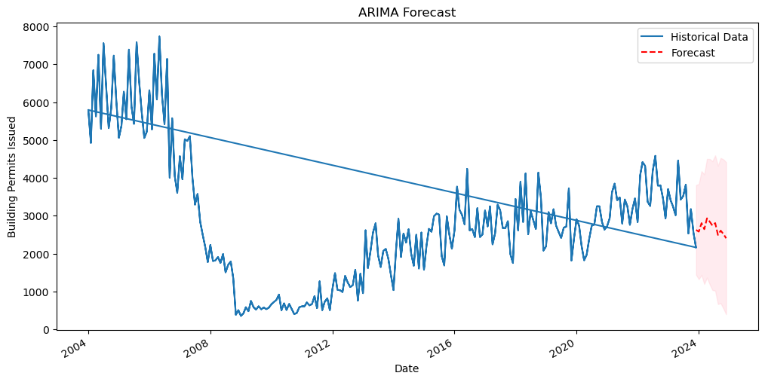
Forecasting & Visual insights
Stationarity & Parameter Tuning
Augmented Dickey-Fuller (ADF) test confirms data stationarity, a prerequisite for reliable ARIMA modeling.
Careful tuning of ARIMA's p,d,q parameters ensures optimal model fit.
ARIMA Predictions
ARIMA model forecasts future permit issuance with sensible accuracy for up to 12 months, within 95% confidence intervals.
Predictive graphs showcase potential future trends, aiding in strategic planning.

Slide 8

Future Enhancements
Airflow Integration: Implement Apache Airflow to automate the ETL pipeline, enabling the project to run on a monthly schedule and ensure timely data processing and analysis.
Refactor: The load.py script is procedural and can be updated to use classes instead.
Dockerization: Containerize the application to streamline deployment and ensure consistency across development environments.
Database Upgrade: Transition from SQLite to PostgreSQL with the PostGIS extension to enhance data handling capabilities and facilitate spatial data analysis. Use Alembic to manage migrations.
API Development: Construct a RESTful API on top of the database to provide programmatic access to the data and analyses.
Frontend Development: Develop a frontend interface with analytics features to offer visual insights into the building permits data, making the data more accessible and interpretable.
Granular Data Analysis for Housing Solutions: take advantage of the detailed permit data split by unit type (single, double, triple, and multi-unit residential permits). Enable in-depth analysis to understand housing crisis nuances and inform targeted solutions.

Slide 9

Q&A
Your insights and questions are welcome.
Let’s discuss: alfonso.m.hernandez@gmail.com

Slide 10
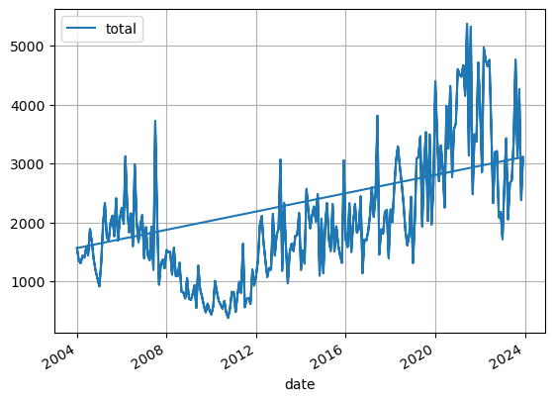
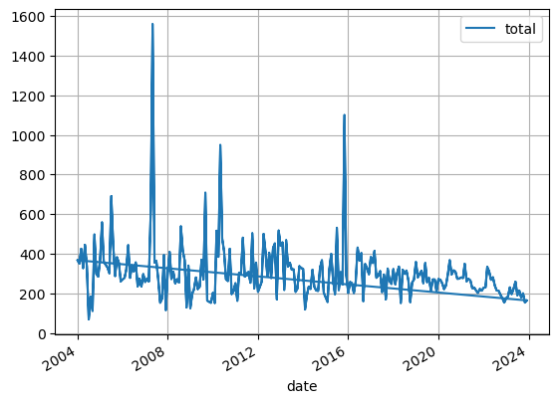
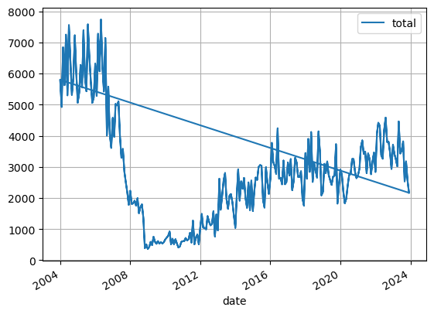
Appendix–Graphs
Austin, TX
El Paso, TX
Atlanta, GA

Slide 11

Acknowledgements
Thank you to the PropertyQuants team for a great curriculum and all your patience while I worked on my project. I learned a lot!

