Slide 1
CAPSTONE PROJECT
D.E.B.
Alfonso Ayala

Slide 2
ABOUT ME
[ALFONSO AYALA]
Computer Scientist.
Programmer.

Slide 3
PROBLEM
CURRENT NEED
POOR CODE MANAGEMENT
Develop a data pipeline to help to créate user profiles based on movie reviews, user purchases and log reviews.
No current code repository.
LACK OF ORCHESTATION
NON EXISTENT PROCESSES
Current process is manual and needs to be automated.
Flows must be implemented to prepare data for analysis
COSTLY INFRASTRUCTURE
Currently on-prem, lacks of scalability and costly to manage and scale.

Slide 4
SOLUTION
USE CLOUD
On-prem deployments are slow and expensive. Cloud solutions provide flexibility, horizontal scalability and pay-as-you-use costs.
USE CODE DEFINED INFRASTRUCTURE
Using infrastructure as code, deployments are faster and cleaner.
USE AIRFLOW ORCHESTATOR
Airflow DAGs allow data pipelines fast implementation and maintenance.
EASY TO MANTAIN
The solution is adaptable and eases modification due to code defined infrastructure and data pipelines defined as DAGs.

Slide 5
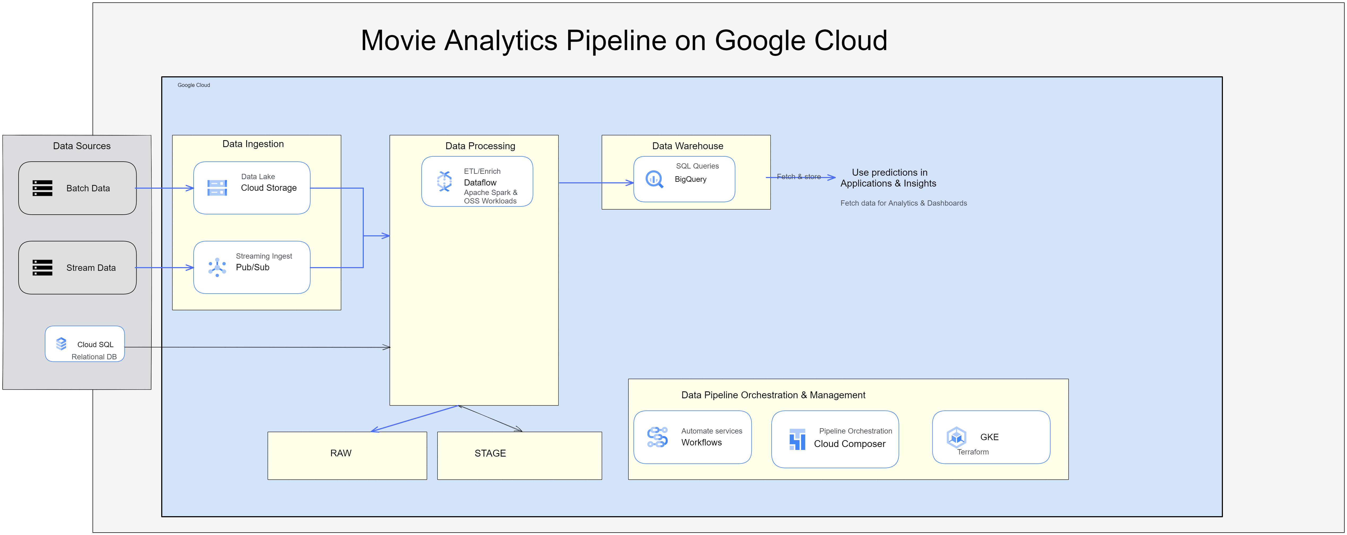
SOLUTION DESCRIPTION

Slide 6



BENEFITS
Cloud based.
Terraform infrastructure as code.
Ready to analyze and provide insights on data
Scalability

Slide 7
SOLUTION’S RATIONALE

Slide 8



PHASES
CLOUD INFRASTRUCTURE
DATA PIPELINES
FEEDBACK
Define a cloud environment for the data pipeline.
Analyze the need and provide a sound solution.
Pipelines are deployed as Airflow’s DAGs.
User final checkpoint is the green light to go live.
User checkpoints are frequent to maximize satisfaction.

Slide 9
SUMMARY
A state of the art Data Engineering solution is provided for the Movie Review problem using GCP, Airflow, Bigquery, Postgresql, Terraform, and Kubernetes.

Slide 10
THANK
YOU
Alfonso Ayala
+57 320-347-67 02
alfonsoayalapaloma@gmail.com

