Slide 1
INTRODUCTION TO TOPIC MODELLING
A Machine Learning method for an automatic analyse of text data.
Notes:
Topic modeling is a technique that’s capable of scanning a set of documents, detecting word and phrase patterns within them, and automatically clustering word groups and similar expressions that best characterize a set of documents.
By using topic analysis models, businesses are able to offload simple tasks onto machines instead of overloading employees with too much data. Just imagine the time your team could save and spend on more important tasks, if a machine was able to sort through endless lists of customer surveys or support tickets every morning.

Slide 2
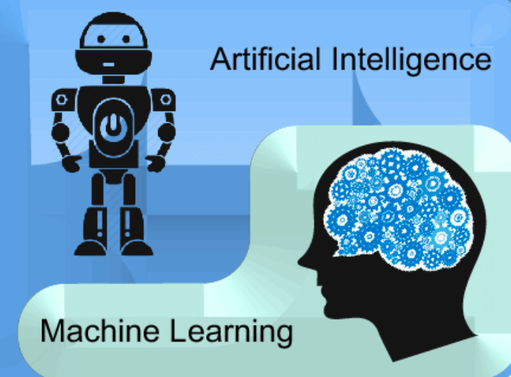
WHAT IS machine learning ?
Artificial Intelligence (AI):
a field of computer science
a computer system that can mimic human intelligence.

Slide 3
WHAT IS machine learning ?
Artificial Intelligence (AI):
a field of computer science
a computer system that can mimic human intelligence.
Machine learning (ML):
a subfield of AI that is about extracting knowledge from the data,
allows machines to learn without first having been programmed specifically for this purpose.

Slide 4
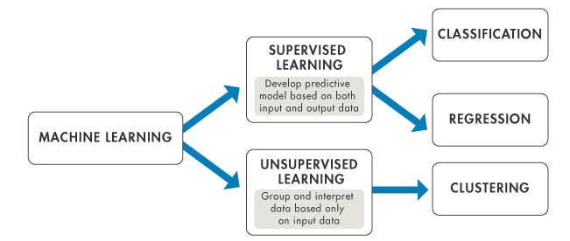
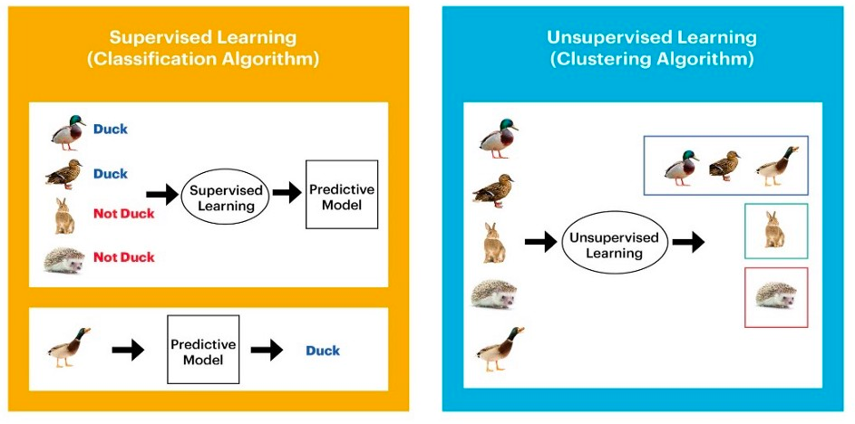
SUPERVISED VS UNSUPERVISED MACHINE LEARNING
Notes:
What to say:
There are two types of ML:
SUPERVISED: develops predictive models thanks to the input and its label: see the example: the model first need to be trained with data training: (X,Y)train that will be feed in the model.
Here X= the images, Y= Duck or not (= the label)
Once trained: the model is ready to make any predictions from an image, and predict Duck or Not
UNSUPERVISED : Don’t need any training step, need only the input, and from it will find some patterns, clusters and output them. Example here: The model itself made some clusters, it is the output

Slide 5
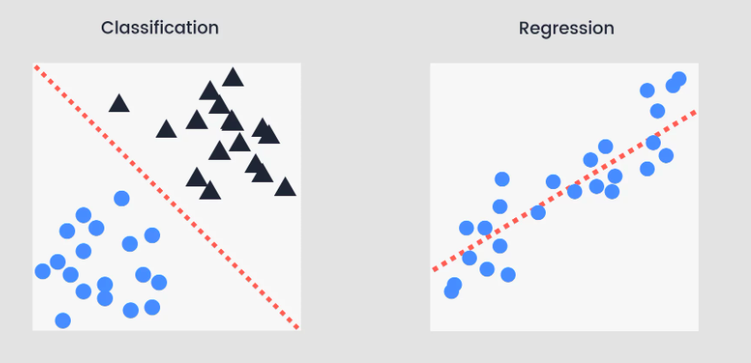
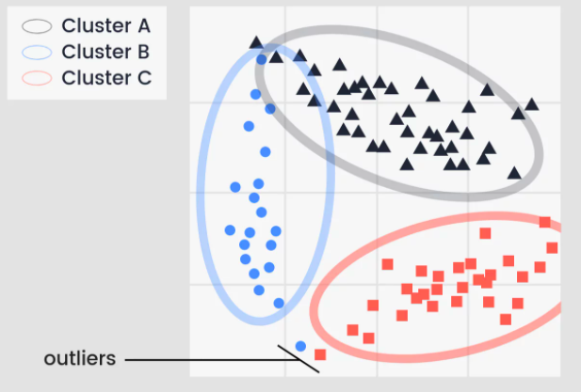
SUPERVISED VS UNSUPERVISED MACHINE LEARNING
SUPERVISED: Mapping of Y_{train}= f(X_{train})
Classification: for categorical values: Duck/Not Duck
Regression: for continuous value, for example, the prediction of pressure, temperature, etc.
UNSUPERVISED: only input data required
Clustering: used to discover groupings found in the input data.

Slide 6
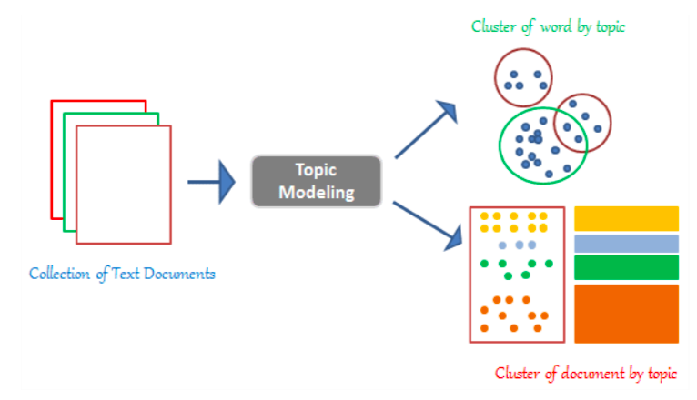
TOPIC MODELLING: UNSUPERVISED APPROACH
Topic Modeling: the process of dividing a corpus of documents in two:
A list of the topics covered by the documents in the corpus
Several sets of documents from the corpus grouped by the topics they cover.

Slide 7
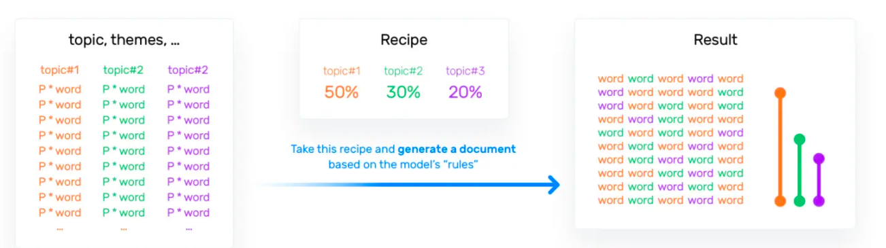
LATENT DIRICHLET ALLOCATION (LDA)
Hypothesis:
Mixture hypothesis: every document comprises a statistical mixture of topics.
Distributional hypothesis: similar topics make use of similar words.
Purpose of LDA :
Assign topics to arrangements of words.
Figure out which topics are present in the documents of the corpus and how strong that presence is.

